Slide 1
Where the rubber meets the road: Understanding how Resource Theory is critical to integration for refugees in the United States” Presented by Denise C. Bates Ph.D., CHES Middle Tennessee State University Department of Health and Human Services Community and Public Health

Slide 2
Resettlement Background
Following World War II, the U.S. Congress enacted the Displaced Persons Act of 1948. This legislation provided for the admission of an additional 400,000 displaced Europeans. Communist regimes from Hungary, Poland, Yugoslavia, Korea and China, and Cuba. Most of these waves of refugees were assisted by private ethnic and religious organizations in the U.S. which formed the basis for the public/private role of U.S. refugee resettlement today. In 1975 the U.S. resettled hundreds of thousands of Indochinese refugees through an ad hoc Refugee Task Force with temporary funding. This experience prompted Congress to pass the Refugee Act of 1980, which incorporated the United Nations definition of “refugee” and standardized the resettlement services for all refugees admitted to the U.S.

Slide 3
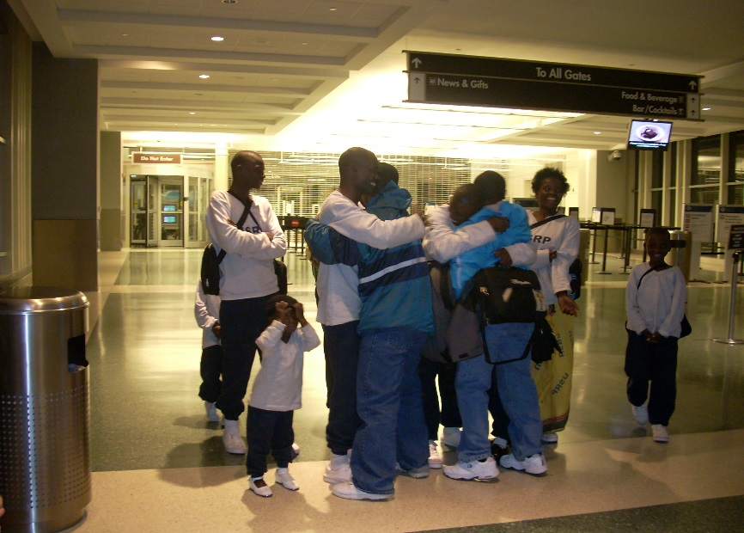
Resettlement Background Continued
The Refugee Act provides the legal basis for today’s U.S. Refugee Admissions Program and is administered by the Department of State in conjunction with the Office of Refugee and offices in the Department of Homeland Security (DHS). The 10 U.S. Refugee Resettlement Agencies help newly arrived refugees settle into local communities. These organizations are also known as Voluntary Agencies (volags) or Resettlement Agencies. Since 1975, the U.S. has resettled over 3 million refugees, with annual admissions figures ranging from a high of 207,000 in 1980 to a low of 27,110 in 2002.
Extracted from Refugee Council USA

Slide 4
Imagine
Last year, your community received 100 refugees who have lived in camps for over 30 years. Many of them knew no other life.
They are virtually illiterate in their own written language and have few skills that convey to the work environment in the U.S.
They mostly farmed and worked in small gardens when in the camps. Many can make baskets.
The refugees came in with very few personal belongings.
The refugee agency was given some funding for housing, employment, school for children and started them in English classes. This funding expired after 6 months after arrival.
The parents don’t speak English because they are required to be employed within 30 days of arrival.

Slide 5
The refugee children have become a discipline problem in the school district. Teachers are exasperated. The children are disruptive and there is evidence that the children have been stealing food and property from other children at the school. Many of the older children are being lured into local gangs. The parents are neither cooperative nor compliant when letters are sent home.
You are a principal in one of the schools with the greatest problems and you assign a team of people to address the “problems” created by these refugees.
What will you direct your team to do?

Slide 6
Refugees incoming U.S. State Department 2013
Region | FY 2012 Actual Arrivals | FY 2013 Estimated Arrivals | FY 2014 Approved Arrivals
Africa | 10,608 | 15,000 | 14,000
East Asia | 14,366 | 17,000 | 14,0001
Europe and Central Asia | 1,129 | 2,000 | 1,000
Latin America/Caribbean | 2,078 | 5,000 | 5,000
Near East/South Asia | 30,057 | 32,000 | 34,000
Totals | 58,238 | Approx. 70,000 | 70,000

Slide 7
What we think we know about Refugees’ experiences
Cultural Context/ Reference
Language proficiency
Transportation/mobility
Social isolation
Lack of education/literacy
Economics
Income/employment
Generalized Depression/ Mental Health/PTSD

Slide 8
Resource Theory
Resources- “means by which individuals satisfy needs, pursue goals and manage demands.” Ryan et al.
Personal Resources- physical or psychological
Material Resources- money, property, employment
Social resources- personal relationships, emotional,
informational
Cultural Resources- skills, knowledge and beliefs
(cognitive skills)

Slide 9
Resource Gain or Loss: Needs, Goals and Demands
Well being is generally defined as the satisfaction that BASIC physiological and psychological needs have been met. (Maslow)
The greater level need deprivation and perceived loss, thwarting of personal goals and the greater the environmental demands, the more the receiving community may need to create a sense of “well being” for the refugee.

Slide 10
Community Based Participatory Research? (CBPR)
Community-based participatory research is a conceptual orientation to research in which community members are viewed as valued and respected partners in each research phase.

Slide 11
-equitably involves all members (community members, organizational representatives, and researchers) in all aspects of the research process; -enables all partners to contribute their expertise, with shared responsibility and ownership; -integrates the knowledge gained with interventions to improve the health and well-being of community members.
The basic constructs:

Slide 12
Work with Burundian Refugees however… This work had been applied with Sudanese, Migrant Farm Workers, People living in slums in Kenya, Latinos in West Dallas.

Slide 13
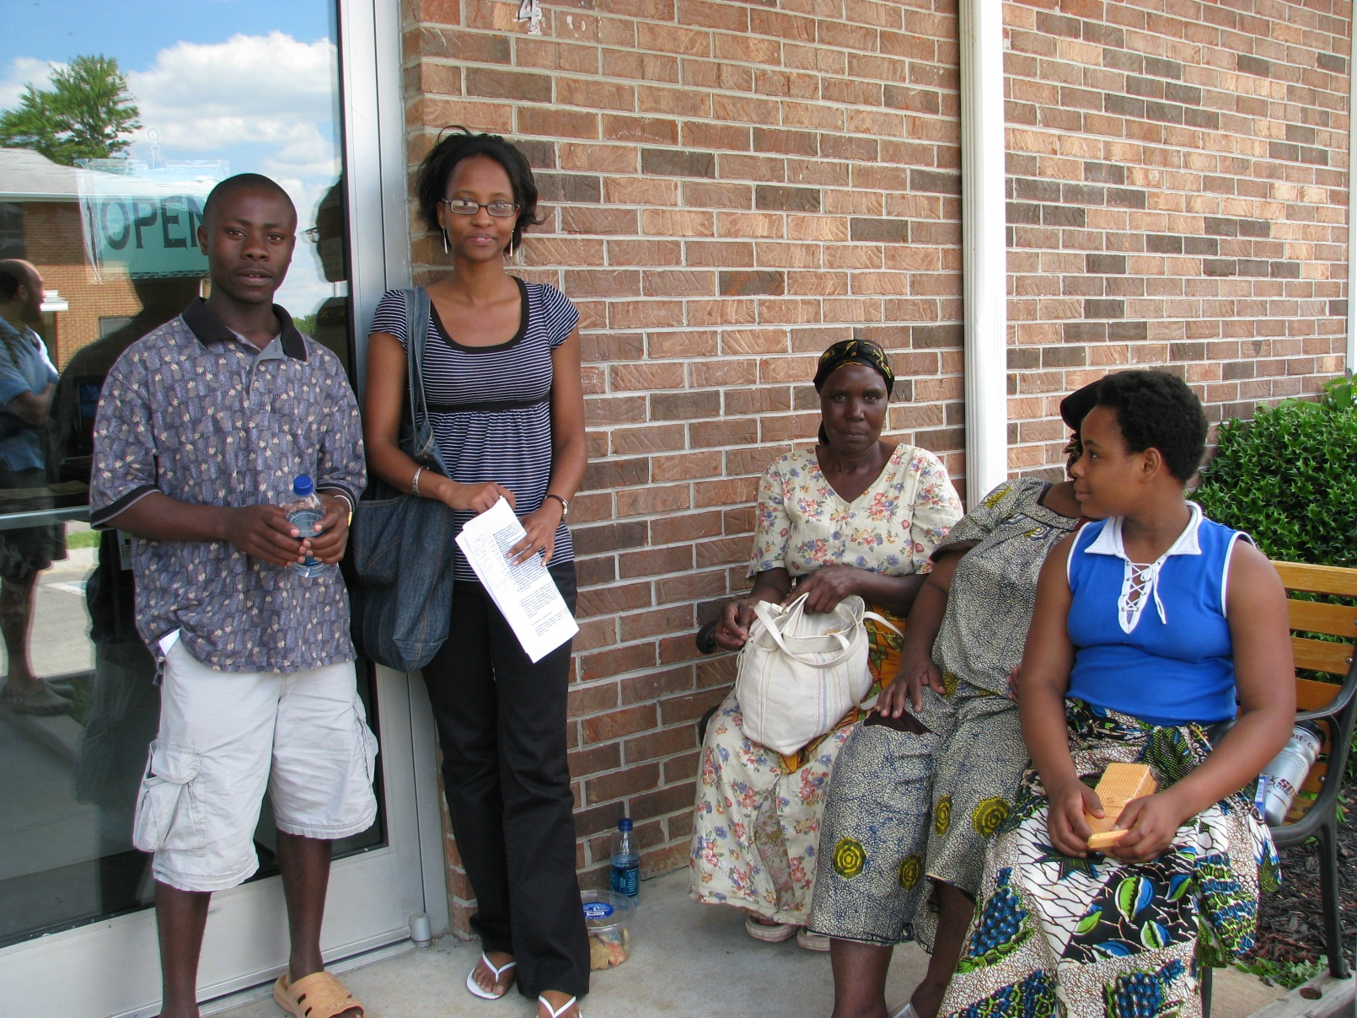
To assess how social/contextual factors impact positive integration to the larger community.

Slide 14
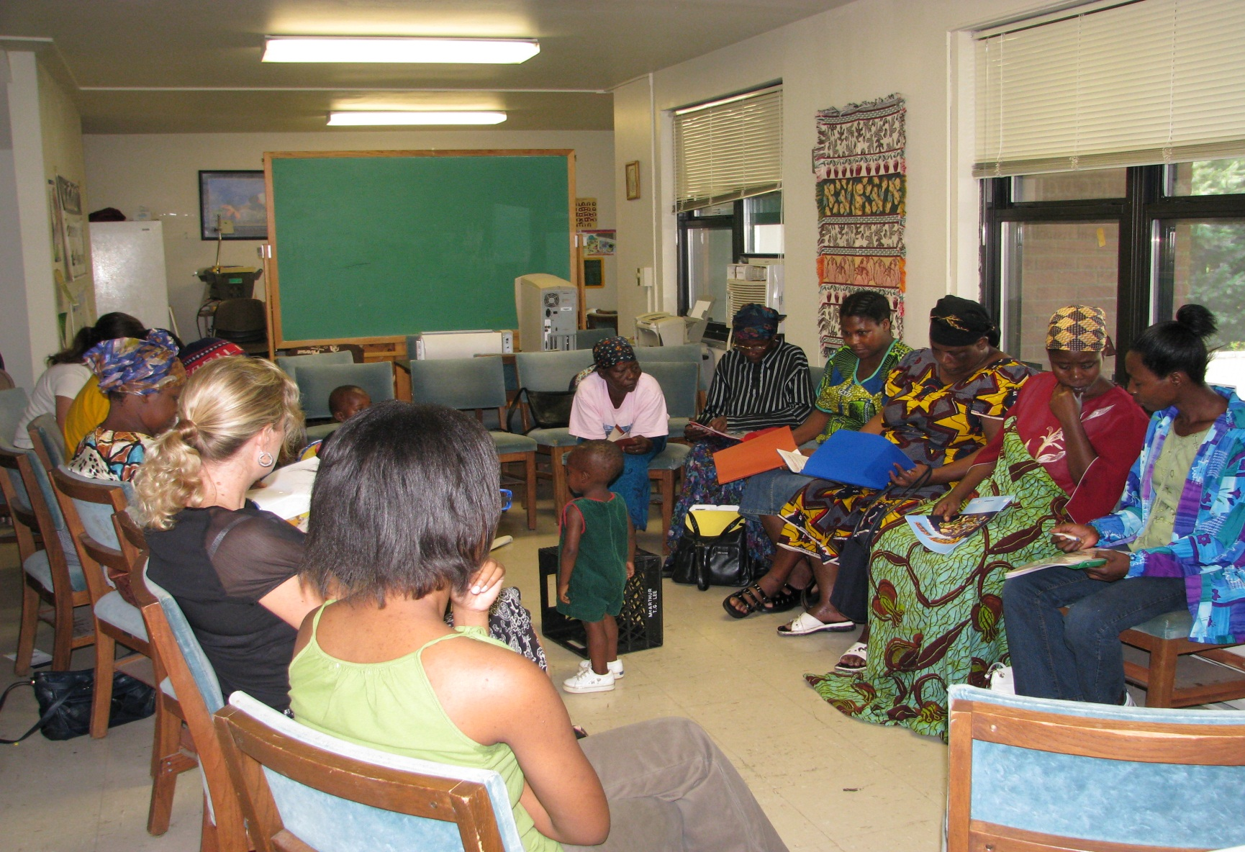
To establish an effective intervention model for newly arriving refugees to promote positive integration and well being.

Slide 15
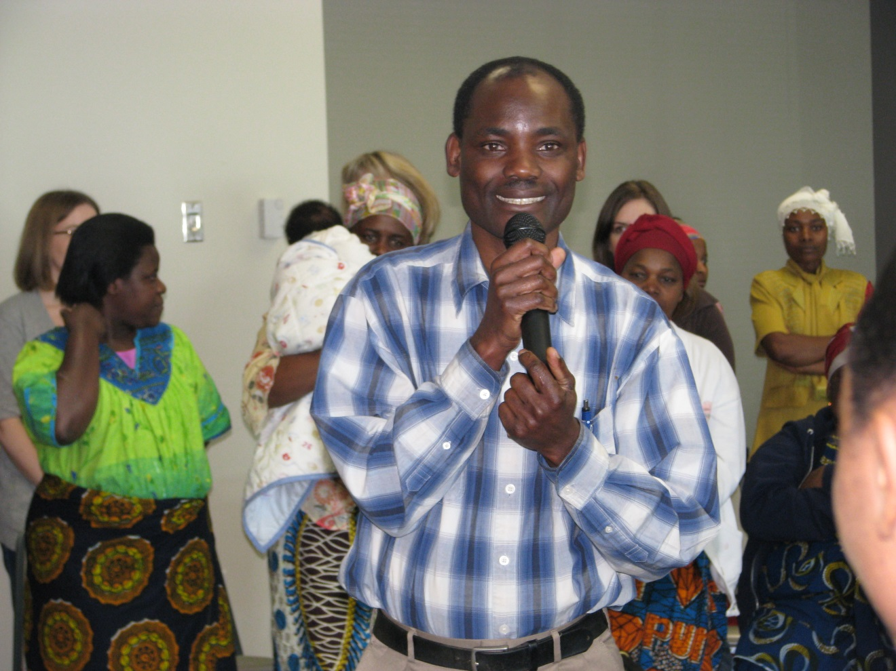
Located leadership (gatekeepers)

Slide 16
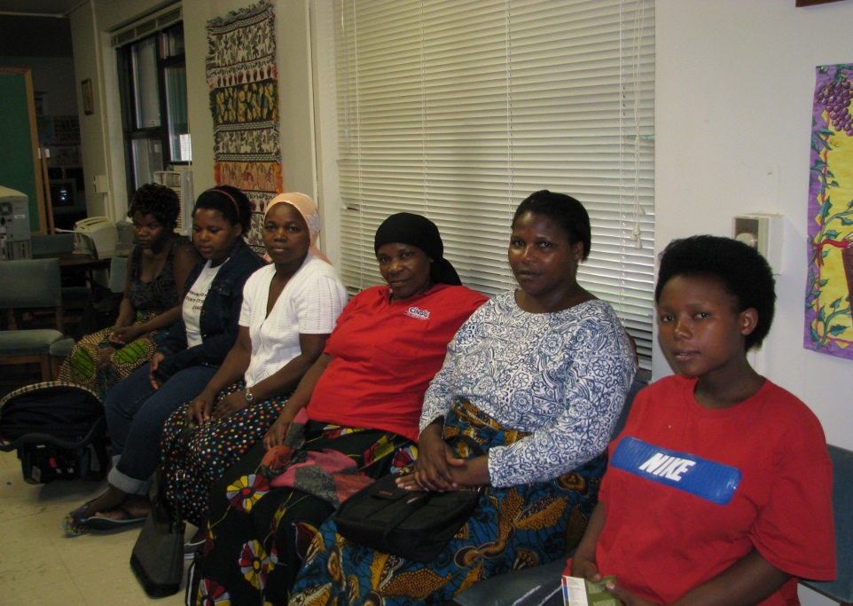
Focus Groups

Slide 17
Outcomes of 6 Initial Focus Groups (n=39)
Cannot learn the language
Cannot discipline their children in America- “Its hopeless”
Children are in age appropriate classes, not academically appropriate by law
No transportation available/ limited mobility
“Live away from all of my friends and family”
Lack of education/literacy
Economics- “too expensive to live and eat”
Lack of income/employment
Depression/Sadness- “I am so sad”
“Cannot understand the doctor”
Fear
Guilt
Want to go home

Slide 18
Individual Resource Interviews
Better understand unique needs
Identify personal goals
Identify environmental demands
Cognitive Mapping to access cultural resources

Slide 19
Individual Questions sample pre
Describe how you experienced life living in the camps in Africa.
Describe a time when you felt safe or stable in the camps?
What did you have or experience that made you feel this way?
Did you have something that others did not?
Tell me about times that you have felt unsafe in the refugee camp.
What do you miss most about living in the camps?
What was important in your life every day?
What do you wish you had more of when you lived in the camps?
Describe things you could not live without in the camps.
Who were the people who were important to you in the camps?
Tell me about a typical day in the camps.

Slide 20
Cognitive Mapping

Slide 21
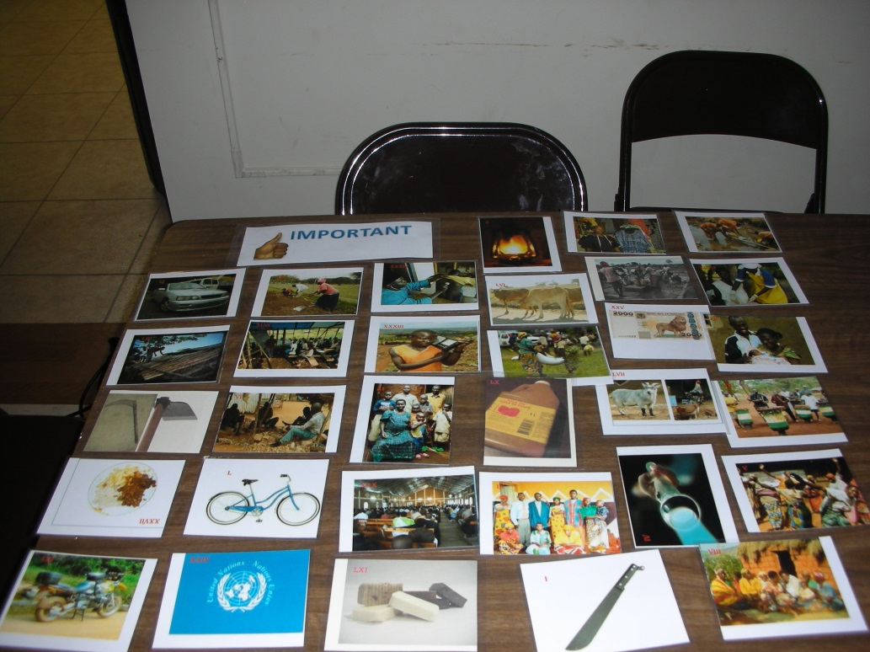
Cognitive Mapping

Slide 22
Individual Questions post
Describe your journey to the U.S.
Describe how you felt in your journey?
What did you have or experience that made you feel this way?
Did you have something that others did not?
Describe your life in the U.S.
Do you feel safe in your community?
Do you feel that your family is stable in the U.S.?
What did you have or experience that made you feel this way?
Did you have something that others did not?
Tell me about times that you have not felt stable or secure in the U.S.
What made you feel that way?
Are there things you could have that would make it easier for you and your family to feel secure or stable?
What is important to have in your life every day?

Slide 23
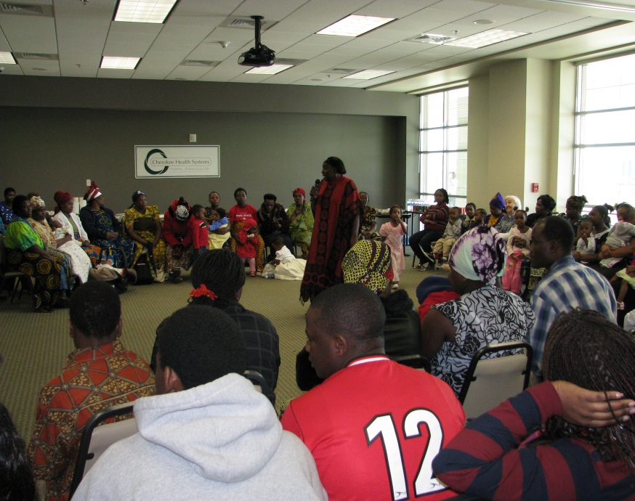
Community Forum
Discussion of data collected
Asked for Interpretation of data
Led discussion of next steps

Slide 24
Establishment of a 501c3
Election of officers and nomination of board members
Monthly member meetings and board meetings
Established a Family Stabilization Committee
Activities since inception:
Grantwriting
Fundraising
Basket making
Dance and choir
16 high school graduates
6 in community college
Children’s group
Teenager’s Group
22 enrolled in GED classes

Slide 25
Development of Community Liaisons

Slide 26
Collaborated in Education Programs

Slide 27
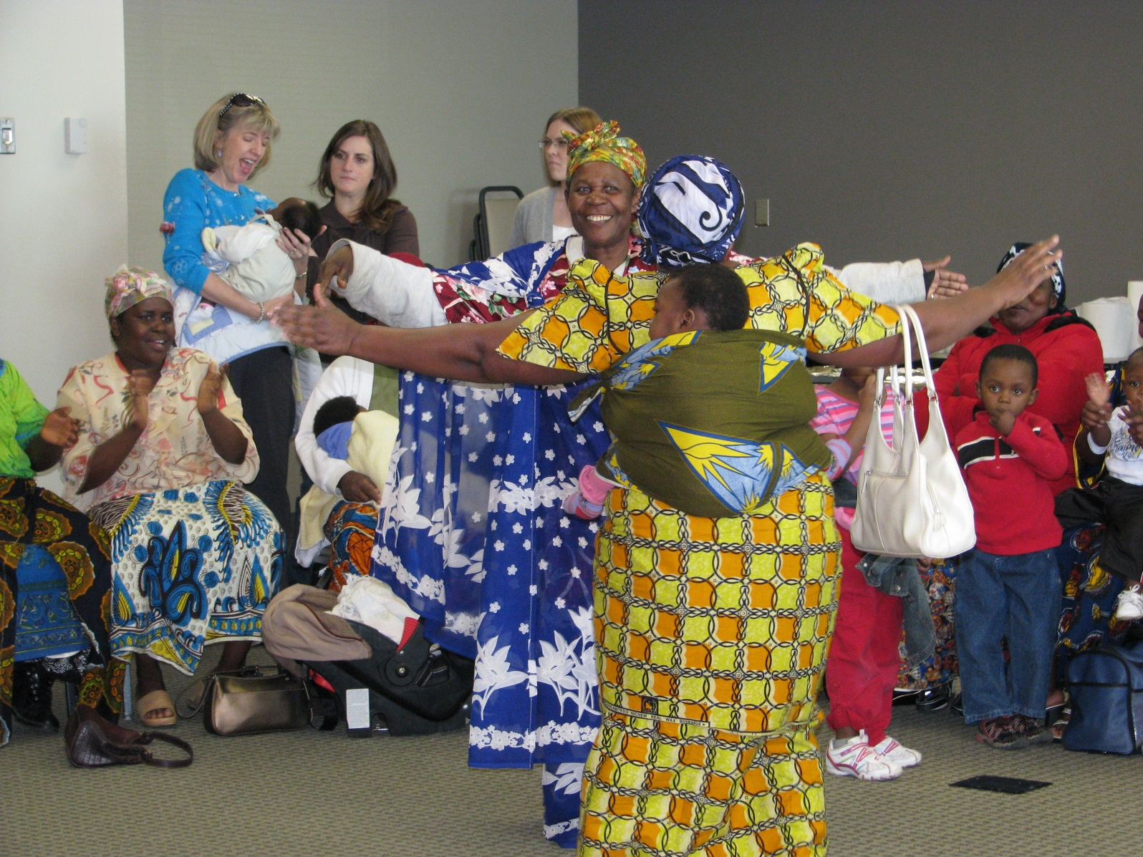
Cultural sharing and integration

Slide 28
New opportunities
Burmese (Karen) in Smyrna
Somali/Sudanese in Shelbyville
Bhutanese, Sudanese in Nashville

Slide 29
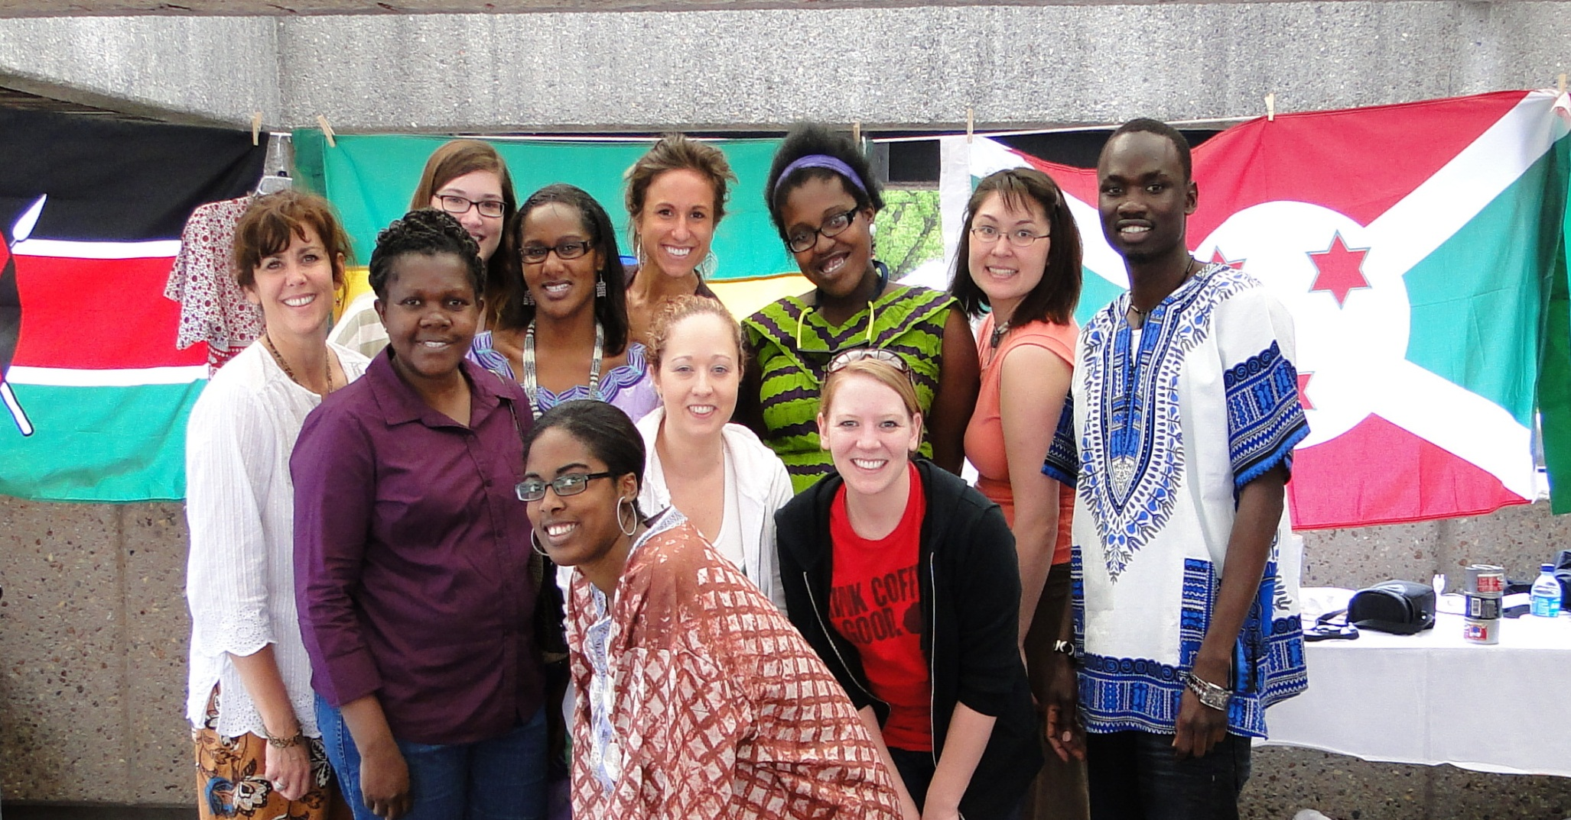
Community Engaged Scholarship

Slide 30
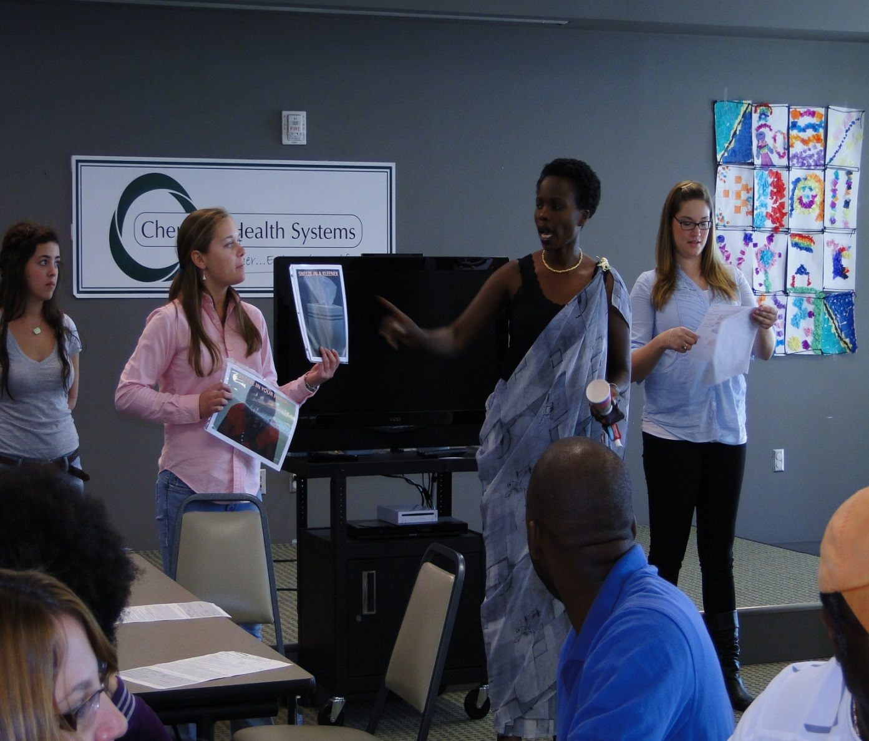
To provide a local opportunity for multi-disciplinary students to learn the value of integrating multiple perspectives (both academic and community) for community service-learning and community based research.

Slide 31
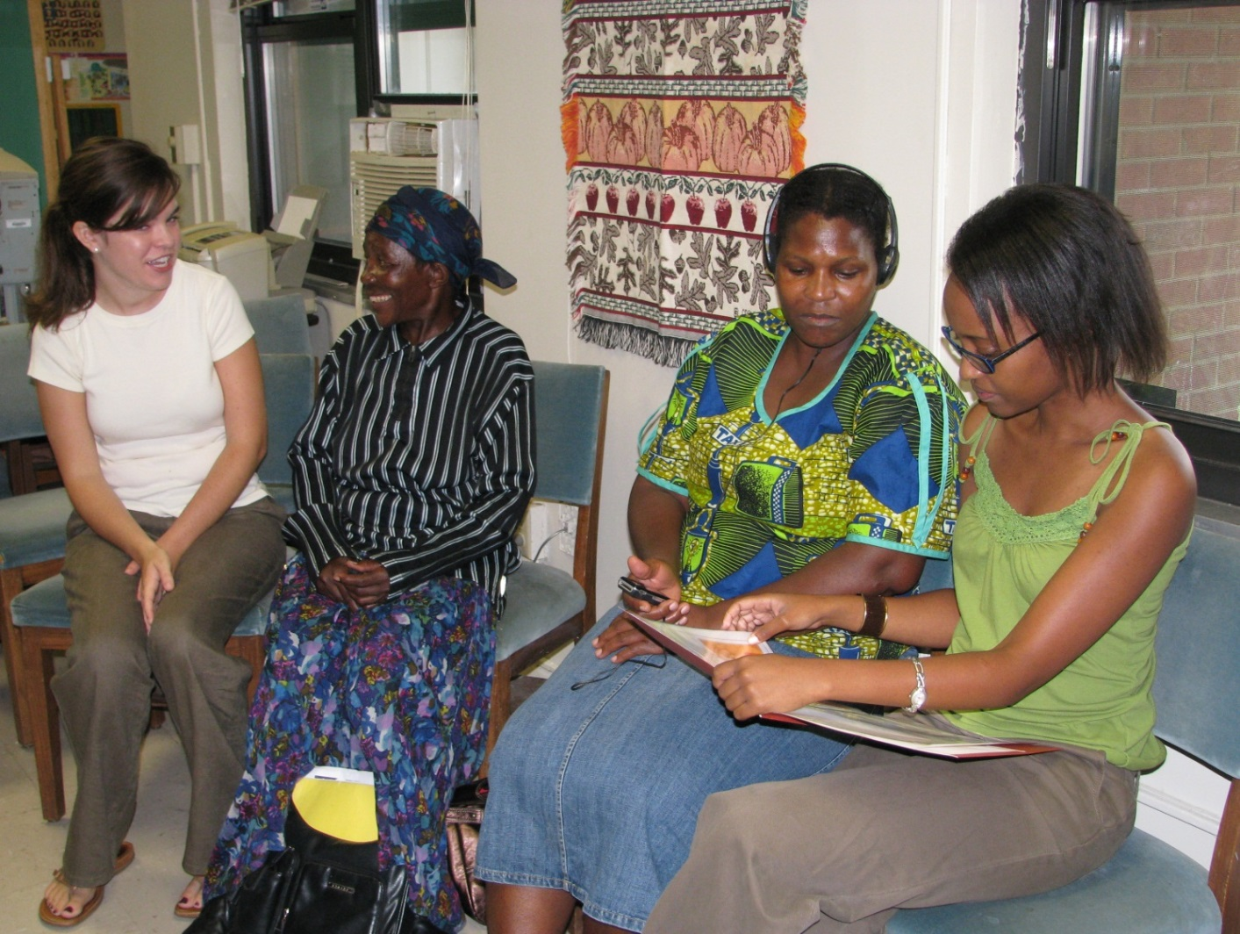
Community engaged scholarship promotes applied research and front line community experiences for students.

Slide 32
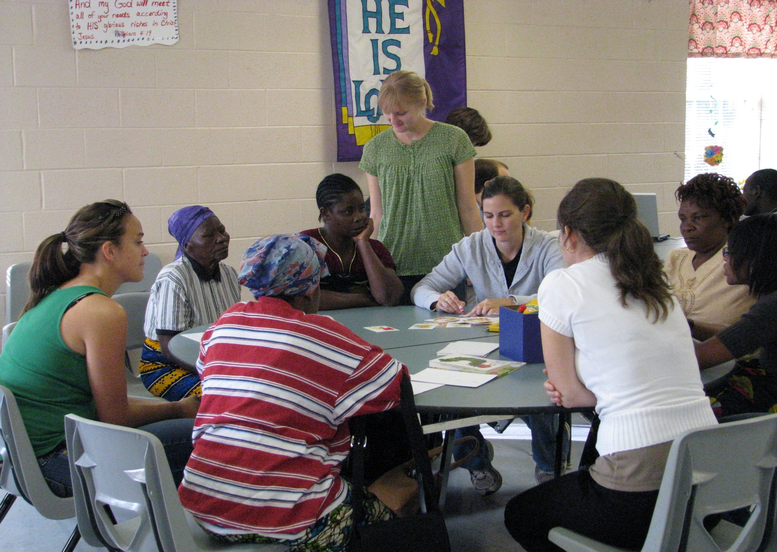
Students learn to integrate Public Health knowledge and training in applied research, practice, cultural sensitivity, program development and advocacy.

