Slide 1
Intro to FBA
Casey Brasher, Ph.D.
School Psychologist

Slide 2

A Little History
B.F. Skinner (1904-1990)
Focus is on observable and measurable aspects of human behavior.
  Stimulus-response associations
  Rewards and punishments
Beliefs
  Human behavior is predictable
  All behavior is learned
  Behavior can be unlearned, and replaced by new behaviors

Slide 3
Behaviorism
Desired responses must be rewarded – rewarded response
  Positive Reinforcement- Something is added to increase desired behavior. Ex: Smile and compliment student on good performance.
  Negative Reinforcement- Something is removed to increase desired behavior. Ex: Give a free homework pass for turning in all assignments.
  Positive Punishment- Something is added to decrease undesired behavior. Ex: Give student detention for failing to follow the class rules.
  Negative Punishment- Something is removed to decrease undesired behavior. Ex: Make student miss their time in recess for not following the class rules.

Slide 4
Applied Behavior Analysis
What are the Principles of Applied Behavior Analysis (ABA)?
Behaviors are affected by their environment.
Behaviors can be strengthened or weakened by its consequences.
Behavior changes are more effective with positive instead of negative consequences.

Slide 5
Applied Behavior Analysis
Broadly speaking, behaviors can be sorted into the following four categories:
Access to attention: Behavior is rewarded with attention by adults or peers. For example, a student might start shouting during a lesson with the hopes of being noticed by their classmates.
Access to tangibles: Behavior is rewarded with a desired item or preferred activity. One classic scenario is a child who cries and whines for candy in the checkout aisle. The parent acquiesces, so the child learns that this behavior is effective.

Slide 6
Applied Behavior Analysis
Access to escape: Behavior is rewarded with the removal of a demand or aversive. Typically, people are trying to escape boring tasks, reprimands, physical demands and non-preferred activities, people or spaces.
Sensory: Behavior is automatically reinforced with a pleasant nervous system response or sensation. Cracking knuckles, clapping hands, bouncing knees and fidgeting are everyday examples of sensory-seeking behavior.

Slide 7
Who is required to have a FBA and formal behavior intervention plan?
  Any student who has been removed from the educational setting through ISS, OSS, expulsion and had a FBA due to manifestation
  Students with chronic behavior that removes them from the LRE, even to a sped setting should be considered for a BIP
Not necessary for:
  Students who have a behavior deficit that can be addressed through goals/objectives/accommodations AND the behavior is not harmful or dangerous

Slide 8
Multi Tiered Instruction
Positive Behavior
Interventions and Support
Tier III Interventions
Specialized
Individualized
Systems for Students with High-Risk Behavior and Academic Difficulties
FBA
Tier II Interventions
Specialized Group
Systems for Students who are at-risk for behavior and academic difficulties
Tier I Interventions
School-/Classroom-
Wide Systems and Instruction for
All Students,
Staff, & Settings

Slide 9

Understanding Chronic Misbehavior
If a student repeatedly engages in a problem behavior, he/she is most likely doing it for a reason, because it is paying off for the student
  The behavior is functional or serves a purpose
Behavior is a form of communication, unfortunately some students learn that problem behavior is the best way for them to get their needs met

Slide 10
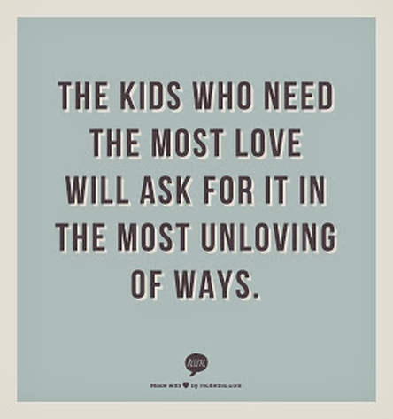
So, It Is Important To
Determine the “REAL” function of the behavior and the “REAL” message being communicated.

Slide 11
So, it’s a process…
Collect Data
Analyze Data
Identify Function
Develop Hypothesis
Develop Hypothesis

Slide 12
How do we collect data?
Indirect
  Interviews only (teacher, parent, student)
Direct without environmental manipulation
  Interviews
  Observations
Structural analysis
  Interviews
  Structured observations
    Systematically altering antecedents
Experimental analysis (functional analysis)
  Setting up controlled conditions

Slide 13
Indirect assessments rely on reports about a student’s behavior rather than direct observation of the behavior.
  Many interviews and rating scales exist
  Should focus on:
      The problem behavior(s)
      Context/routines where problem behavior is most and least likely
      Specific events (discriminative stimuli) that occasion the problem behavior(s)
      Specific consequences that appear reinforcing.

Slide 14
Example Interview
  FACTS Interview (Functional Assessment Checklist for Teachers and Staff)
    Designed to be conducted with the teacher(s) and staff most familiar with the individual student and the problem behaviors that are occurring
    20-45 minutes depending on complexity of problem behavior
    Should be conducted prior to behavior support plan meeting

Slide 15
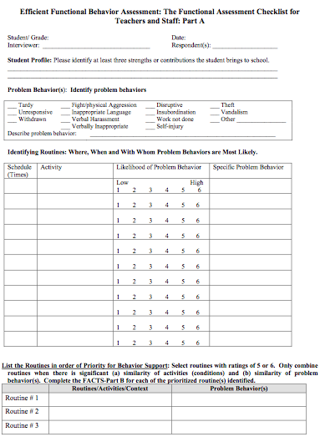
Part A
Student strengths
Problem behavior(s)
Routines analysis
Target routine(s)
Notes:
Strengths: open interview on a positive note, helps focus on strengths as well as challenges, can be incorporated into behavior support plan
Problem Behaviors: Identify the specific student behaviors that are barriers to effective education, disrupt the education of others, interfere with social development or compromise safety at school; if multiple behaviors noted, indicate behaviors of most concern
Routines: isolate routines in which problem behavior reliably does and does not occur
List all activities in students day, indicate activity occurring during each period, complete scale to identify likelihood of problem behavior occurring
Target routines: routines with 4, 5,or 6 ratings; complete part B for all routines

Slide 16
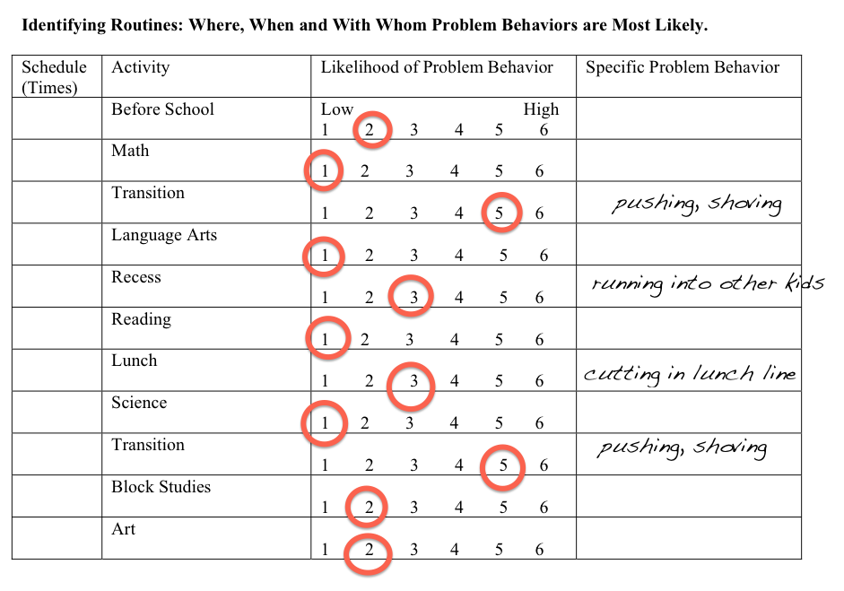
Example: Routines

Slide 17
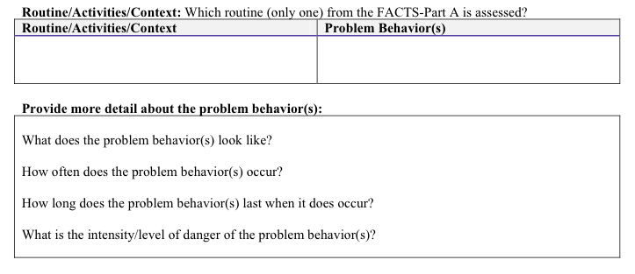
Description of Problem Behavior
Targeted routine
Problem behavior detail
Notes:
Detail: topography, frequency, duration, intensity
-Help develop operational definition

Slide 18
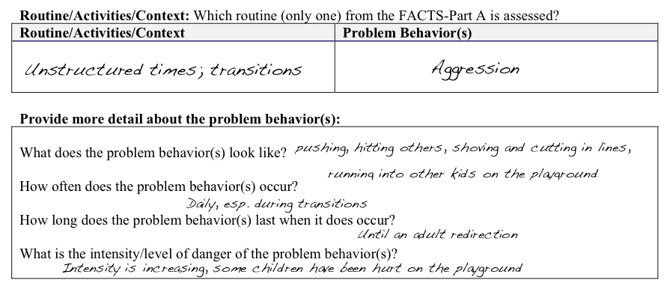
Example: Problem Behavior Description

Slide 19
Data Collection
How often should we collect data?
  When implementing a new program or teaching a new skill, data should be collected every day or every teaching session over 6 data points, or 2 weeks.
  Once progress is seen, data collection twice a week is sufficient.
  Most common frequency is once per week.

Slide 20
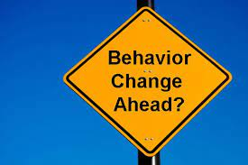
Data Collection
Event Recording
Interval Recording
Time Sampling
Duration Recording
Latency Recording

Slide 21
Summary of Data Collection Systems
Is the target behavior numerical or temporal?
If it is numerical…
  Is it discrete or continuous?
  Is it expected to occur at high, moderate, or low frequency?
  Can teacher collect or third party?
If it is temporal…
  Time before initiation of response or time elapsed during performance of the response

Slide 22
Data Analysis
Data analysis should occur daily and weekly.
A review of the day’s data should include confirmation of target behavior, validity of operational definition, occurrences of new inappropriate behaviors, consistent patterns/relationships with antecedents or consequences, emerging functions.

Slide 23
Direct Observation
Direct observation is often done to validate information obtained through interviews.
The student is observed in the context/routine where the problem behavior is most likely to occur.
Direct observation focuses on identifying the specific antecedents and consequences that appear to control the problem behavior.

Slide 24
Conduct “ABC” Observation(s)
  Observe student during setting/routine where problem behavior is most likely to occur
  Focus on:
    Antecedents (what triggers problem behavior?)
    Behavior (what does the problem behavior look like? How often does it occur?)
    Consequences (what happens directly after problem behavior occurs? How do adults and other students respond?)
  Observation forms:
    Generic ABC observation forms

Slide 25
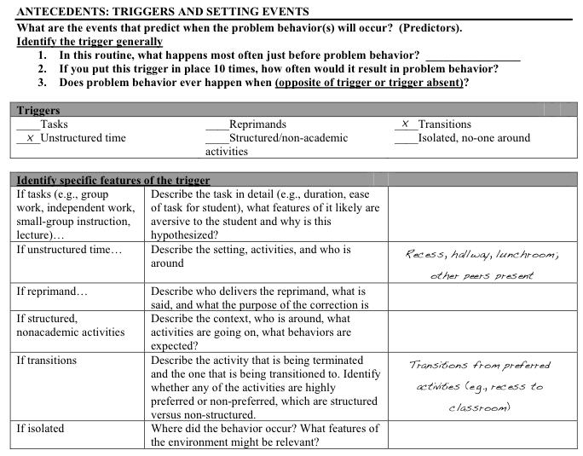
Example: Antecedents

Slide 26
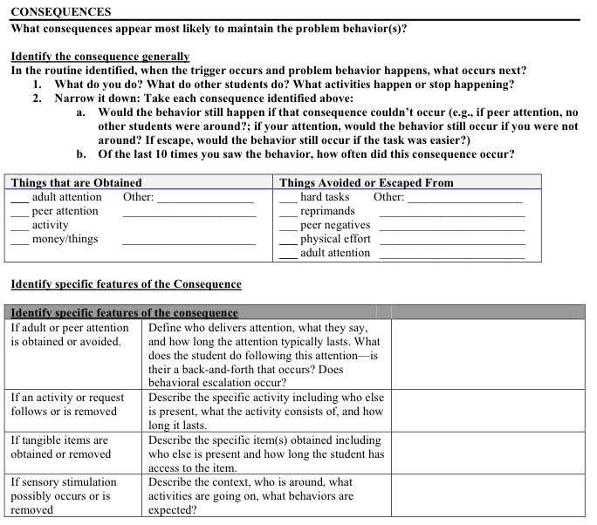
Guiding
questions
Consequence
category
Follow-up questions
Notes:
Follow-up questions as “test conditions”
Indicate most relevant consequence as no. 1 and next relevant consequence w/ no.2

Slide 27
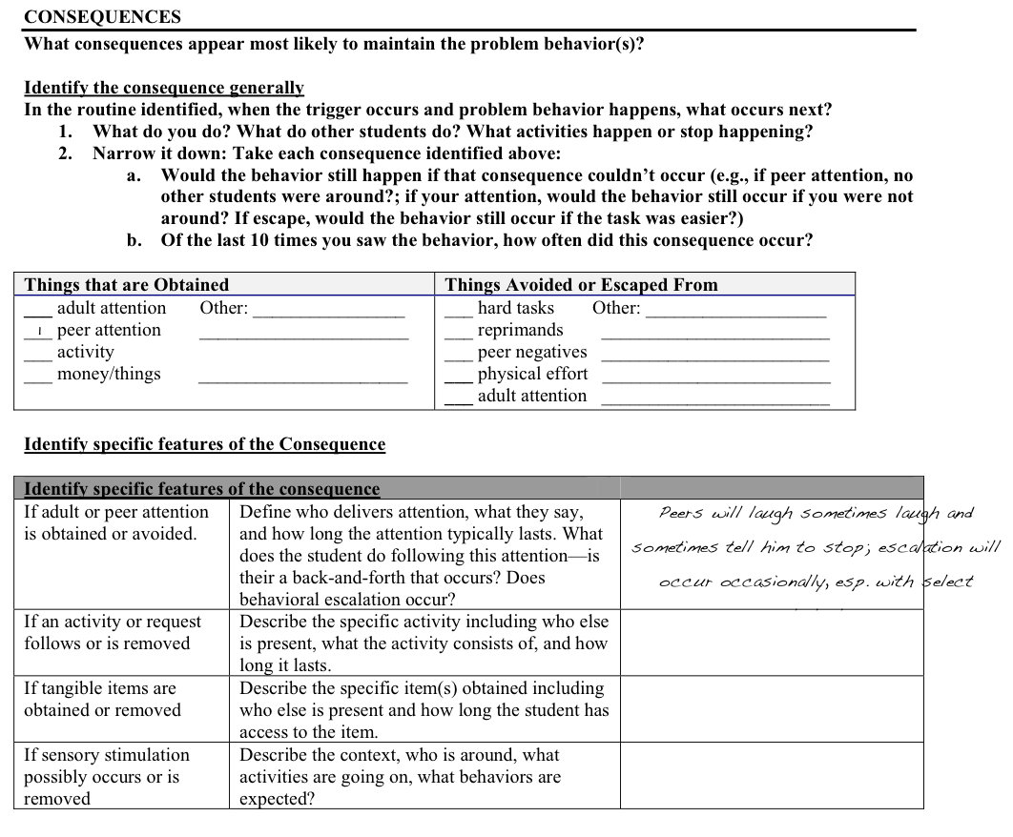
Example: Consequences

Slide 28
Critical Features
Clear and measurable definition of target (problem) behaviors
Antecedent events (triggers) that predict when the problem behavior is most likely to occur
What is the consequence that contributes most to maintaining the problem behavior in that routine (i.e., the function of the behavior)
Summary statement of findings
Behavior support plan developed based on summary statement (FBA findings)

Slide 29
Target Behavior
Operationally defining behavior:
Behavior must be observable and measurable
Unambiguous and objective
Tells exactly what the student says or does
Can you see the behavior?
Can you count the behavior?
Observable beginning and end
Independent observers agree

Slide 30
Operationally Defining Behavior
Talking out
Any vocalizations that are not initiated by the teacher, are out of turn, or are unrelated to academic content
Off-task
Eyes oriented away from teacher/instructional materials, using materials inappropriately, and/or fails to comply with teacher requests within 5-sec of the request

Slide 31

Pair with a partner.
Think and write a description of a “tantrum” on a piece of paper. Determine exactly what a tantrum looks like.
Share your description with the group.
  Operational Definitions- A Test
  Can you count the behavior?
  Will a stranger know what to look for?
  Can you break the definition into smaller components that are more specific and observable?

Slide 32
Understanding Antecedents
What typically happens just before problem behavior to trigger it?
    If this antecedent were in place 10 times, how often would it result in problem behavior?
    Does the problem behavior ever happen when the antecedent is absent/opposite of antecedent?
    If you wanted to set up the student to engage in the problem behavior, what would you do?

Slide 33
Understanding Antecedents
What specific features of the antecedent are important?
What specific activity?
Which specific peers?
What tasks?
The more specifically you can narrow, the better you can prevent the problem behavior from occurring.
Examples:
Independent math worksheets
Large group reading
Unstructured activities when sitting near preferred peers

Slide 34
Understanding Consequences and Function
  What happens immediately after the behavior?
    How do peers respond?
    How do the adults respond?
    What are the consequences for the student?
    What activities change or stop?
    How many times out of 10 do each of these responses occur following the problem behavior?
  Examples:
    Sent to office
    Behavior is ignored
    Peers laugh at student
    Student is verbally corrected

Slide 35
Understanding Consequences and Function
  Narrowing down potential consequences:
    Would the behavior still happen if that consequence didn’t exist?
      Peer attention: If no peers were around?
      Adult attention: If no adults were around?
      Escape: If the task were easier?
    Of the last 10 times you saw this behavior, how often did that consequence occur?
  Consequence vs. Function
    The consequence is the event that occurs immediately after problem behavior
    Function is what the student is getting out of the behavior

Slide 36
Understanding Consequences and Function
Function
  The general outcome of a behavior, the purpose
  What is the student gaining/avoiding?
  peer attention, adult attention, task/work, tangible, preferred activity/non-preferred activity, sensory stimulation
  Non-examples:
  Retaliation, intimidation, fear, control

Slide 37
What is a “Setting Event”?
Situations or factors unique to the individual:
  Make problem behavior more intense or more likely to occur by changing the value of reinforcers
  Examples include illness, fatigue, hunger, social conflict
  In many cases, there will not be a relevant setting event.

Slide 38

Summary Statement
4 1 2 3
Skips breakfast Asked to complete Lays on the Escape task
an academic task floor and kicks
(1) When asked to complete an academic task, Jimmy (2) lays on the floor and kicks at his teachers in order to (3) escape the task. This is more likely to occur on days when Jimmy does not eat breakfast.

Slide 39
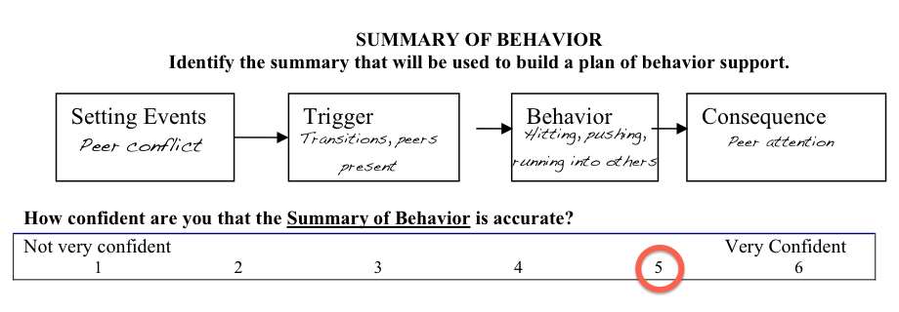

Slide 40
Once you establish the function of a behavior, you need to determine how the ADULT might be contributing to the problem.
Just how does she think I contribute to THEIR behavior?
Do you mean that I must change so the student will change?

Slide 41
The FBA is only useful if it is used to develop a Behavior Plan (BIP/BSP)
The BIP should match the function or purpose the behavior serves.
The goal is that the FBA process will make the problem behavior irrelevant (antecedent manipulation/prevention), inefficient (teacher more effective alternative behaviors), or ineffective (alter the consequences).
Terms to know: Shaping, Cueing, Prompting, Fading, Alternative (replacement) Behaviors

Slide 42
Example Replacement Behaviors
Students runs out of the classrooms and/or building – Student requests time in “safe spot” through the use of a signal
Student bites adults, self, or peers – Student uses a safe necklace, pencil topper, or hard candy to chew when needed
Student yells and throws items at the teacher – Student requests time to talk with the teacher or moves to a seat near the teacher
Student steals from the cafeteria – Student assists in the cafeteria to earn a small snack or “money” in their lunch account

Slide 43
Behavior Strategies Based on Function
Setting Event – Neutralize/eliminate effect of setting event
Antecedent Strategy – Prevent problem behavior from occurring
Behavior Teaching – Teach alternative and desired behaviors
Consequence Strategy – Increase desired behaviors & decrease problem behaviors

Slide 44
Remember, it’s a process…
Even with strong data collection, collaboration, and thoughtful planning the BIP may not be entirely effective the first time
  Remember, it is a plan for improvement, not a magic wand, give it some time (3-4 weeks unless at a crisis level during that time)
  There may be more the student is telling us that we just haven’t heard clearly yet
  If at first you don’t succeed, try again. This is about a student’s life, not that moment

Slide 45

Ooops….
Sometimes we reinforce the incorrect behavior:
It is significantly easier to get attention for doing something wrong than doing something right.
The undesired behavior evokes an emotional response that creates reinforcement for the child.
We are human, we make mistakes, get tired, and balance a lot at once.
No one is perfect. • No plan is perfect. • No day is perfect.

