Slide 1
Exclusionary Practices in Education
Presenters:
Adrienne Cook, Ex. Ed Coach
Sonya Dobbs, Ex.Ed. Director
Christopher Flor, Ex.Ed. Coordinator
Metropolitan Nashville Public Schools
Notes:
Good morning/afternoon and welcome to The Implementation of Accommodations and Modifications in the Classroom setting. This training has been adapted to consider both virtual and face-to-face instruction.
Determine which of the following welcoming rituals you will use: There is one for in-person and one for virtual (make sure to hide the one you are not using)

Slide 2
Brave Space Norms
Be vulnerable
Look to your own growth first
Accept non-closure
Take the perspective of others
Assume best intentions
Lean into discomfort/fear
Think critically
Consider impact over intent
Practice mindfulness

Slide 3
Participants will confidently be able to:
Distinguish
Distinguish between inclusive and exclusionary practices in behavior managing behavior
Explain
Explain the function and consequences of exclusionary practices
Identify
Identify the supports needed to keep students in the Least Restrictive Environment
Define
Define disproportionality and explain the data behind it.
Define
Define Exclusionary Practices

Slide 4
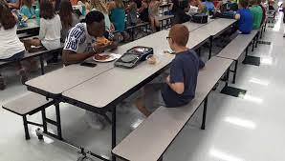
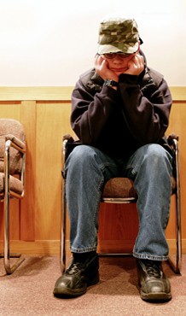
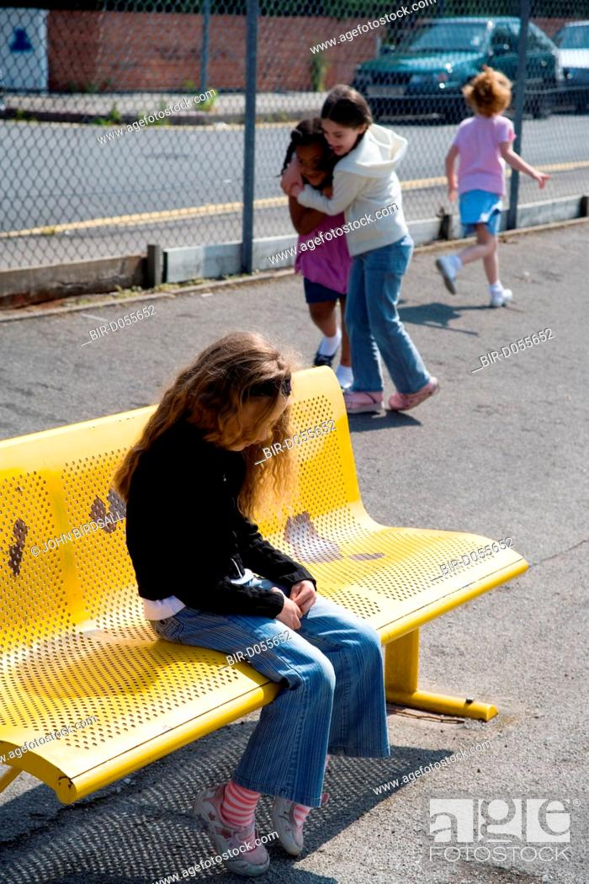
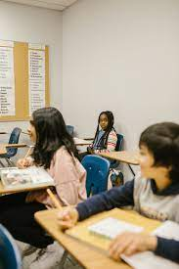
What do Exclusionary Practices look like?

Slide 5
What are Exclusionary Practices?
Any type of action by school staff that either removes or excludes a student from their educational setting or activities in the absence of meaningful evidence gathering and intervention.
In-Class Exclusion (academic, social, behavioral)
Physical Exclusion (ex: barred access from participation in group activities, lunch, recess, etc.)
Office Referrals
Expulsion/Suspension
Segregating Students (Special classes or separate schools)

Slide 6
Cycle of Exclusionary Practices
Behavior Exhibited
Exclusion
Increase in Deficits
Gaps Widen
Intensity of behavior Increases
Intensity of Exclusion Increases

Slide 7
Research on Exclusionary Discipline
School discipline research, policy, and practice are reviewed in a recent National Association of State Boards of Education report that noted "several worrisome trends" including continued reliance on exclusionary discipline that does not increase student safety, as well as disparate treatment of certain student groups.
Authors Greta Colombi and David Osher, American Institutes for Research analysts, also presented promising local school disciplinary practices in Advancing School Discipline Reform, which appeared in the August edition of Education Leaders Report.

Slide 8
What are the consequences of not addressing behavior proactively?

Slide 9
What happens when a SCHOOL does not proactively address behavior?
Staff Attrition
Annual Performance Measures Not Met
Disproportionality: Increased Office Referrals, Suspensions, Expulsions
Decreased Academic and Social Engagement
Deteriorating school culture and climate

Slide 10
What happens to STUDENTS when schools do not proactively address behavior?
Missed Academic Content
Poor Performance
Mental health issues
Involvement in Juvenile Justice
Repeated Grades / Dropping out

Slide 11
What happens to TEACHERS when schools do not proactively address behavior?
Burnout
Low Morale / Increased Apathy
Increased Absenteeism
Low Teacher Performance
Increased Mistrust / Loss of Confidence

Slide 12
What is the research telling us?
Students must feel emotionally and physically safe, connected supported, challenged, engaged, and socially capable to succeed academically. Thus, the way students experience discipline is a condition for learning.
Recent years have found more LEAs relying on exclusionary measures and using them for minor or subjective infractions, "the more exclusionary discipline practices are applied, the worse students perform academically, even after controlling for poverty and other demographic factors." - Advancing School Discipline Reform

Slide 13
What is the research telling us?
Little evidence that suspending or expelling a student works as a deterrent for bad behavior.
Research supports PBIS as well as targeted interventions responding to early warning signs.
Copyright 2015@LRP Publications

Slide 14
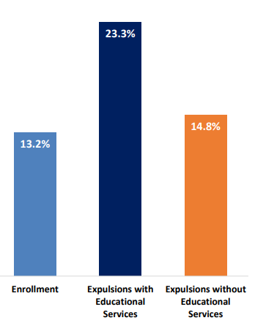
Let’s look at the data
In 2017-18, students with disabilities served under IDEA represented 13.2% of the total student enrollment and received 23.3% of all expulsions with educational services and 14.8% of expulsions without education services. – U.S. Department of Education

Slide 15
Legal framework for behavior and discipline under IDEA
The cornerstone of IDEA is the entitlement of each eligible child with a disability to FAPE that emphasizes special education and related services designed to meet the child's unique needs and that prepares the child for further education, employment, and independent living.
IDEA and its implementing regulations require IEP Teams to follow certain procedures to ensure that IEPs meet the individualized needs, including the behavioral needs, of children with disabilities. 20 U.S.C. § 1414(d) and 34 C.F.R. §§ 300.320 through 300.324

Slide 16
Legal Requirements
IDEA specifically requires IEP Teams to consider the use of positive behavioral interventions and supports, and other strategies, for any child with a disability whose behavior impedes their learning or that of others. 20 U.S.C. § 1414(d)(3)(B)(i); 34 C.F.R. § 300.324(a)(2)(i).
The IEP Team may elect to address the behavior through annual goals in the IEP. 34 C.F.R. § 300.320(a)(2)(i).
The child's IEP may include modifications to the child's program, supports for the child's teachers or other school personnel, and any special education and related services and supplementary aids and services necessary to enable the child to advance appropriately toward attaining those behavioral goals. 34 C.F.R. § 300.320(a)(4).

Slide 17
Office of Special Education Programs (OSEP)
Schools may not impose discipline on students with disabilities in a manner that constitutes disability discrimination under Section 504 of the Rehabilitation Act of 1973.
Generally speaking, there are two ways in which a school’s use of discipline could discriminate against students with disabilities under Section 504, namely, when:
the school subjects a student to unnecessary different treatment based on disability, or
the school’s criteria, policies, practices, or procedures have unjustified discriminatory effects on students based on disability.

Slide 18
Office of Special Education Programs (OSEP)
Disparities in exclusionary discipline place students at risk for negative outcomes:
Lower achievement
Increased likelihood of not graduating
Positive proactive strategies, however, reduce rates of discipline and improve school climate and student outcomes.
Copyright 2022@LRP Publications

Slide 19
Shifting our Thinking
Notes:
READ THIS AND DISCUSS….what do you think about this wording in the law? Do you agree?

Slide 20
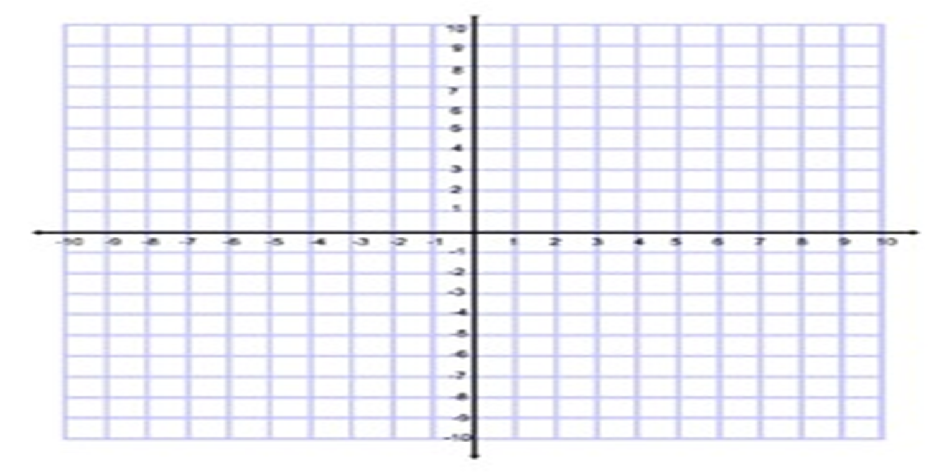
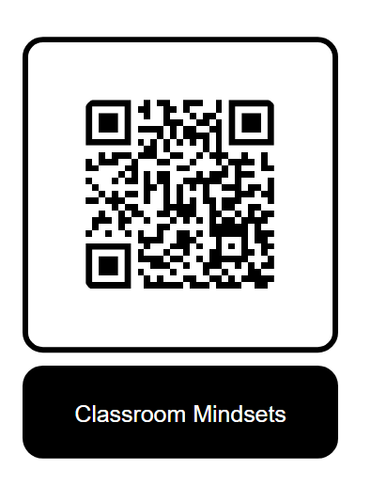

Slide 21
Antecedent | Behavior | Consequence
Class with chronic misbehavior. | Teacher begins to micromanage classroom. | Students are deprived opportunity to engage in rigorous learning, but teacher is relieved the stress of chaotic environment
What is the function of the teacher’s behavior?
Antecedent | Behavior | Consequence
Student smacks another child on the cheek. | Teacher codes the infraction as “assault of student.” | Student now faces expulsion.
Antecedent | Behavior | Consequence
Student commits an expellable offense. | IEP Team does not review data or discuss whether services have been provided. | Student now faces expulsion.

Slide 22
Improving Behavior
Moving to a more restrictive setting
Therefore, the destination is critical when responding to behavior

Slide 23
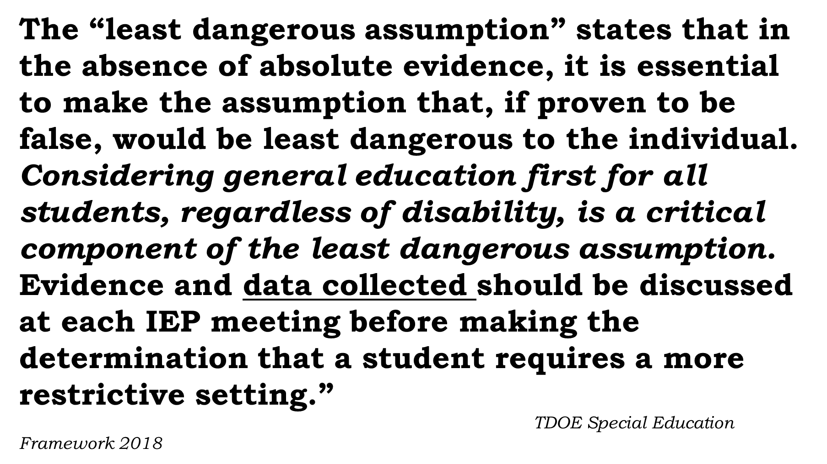

Slide 24
Exclusionary | Identifying the extent of a student's LRE
Moving students without attempting behavior interventions | Meaningful interventions applied with fidelity
Moving students without have the data to justify the move. | Consistent and ongoing data showing regression
How you arrive at the destination is also important.

Slide 25
When should positive behavior supports be considered?
ALWAYS!

Slide 26
Multi-Tiered Systems of Support And Positive Behavior Supports

Slide 27
Tier 1 Classroom Fidelity Checklist

Slide 28
Tier 1 Is there a well-defined school-wide culture? Mission? Vision?

Slide 29
Tier 1 Are there well -defined universal expectations?

Slide 31
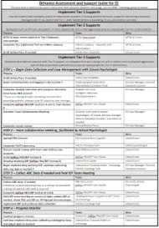
Behaviors that require Tier 2 intervention are those that did not respond adequately to the high-quality instruction provided in the general education classroom (Tier I). This tier of RTI usually involves more intensive targeted intervention and frequent monitoring.

Slide 32
Identify the need
Universal Screeners
Collaborative Referral
MTSS-B Meeting data reviews
Attendance
Discipline referrals
Suspensions
Navigator data
Universal Screener
MTSS-B Data
Collaborative Referral

Slide 33
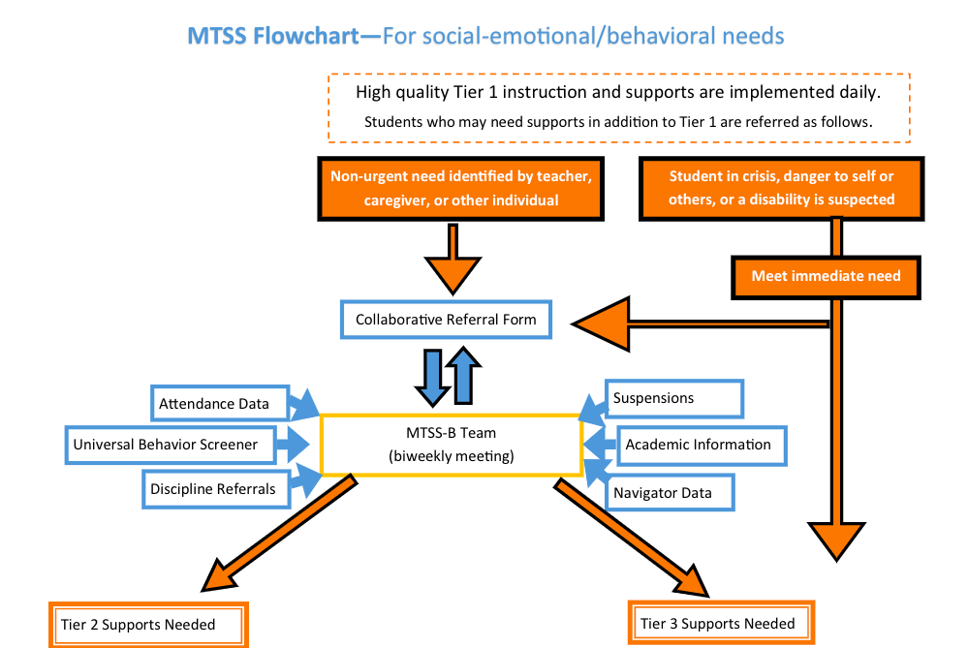
Notes:
Flowchart for MTSS-B
Let's walk through the process of how an individual student might access tier 2 and tier 3 social-emotional and behavioral supports. Tier II is group based intervention, Tier III is more individualized. If Tier II, you document in the RTI module in IC just like academics. If we don't document for a student, we don't know what is and is not working.

Slide 34
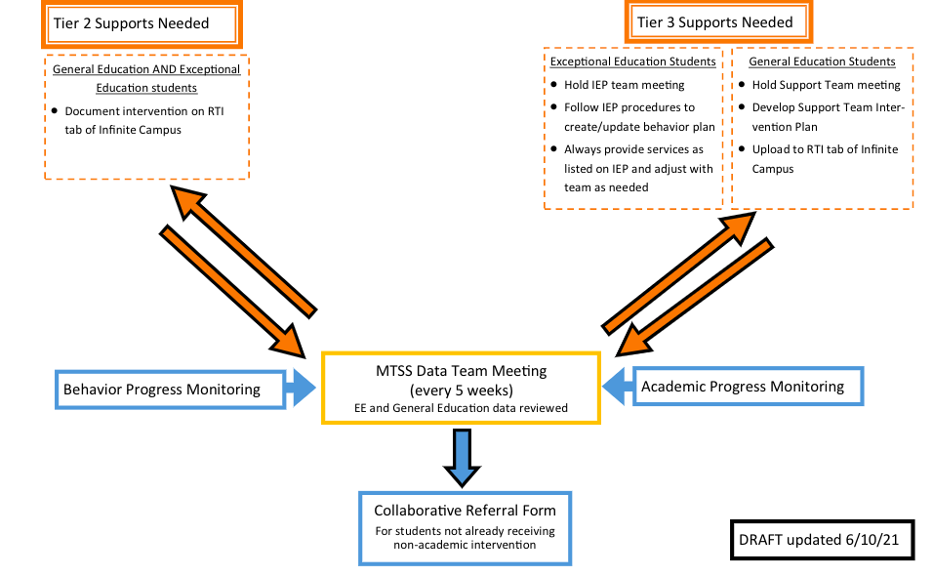

Slide 35
An FBA shall be conducted to inform the development or revision of a BIP in any of the following situations:
When a student receiving Special Education and Related Services engages in conduct that results in a change of placement as defined by 34 C.F.R. 300.356 and the LEA, the Parent, and relevant members of the IEP team determine that the student’s conduct that gave rise to the change in placement was a manifestation of the child’s disability;
When an IEP provides for the use of restraint or isolation, as required by T.C.A. 49-10- 1304(b);
When the student exhibits a pattern of behaviors that impede their learning or that of others;
When the student exhibits a pattern of behavior that places the student or others at risk of harm or injury;
When the student’s IEP team is considering a more restrictive placement as a result of the student’s behavior; or
When determined appropriate by the student’s IEP team
State Board Rule 0520-01-09-.24

Slide 36
An FBA shall be conducted, as appropriate, to inform the development or revision of a BIP in the following situations:
When a student receiving Special Education and Related Services is removed from their current placement for more than ten (10) consecutive school days for behavior not determined to be a manifestation of the student’s disability; or
When a student receiving Special Education and Related Services is removed to an interim alternative education setting for up to forty-five (45) school days for weapons, drugs, or serious bodily injury, irrespective of whether the student’s behavior is a manifestation of the student’s disability.
State Board Rule 0520-01-09-.24

Slide 37
MNPS Demographics
80,800 Students
11,000 SWD
30,000 Econ. Dis.
19,000 ELL
Notes:
Before we can talk about accommodations and modifications, we have to understand the laws that govern students with disabilities. Read bold statement first “Federal and State…)
Click prior to reading each bullet to highlight the bullet you are on:
(Click) “The Individuals…”
(Click) “Section 504”
(Click) “The Americans…”
ADA prohibits discrimination on the basis of disability, so schools need to accommodate for student’s disability within the general curriculum.

Slide 38
MNPS Disproportionality: A long journey 2017-Present
Notes:
Before we can talk about accommodations and modifications, we have to understand the laws that govern students with disabilities. Read bold statement first “Federal and State…)
Click prior to reading each bullet to highlight the bullet you are on:
(Click) “The Individuals…”
(Click) “Section 504”
(Click) “The Americans…”
ADA prohibits discrimination on the basis of disability, so schools need to accommodate for student’s disability within the general curriculum.

Slide 39
Intellectual Disabilities
Office of Civil Rights 2017
Notes:
Before we can talk about accommodations and modifications, we have to understand the laws that govern students with disabilities. Read bold statement first “Federal and State…)
Click prior to reading each bullet to highlight the bullet you are on:
(Click) “The Individuals…”
(Click) “Section 504”
(Click) “The Americans…”
ADA prohibits discrimination on the basis of disability, so schools need to accommodate for student’s disability within the general curriculum.

Slide 40
Emotional Disturbance
Office of Civil Rights 2017
Notes:
Before we can talk about accommodations and modifications, we have to understand the laws that govern students with disabilities. Read bold statement first “Federal and State…)
Click prior to reading each bullet to highlight the bullet you are on:
(Click) “The Individuals…”
(Click) “Section 504”
(Click) “The Americans…”
ADA prohibits discrimination on the basis of disability, so schools need to accommodate for student’s disability within the general curriculum.

Slide 41
Student Retention
Office of Civil Rights 2017
Notes:
Before we can talk about accommodations and modifications, we have to understand the laws that govern students with disabilities. Read bold statement first “Federal and State…)
Click prior to reading each bullet to highlight the bullet you are on:
(Click) “The Individuals…”
(Click) “Section 504”
(Click) “The Americans…”
ADA prohibits discrimination on the basis of disability, so schools need to accommodate for student’s disability within the general curriculum.

Slide 42
Discipline
Office of Civil Rights 2017
Notes:
Before we can talk about accommodations and modifications, we have to understand the laws that govern students with disabilities. Read bold statement first “Federal and State…)
Click prior to reading each bullet to highlight the bullet you are on:
(Click) “The Individuals…”
(Click) “Section 504”
(Click) “The Americans…”
ADA prohibits discrimination on the basis of disability, so schools need to accommodate for student’s disability within the general curriculum.

Slide 43
Expulsions SWD
Office of Civil Rights 2017
Notes:
Before we can talk about accommodations and modifications, we have to understand the laws that govern students with disabilities. Read bold statement first “Federal and State…)
Click prior to reading each bullet to highlight the bullet you are on:
(Click) “The Individuals…”
(Click) “Section 504”
(Click) “The Americans…”
ADA prohibits discrimination on the basis of disability, so schools need to accommodate for student’s disability within the general curriculum.

Slide 44
“Gifted and Talented”
Office of Civil Rights 2017
Notes:
Before we can talk about accommodations and modifications, we have to understand the laws that govern students with disabilities. Read bold statement first “Federal and State…)
Click prior to reading each bullet to highlight the bullet you are on:
(Click) “The Individuals…”
(Click) “Section 504”
(Click) “The Americans…”
ADA prohibits discrimination on the basis of disability, so schools need to accommodate for student’s disability within the general curriculum.

Slide 45
MNPS Disproportionality 2021-22
Notes:
Before we can talk about accommodations and modifications, we have to understand the laws that govern students with disabilities. Read bold statement first “Federal and State…)
Click prior to reading each bullet to highlight the bullet you are on:
(Click) “The Individuals…”
(Click) “Section 504”
(Click) “The Americans…”
ADA prohibits discrimination on the basis of disability, so schools need to accommodate for student’s disability within the general curriculum.

Slide 46
MNPS Disproportionality 2022-23
Notes:
Before we can talk about accommodations and modifications, we have to understand the laws that govern students with disabilities. Read bold statement first “Federal and State…)
Click prior to reading each bullet to highlight the bullet you are on:
(Click) “The Individuals…”
(Click) “Section 504”
(Click) “The Americans…”
ADA prohibits discrimination on the basis of disability, so schools need to accommodate for student’s disability within the general curriculum.

Slide 47
Con$equence$:
Notes:
READ THIS AND DISCUSS….what do you think about this wording in the law? Do you agree?

Slide 48
What are we doing about it?
Notes:
READ THIS AND DISCUSS….what do you think about this wording in the law? Do you agree?

Slide 49
Questions?
Notes:
READ THIS AND DISCUSS….what do you think about this wording in the law? Do you agree?

