Slide 1
RAMPing Up Your School Counseling Program
School Counselors Collaborative Academy, July 13, 2023
Joyce Hollins and Desirae Skelley
Summit High – Williamson County

Slide 2
Agenda
What is RAMP?
Why is RAMP Important?
Our RAMP story/journey
How do I know if my program is ready to RAMP?
Resources

Slide 3
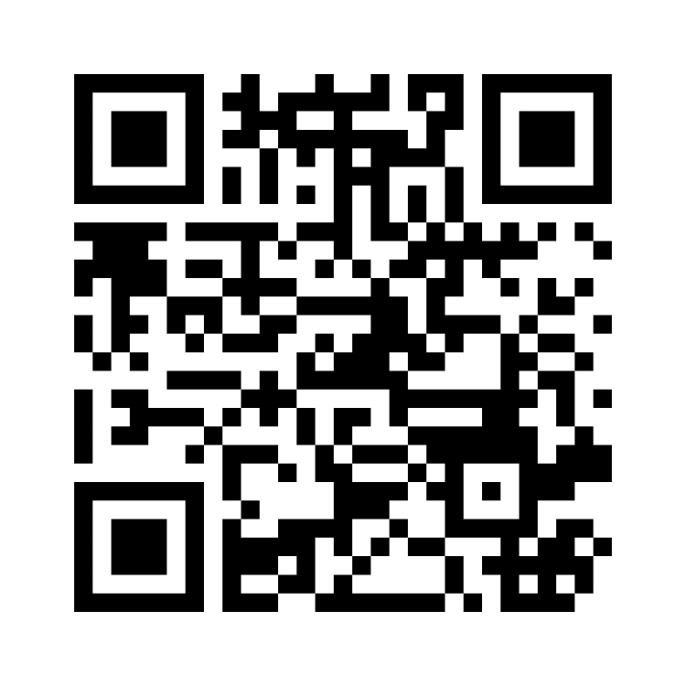
Introduction
https://www.menti.com/alcznge2m25v

Slide 4
What is RAMP?
Recognized ASCA Model Program
Program alignment with the ASCA National Model
Evidence of:
Direct and Indirect services
Program Planning
Improved Student Outcomes (achievement, attendance, or discipline)

Slide 5
What is RAMP?
101 schools in 21 states achieved the RAMP designation this year
1,300 schools have received the RAMP designation since the program’s inception
RAMP designation is good for 5 years
15 schools earned Re-RAMP this year

Slide 6
TN RAMP Schools
Clarksburg High School, Clarksburg, TN – 2010
Cleveland High School Cleveland TN – 2014
Hillsboro High School Nashville TN – 2014
Houston Middle School Germantown TN – 2016
Dan Mills Elementary School Nashville TN – 2017

Slide 7
Current TN RAMP Schools
Central Heights Elementary School, Blountville - 2021
Dan Mills Elementary School, Nashville-Re-RAMP 2022
Houston Middle School, Germantown – Re-RAMP 2021
Ketron Elementary School , Kingsport - 2020
McGavock High School, Nashville - 2019
Summit High School, Spring Hill -2022
Sycamore Elementary School, Cookeville -2021

Slide 8
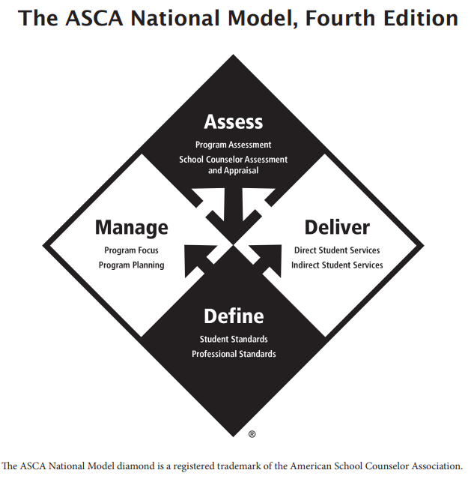
ASCA National Model
Define: Student and Professional Standards that guide the development of our school counseling programs
ASCA Student Standards
ASCA Ethical Standards
ASCA Professional Standards

Slide 9
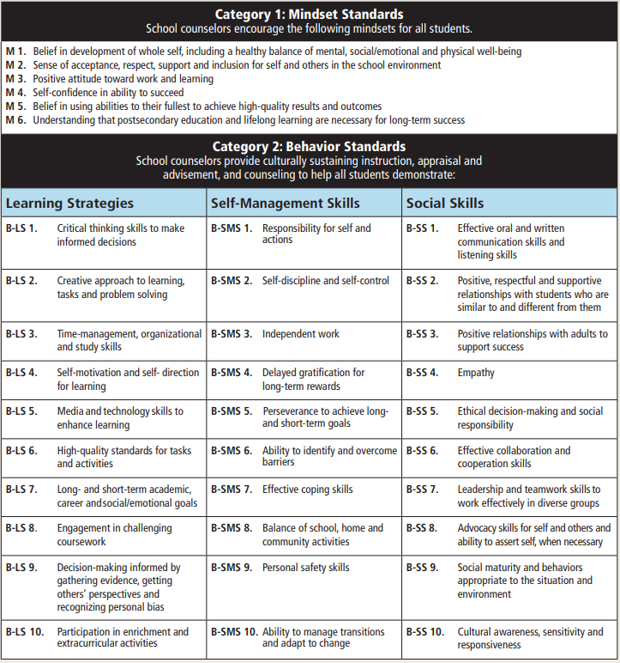
ASCA Student Standards: Mindsets and Behaviors for Student Success

Slide 10
ASCA National Model
Manage: Program Focus and Program Planning
Program Focus
Beliefs
Vision Statement
Mission Statment

Slide 11
ASCA National Model
Manage:
Program Planning
School data summary
Student Outcome Goals
Action Plans and Lesson Plans
Annual Administrative Conference
Use of Time/Calendars
Advisory Council

Slide 12
ASCA National Model
Deliver: Services Provided
Direct: (Face-to-Face)
Counseling, Instruction, Appraisal
Individual, Small Group, Classroom
Indirect: (On Behalf of the student)
Consultation, Collaboration, Referrals

Slide 13
ASCA National Model
Assess: evaluate the effectiveness of your program and the need for changes
Program Evaluation
Program Assessment
Results Reports
School Counselor Assessment and Appraisal

Slide 14
Data
Participation data
Who, What, How Many
Mindsets and Behavior Data
Pre/Post Tests
Results Data
Achievement, Attendance, and Discipline

Slide 15
Data Review
https://www.menti.com/alcznge2m25v

Slide 16
RAMP Rubric
10 sections:
Vision and Mission – 6 points
Student Outcome Goal – 7 points
Classroom and Group Mindsets and Behaviors Action Plan – 5 points
Annual Administrative Conference – 5 points
Advisory Council – 6 points

Slide 17
RAMP Rubric
10 sections continued:
Annual Calendar – 3 Points
Lesson Plans (Classroom and Group) – 5 points
Classroom Instruction Results Report – 7 points
Small Group Results Report – 7 points
Closing the Gap Action Plan and Results Report- 9 points

Slide 18
RAMP Rubric
Each section requires specific information and documents either uploaded or copy and pasted into the RAMP portal
Each section has at least one reflection
250-word limit – do not exceed
Be sure to follow the prompt exactly

Slide 19
RAMP Rubric
60 total possible points
Required 54 points or higher to earn RAMP
If you do not obtain a score of 54 or higher after your first submission you may be invited to revise certain sections and resubmit
Must use the ASCA Templates
Keep it simple and follow the rubric

Slide 20
Why is RAMP Important?
Alignment with the National Counseling Model (TN School Counseling Model)
Comprehensive School Counseling Program → Best for students
Improves student outcomes
Improves the use of data
Advocacy

Slide 21
No interest in applying for RAMP?
No problem! The application process is not for everyone
The most important part is the PROCESS!
Building a comprehensive school counseling program is BEST PRACTICE
Start small and grow each year
Develop a goal, assess, repeat

Slide 22
Summit’s RAMP Story

Slide 23
Our team…from the beginning
…to the end.

Slide 24
SHS RAMP Timeline
July 2020
August 2021-June 2022
ASCA Annual Conference cancelled – delayed our data collection year
Data Collection Year
July 2021
July-Oct 2022
Attended ASCA Annual Conference in Las Vegas as a team
Worked on our RAMP Application

Slide 25
SHS RAMP Timeline
October 2022
February 2023
Submitted RAMP Application
Submitted RAMP Revisions
January 2023
March 2023
Received notification that in order to receive the RAMP designation we would need to submit revisions.
Received notification that we achieved the RAMP designation!

Slide 26
Many of life’s failures are people who did not realize how close they were to success when they gave up. - Thomas Edison

Slide 27
Is my program ready to RAMP?
Complete the ASCA Program Assessment Tool and review the RAMP Rubric
Assess your program’s strengths and areas of growth
What improvements are necessary prior to applying
The RAMP process from start to finish is at least 3 years – what is your level of commitment?

Slide 28
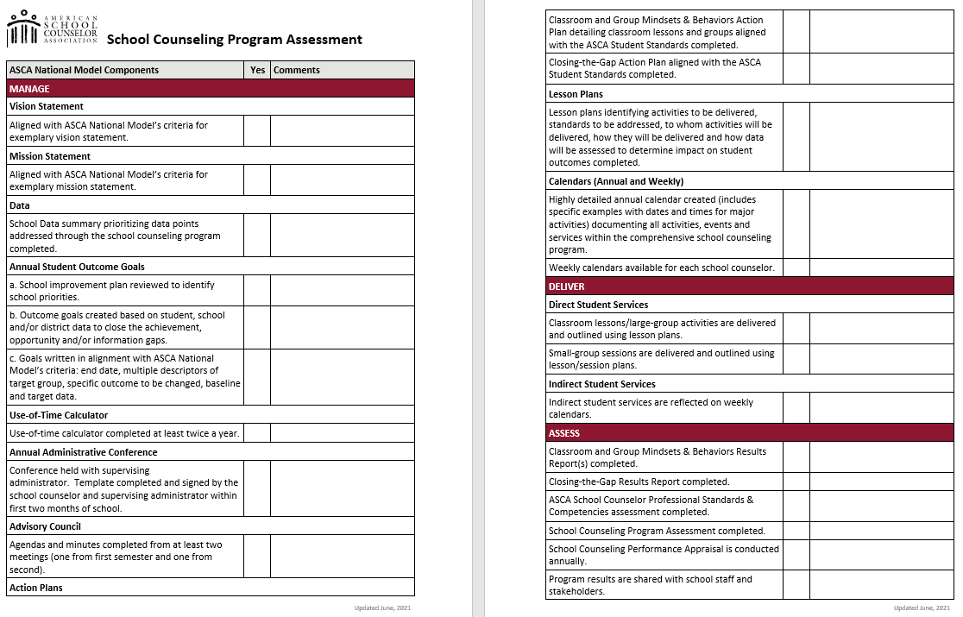

Slide 29
Tips
Attend trainings, watch webinars, read books and articles, follow social media – Educate yourself as much as possible
Follow the rubric!
Calendar dates to work on your application
Do not work in a silo – ask for help, have “outsiders” read your application
Expect to make revisions

Slide 30
Resources
www.schoolcounselor.org
RAMP Office Hours
ASCA Annual Conference (attend RAMP Camp, and specific sessions on each component)
Webinars
ASCA Coaching
Hatching Results: www.hatchingresults.com
Books, online training sessions (specifically data)

Slide 31
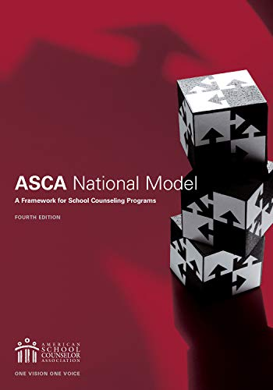
Additional Resources
ASCA National Model, 4th edition
ASCA National Model Implementation Guide: Manage and Assess
ASCA National Model Implementation Guide: ASCA Student Standards
Making Data Work, 4th edition

Slide 32
Thank you
Joyce Hollins
joyceh@wcs.edu
Desirae Skelley
Desirae.skelley@wcs.edu

