Slide 1
Wida Standards Framework
Instructional Strategies to Meet Academic Language Expectations
Katherine Perry
ESL Instructor
Arlington Community Schools
Shelly Misenheimer
ESL Instructor
Collierville Schools

Slide 2
Essential Learning Questions
What are WIDA’s big ideas/ framework components?
How does the framework compare & contrast to from 2004 - 2020?
How can I utilize the Can Do Descriptors for differentiated instruction?
How my MLLs make the jump between language proficiency levels?
How can I understand and apply WIDA content standards to implement scaffolding and meet academic language demands?
How does collaboration benefit your MLLs?

Slide 3
WIDA: The Big Ideas
Source: https://wida.wisc.edu/teach/standards/eld
Notes:
Focus: Integration of content & language
Functional Approach: the purposeful use of language for a given task
KLU: summarizes the prominent language across all content areas/helps to organize & coordinate instruction
Reflect high level language in the educational setting
Narrate: real or imaginery
Inform: conveys factual information (categorize, compare/contrast,
Explain: accountable talk, sequencing, synethesis
Argue: develop a claim/counterclaim, critical response, book review, defend their opinions
***Highlights the most prominent language across grade levels & domains

Slide 4
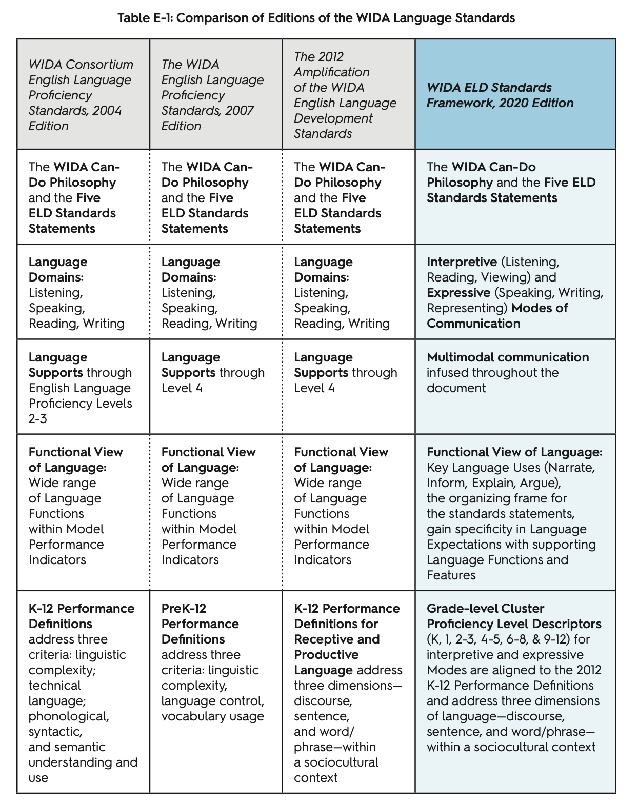
Comparison of ELDA Framework Standards
Highlight & identify key language terms added to 2020 Edition
How has the focus shifted?
How does the shift affect planning and instruction?
Source: https://wida.wisc.edu/sites/default/files/Website/Teach/ELDstandards/AppendixE-Standards-Edition-Comparision.pdf
Notes:
What hasn’t changed: CanDo Philosophy, emphasize on assets & potential of MLLs, 5 WIDA ELD standard statements, 6 levels of language proficiency, & the grade clusters.

Slide 5
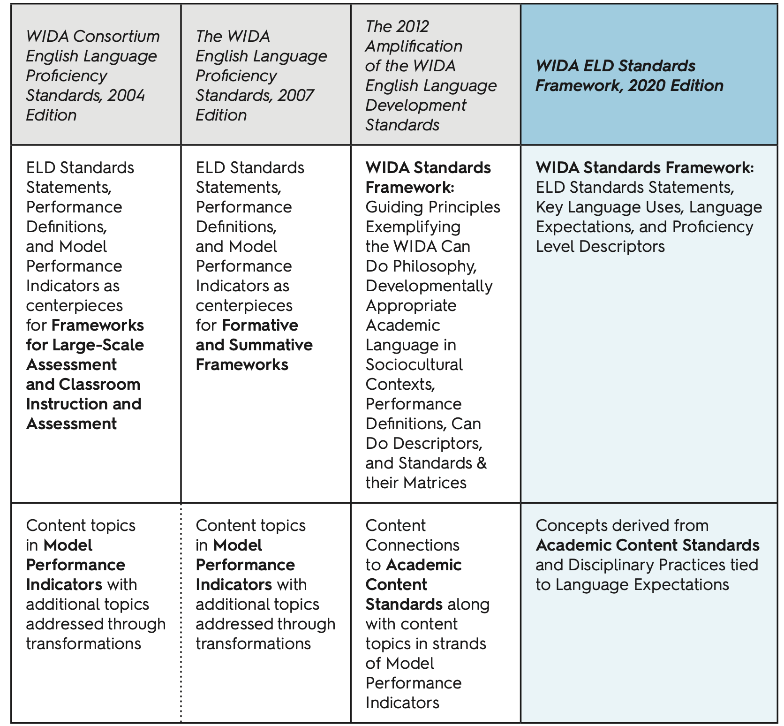
Comparison of ELDA Framework Standards
Source: https://wida.wisc.edu/sites/default/files/Website/Teach/ELDstandards/AppendixE-Standards-Edition-Comparision.pdf
Notes:
Changes: Key Language Uses – Narrate, Inform, Explain, Argue
Language Expectations & Proficiency Level Descriptors

Slide 6
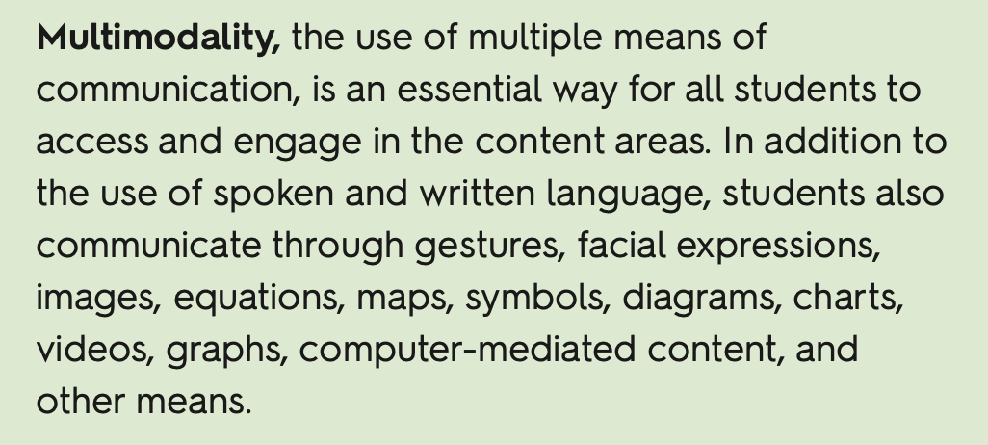
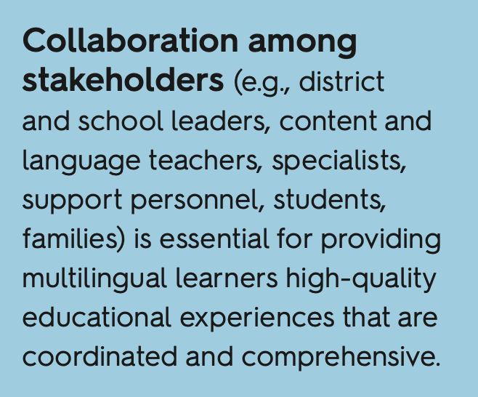
Form, Function, & Social Context
Expressive Communication: Speaking, Writing, & Representing
Interpretive Communication: Listening, Reading, & Viewing
Focus is on a broader form of expression
Notes:
Multimodality allows all students to use multiple means to engage, interpret, represent, act, and express their ideas in the classroom. For example, as students read, they also might refer to illustrations or diagrams, and as students write, they might also represent their ideas numerically or graphically.
Collaboration
Functional Language Approach: . The explicit teaching of how language works can help multilingual learners expand what they can do with language, thereby growing their language toolbox. The result is that students become increasingly aware and strategic in their use of language to negotiate meaning and achieve their purposes in various contexts.
Which communication lends itself to multimodal communication?

Slide 7
Halliday’s Language Functions
Function | Classroom Experiences
Instrumental: I want/need | Student clarifies instruction from morning routines Asks for supplies or books
Regulatory: Do as I say | Role-playing with partners/groups Determining steps for assigned tasks
Interactional: Social interaction | Cooperative learning/Collaboration
Personal: Here I am/Individuality | Sharing about oneself Sharing language-experience stores with others Personal experiences
Heuristic: Why/Seeking knowledge | Clarifying questions Explaining or retelling a story
Imaginative: Pretend & Create | Wordless books/visuals to create new stores Creatve dramatics to act out original ideas
Informative: Communicating Info, Description/Ideas | Sharing of ideas studied in projects/thematic units Explaining an event with sequencing Describing a favorite video/movie/TV show
Divertive: Fun/Jokes, Puns, Riddles | Ability to tell a riddle/joke in appropriate context

Slide 8
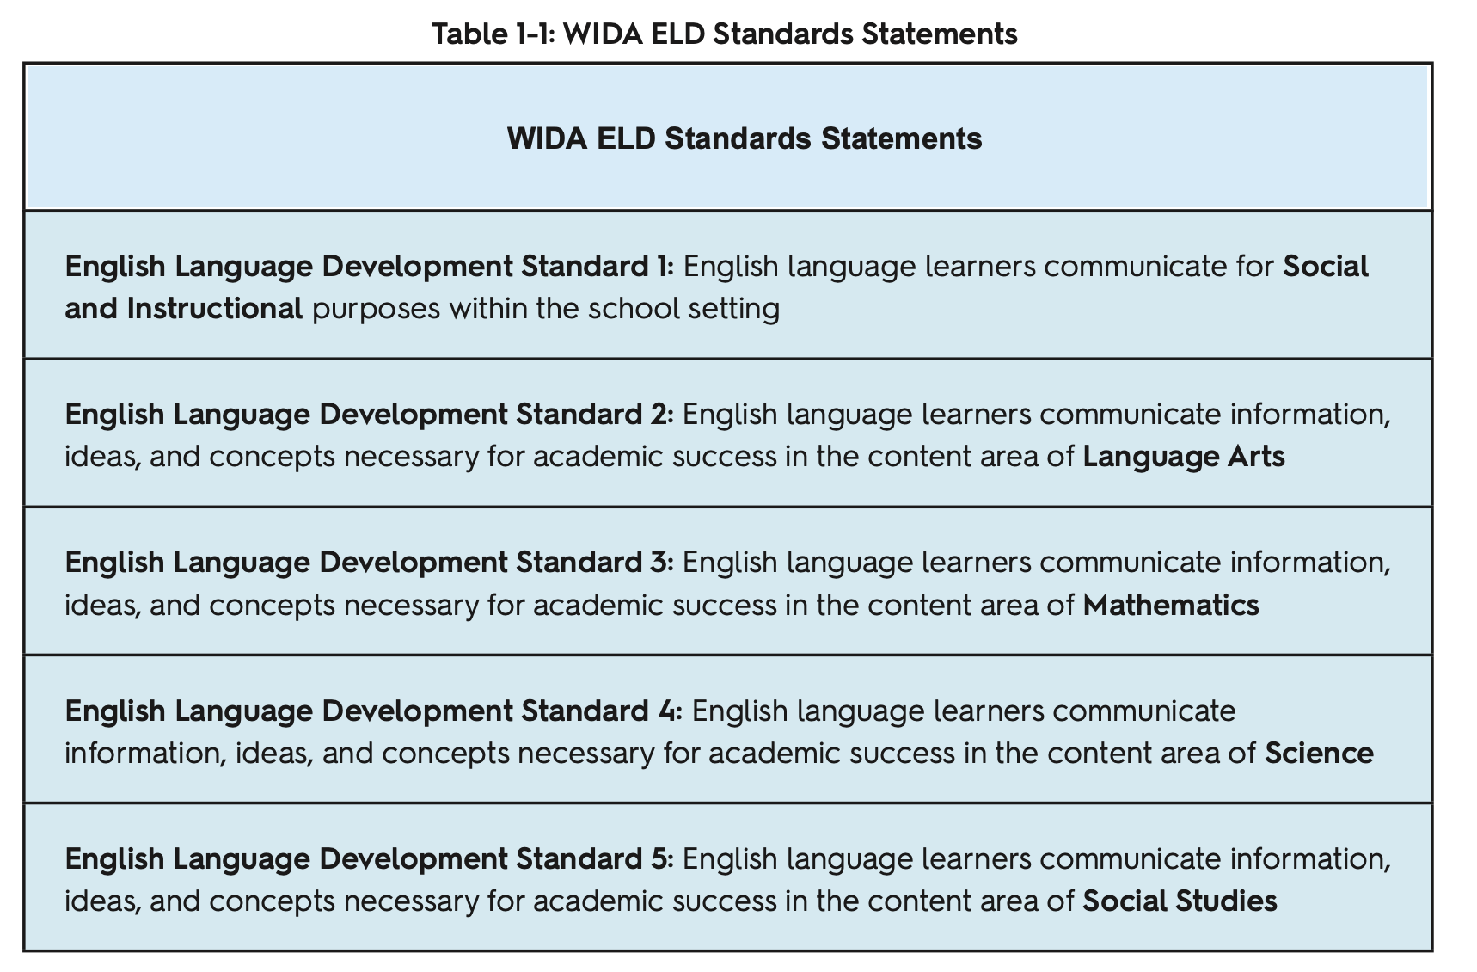
WIDA Standards Deconstructed
Notes:
adding new and expanded resources to address updates in policy, theory, and practice.
Emphasis on the for due to the functional approach
Language for thinking & producing in the content area
Standard 1 is a precursor to learning content specific language
Purpose driven language

Slide 9
Breaking Down The Standard

Slide 10
Simplifying the Process
How does WIDA complement and integrate with Common Core or your State Standards?
What are MPIs? How do I apply them within content lessons?
Notes:
MPIs are Model Performance Indicators that describe how MLLs/ELLs at their proficiency level can meet the demands of the task. They are content objectives that are differentiated.

Slide 11
Discourse, Form, & Vocabulary Usage

Slide 12
Utilizing CanDo Descriptors for Differentiated Instruction
Interpreting the data
Defining your Individual Learning Plan
Growth Goals
Collaboration
Notes:
Utilize your can do descriptors to move your students to the next level through scaffolding & differentiated instruction

Slide 13
Notes:
Utilize your can do descriptors to move your students to the next level through scaffolding & differentiated instruction

Slide 14
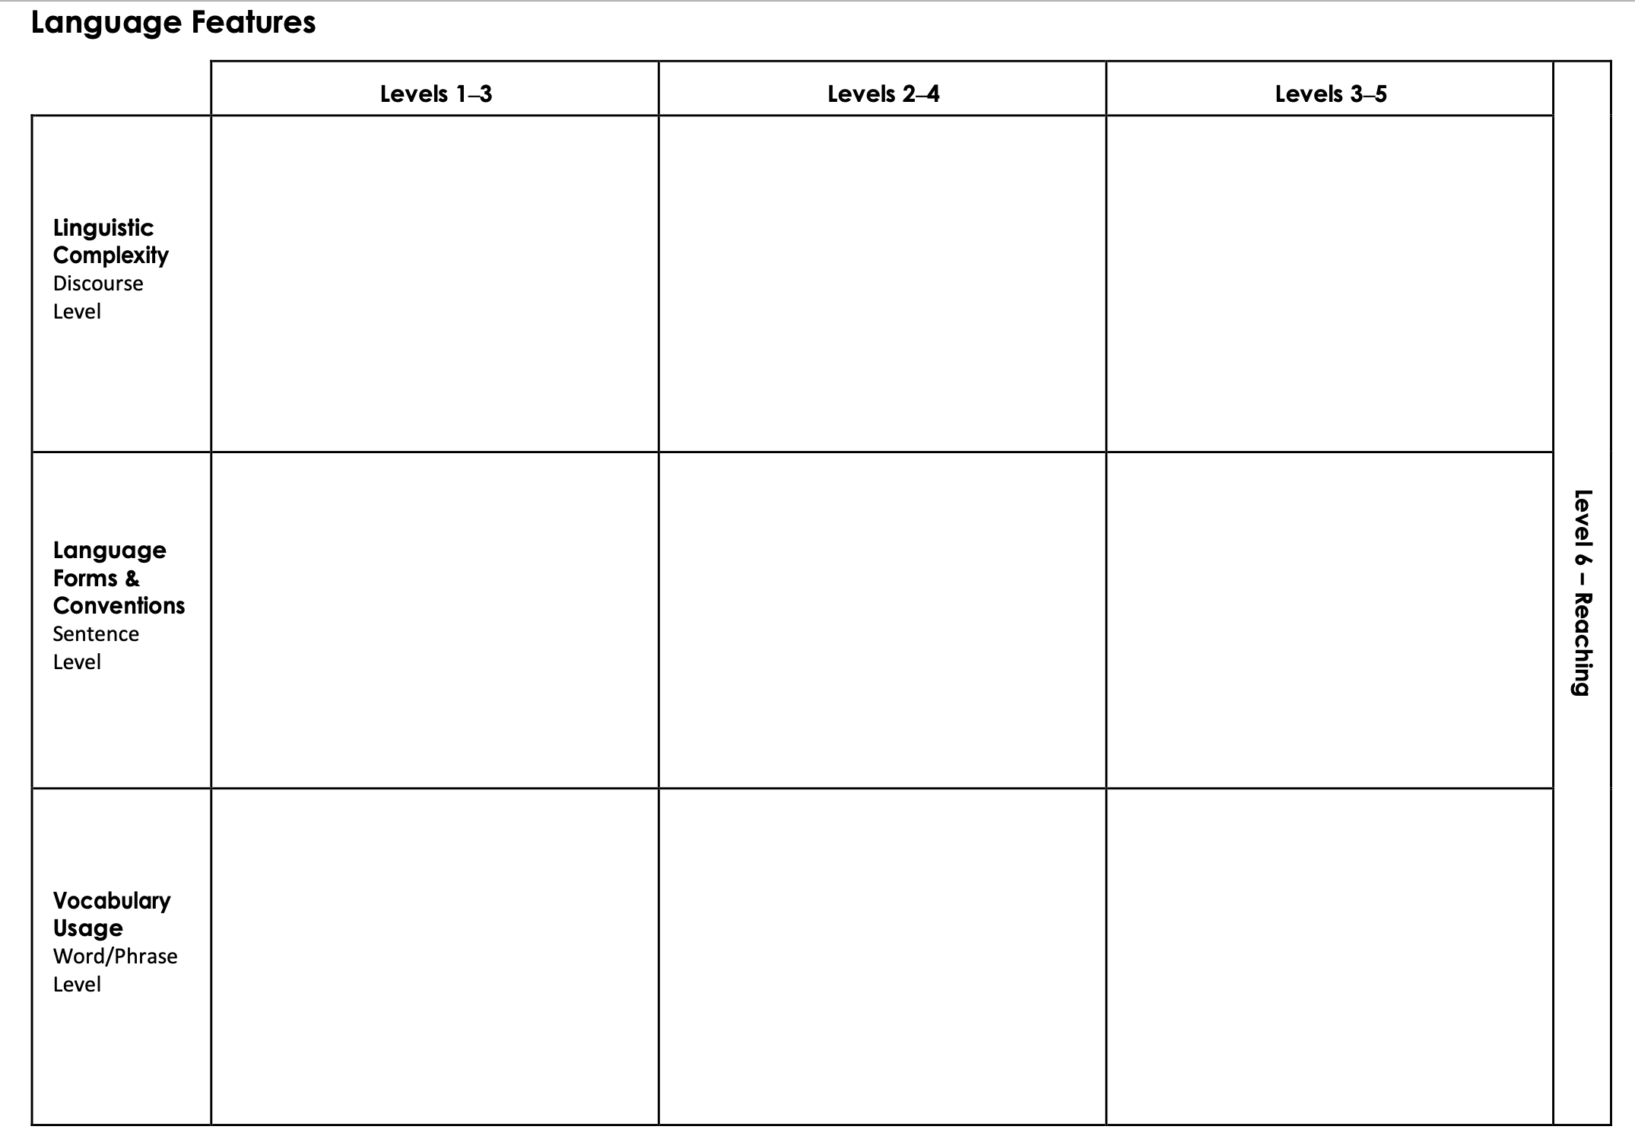
Old School Lesson Template

Slide 15
Standards Satchel/2020 Digital Explorer Accessible via WIDA Website or Standards Satchel
https://satchel.commongoodlt.com/97c883b4-8590-454f-b222-f28298ec9a81/9dc93cbf-32e9-4f0f-9ac8-5ebd1416ceb8/139

Slide 16
Works Cited
https://wida.wisc.edu/sites/default/files/resource/WIDA-ELD-Standards-Framework-2020.pdf
https://www.youtube.com/watch?v=9hekJsCOHLU
https://www.youtube.com/watch?v=E794aTuyHng
https://www.youtube.com/watch?v=K49p3vl_5Zk
https://satchel.commongoodlt.com/97c883b4-8590-454f-b222-f28298ec9a81/b260f90e-de59-4c32-83c0-023d6254333e/3). Pearson.
Peregoy, S.F., Boyle, O.F., & Amendum, S.J. (2023). Reading, writing, and learning in ESL: A Resource book for teaching K-12 multilingual learners (8th ed). Pearson.
Wisconsin Center for Education Research. (2020). WIDA English Language Development Standards Framework, 2020 Edition Kindergarten—Grade 12. Madison; Board of Regents of the University of Wisconsin System.

