Slide 1

ENGLISH LEARNER SCAFFOLDS THAT WORK!
July 6, 2023
EMILY C. DAVIS, MEd
ANDREW RANEY, MEd
CHRIS TENNYSON, EdD
ELL COLLABORATIVE
MIDDLE TN STATE UNIVERSITY

Slide 2


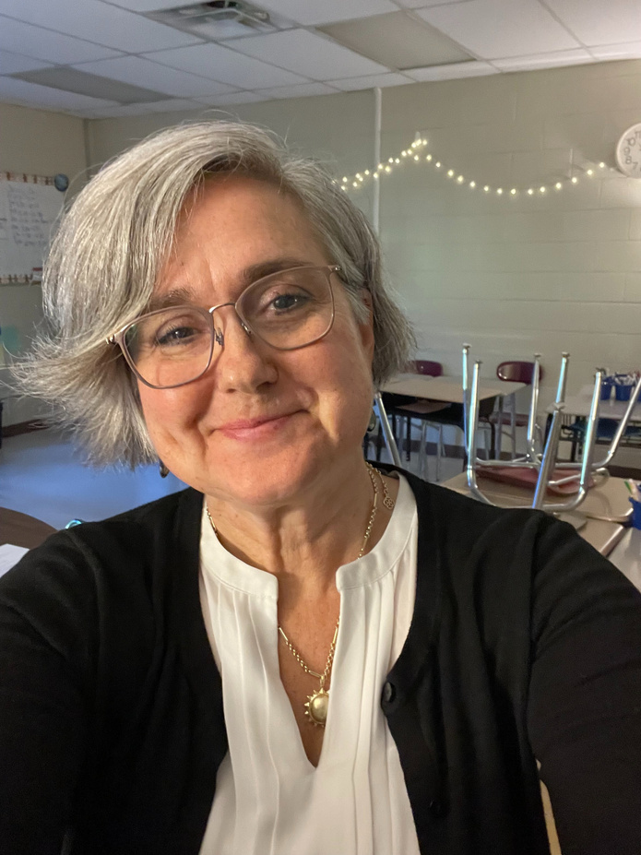
WHO ARE WE?
Emily Davis, MEd
Andrew Raney, MEd
Chris Tennyson, EdD

Slide 3
AGENDA
  Discuss ways to create school-wide buy in for serving English learners
  Identify easy-to-implement accommodation strategies accessible to all content teachers
  Analyze how to determine the language a student needs.
  Explore the connection between the student and the learning.
Buy In
Fast
Strategies
Deeper
Practice

Slide 4

English Learners!
  Discuss ways to create school-wide buy in for serving English learners
Buy In

Slide 5



Buy In
Discuss ways to create school-wide buy in for serving English learners
Inform faculty in small chunks
Advocate for ESL representation in PLCs and Leadership Teams.
Give a teacher a scaffold, he supports an English learner for a day. Teach a teacher to scaffold, he supports an English learner for a lifetime.

Slide 6
Buy In
Discuss ways to create school-wide buy in for serving English learners
Inform faculty in small chunks
  Email Considerations
  ESL Spotlights
  Professional Development

Slide 7
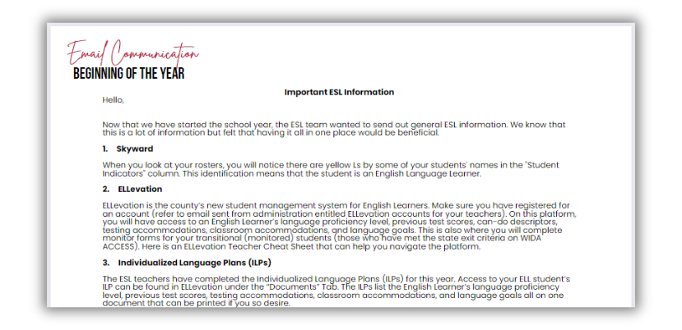
Buy In
Discuss ways to create school-wide buy in for serving English learners
EMAIL CONSIDERATIONS
  Beginning of the year
  Mainstream PLCs
  Monitoring
  Midterms
  WIDA ACCESS testing
  Finals
Notes:
It is important to communicate with your staff throughout the year and keep them informed of ESL-related information. Here are suggestions on email communications you could incorporate throughout the school year. Email templates are included.

Slide 8

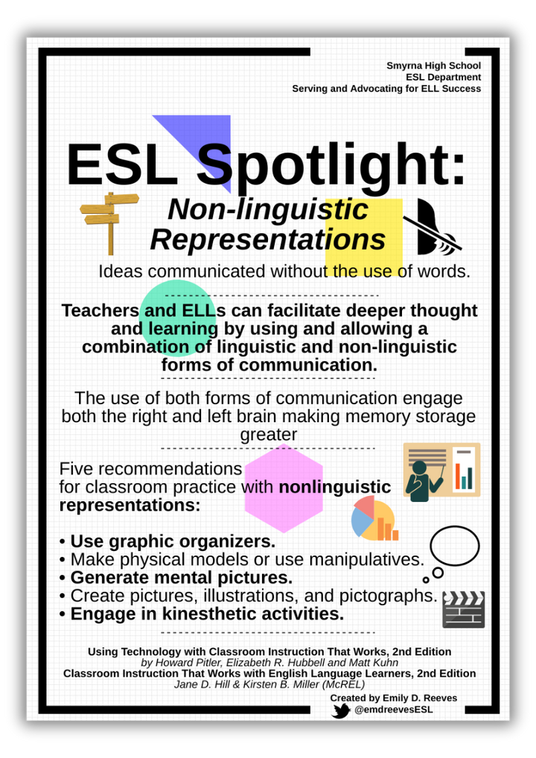
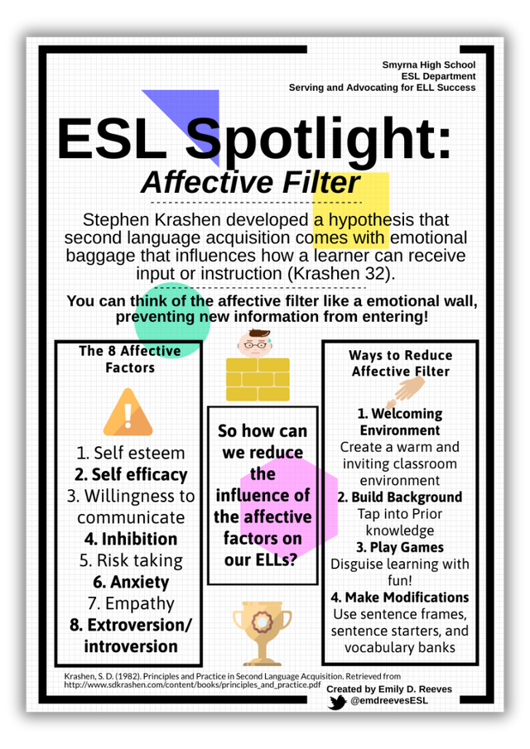
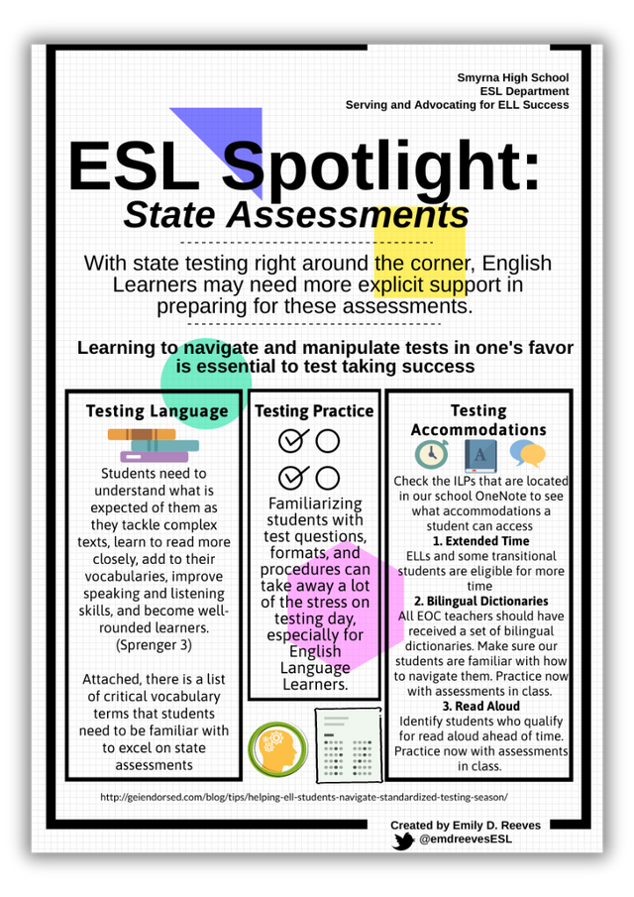
Buy In
Discuss ways to create school-wide buy in for serving English learners
MONTHLY SPOTLIGHTS

Slide 9

Buy In
Discuss ways to create school-wide buy in for serving English learners
Professional Development
  New teacher sessions & professional development sessions
  EL Support Overview
    Terms to know
    Identification of students
    Proficiency Level

Slide 10

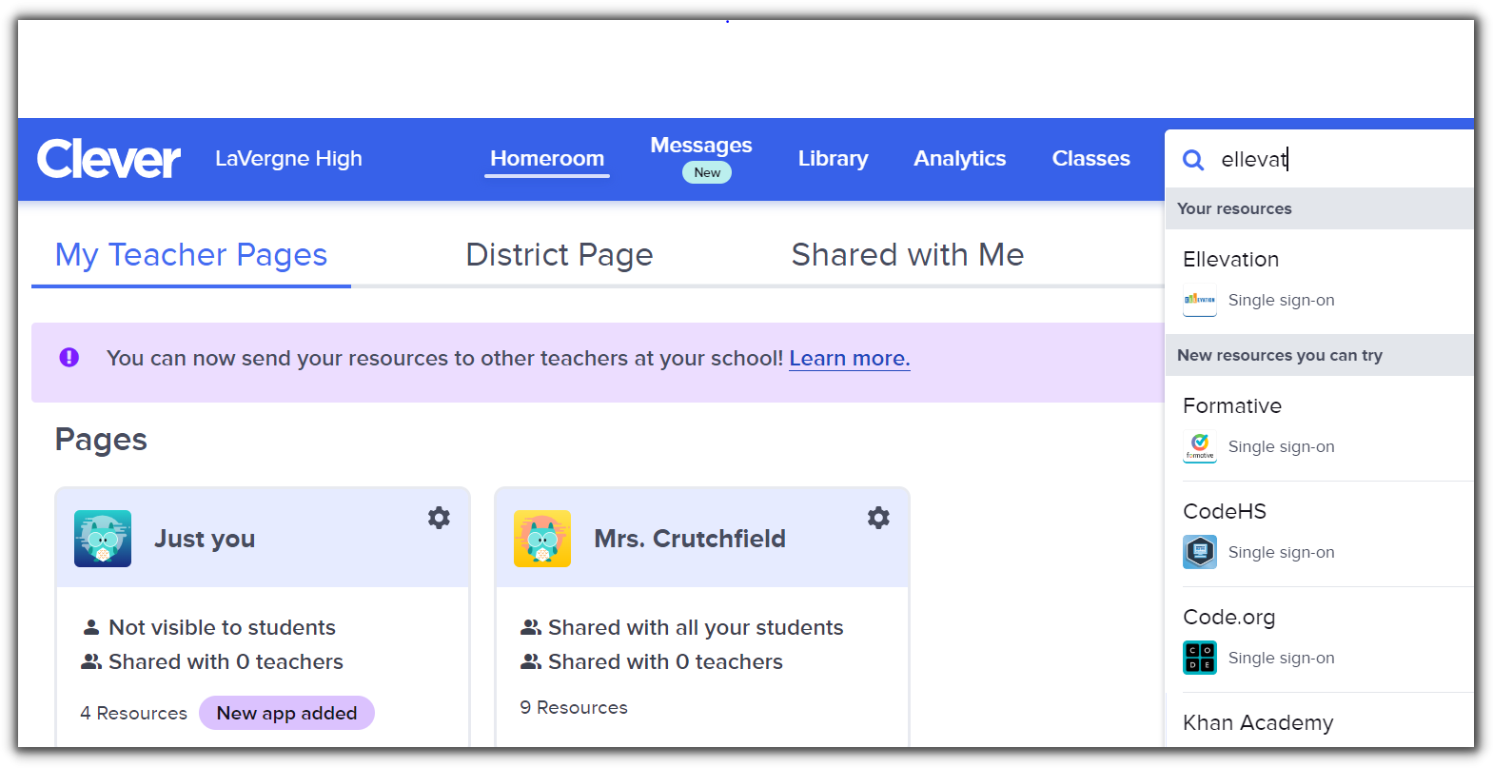
Buy In
Discuss ways to create school-wide buy in for serving English learners
The student management system that holds all data concerning English Learners

Slide 11
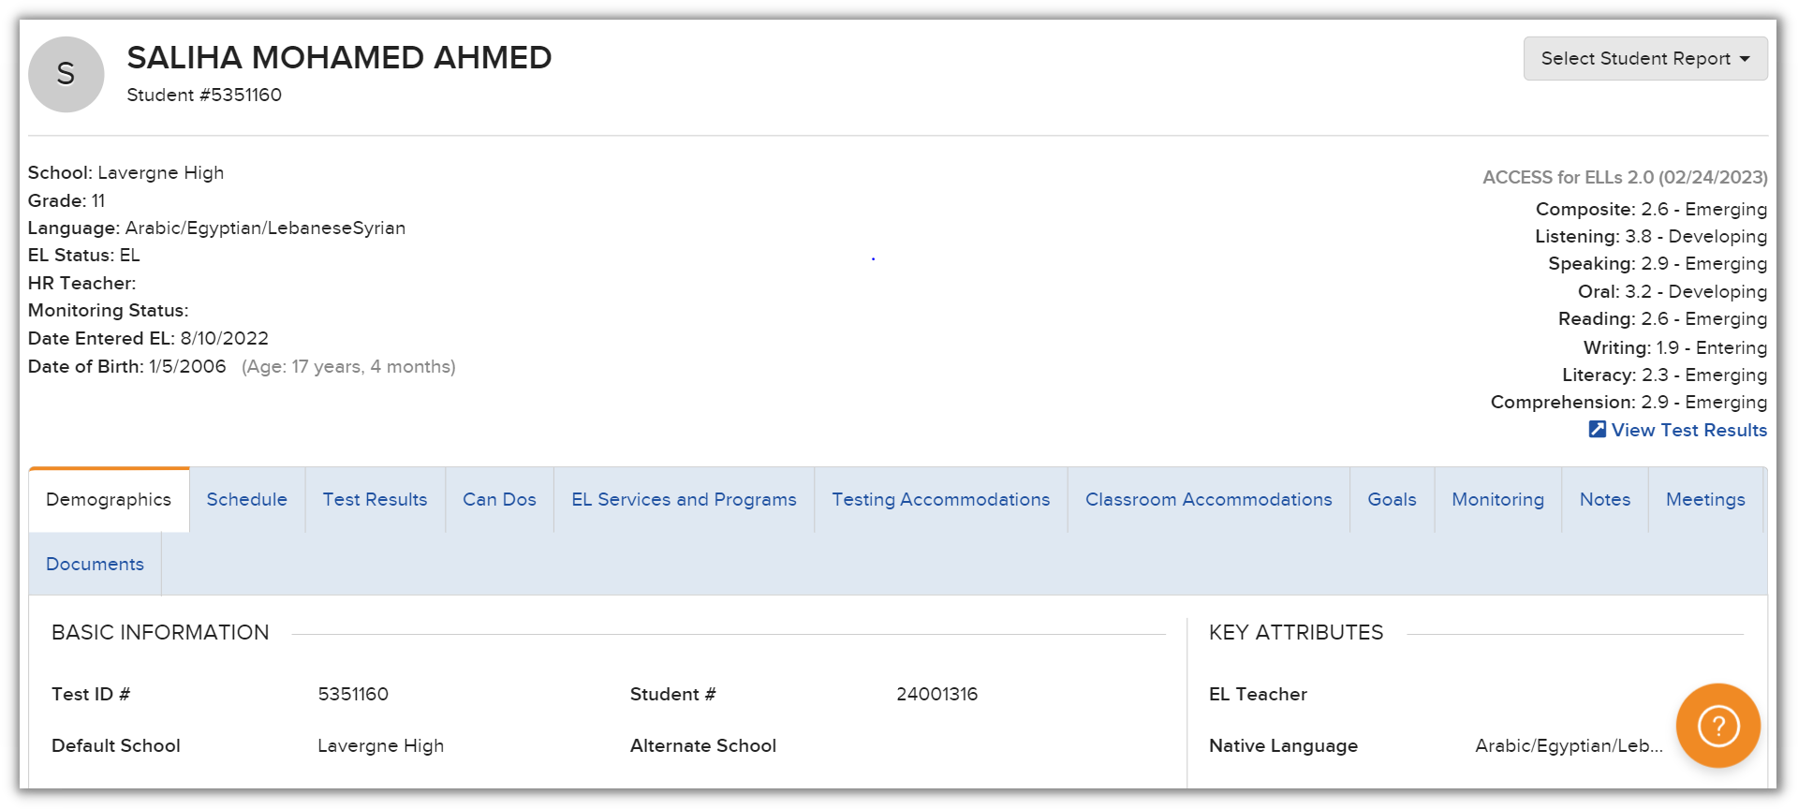
Buy In
Discuss ways to create school-wide buy in for serving English learners

Slide 12
Buy In
Discuss ways to create school-wide buy in for serving English learners
English Language Proficiency Levels Students’ English language proﬁciency levels are assessed annually using WIDA ACCESS assessments. Students are assessed in four language domains: Listening, Speaking, Reading, and Writing. A score is given in each domain along with a composite score. The scores align with the WIDA English language proﬁciency levels, which describe student language skills. | English Language Proficiency Levels Students’ English language proﬁciency levels are assessed annually using WIDA ACCESS assessments. Students are assessed in four language domains: Listening, Speaking, Reading, and Writing. A score is given in each domain along with a composite score. The scores align with the WIDA English language proﬁciency levels, which describe student language skills. | English Language Proficiency Levels Students’ English language proﬁciency levels are assessed annually using WIDA ACCESS assessments. Students are assessed in four language domains: Listening, Speaking, Reading, and Writing. A score is given in each domain along with a composite score. The scores align with the WIDA English language proﬁciency levels, which describe student language skills. | English Language Proficiency Levels Students’ English language proﬁciency levels are assessed annually using WIDA ACCESS assessments. Students are assessed in four language domains: Listening, Speaking, Reading, and Writing. A score is given in each domain along with a composite score. The scores align with the WIDA English language proﬁciency levels, which describe student language skills. | English Language Proficiency Levels Students’ English language proﬁciency levels are assessed annually using WIDA ACCESS assessments. Students are assessed in four language domains: Listening, Speaking, Reading, and Writing. A score is given in each domain along with a composite score. The scores align with the WIDA English language proﬁciency levels, which describe student language skills. | English Language Proficiency Levels Students’ English language proﬁciency levels are assessed annually using WIDA ACCESS assessments. Students are assessed in four language domains: Listening, Speaking, Reading, and Writing. A score is given in each domain along with a composite score. The scores align with the WIDA English language proﬁciency levels, which describe student language skills.
English Language Proficiency Levels Students’ English language proﬁciency levels are assessed annually using WIDA ACCESS assessments. Students are assessed in four language domains: Listening, Speaking, Reading, and Writing. A score is given in each domain along with a composite score. The scores align with the WIDA English language proﬁciency levels, which describe student language skills. | English Language Proficiency Levels Students’ English language proﬁciency levels are assessed annually using WIDA ACCESS assessments. Students are assessed in four language domains: Listening, Speaking, Reading, and Writing. A score is given in each domain along with a composite score. The scores align with the WIDA English language proﬁciency levels, which describe student language skills. | English Language Proficiency Levels Students’ English language proﬁciency levels are assessed annually using WIDA ACCESS assessments. Students are assessed in four language domains: Listening, Speaking, Reading, and Writing. A score is given in each domain along with a composite score. The scores align with the WIDA English language proﬁciency levels, which describe student language skills. | English Language Proficiency Levels Students’ English language proﬁciency levels are assessed annually using WIDA ACCESS assessments. Students are assessed in four language domains: Listening, Speaking, Reading, and Writing. A score is given in each domain along with a composite score. The scores align with the WIDA English language proﬁciency levels, which describe student language skills. | English Language Proficiency Levels Students’ English language proﬁciency levels are assessed annually using WIDA ACCESS assessments. Students are assessed in four language domains: Listening, Speaking, Reading, and Writing. A score is given in each domain along with a composite score. The scores align with the WIDA English language proﬁciency levels, which describe student language skills. | English Language Proficiency Levels Students’ English language proﬁciency levels are assessed annually using WIDA ACCESS assessments. Students are assessed in four language domains: Listening, Speaking, Reading, and Writing. A score is given in each domain along with a composite score. The scores align with the WIDA English language proﬁciency levels, which describe student language skills.
Level 1: Entering | Level 2: Emerging | Level 3: Developing | Level 4: Expanding | Level 5: Bridging | Level 6: Reaching

Slide 13
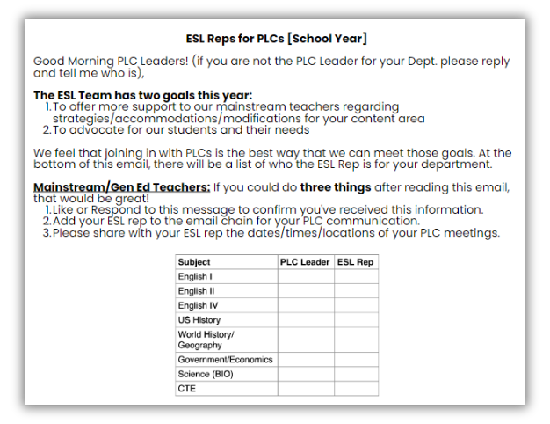
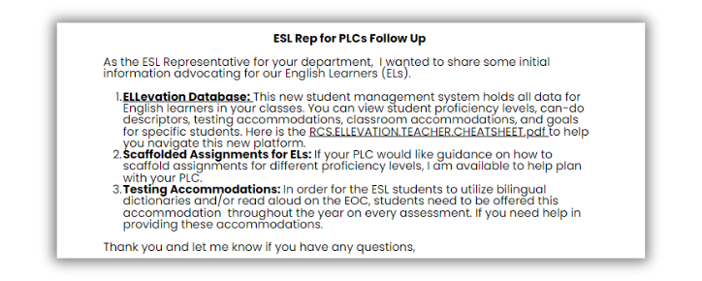
Buy In
Discuss ways to create school-wide buy in for serving English learners
Advocate for ESL representation in PLCs and Leadership Teams.
ESL REPRESENTATIVES FOR PLCS

Slide 14
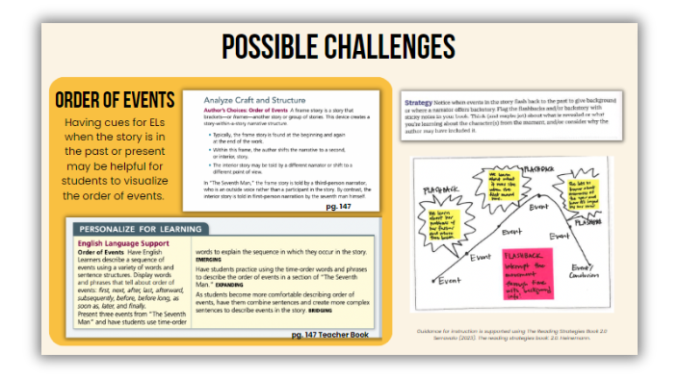
Buy In
Discuss ways to create school-wide buy in for serving English learners
Give a teacher a scaffold, he supports an English learner for a day. Teach a teacher to scaffold, he supports an English learner for a lifetime.
SCAFFOLDING WORKSHOPS
to show HOW to scaffold with their content area materials

Slide 15

Fast Strategies
  Identify easy-to-implement accommodation strategies accessible to all content teachers

Slide 16
Fast Strategies
Identify easy-to-implement accommodation strategies accessible to all content teachers
CONTEXT FOR FAST STRATEGIES
  New teacher sessions & professional development sessions
  Content teachers want easy-to-implement accommodations
  Start with EL basics
    jargon - establish a shared lexicon
    ILPs - create a frame of reference
    Accommodations for ILPs vs. IEPs/504s - build on existing knowledge and assess biases

Slide 17



Fast Strategies
Identify easy-to-implement accommodation strategies accessible to all content teachers
1
extended time
KEY ACCOMMODATIONS
2
bilingual dictionary (as needed)
I ALWAYS provide...
3
notes/study guide w/ answers
4
shorten assignments
5
model language & task
6
monitor rate of speech
7
scaffold responses
8
highlight key information
9
support essential content vocab

Slide 18

Fast Strategies
Identify easy-to-implement accommodation strategies accessible to all content teachers
SCAFFOLD RESPONSES
  Do you agree with President Truman’s decision to drop an atomic bomb on Japan? Give at least two facts to support your opinion.​

Slide 19
Fast Strategies
Identify easy-to-implement accommodation strategies accessible to all content teachers
SCAFFOLD RESPONSES
  Do you agree with President Truman’s decision to drop an atomic bomb on Japan? Give at least two facts to support your opinion.​
I _______ (agree or disagree) with President Truman’s decision to drop an atomic bomb on Japan because ______________________________________​.
I also think this because ___________________________________________________ ______________________________________________________________________________.

Slide 20

Fast Strategies
Identify easy-to-implement accommodation strategies accessible to all content teachers
SCAFFOLD RESPONSES
Your Turn!
  Why did Katniss volunteer at tribute in The Hunger Games? Give at least two examples to support your answer.
  Explain the steps of the water cycle. Write at least three sentences.

Slide 21

Fast Strategies
Identify easy-to-implement accommodation strategies accessible to all content teachers
SCAFFOLD RESPONSES
Tell Your Teachers
  Scaffolds are meant to be removed!
  Scaffolds are not one size-fits-all!
  Be careful with repetitive language
  Play around with:
    sentence starters
    sentence frames
    a word bank of transition words and vocabulary for longer responses

Slide 22


Fast Strategies
Identify easy-to-implement accommodation strategies accessible to all content teachers
HIGHLIGHT
KEY INFORMATION
What happened to farmers after World War I ended?

Slide 23
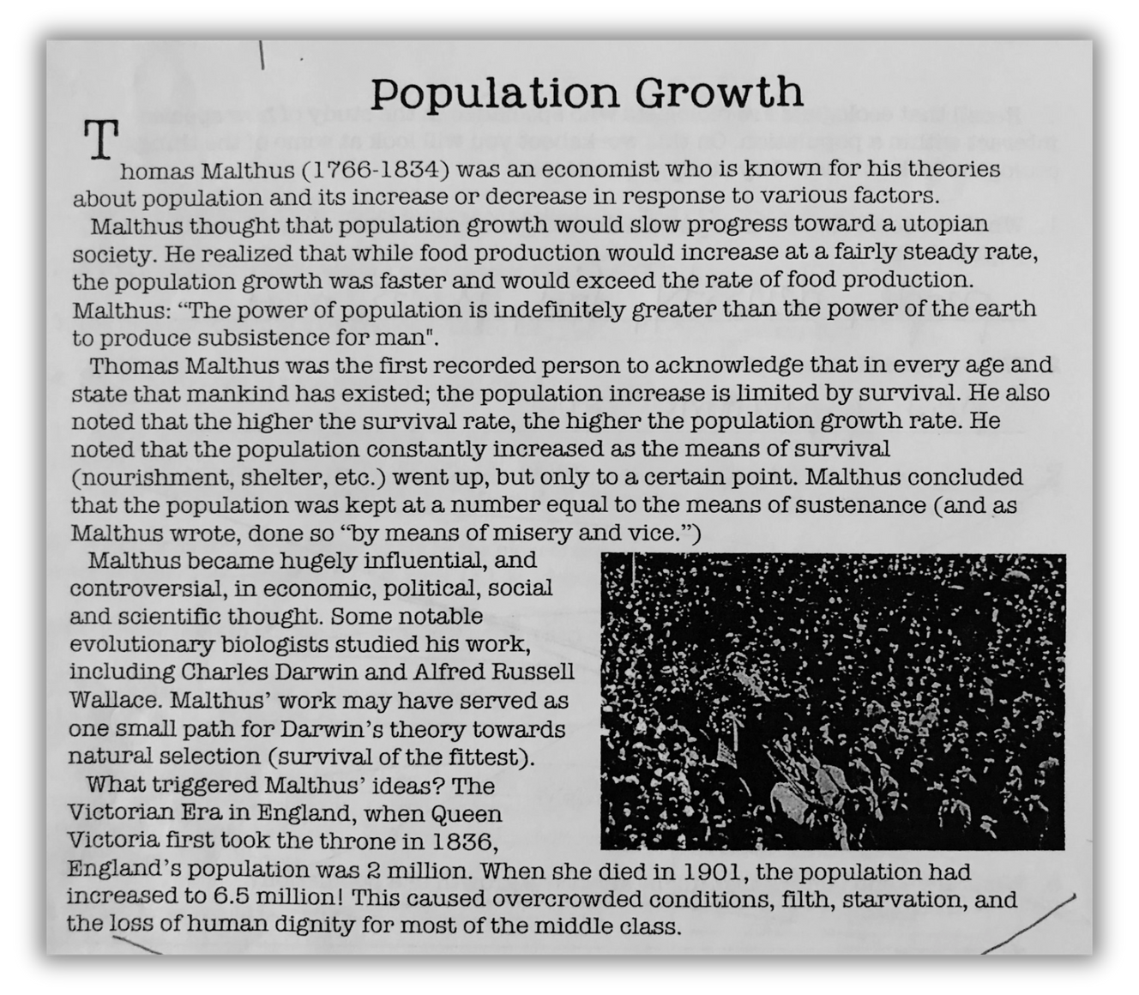
Fast Strategies
Identify easy-to-implement accommodation strategies accessible to all content teachers
HIGHLIGHT
KEY INFORMATION
Your Turn!
What did Malthus think about population growth?
Which scientists did Malthus influence with his theories?
What type of growth was seen during Queen Victoria's reign?

Slide 24


Fast Strategies
Identify easy-to-implement accommodation strategies accessible to all content teachers
HIGHLIGHT KEY INFORMATION
Tell Your Teachers
  Scaffolds are meant to be removed!
  Scaffolds are not one size-fits-all!
  be careful not to encourage direct copying
  Play around with:
    length of excerpts identified
    methods highlighted
    how specific identifiers are
    providing more highlighted information than necessary

Slide 25
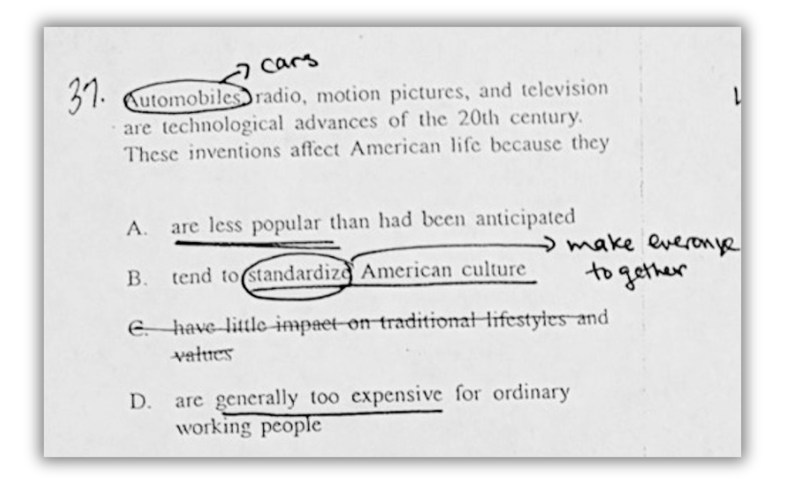
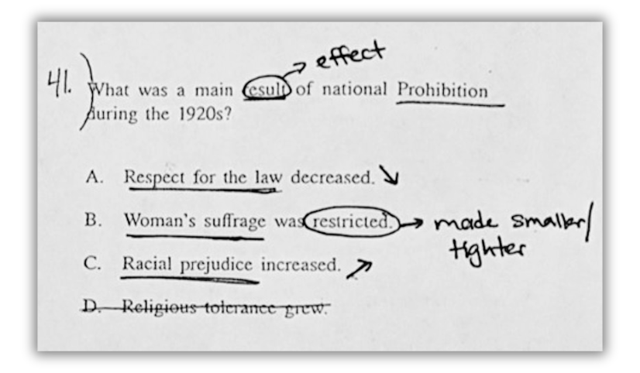
Fast Strategies
Identify easy-to-implement accommodation strategies accessible to all content teachers
SUPPORT ESSENTIAL CONTENT VOCABULARY

Slide 26
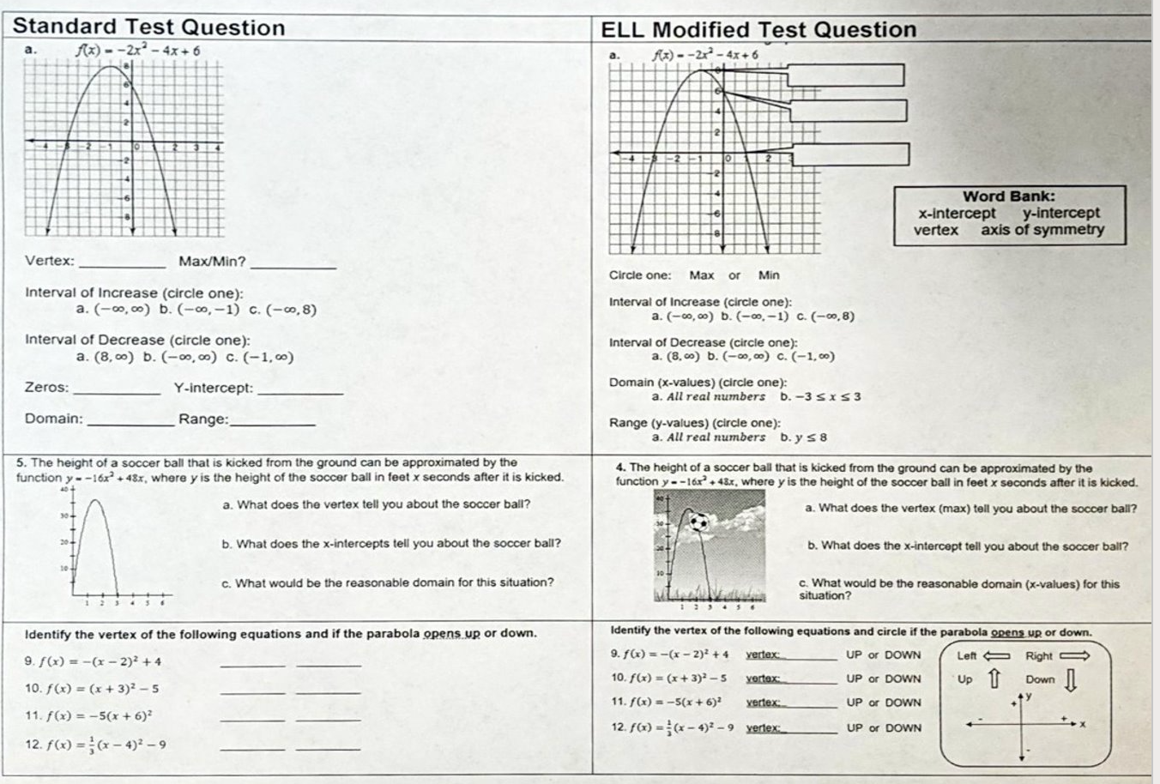
Fast Strategies
Identify easy-to-implement accommodation strategies accessible to all content teachers
SUPPORT ESSENTIAL CONTENT VOCABULARY

Slide 27
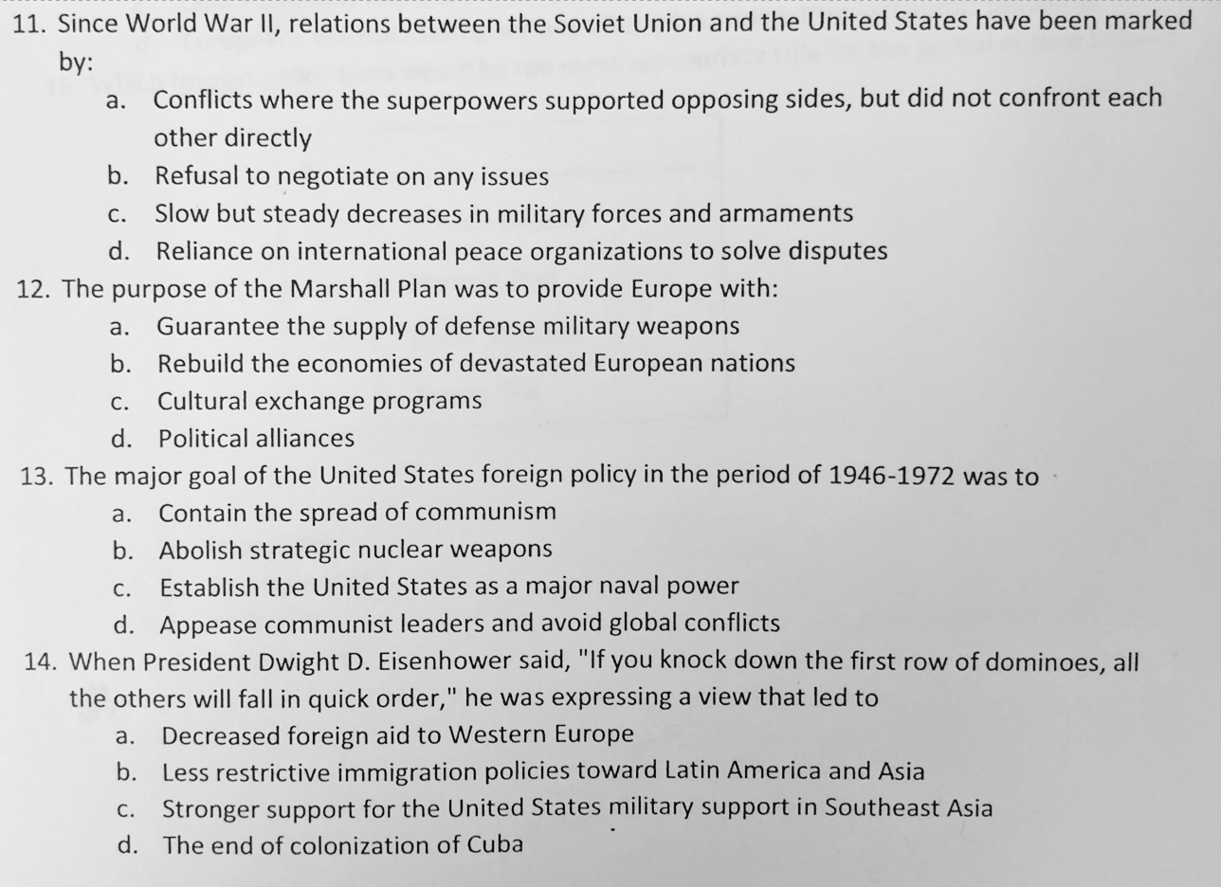
Fast Strategies
Identify easy-to-implement accommodation strategies accessible to all content teachers
SUPPORT ESSENTIAL CONTENT VOCABULARY
Your Turn!

Slide 28





Fast Strategies
Identify easy-to-implement accommodation strategies accessible to all content teachers
SUPPORT ESSENTIAL CONTENT VOCABULARY
Tell Your Teachers
  Scaffolds are meant to be removed!
  Scaffolds are not one size-fits-all!
  Some items can be modified, some need to be recreated
  Pay attention to homonyms, idioms, etc.
  Play around with:
    methods of representing vocabulary
    pre-teaching vocabulary
    using text or materials already present to provide vocabulary support
Academic Vocabulary | Academic Vocabulary
Term | Image
evidence
credible
valid
formulate
logical

Slide 29
Deeper
Practice
  Analyze how to determine the language a student needs.
  Explore the connection between the student and the learning.

Slide 30
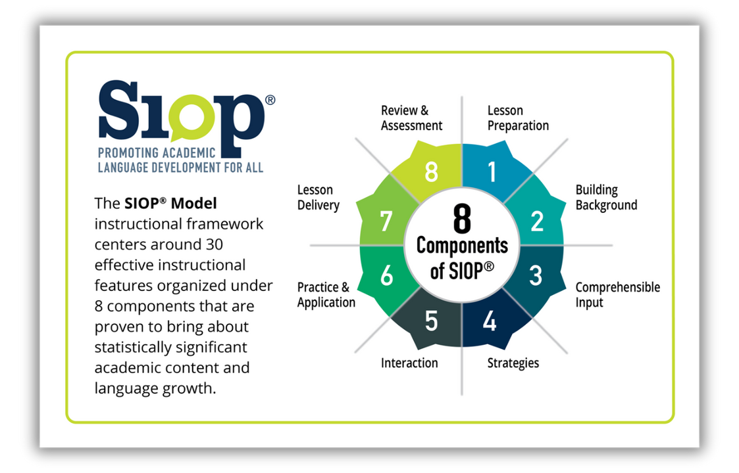

Deeper Practice
Explore the connection between the student and the learning.
Analyze how to determine the language a student needs.
TWO STRONG SOURCES OF RESEARCH

Slide 31

Deeper Practice
Explore the connection between the student and the learning.
Analyze how to determine the language a student needs.
DO STUDENTS KNOW WHAT THEY ARE SUPPOSED TO THE LEARNING?
  Content Standards - What is being learned
    Use verbs related to knowledge of the content​
  Language Objectives - Target language needed for comprehension and use
    Address the language needed to achieve the content objectives​
  Hattie Effect Size
    Learning Intentions and Success Criteria
    Teacher Clarity .75
    Learning Goals vs. No Goals .68​

Slide 32

Deeper Practice
Explore the connection between the student and the learning.
Analyze how to determine the language a student needs.
WHY TEACHING LINGUISTIC DEMANDS OF THE DISCIPLINE IS IMPORTANT?
Critical for mastery of the learning
how does language convey information?
how does language apply information?

Slide 33
Deeper Practice
Explore the connection between the student and the learning.
Analyze how to determine the language a student needs.
HELPING CONTENT EXPERTS
DETERMINE THE LANGUAGE NEEDED

Slide 34




Deeper Practice
Explore the connection between the student and the learning.
Analyze how to determine the language a student needs.
CONSIDER SOURCES OF LANGUAGE USE
Text
Task
Talk
Test
SIOP 6th edition p.41

Slide 35
Deeper Practice
Explore the connection between the student and the learning.
Analyze how to determine the language a student needs.
CONSIDER SOURCES OF LANGUAGE USE
What language will students need to understand your speech?
What language will students need to comprehend the text?
What language will students need to comprehend the assessment?
What language will students need to complete assignment?

Slide 36
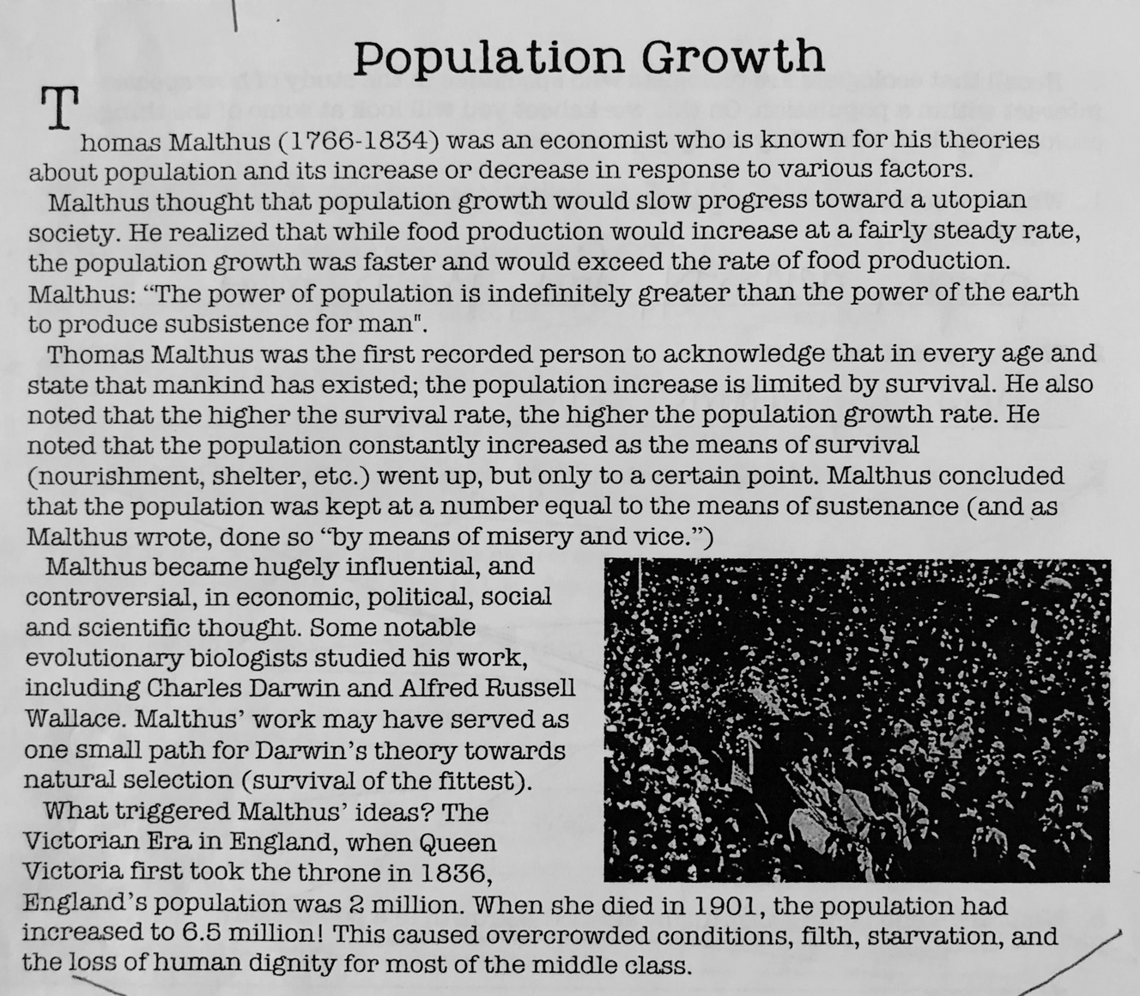
Deeper Practice
Explore the connection between the student and the learning.
Analyze how to determine the language a student needs.
LET'S REVISIT THE TEXT
Considering the questions below, what language (not just vocab) do students need to understand the text and the task?
What did Malthus think about population growth?
Which scientists did Malthus influence with his theories?
What type of growth was seen during Queen Victoria's reign?

Slide 37
Deeper Practice
Explore the connection between the student and the learning.
Analyze how to determine the language a student needs.
LET'S REVISIT THE TEXT
Now, can you orally share one or two language objectives?
Now, share how this can be helpful to content teachers, for ALL students.

Slide 38

Deeper Practice
Explore the connection between the student and the learning.
Analyze how to determine the language a student needs.
MAKING THE LEARNING CONNECT
  Hooking new language onto a student’s background and life experiences
  Hook new language onto prior learning.
  Creating context for language where none exists.

Slide 39

Deeper Practice
Explore the connection between the student and the learning.
Analyze how to determine the language a student needs.

Slide 40
Deeper Practice
Explore the connection between the student and the learning.
Analyze how to determine the language a student needs.
The Only way to do make connections is for content teachers to know their students.
We, the ESL teacher, must help with this!

Slide 41

Deeper Practice
Explore the connection between the student and the learning.
Analyze how to determine the language a student needs.
WAYS TO KNOW A KNOW A STUDENT
  Data
  Their story
  Their personality
  Educational Background
Discuss with your neighbors all the types of data to collect for each category.

Slide 42

Deeper Practice
Explore the connection between the student and the learning.
Analyze how to determine the language a student needs.
ONE EXAMPLE: CONNECT TO CONTEXT
How can knowing a students background help support a teachers subject?
Authorial Context
Historical Context
Cultural Context
Social Context
Political Context
Personal Context
Expectations of Genre

Slide 43
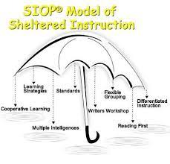
Deeper Practice
Explore the connection between the student and the learning.
Analyze how to determine the language a student needs.
NOW TO PLAN A LESSON
My scaffolding go-tos with links to Hattie!

Slide 44


Deeper Practice
Explore the connection between the student and the learning.
Analyze how to determine the language a student needs.
PUTTING IT ALL TOGETHER
Content and
Context
Language Target
Knowledge of Student
Learning Outcome

Slide 45
AGENDA
  Discuss ways to create school-wide buy in for serving English learners
  Identify easy-to-implement accommodation strategies accessible to all content teachers
  Analyze how to determine the language a student needs.
  Explore the connection between the student and the learning.
Buy In
Fast
Strategies
Deeper
Practice

Slide 46
Deeper Practice
Explore the connection between the student and the learning.
Analyze how to determine the language a student needs.
REFERENCES
Echevarría, J., Vogt, M.E., & Short, D., Toppel, K. (2024). Making content comprehensible for Multilingual learners: The SIOP® Model (6th ed.). Boston, MA: Pearson
Hattie, J. (2008). Visible learning. Routledge.
Text Samples in Fast Strategies section pulled from teacher-prepared classroom materials.
Accommodations in fast strategies section pulled from Ellevation.

Slide 47
Emily C. Davis
Secondary ESL Facilitator
Rutherford County Schools
davisem@rcschools.net
Andrew Raney
ESL Teacher
Riverdale High School
raneya@rcschools.net
Dr. Chris Tennyson
ESL Teacher
Riverdale High School
tennysonc@rcschools.net
Thank you!

