Slide 1
HABNBAN Confucius Institute Headquarters Beijing, China
By: Sidney A. McPhee President - Middle Tennessee State University East China University - Shanghai, China – July 26, 2017

Slide 2
Presentation to Chinese Confucius Institute Co-directors Training And Workshop
Strategies for Success: Preparation for Leadership Role Abroad
成功之路:
为如何在国外扮演好 领导角色做准备
HABNBAN Confucius Institute Headquarters Beijing, China
By: Sidney A. McPhee President - Middle Tennessee State University East China University - Shanghai, China – July 26, 2017
Notes:
Good morning
Thank you for that kind introduction.
I am pleased to be with you today as a member of the Confucius Institute family, and I very much appreciate the opportunity to present this workshop on strategies for dealing with the American Media.
I have been asked to share with you a few thoughts about ways to better position the message and marketing of this great organization, which is dedicated to the support of teaching Chinese language and promoting cultural exchanges between China and other countries around the world.
Today, I have entitled this workshop Confucius Institutes: Strategies for Success: Preparation for Leadership Role Overseas
As new Co-CI Directors, it is critical that you understand the perceptions of CIs and be prepared to address these perceptions when they do not fit with the realities, mission and goals of the organization.
INTRODUCTION

Slide 3
Introduction(内容提要):
Prepare for transition (做好角色转变的准备).
Understand purpose and role(找准目标和角色).
Knowledge of campus culture.(了解校园文化)
Academic freedom. (学术的自由)
Notes:
Setting the context in which the CIs operate
Observe new environment.
Understand how the US university functions and who are the people that make it function.
Understand their leadership philosophy and style, and think about your own and how to fit in.
Understand the role and responsibility of the US CI Director, and CI’s position in the university’s structure.
Learn the history of your CI and its current programs.
Ask questions about procedures and how things are currently working. This will allow for the reduction of duplicate work and a better pathway to present your ideas based on the work that has already been done.
Open communication with the US Director and be a bridge between your CI, Hanban and your home institute
ASSESSING AND DEFINING CI

Slide 4
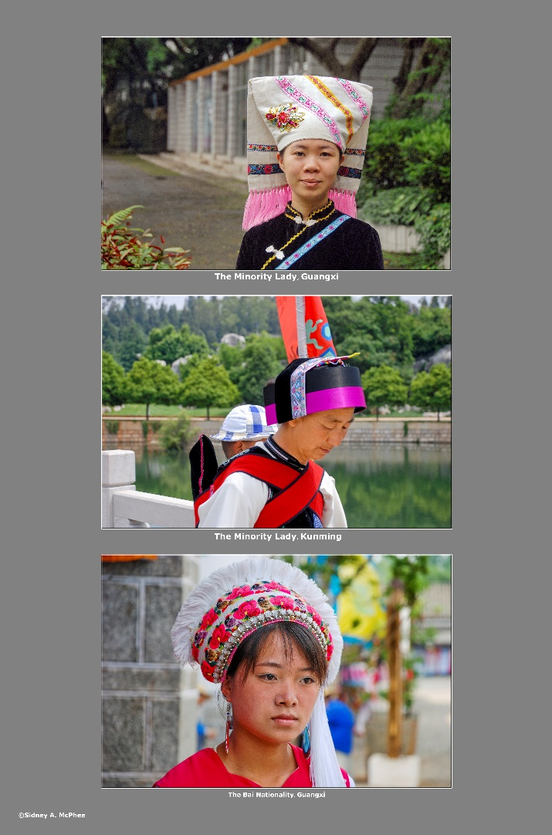
Assessing the environmental context (评估周边环境)
The community, local and state.(对社区、当地环境和整个州的考察)
The campus.(对校园环境的考察)
HOW?(如何做) – WHAT?(是什么) – WHY?(为什么)of CI(孔子学院)
CI alignment.(与孔院的合作)
Notes:
Assessing and defining CI
Acknowledging the context of CI existence
It is necessary to articulate the HOW, WHAT, and WHY of establishments of the CIs around the world.
Be prepared to explain “how CI aligns with the university’s mission and values
Academic freedom
Look at the university policy that aligns with AAUP guidance regarding academic freedom.
Study/Research media reports and past issues regarding this topic
Ask questions (to the US director) about any past issues or struggles within the local CI
AGREEMENT

Slide 5
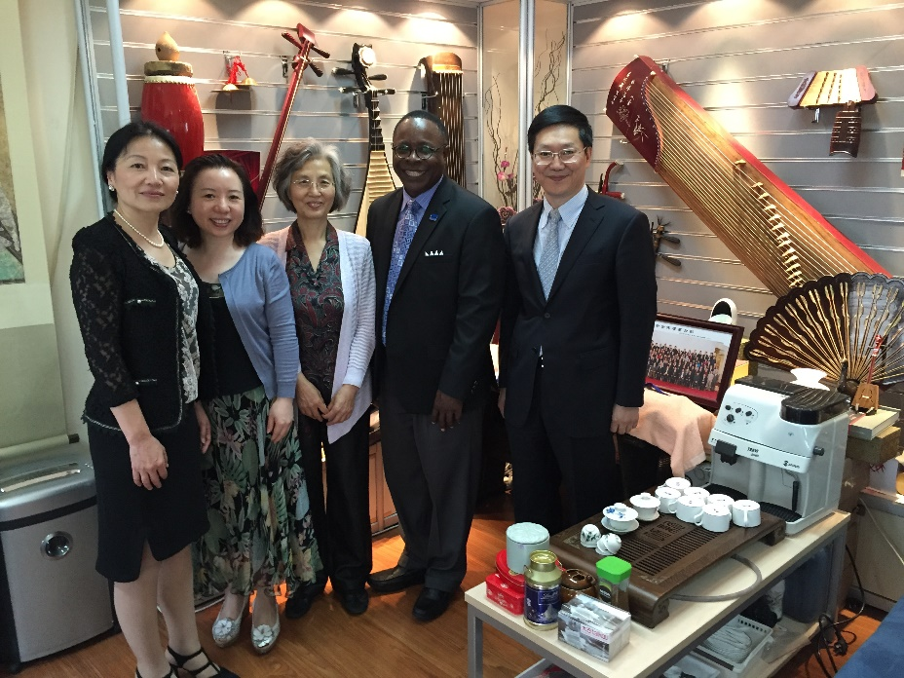
Agreement(共识):
Consistent with institutional mission (统一双方的宗旨和使命)
Awareness among campus and community constituent groups（加强学校与社区团体的合作意识）
Assuming ownership（评定所有权）
Keeping stakeholders informed （确保股东的知情权）
Notes:
MTSU EXAMPLE: MTSU was in agreement with its general philosophy and how it fit in with our mission. It fit well with our goals of expanding our reach internationally and our commitment to preparing students to thrive in a changing global society.
Does the campus and local community know that this relationship is still relevant and why?
Does my campus and local community know that this relationship and why?
Key Point: If we believe the mission of the Confucius Institute remains relevant, we must take ownership of it and keep key stakeholders informed of our progress and plans.
PUBLICE RELATIONS AND MEDIA

Slide 6
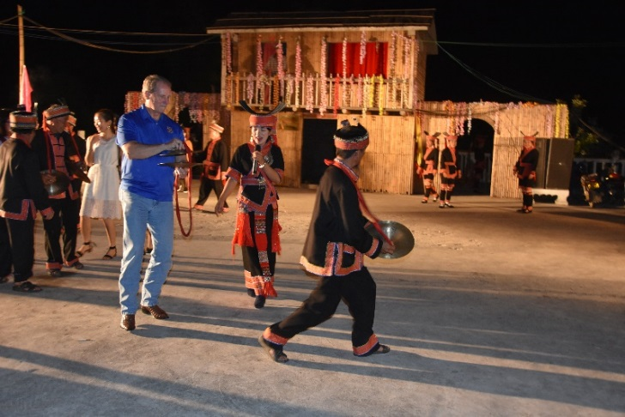
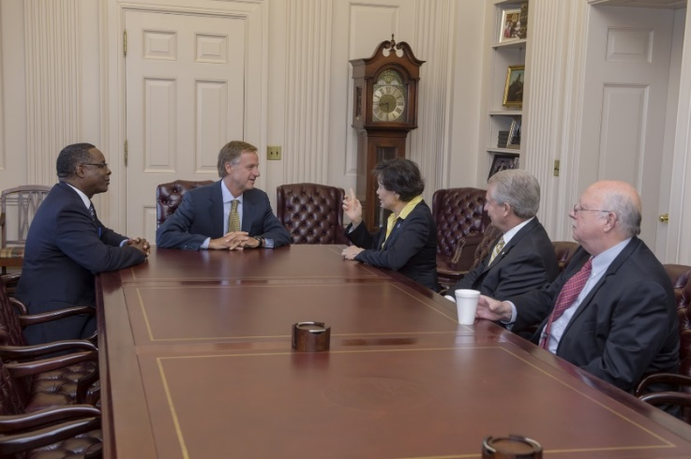
Understand public relations and media.(了解公众关系和媒体)
Media in America.(美国的媒体)
The politics of your campus and community. （学校和社区团体的政策）
Notes:
Understand Public Relations and Media
Learn about US media, institution and society.
Understand the local political environment of your CI.
Universities will normally have policy about responding to the media as well as an office or officers that will focus on media responses. Know this procedure and who these people are.
If ever approached by the media defer to the US director or appropriate university personnel.
PROMOTE YOUR CI

Slide 7
Promote your CI(孔院的宣传与推广):
Make no assumptions.(不要做任何假设)
Connect with pubic relations and media office.(建立与公众和媒体的关系)
Tell your stories again and again and again.(不厌其烦地讲述你的故事)
Notes:
Now, I want to share some of my experiences in this regard that I think might be helpful
I started travelling to China two years before I joined MTSU.
So, in 2001, when I became president, I began efforts on our campus to focus on international / globalization . China was a main point of interest.
As a result, we were able to build relationships that led to the creation of our Confucius Institute
We were so busy establishing relationships with Chinese universities and building our Confucius Institute that we failed to perform one of the most basic forms of public relations: If it was worth doing, it was worth telling others about it.
Do not assume that everyone in the community and on your campus understands and appreciates the value of CI
Get to know and partner with your campus public relations team and forge outreach plans
Tell your stories again and again and again
WHY ENGAGE

Slide 8
Why Engage?(为什么要与媒体建立密切的关系？)
Proactive media relations to shape your public narrative.(提高媒体曝光率,建立良好的公众形象)
Dispel myths or inaccuracies.(消除谬见与误解)
Drive the discussion.(推动进一步的商讨)
Improve the effectiveness of your messaging.(提高信息传达的有效性)
SOURCE: Ron Sachs Communications Florida League of Cities training, 2011
Notes:
Many officials fail to grasp the importance of shaping and projecting a powerful message that reaffirms the value and worth of your organization.
YOU must be able to convey the message
Need to give adequate attention to building a cohesive communication strategy.
Proactive media relations helps shape your public narrative. And its best to begin and sustain this work when times are good, rather than in a crisis.
It can:
Dispel myths or inaccuracies
Drive the discussion
Boost the effectiveness of your efforts by reaching the audience that is critical to your success (stakeholders, campus and community influencers, even detractors)
SERIES OF NEWSPAPER ARTICLES

Slide 9
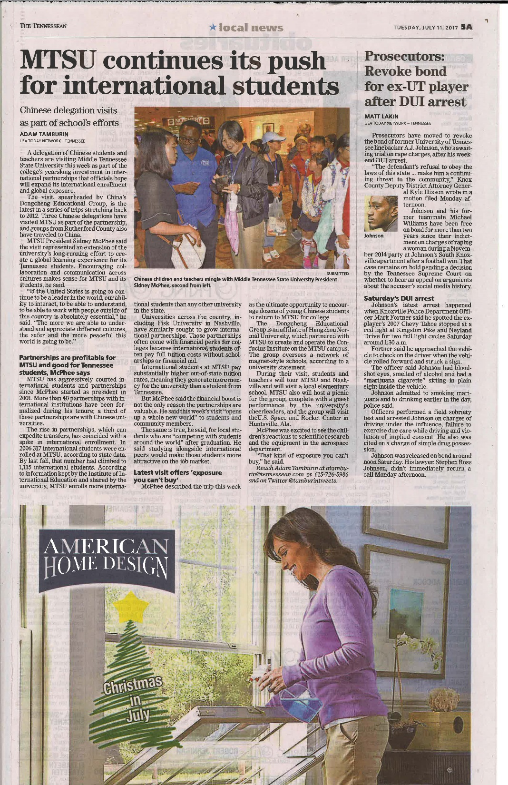
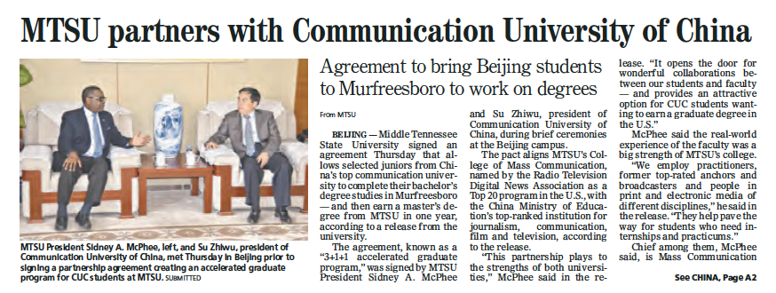
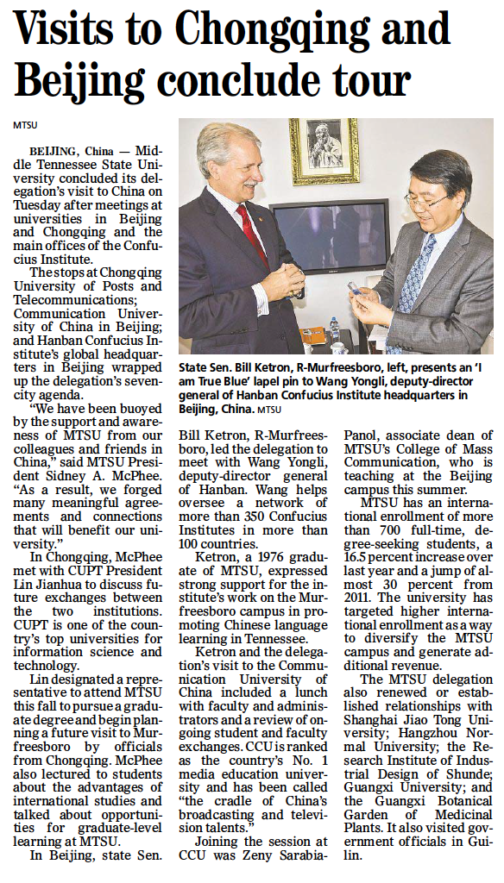
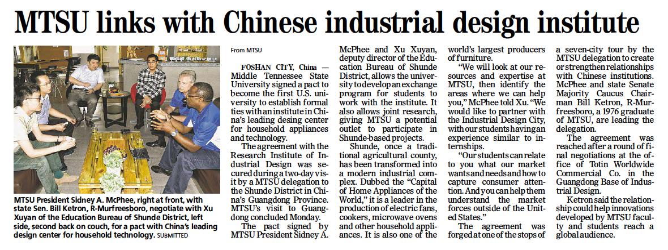
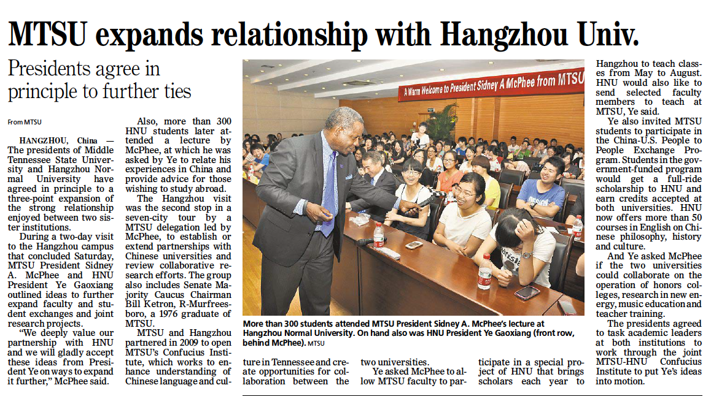
Notes:
About three years ago, we asked our university’s lead marketing and communications executive to join our Confucius Institute board of advisors.
He pointed out to us immediately that we were investing a lot of time, energy and dollars into building a global relationship, yet we made no effort to tell anyone WHAT we were doing and, more important, WHY we were doing it.
In other words, I knew what we were doing was important.
My CI director and key administrators knew what we were doing was important.
But, for a variety of reasons, we simply didn’t draw much attention to our good works.
So, most of the campus and our community didn’t know what were doing and why it was important.
MORE NEWSPAPER ARTICLES

Slide 10
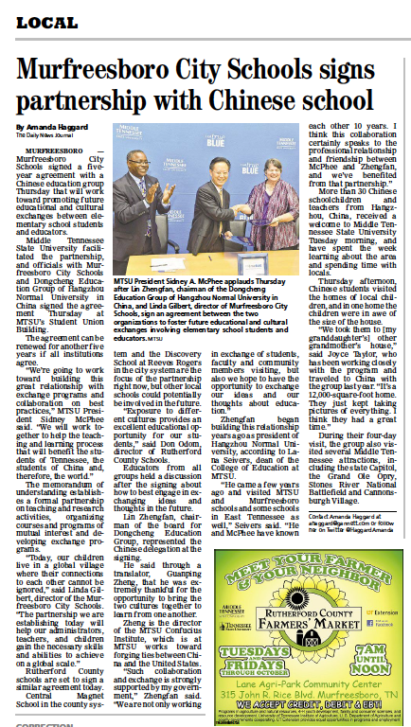
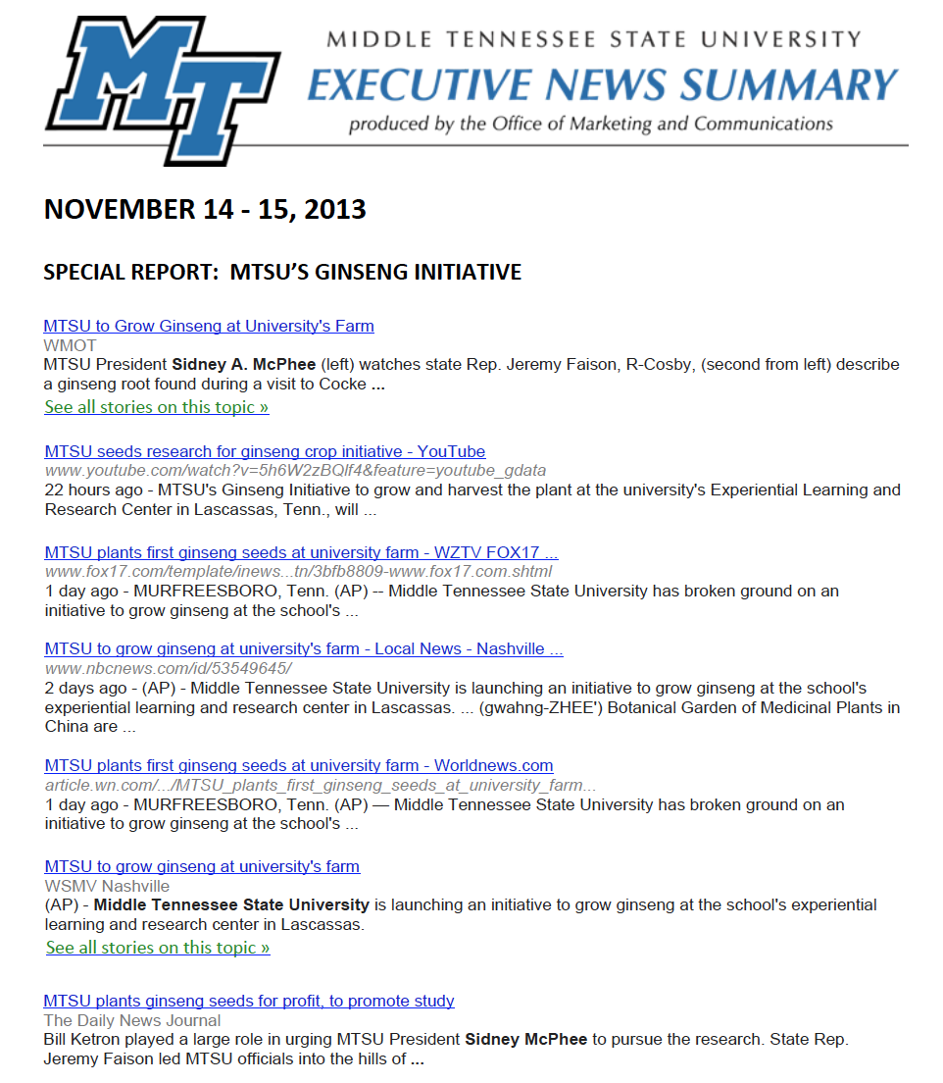
Notes:
And we begin to write stories, take photos and do videos from our stops in China or our work in the community that yielded tangible results or advanced our academic standing.
We told about them in minute detail…
again and again and again.
ADVICE: MAKE YOUR OWN NEWS

Slide 11
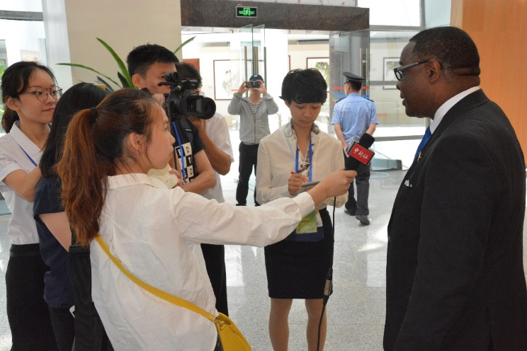
Make Your Own News(制造属于自己的新闻):
Show the human impact.(展示人为影响力)
Have a local angle to connect to bigger stories. Be ready to act!
(以小视角引出大故事，准备好你的表演吧！)
Timing is everything!(时间就是一切)
Develop “NEWS HOOKS,” or ways to connect it with the daily or weekly news cycle. (创造新热点，或把自己的故事与当地的日报或周报新闻相结合)
Make it Memorable(创造使人印象深刻的新闻):
Announce something in a new and novel way. (以新闻报道或小说的形式来刊登你的故事)
Think in terms of visuals – photo and film.(以视觉的方式展示,如照片和电影)
Include media-worthy participants and props.(吸纳有媒体影响力的参与者和支持者)
SOURCE: Ron Sachs Communications Florida League of Cities training, 2011
Notes:
Two quick pieces of advice here:
Make Your Own News and Make it Memorable
By making your own news, I am suggesting that you examine closely the forward-facing elements of your operation and continuously look for ways to share your good work with the media.
Now, a word of caution here: You can’t expect the media to come out and write the same story about the same thing over and over again.
That’s why you need to Make it Memorable.
For example, when our CI enters into a partnership of any kind that we feel advances our story, we hold a full ceremony and put out an angle that is new: New services, new ways to engage the public new ways that we are making a difference.
We always make it relevant: What is new and different and how will this help people?
MANAGING MEDIA EXPECTATIONS

Slide 12
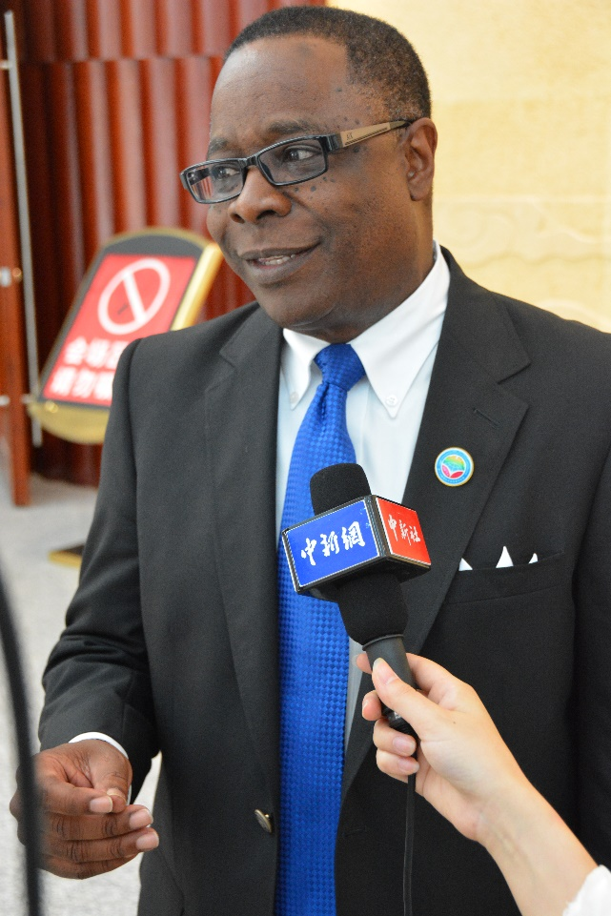
Managing media expectations:
Identify three to five key messages that you wish to share during an interview. (在采访中，确立3到5个你想要分享的关键信息)
Anticipate tough questions and prepare your answers in advance.(提前对可能出现的尖锐问题进行准备)
Shape your message.(提炼你的信息)
Be brief, and say what you mean.(表达简练精准)
Prepare sound bites, your most important points, in advance.(提前准备重点和要点的概括)
Practice with a colleague unfamiliar with the topic and get honest feedback.(与不熟悉这个话题的同事进行预演排练，并得到真实的反馈)
SOURCE: Ron Sachs Communications Florida League of Cities training, 2011
Notes:
While there are considerable differences between Western and Eastern media operations and journalists, there are some key similarities.
First, remember this: You have 10 seconds – or less – to get your big point across with a reporter:
That’s only about 40 words.
This is the era of sound bites. The average network television news sound bite was 6.5 seconds – 21 words.
So, it is important that you decide what you want to get out of the interview.
Be clear in your own mind – and with the reporter – on about what you will, or will not, talk about. Do advance preparation.
MANAGING MEDIA EXPECTATIONS

Slide 13
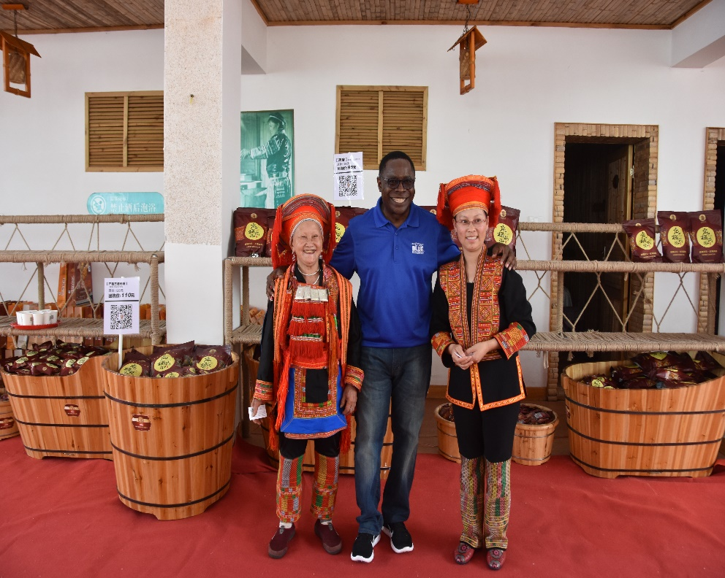
Managing media expectations:（对媒体的期望）
Don’t attempt to censor.(不要企图去审查)
Your control what you say.(把握自己的演讲内容)
No “off-the-record”(提高曝光率，不能消失在大众的视野范围内)
SOURCE: “Meet the Media” guide, USAF PAO
Notes:
Knowing your positives, and making sure you voice them, is your opportunity to shape the outcome of the interview.
However, to be clear, you are not in control of the outcome of any media interaction, particularly with western journalists.
Once you have given permission for an interview, you have given up the right to control what is written or broadcast.
You have no control over what questions you are asked, but you have 100 percent control over what you say during an interview.
There is no such thing as an “off-the-record” interview. Anything you say to or in the presence of media can be reported.
DURING THE INTERVIEW

Slide 14
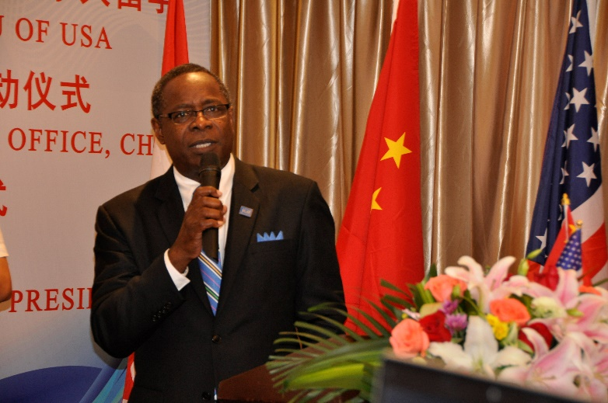
During the interview (在采访中怎么做):
Be brief and to the point. （表达简练精准)
Give quotable quotes.(为媒体提供有价值的新闻点)
Pivot to your message.(以你想要传达的信息为中心)
Prepare for the interview. (做好充足准备)
Stick to the facts.(坚持事实)
Source: “Meet the Media” guide, USAF PAO
Notes:
Reporters generally don’t want lengthy, drawn-out explanations.
They’re looking for quotable quotes – a punchy line that will fill three lines of newsprint or 20 seconds of airtime.
Use your 20 seconds to get you message across –there’s much more likelihood it will be used.
Knowing what you want to say in advance will go a long way in simplifying your answers.
Don’t exaggerate facts by using superlatives that make things sound bigger and better than they are.
DURING THE INTERVIEW

Slide 15
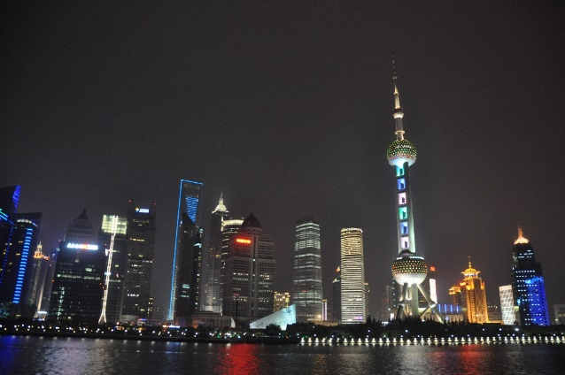
During the interview:（在采访中怎么做）
Come to an interview prepared with your messages and find opportunities to get them across without ignoring the reporter’s questions.(既要精准地传达自己的信息,也要回应采访者的问题)
Give a direct answer when asked a direct question, even if the answer is “No, I don’t know,” or “I’m sorry, I can’t answer that question.” (实话实说，“我不知道”或 “这个问题我没法回答。”)
You will come across as an honest, forthright person. 你会给人留下诚实、直爽的印象)
Be aware of the “bait” (也要小心采访陷阱)
SURCE: Meet “the Media” guide, USAF PAO
Notes:
Finally, I want to relay some tips on how to conduct yourself during a media interview.
Come to an interview prepared with your messages and find opportunities to get them across without ignoring the reporter’s questions.
Give a direct answer when asked a direct question, even if the answer is,
“No, I don’t know,” or “I’m sorry, I can’t answer that question.”
You will come across as an honest, forthright person.
EXERCISE – POWERFUL POINTS

Slide 16
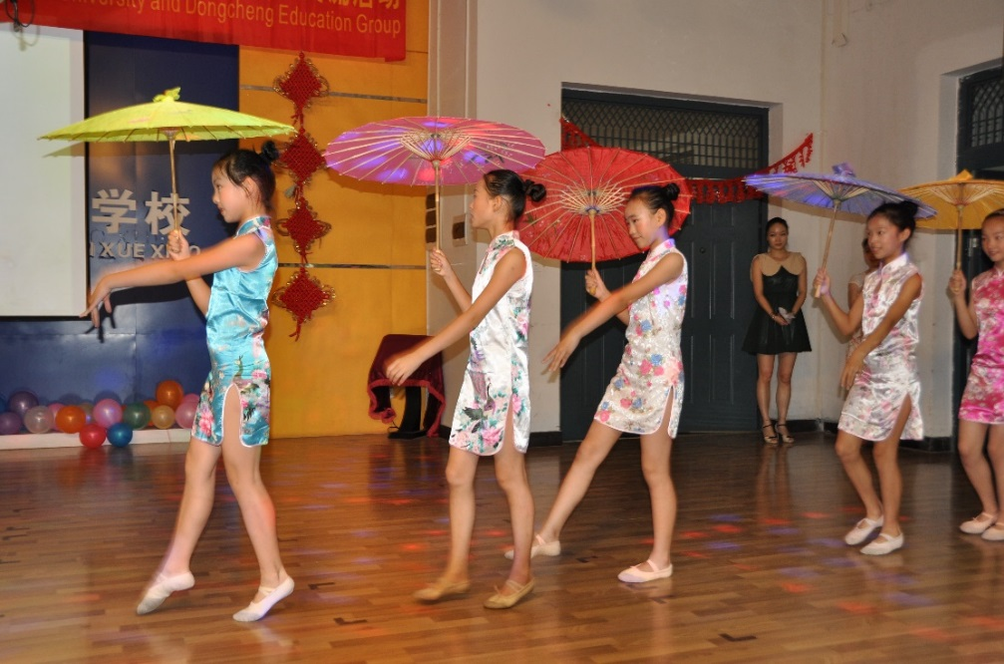
Powerful Points(重点提要):
An Exercise in Putting Your Best Foot Forward
(全力以赴！)
Notes:
EXERCISE:
Let’s take a few minutes here to reflect on these points.
All of you here are very knowledgeable about Hanban and very proud of your organization.
Yet, if someone in the media – or elsewhere – asked you, “What does Hanban do and what is its value?”, would you have an answer?
In other words, HOW WOULD YOU USE YOUR 20 SECONDS?
I would like each of you to write out THREE TO FIVE important points about Hanban.
Make sure at least one of them is about your particular area of responsibility and why you feel it is valuable.
Remember, these need to be SHORT BUT POWERFUL. In the United States, we would call this your ELEVATOR SPEECH.
If you were riding an elevator with someone, and he asked you about where you work, could you answer that question before the doors opened again?
------------------------------------
(AFTER FIVE MINUTES, go around the room and have a few of them present to you)
KNOW YOUR NEGATIVES

Slide 17
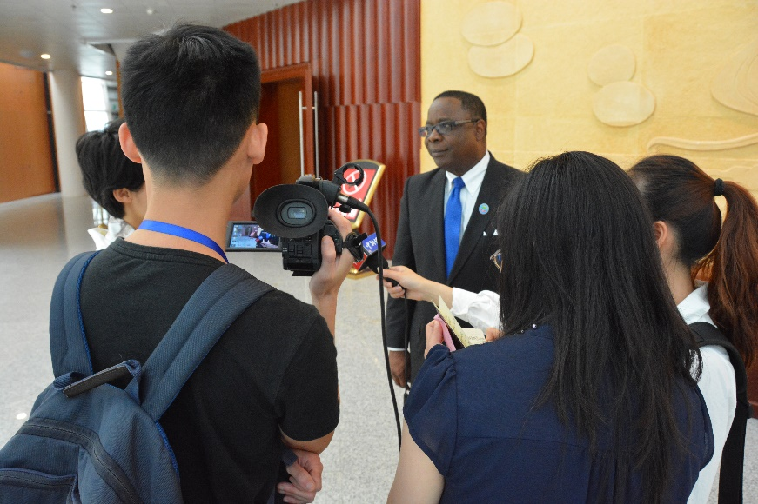
Know your negatives(了解自己的短处):
Make sure you understand the objections being raised by your detractors.(确保自己了解反对者提出的不同意见)
Think through your worst-case scenarios and address them.(充分做好 最坏的打算并想好解决措施)
Prepare and know your narratives.(准备好你要讲的内容)
Notes:
So, given that you cannot control the media, “knowing your negatives” is perhaps the most difficult of the suggestions I am presenting today.
My academic background is in social sciences and I am very much aware of our natural tendencies to avoid or deny bad or negative news. There’s an instinct within all of us to downplay or ignore the things we find difficult to accept. In our country, it’s called denial.
In this case, I’m talking about situations where we ignore the elephant in the room and, through force of personality or application of our power, try to get others to ignore it too.
EMBRACE THE CHALLENGES

Slide 18
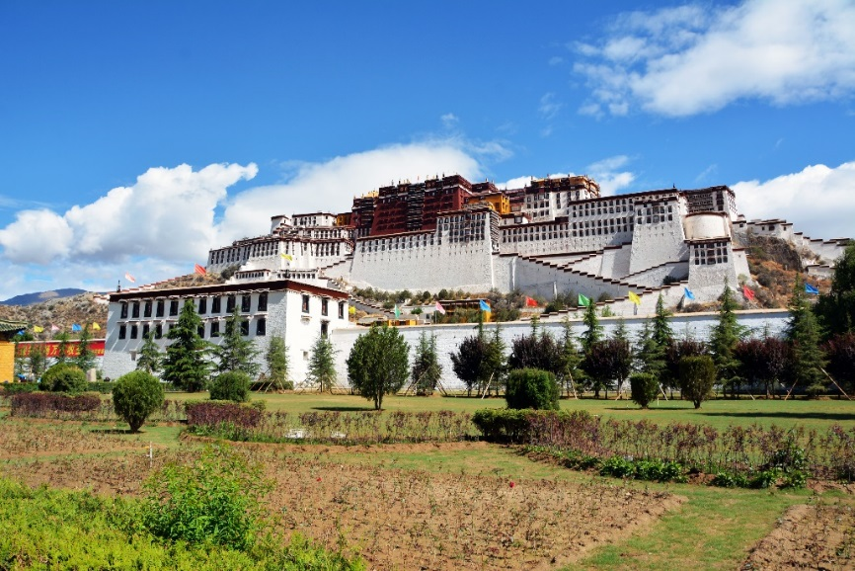
Embrace the challenges(迎接挑战):
Understand and embrace the fact that healthy debate.(求同存异)
Ensure that we can comfortably articulate this relationship in public and to the press.(确保我们能够从容并清楚地向公众和媒体展示我们之间的良好关系)
Address what makes you uncomfortable and make changes that will make you comfortable.
(对不足之处提出改进意见)
Keep your cool at all times.(保持冷静)
Notes:
Most Confucius Institutes are located on university campuses.
As such, we all need to understand and embrace the fact that healthy debate and challenging authority are time-honored and cherished traditions within most such institutions.
To deny that our CI operations will be immune from such debates is simply wishful thinking. And, for those of us in western countries or dealing with western media, it is unwise and unproductive to use our positions of authority to bully or dissuade news organizations from reporting on these debates.
The only effective measure is for us to examine closely our CI operations, how they connect to our universities and to Hanban and ensure that we can comfortably articulate this relationship in public and to the press.
If you cannot do this, you need to address what makes you uncomfortable and make changes that will make you comfortable. THE POST: MTSU SAYS INTERFERENCE …..

Slide 19
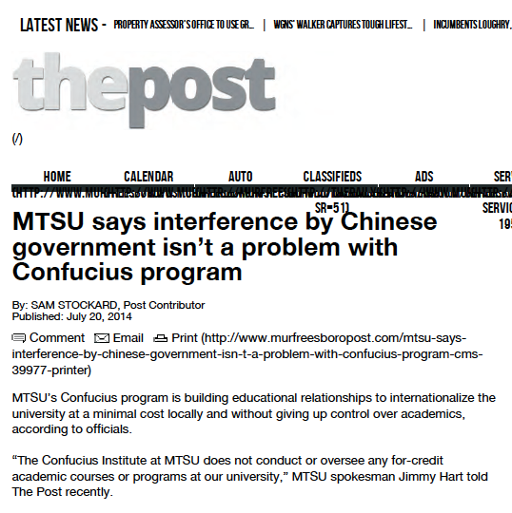
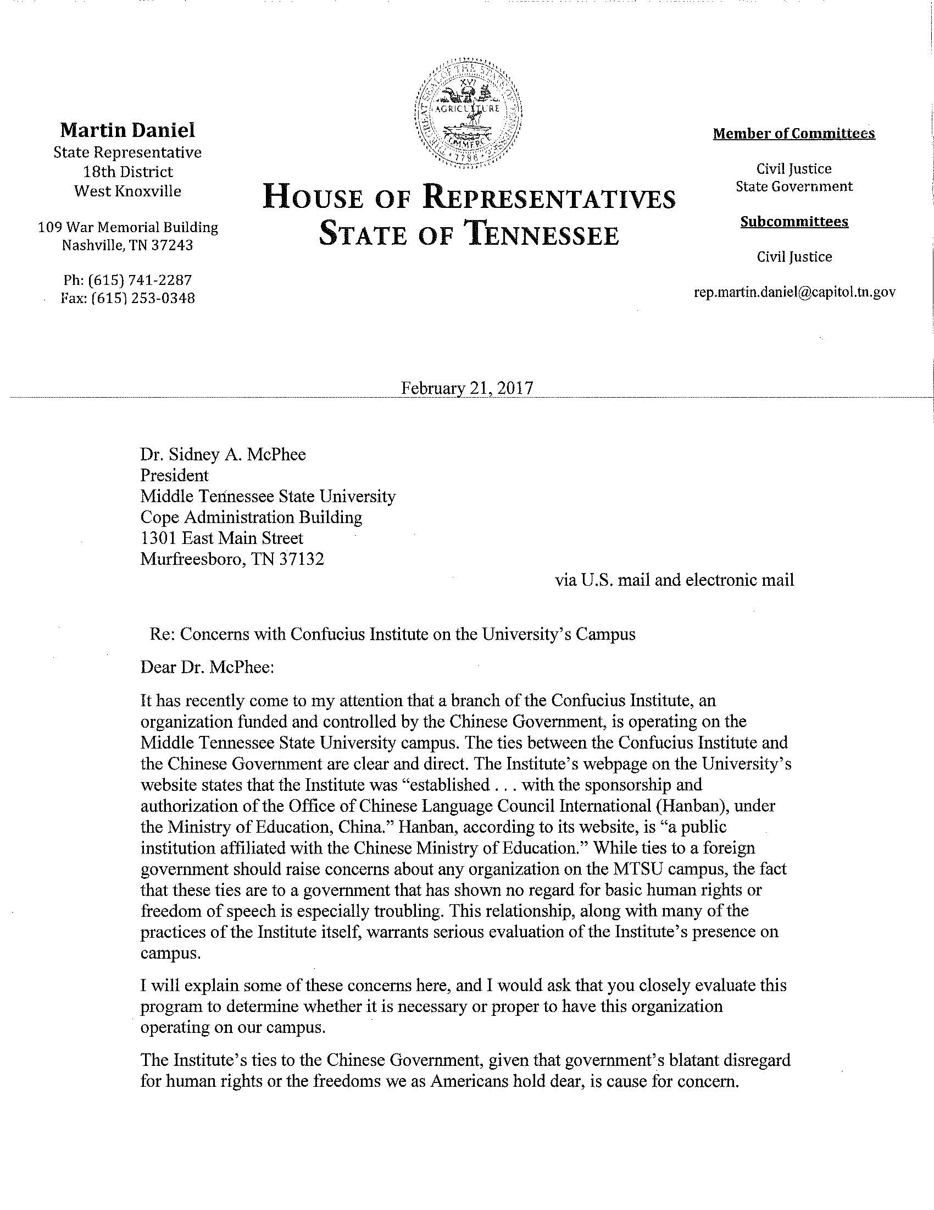
Notes:
We at MTSU have had to address tough stories as well.
One such example is above. We did so by following the suggestion I shared with you today:
We observed reactions and objections being voiced elsewhere;
We examined our practices and policies – before the questions were posed to us – and made sure we were comfortable with the answers we would give if asked.
We didn’t, and don’t, deny that CI is funded by Hanban, and that Hanban is funded by China’s Education Ministry. We acknowledged it and explained how we take the necessary steps to ensure our academic freedom and integrity,
EXERCISE: KEEPING YOUR BALANCE

Slide 20
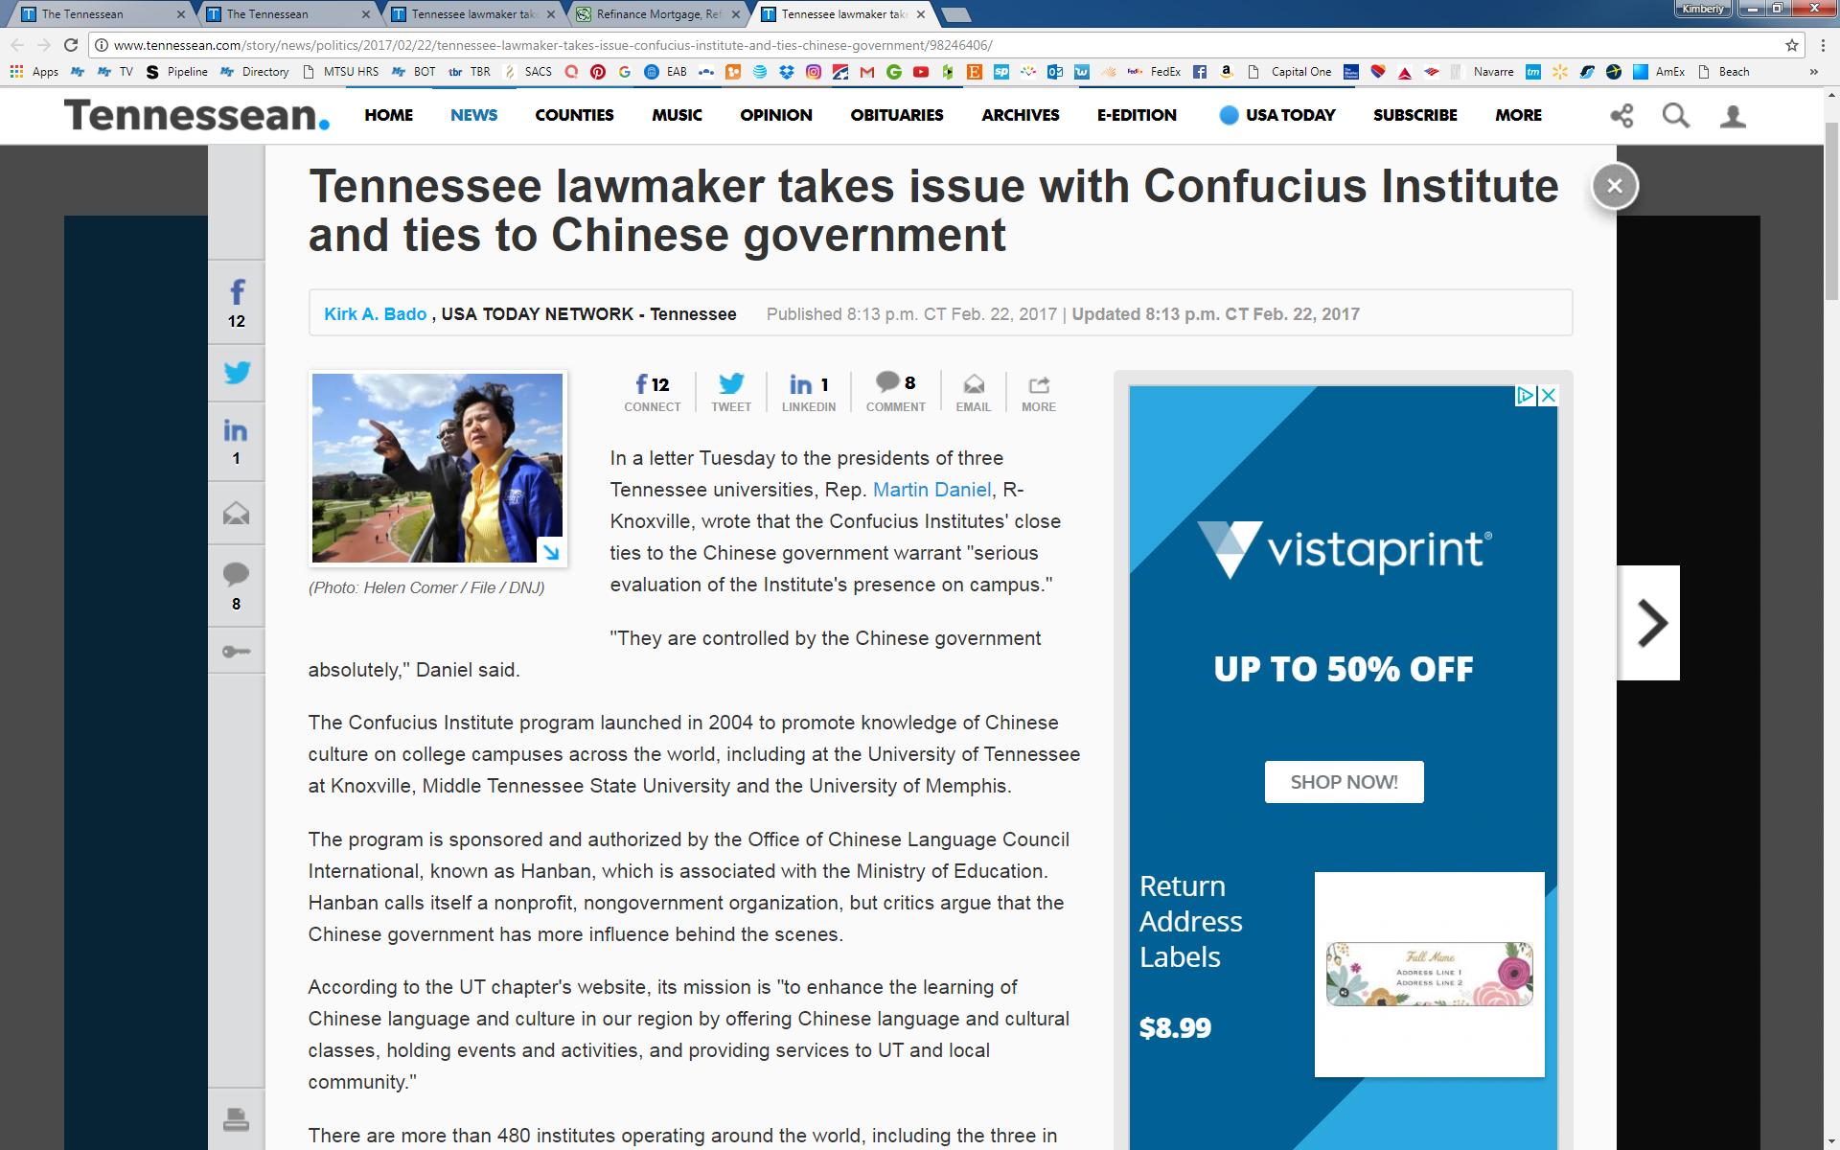
Notes:
EXERCISE: KEEPING YOUR BALANCE

Slide 21
Keeping Your Balance(保持平衡): An Exercise in Remaining Calm and Collected(保持冷静与镇定)
Notes:
EXERCISE #2: “KEEPING YOUR BALANCE.”
Who here is knowledgeable about the wonderful museum and interactive display setting on the first floor of the Hanban building? Raise your hands!
Now, if I were a reporter, which one of you would I interview for a story ?
(You will likely need to insist upon someone to come forward and join you up front, so you can do this)
----------------------------------------------------------------------------
Once the person is up front, loosen him/her up with some fun banter, such as:
Tell me your name?
Which institution you are from.
How long have you worked here?
Compliment him/her on something, like their appearance, manner of speaking, etc.
-------------------------------------------------------------------------------------
(You, speaking as a reporter):
So, tell me about this exhibit: What does Hanban hope to achieve with such a grand museum and display center?
(Let the person answer)
(You, speaking as a reporter)
What parts of the museum are most popular with visitors?
(Let the person answer)
(You, speaking as a reporter – THIS WILL BE THE ZINGER QUESTION – pick the one you are most comfortable saying in front of Hanban officials, but understand the idea is to make your subject uncomfortable)
OPTION 1: I didn’t see anything in the museum on the question of the role that the Dalai Lama plays in Tibet. What’s Hanban’s position on that?
OPTION 2: How does the museum address current events, such as the recent demonstrations in Hong Kong?
(If the person starts to squirm, go after him or her – make it uncomfortable)
--------------------------------------------------------------------------------------------
(You will then need to step back into the mode of instructor and critique his performance)
How did he handle the surprise question? Did he know his negatives? Did he avoid saying no comment? Did he have a prepared response planned that would convey to the reporter that such questions aren’t part of the museum’s purpose?
Did he use his 20 seconds effectively? Did he put forward a clear impression of the value of the museum?
Did he look nervous? Or confident? Eye contact? Posture? Voice tone?
---------------------------------------------------------------------------------------------
Ask the audience to give him/her a round of applause and thank him/her

Slide 22
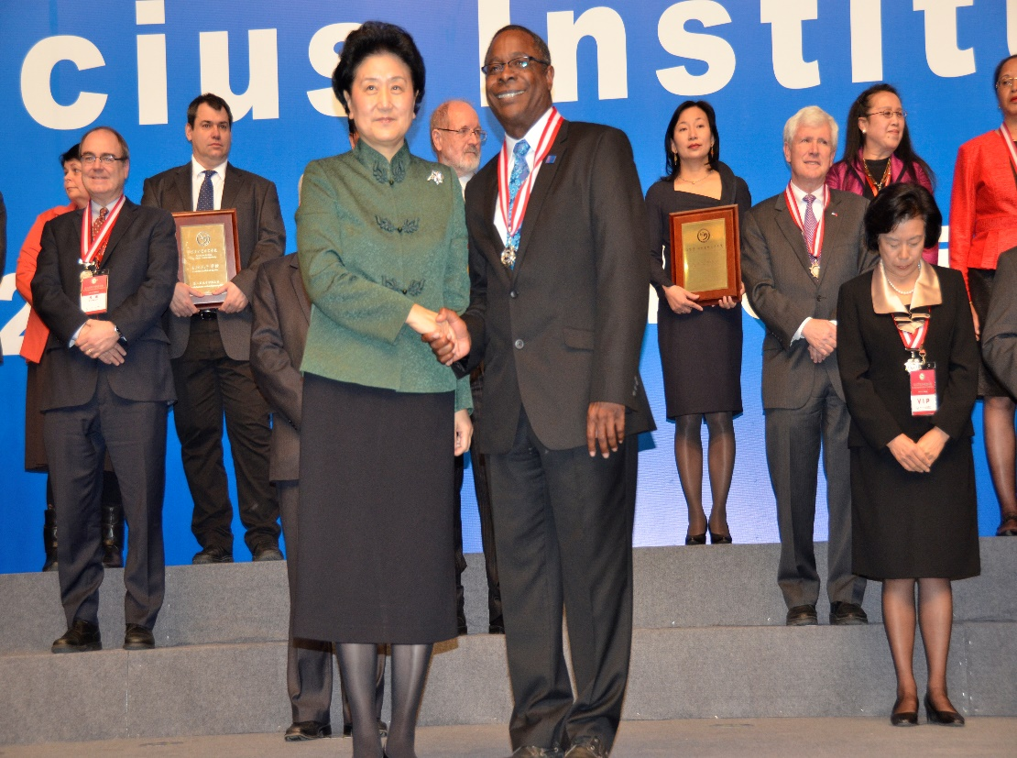
During the interview:（在采访中怎么做）
Listen carefully during an interview.(认真聆听)
Only comment on what you are comfortable with.(只回应你想回应的部分)
The likelihood of your being misquoted is reduced substantially.(不断降低媒体错误报道的可能性)
SOURCE: “Meet the Media” guide, USAF PAO
Notes:
I want to conclude on this important point:
Never ask a reporter, particularly a western reporter, to preview the story.
Reporters generally never let sources review stories, though they often check back concerning complicated details.
It’s better to listen carefully during an interview to be aware of when a reporter may not understand something.
During the interview, you may want to double back on an important point – or simply restate your point in another way – if you sense confusion or if you feel you didn’t get your point across.
The likelihood of your being misquoted is reduced substantially if you speak briefly and clearly.
QUESTIONS AND ANSWERS

Slide 23
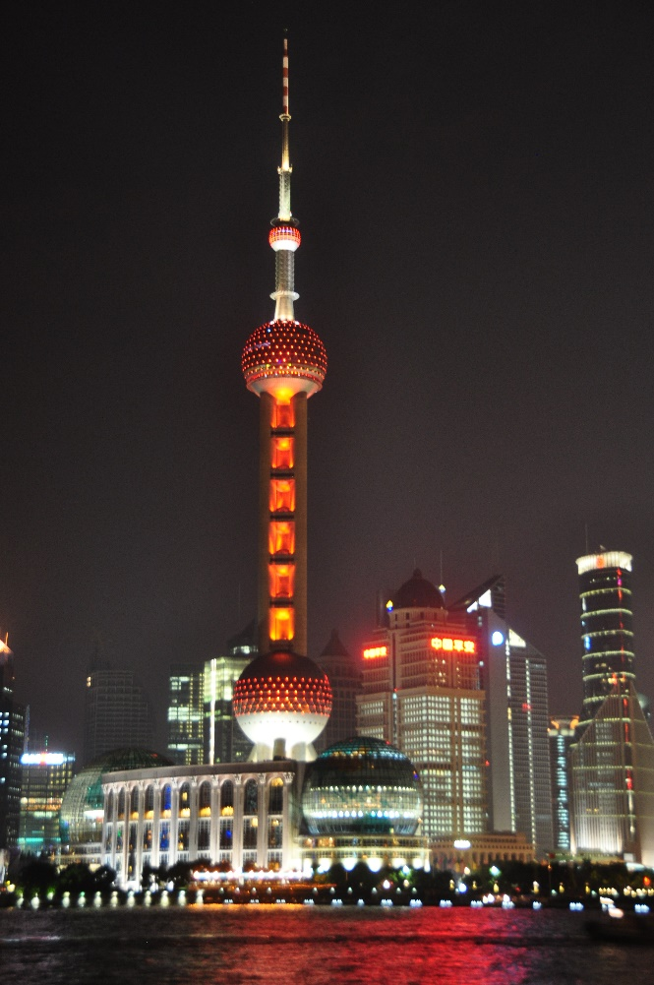
Questions and Answers
问答环节

Slide 24
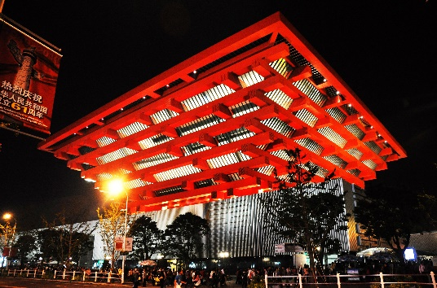
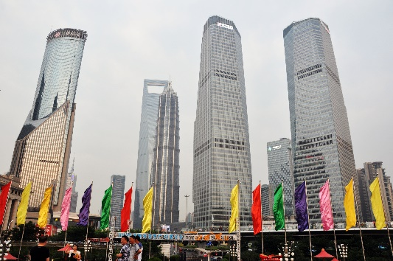
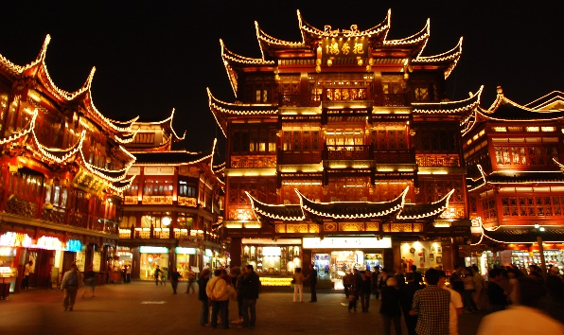
The End
Thank you for your attendance
感谢您出席会议

