Slide 1
Honors in Thailand – January 2018

Slide 2
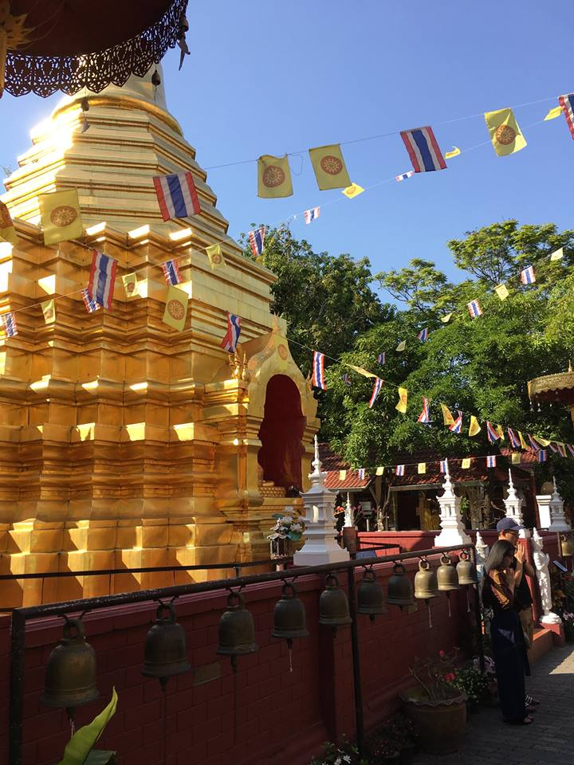
Honors in Thailand – January 1-14, 2018
Chiang Mai
Doi Pui
Bangkok
Kanchanaburi
Ayutthaya
Samet Island

Slide 3
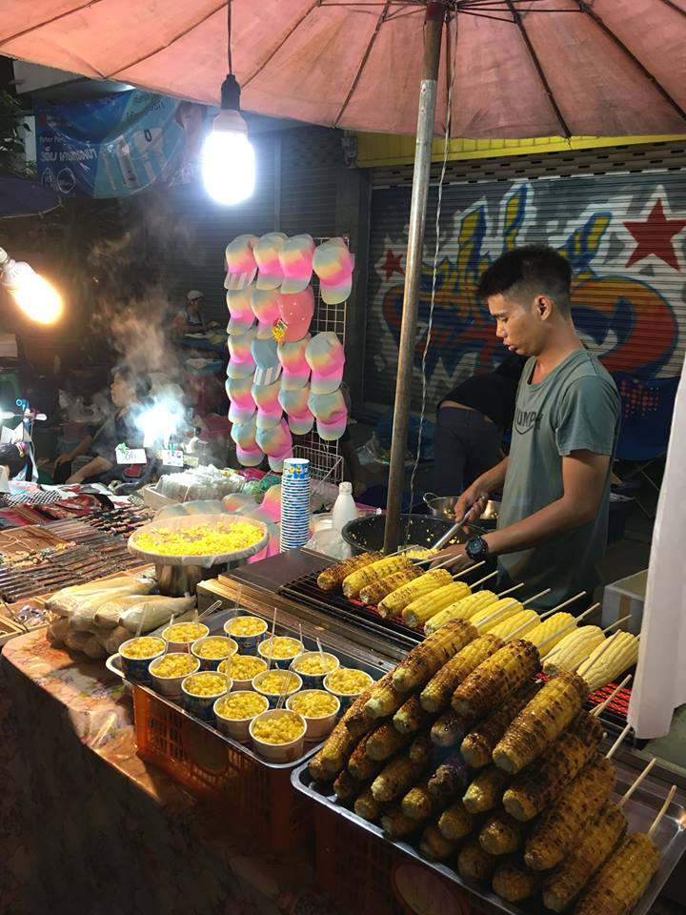
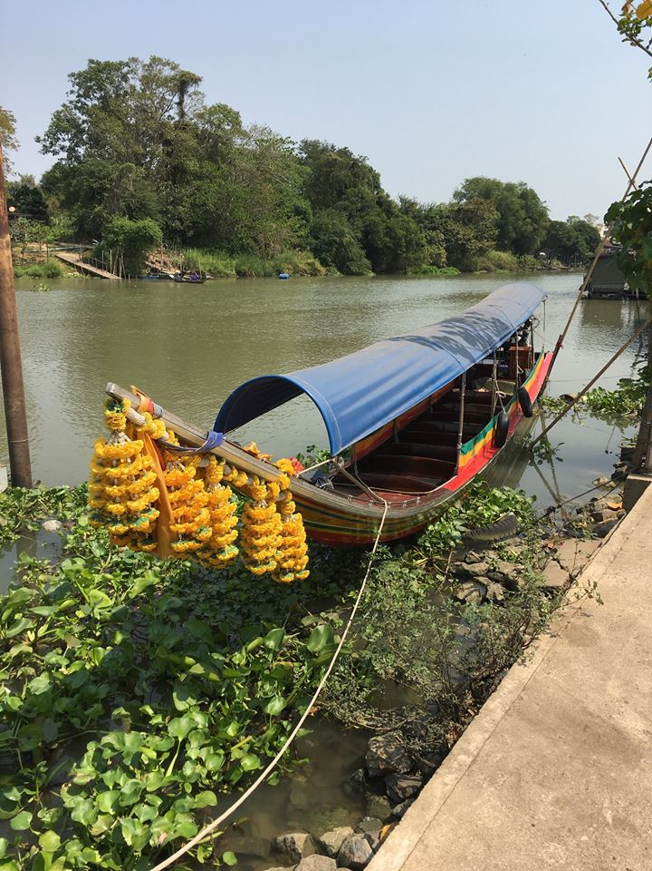
Applicants must have a minimum 3.25 GPA
Enrollment limited to 16 students
Includes an application process (form and essay)
Rolling admission

Slide 4
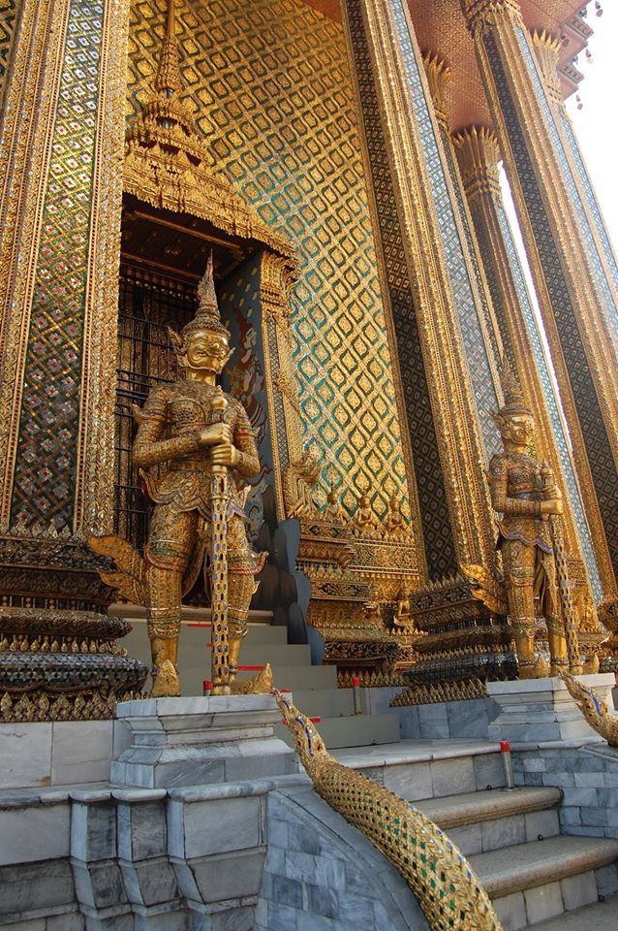
Advantages of Choosing Honors
Taught and led by your own Honors faculty and staff—Dr. Phillips and Ms. Goers
Credit for Honors hours
Selective enrollment
Scholarships available
Safety and support

Slide 5
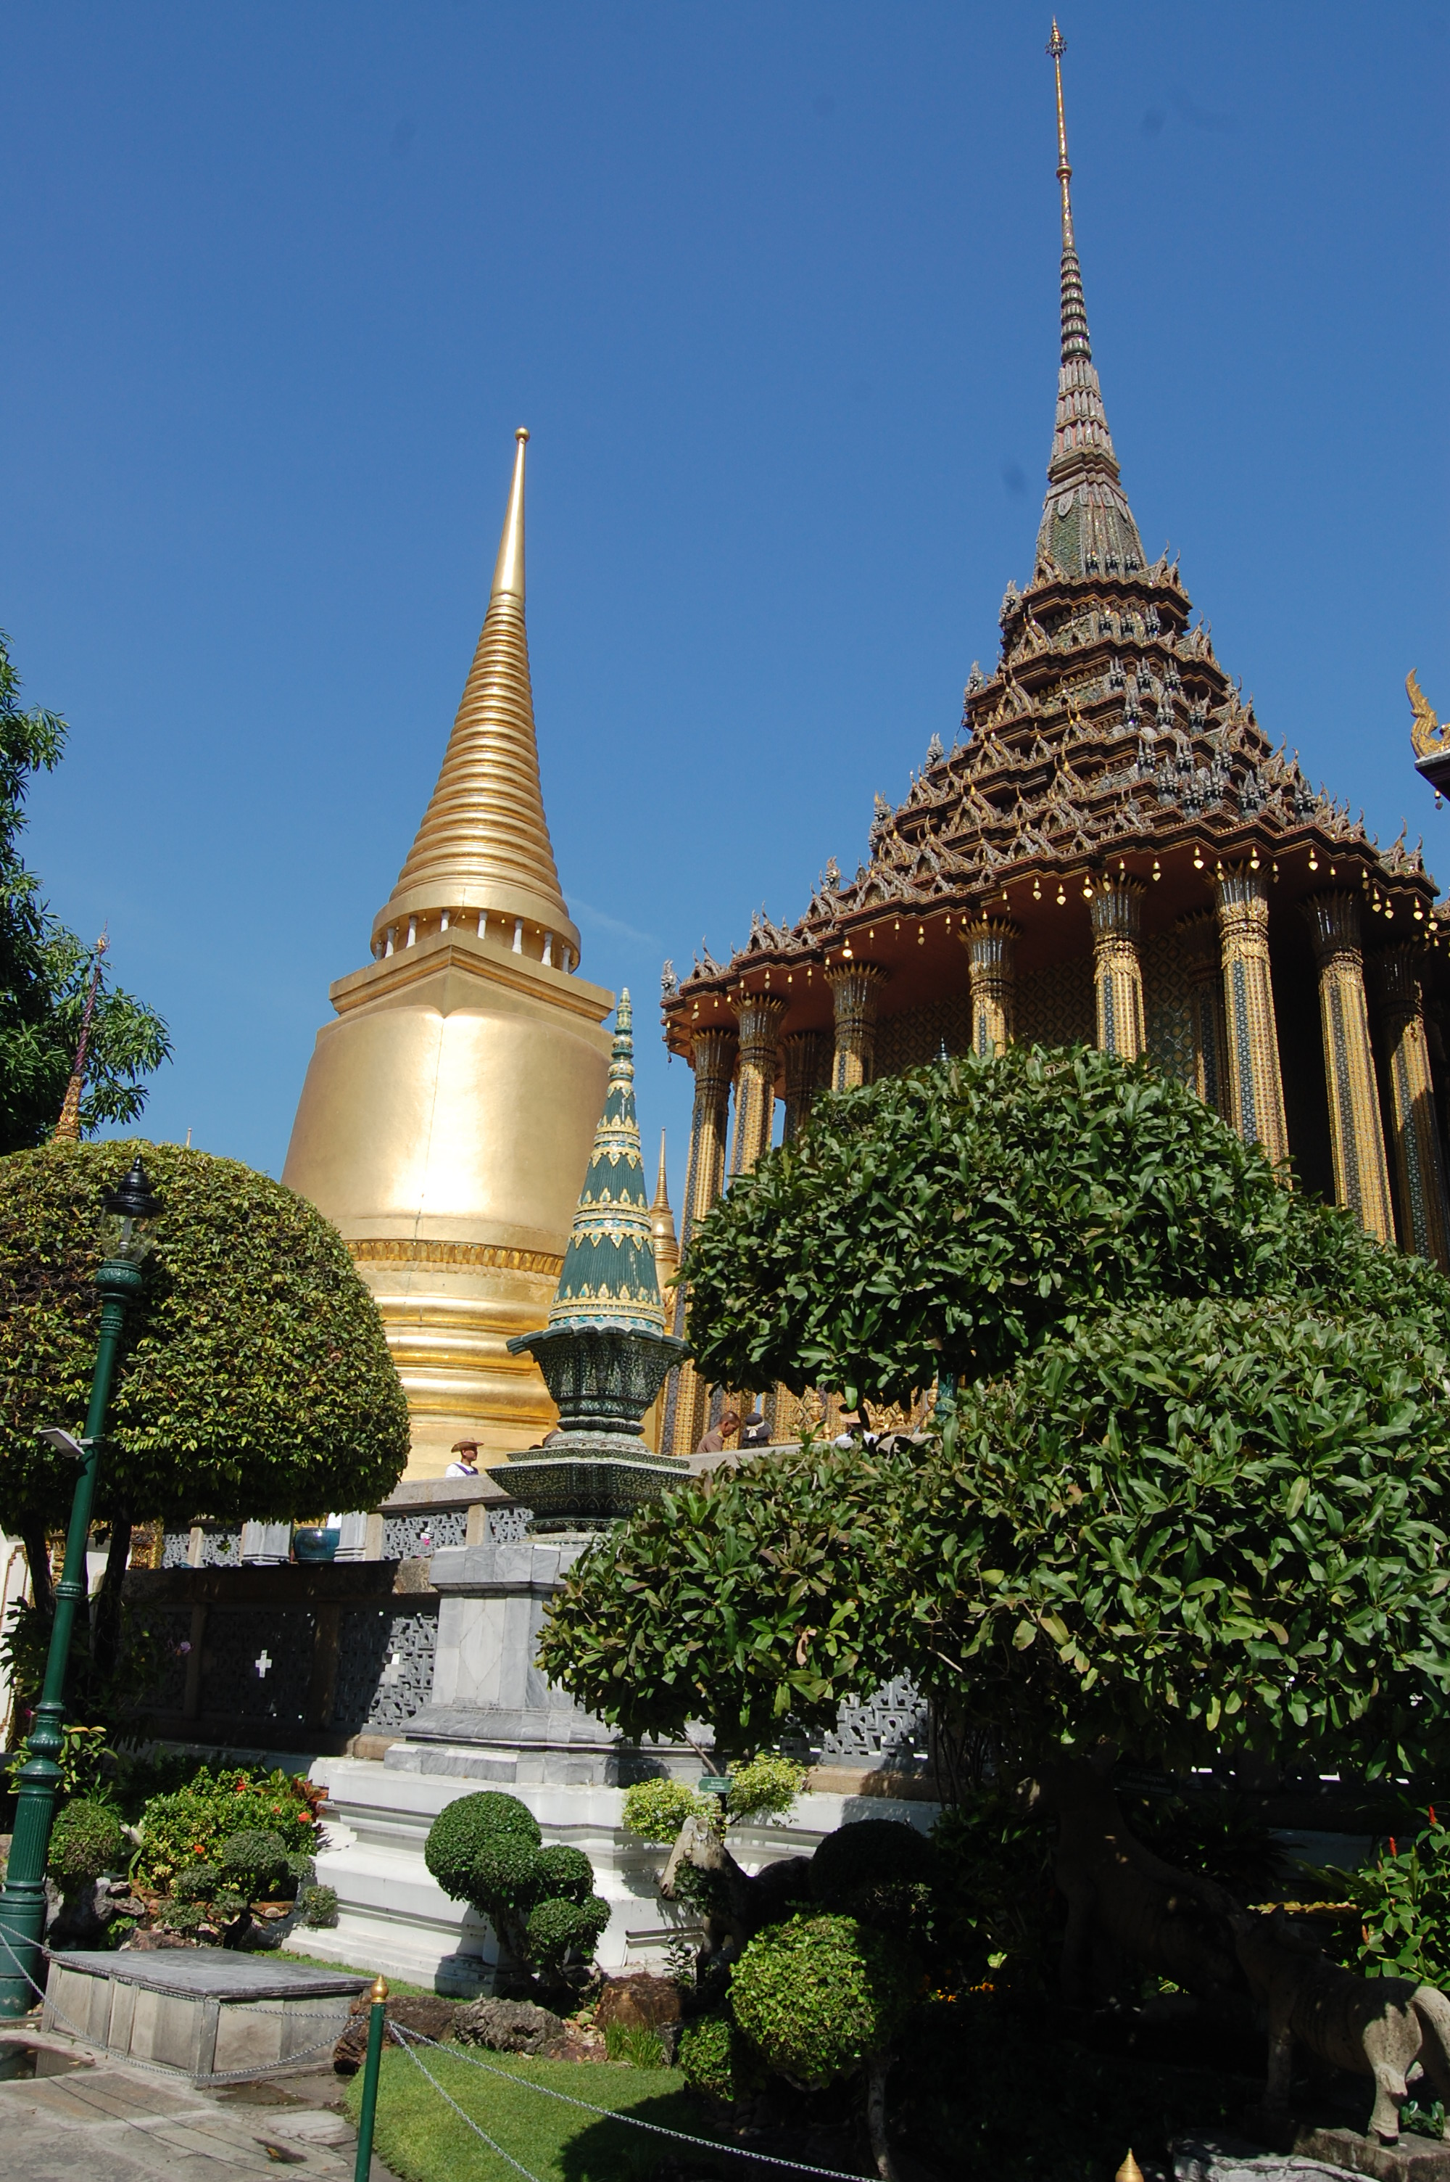
The Coursework
Three (3) hours of Honors credit (UH 3500: Junior Interdisciplinary Seminar)
May count towards interdisciplinary minors in Global Studies (GS 3010)

Slide 6
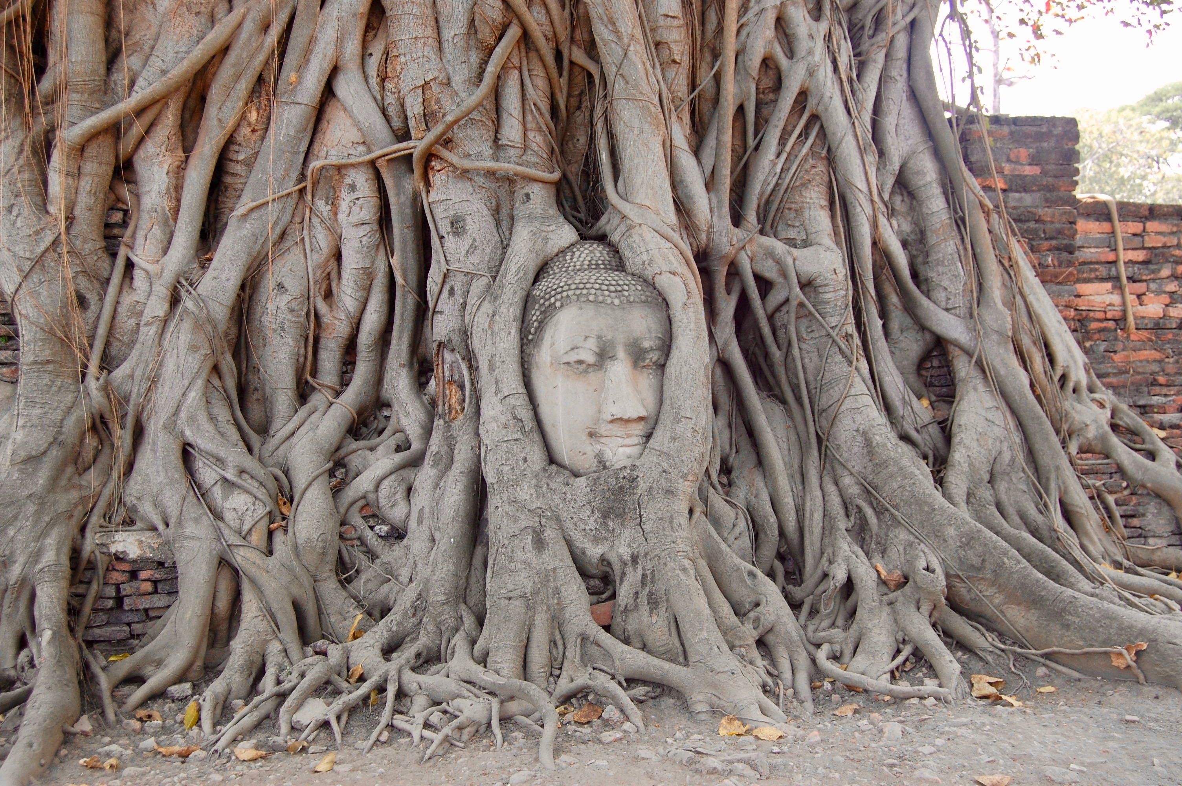
Thai Culture – Literature – Religion - Art Taught by Dr. Philip Phillips, Professor of English and Associate Dean of the University Honors College

Slide 7
Course Description
This short-term education abroad program will introduce honors students to some of the major cultural, literary, religious, and artistic traditions of Thailand. Course readings and in-country educational experiences will emphasize Thailand’s place in the world as viewed historically from Eastern and Western perspectives; consider Buddhism’s central role in Thai culture and art; critically examine selected European, American, and Thai literary works; and explore historical and contemporary issues that contribute to the rich fabric of Thai culture and society. Participating in a service project with the Rotary Club of Chiang Mai will provide students the opportunity to engage directly with people in the local community and to put “service above self.”

Slide 8
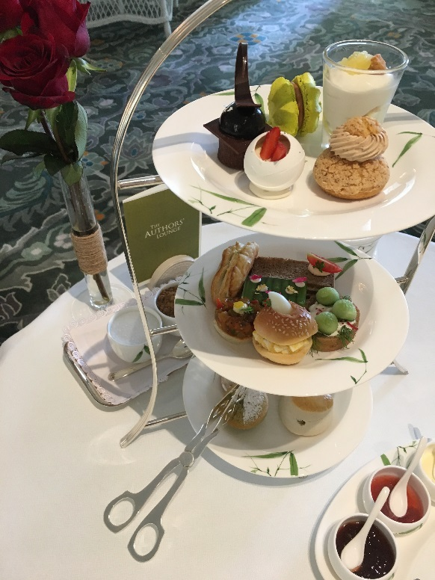
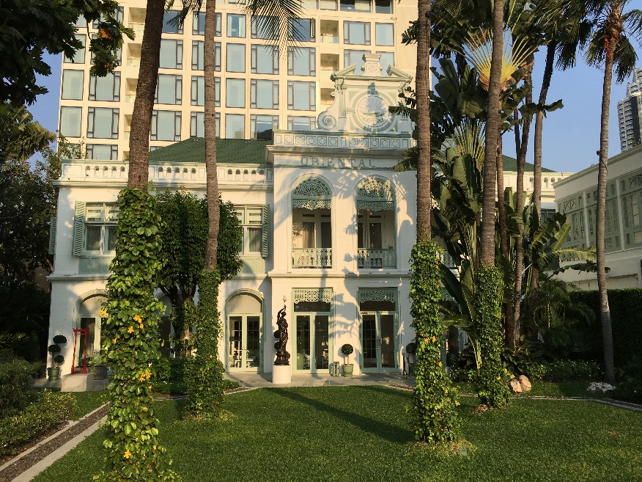
Course Objectives
To develop a knowledge and appreciation of Thai culture, literature, religion, and art through assigned readings, special pre-trip lectures, and tours of sites in Thailand
To Think and write critically and effectively about the readings, cultural experiences, and geographical places encountered.

Slide 9
Course Objectives
To develop skill in critical thinking and writing while following the conventions of an appropriate style manual, such as the MLA Handbook.
To use integrative thinking and reflection to demonstrate the ability to appreciate the interconnectedness of literary themes and conventions through the ages as well as to make connections across cultures, past and present, through education abroad and service learning experience.
Consider adding your Honors in Thailand experience to your MT Engage Portfolio

Slide 10
Meetings/Coursework
This course will include some required pre-trip meetings followed by a two-week, full immersion experience in Thailand.
Assignments will include readings, participation in all required lectures, meetings, quizzes, group activities, a travel journal, and a post-trip reflective essay.

Slide 11
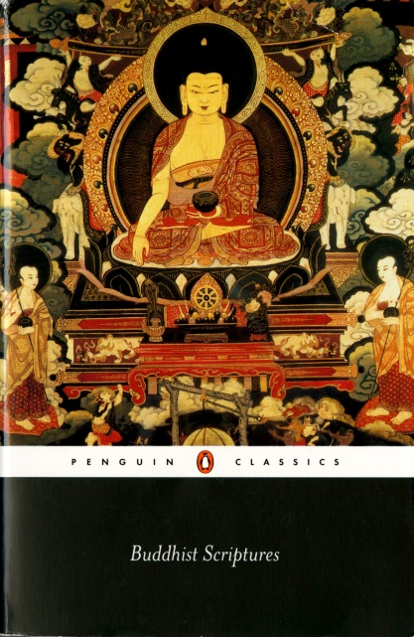
Primary Readings
Our primary readings will include: W. Somerset Maugham, The Gentleman in the Parlour; Joseph Conrad, The Shadow-Line; Pierre Boulle, The Bridge on the River Kwai; Kukrit Pramoj, Four Reigns; and selected Buddhist Scriptures. Other readings may include: selections from Rattawut Lapcharoensap, Sightseeing; Pornchai Sereemongkonpol, Ladyboys; Walpola Rahula, What the Buddha Taught; Martha Mendoza, et al., Fishermen Slaves; Yukio Mishima, The Temple of Dawn; and other works. This is a provisional list and is subject to change at the discretion of the instructor.

Slide 12
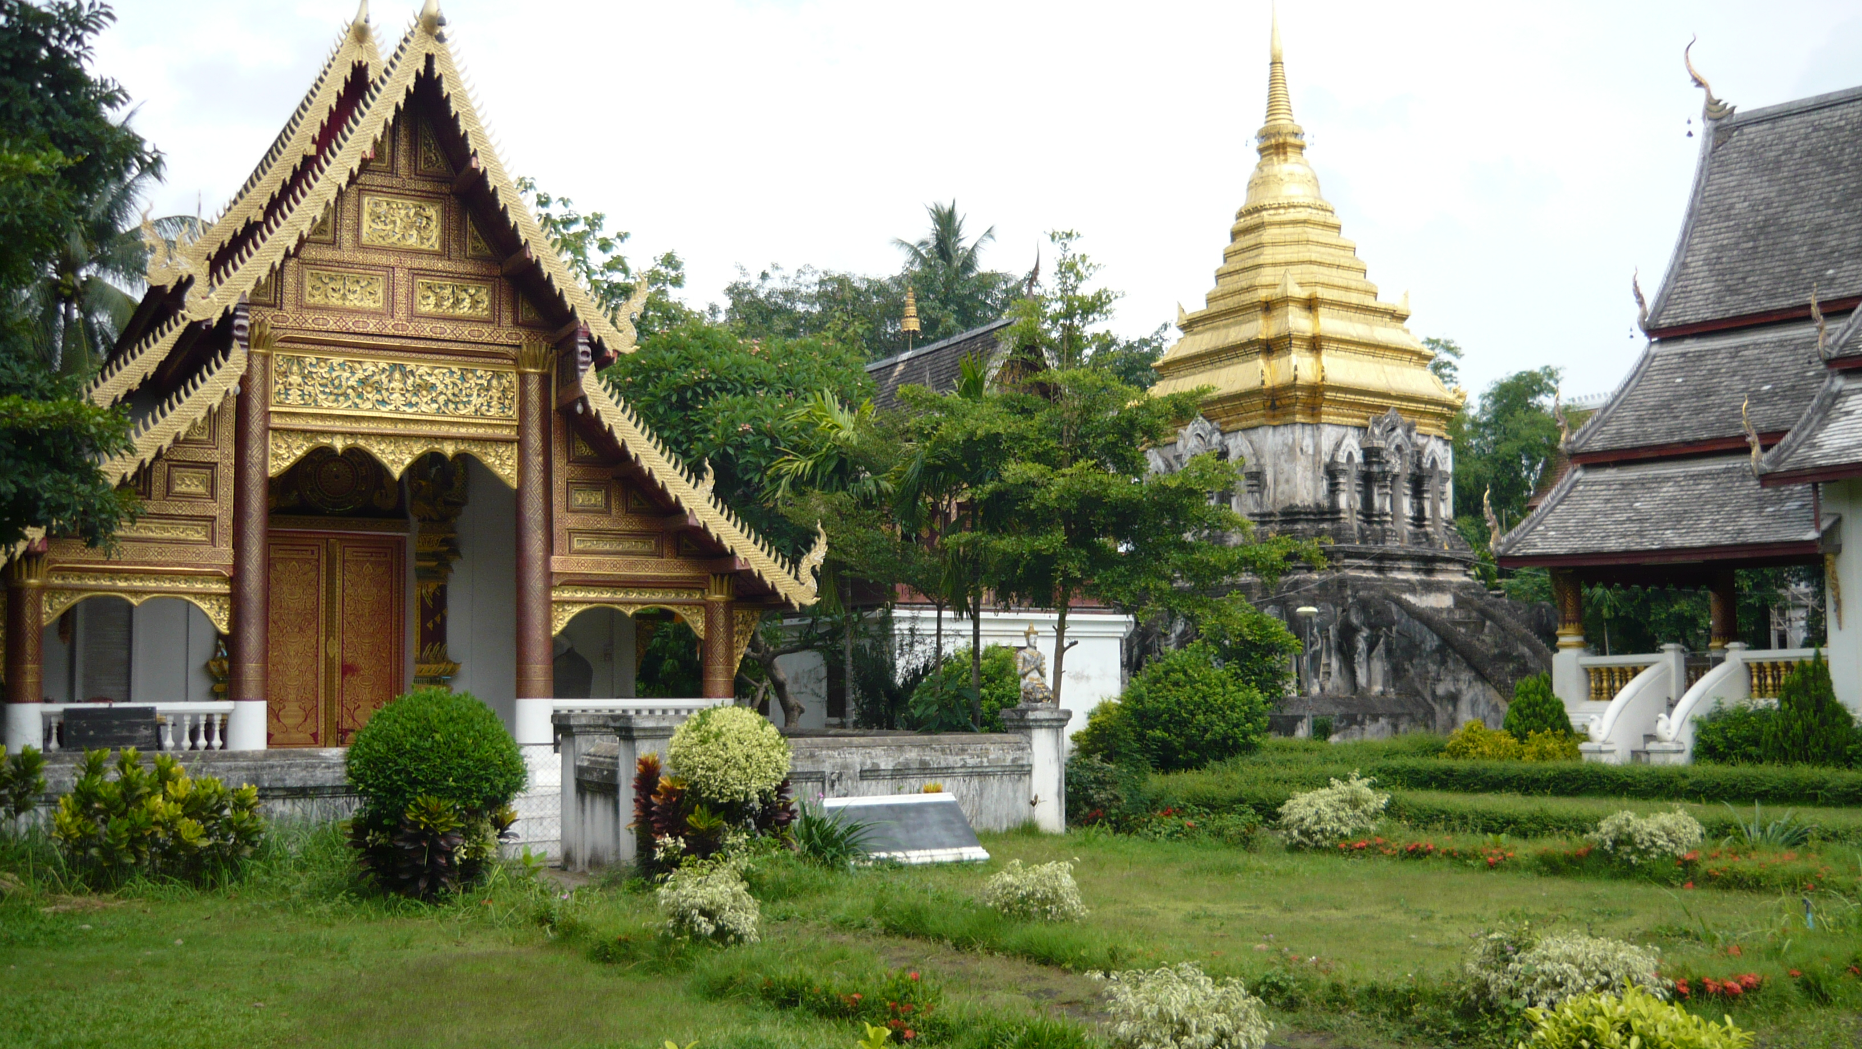
Tentative Itinerary
Day 1:
-Depart for Thailand
Day 2:
-Arrival in Chiang Mai
-On-site orientation
Day 3:
-Chiang Mai Old City
-Wat Chedi Luang temple (chat w/monks)
-Wat Phra Singh, Wat Chiang Man, & Wat Suan Dok temples
-Spend evening in an historic teak house

Slide 13
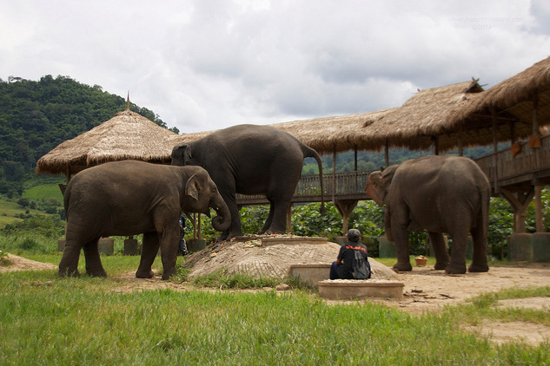
Tentative Itinerary
Day 4:
-Day trip to the highest peak in the Doi
-Doi Suthep Temple
-Blue Hmong village Doi Pui
-Optional evening activities:
boxing class or Thai cooking class
Day 5:
-Service project at Elephant Rescue Nature Park
Day 6:
-Service project with Chiang Mai International Rotary Club

Slide 14
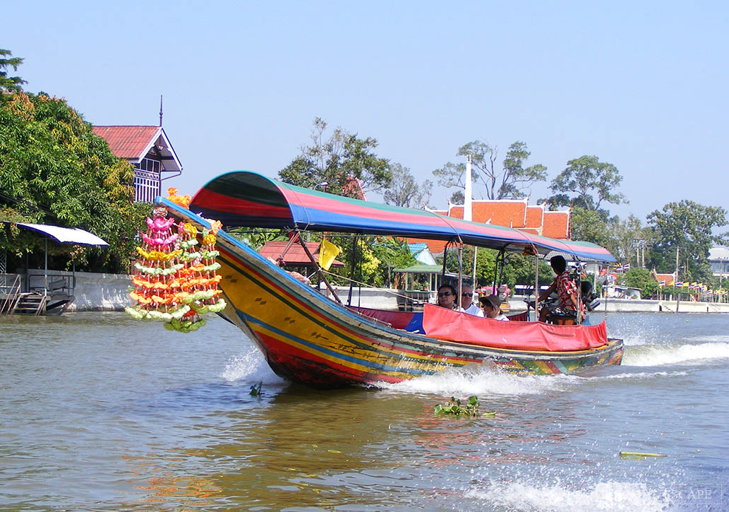
Tentative Itinerary
Day 7:
-Flight to Bangkok
-Museum of Contemporary Art
-Optional activity: visit to Chatuchak Weekend Market
Day 8:
-Temple tour of Bangkok
(Wat Traimit, Wat Pho,
Grand Palace, Wat Arun,
& Wat Phra Kaew)
-National Museum
-Explore canals in a
traditional long tail boat

Slide 15
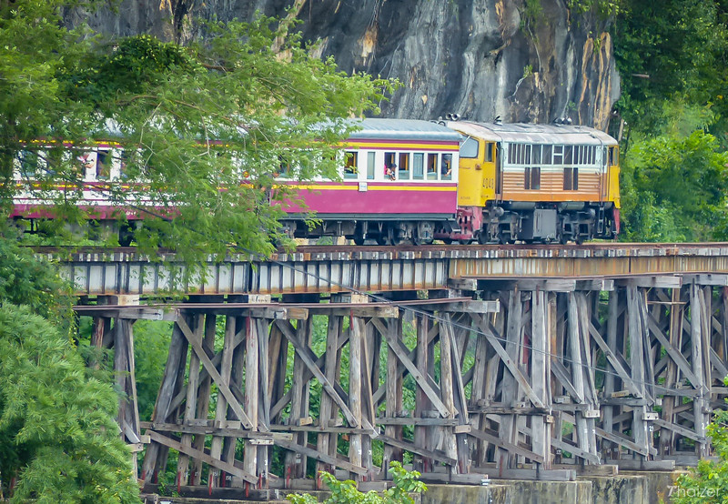
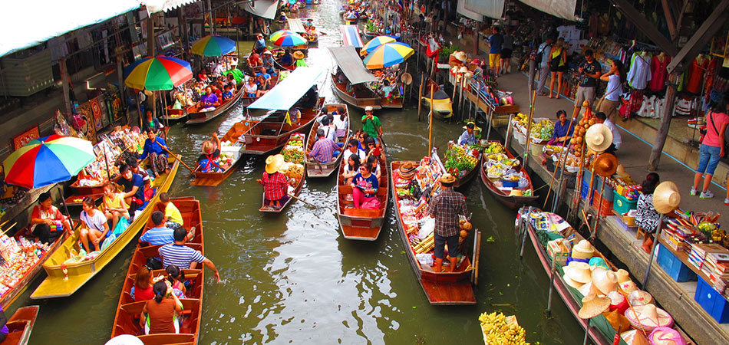
Tentative Itinerary
Day 9:
-Travel to Kanchanaburi (day trip)
-Thailand-Burma Railway Center
-Kanchanaburi War Cemetary
-Ride on historic Death Railway
-Hellfire Pass
-Hellfire Pass Memorial Museum
-Return to Bangkok
Day 10:
-Damnoen Saduak Floating Market
-Mae Klong Railway Market
-Jim Thompson House and Art Center
-Mandarin Oriental Hotel Bangkok
for High Tea
-Optional activity: Muay Thai Boxing Show

Slide 16
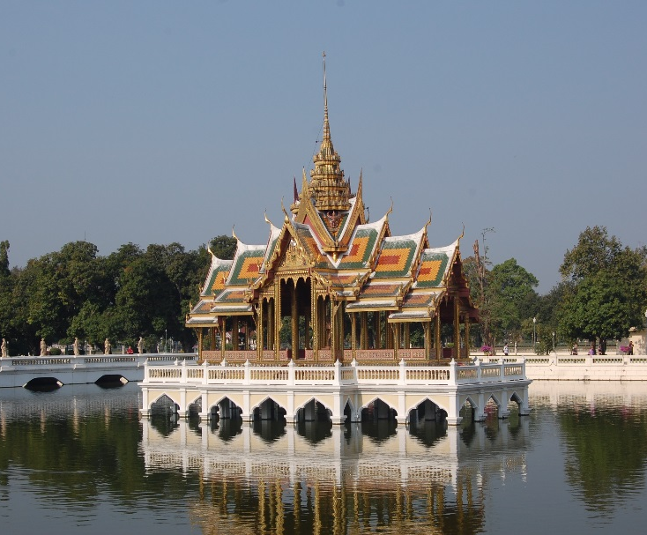
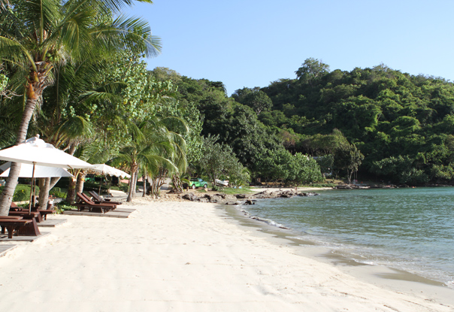
Tentative Itinerary
Day 11:
-Day trip to Ayutthaya
-Bang Pa-In Palace
-Wat Yai Chai Mongkol
-Wat Phra Sri Sanphet temple
-Wat Mahathat temple
-Riverboat tour around the island
-Return to Bangkok
Day 12:
-Overnight trip in Koh Samet
-Beach

Slide 17
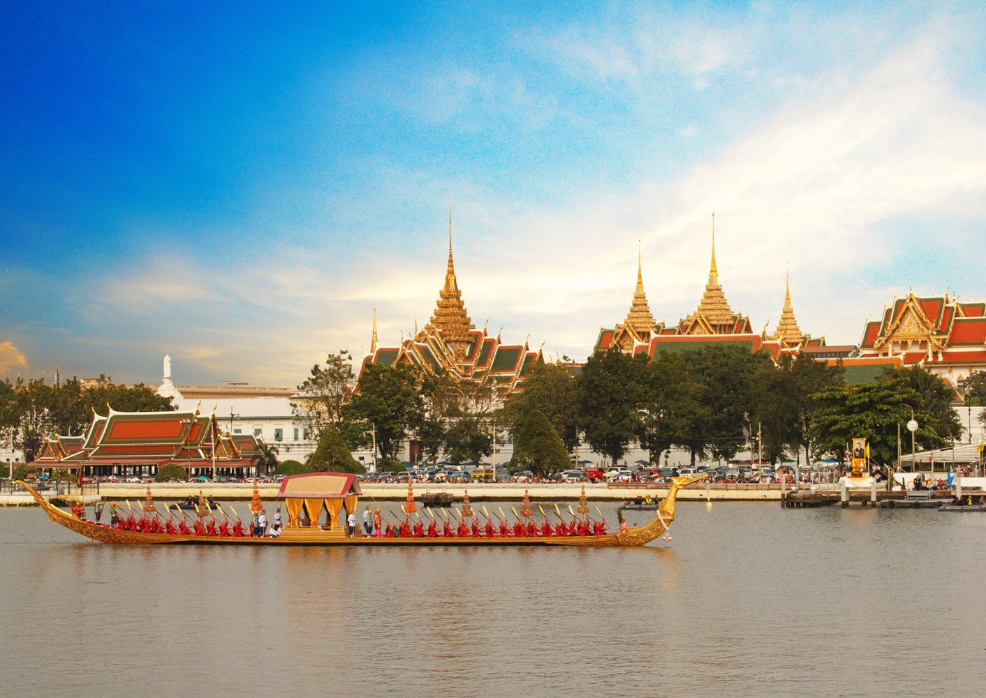
Tentative Itinerary
Day 13:
-Return to Bangkok
and depart for home
Day 15:
-Arrive home

Slide 18
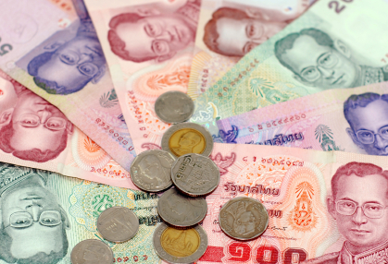
The Cost
Approximately $1,750-$1900 includes: on-site transportation; lodging; cultural activities and excursions with English-speaking guides; guest lecturers; service activity; emergency support; and daily breakfast
Program costs not included: international airfare (estimate- $1,825); tuition (included in Spring 2018 tuition); books; $82 education abroad and iNext fee; immunizations/vaccinations; passport; some meals, and personal spending money

Slide 19
Application Process
Pre-approval advising appointment with Office of Education Abroad (Peck Hall 207)-Pre-approval request due by Monday, Sept. 18 (same as application deadline)
Submit application and confirmation of paid deposit for Honors Thailand Program by Monday, Sept. 18, to April Goers HONR 228 or HONR 205 (main office)
-$500 deposit is submitted to the Business Office
-Application and deposit form found at
http://mtsu.edu/honors/studyabroad.php

Slide 20
Application Process
Check within your degree program for any study abroad scholarship opportunities
Apply for Honors Study Abroad Scholarship by September 30, 2017
http://mtsu.edu/honors/studyabroad.php
Apply for Education Abroad Scholarship by October 5, 2017
http://mtsu.studioabroad.com/

Slide 21
Questions?
Course Information
Dr. Philip E. Phillips
philip.phillips@mtsu.edu
Travel Information
April Goers
615-494-7767
april.goers@mtsu.edu

