Slide 1
Creating SMART Goals
TRIO SSS Middle Tennessee State University
Fall 2016

Slide 2
What Are Goals
A Goal is the object of a person’s ambition or effort.
It is an aim, a part of a person’s overall vision.
Purpose of Goals
To maintain focus and make progress toward the vision overall.
Types of Goals
Personal, professional, financial, mental, spiritual, social, etc.

Slide 3
Short Term v. Long Term Goals
Short Term
Weeks
Months
Long Term
Months
Years
Short Term Goals
Goals that can be accomplished within a relatively short amount of time.
Long Term Goals
Goals that take longer to accomplish and are possibly harder to achieve.
Notes:
Long term goals can include short and mid-range goals. Shorter goals can also build up to and work towards long term goals.

Slide 4
Short Term Goals Examples
Day
Week
Month
Use my alarm to wake up by 7a.m.
Workout at least three times this week.
Pass my midterms

Slide 5
Long Term Goals Examples
Months
Create and edit my resume
Year
Study and take the GRE
Years
Graduate from grad school

Slide 6
Flexible v. Fixed Goals
Flexible
Flexible goals are not limited to a specific time table; these goals are fluid and can be built into other goals
Fixed
Fixed goals have a specific outcome that is time/date limited

Slide 7
Flexible and Fixed Goals Examples
Flexible
Workout three times this week
Fixed
Workout on Monday, Wednesday, and Friday.

Slide 8
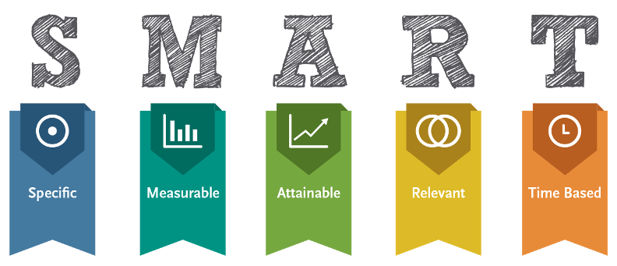
Make Your Goal

Slide 9
Specific
Specific goals are clear and defined with no ambiguous language.
A specific goal should answer the five W questions:
WHO is involved?
WHAT do I want to accomplish?
WHEN do I want to start and finish this goal?
WHERE will I complete this goal? Is the goal location specific?
WHY is this important to me?
Notes:
Define the goal as much as possible. They goal should be concise, specific, and easy to refer to.

Slide 10
Specific Example
Example: To get my time management under control.
Specific goal: To improve my time management skills I will use my daily planner to keep track of all class assignments, projects, work schedules, and free time.
Being specific shows who will improve in time management, what tools are being used, and why this task is important.
Notes:
Who? I will… What? Use my planner to keep track of my assignments, projects, work schedules, and free time…Why? To improve my time management skills.

Slide 11
Measurable
Measurable goals have outcomes that provide proof of success or failure of the goal.
Measurable goals should answer the how questions:
How many?
How much?
How will I know it is accomplished?
Notes:
SMART goals should be able to be measured and tracked over time. You should be able to track progress and measure the outcome.

Slide 12
Measurable Example
Example: To use my planner more.
Measurable goal: To increase my planner usage to five days a week.
The measurable portion of the goal shows how the planner will be used more and specifically how many times per week the planner will be used.
Notes:
How will I use my planner more? I will use my planner more frequently – five times a week.

Slide 13
Attainable
Attainable goals are challenging yet feasible to complete.
Attainable goals should be set above standard performance levels but not too far outside of current skill levels.
Having goals that are not attainable could deter you from achieving the goal.

Slide 14
Attainable Example
Example: To reserve one day each week to plan for the next week.
Attainable goal: To set aside two hours on Sunday to write down my plan for the next week.
Setting aside two hours once a week is attainable and feasible to maintain each week.

Slide 15
Relevant
Relevant goals meet your current needs and wants while supporting your overall vision.
Relevant goals also need to be realistic in order to maintain their attainable and measurable qualities.
Realistic goals consider what can be done with the resources available.

Slide 16
Relevant Example
Example: To keep up with my planning schedule through senior year.
Relevant goal: To keep up with managing my planner through midterm.
Keeping track of the goal for a shorter period of time is relevant to the goal and current semester needs and more realistic than setting the goal through senior year.
Notes:
Keeping track through midterm is realistic and relevant. Trying to set a goal through senior year can be an ongoing long term goal.

Slide 17
Time Based
Time based goals include a time commitment that provides a hard deadline for achieving the goal.
Deadlines keep you accountable and motivated to complete the goal.
Remember short term and long term goals hold different time based deadlines.
Notes:
A timeframe is needed.

Slide 18
Time Based Example
Example: To maintain my planner through senior
Time based goal: To maintain the Sunday planning time and planner usage by midterm.
Midterm is the deadline for tracking progress and success of the goal.

Slide 19
The SMART GOAL is…
To improve my time management skills by using my daily planner to keep track of my class assignments, exams, work schedule and free time at least five times a week with a two hour planning time on Sundays until midterm.

Slide 20
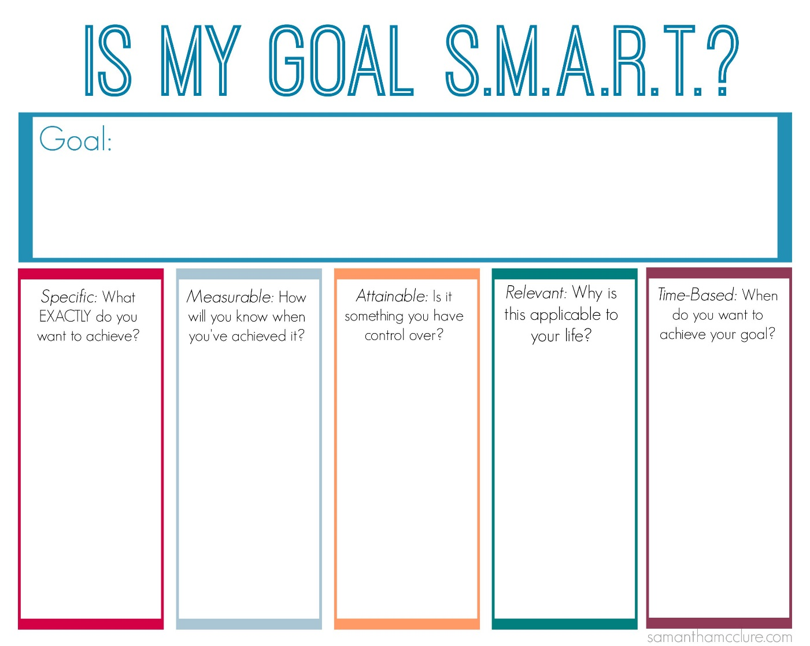
Creating SMART Goals
Click on the SMART Goal link and print out the goal creation worksheet.
Notes:
**Attach the link to the SSS webpage.
Create 2-3 goals that you want to accomplish this semester.

Slide 21
Congratulations!
You have successfully completed the SMART Goals workshop. Complete the SMART goals worksheet and the workshop evaluation and turn it into SSS office.

