Slide 1

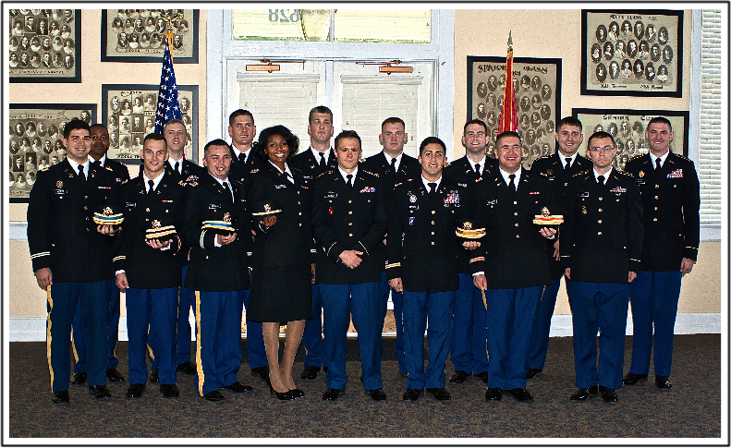


Army Reserve Officer Training Corps
(MTSU Army ROTC)

Slide 2
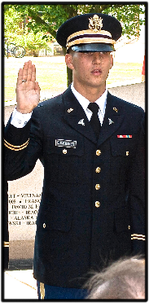
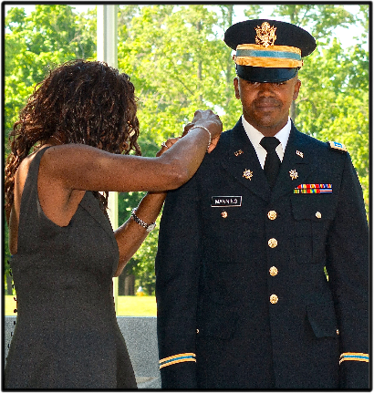
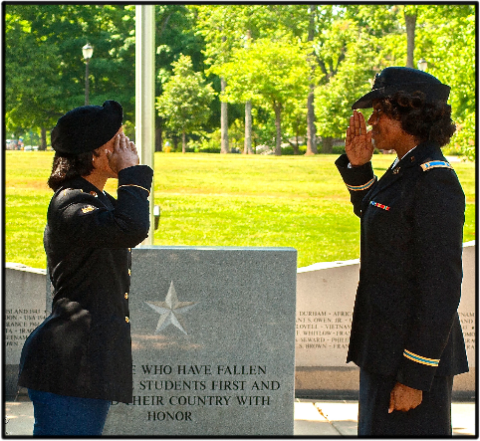
Army ROTC MISSION
Commission the future Army officer leadership for service to the Army and Nation through precision recruiting, rigorous leader development and focused retention; in addition, motivate young people through caring leadership and positive influence to be better citizens for life-long service to community.

Slide 3
THE ACADEMIC PATHWAY
MIL SCI Level I
Freshman
MIL SCI Level II
Sophomore
***MS 3080
MIL SCI MIL HISTORY
2 credits
???
BASIC
COURSE
ADVANCED
COURSE
Fall
MS 1010
2 cr
Spring
MS 1020
2 cr
Fall
MS 2010
2cr
Spring
MS 2020
2 cr
Summer
Basic Camp
MIL SCI Level III
Junior
MIL SCI Level IV
Senior
Fall
MS 3110
3 cr
Spring
MS 3120
3 cr
Summer
MS 3130
6 cr
Fall
MS 4110
3 cr
Spring
MS 4120
3 cr
Graduation &
Commissioning!
Advanced Camp
***MS 3080
MIL SCI MIL HISTORY (2 credits)

Slide 4
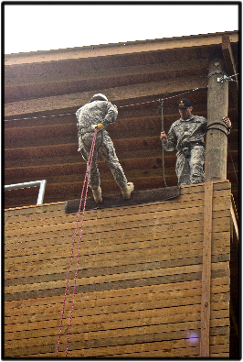
Military Science Classes
Basic Course Classes (Freshman and Sophomore)
Learn practical application in adventure
- oriented skills:
- rappelling
- marksmanship techniques
- survival
- land navigation (map and compass)
- first aid skills
Includes a general overview of the Army's
mission, organizational structure, customs
and traditions. Focus is on leadership
development.

Slide 5
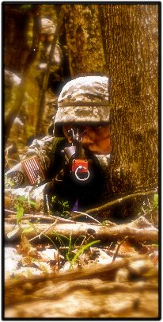
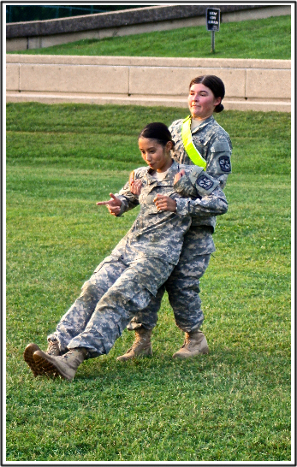
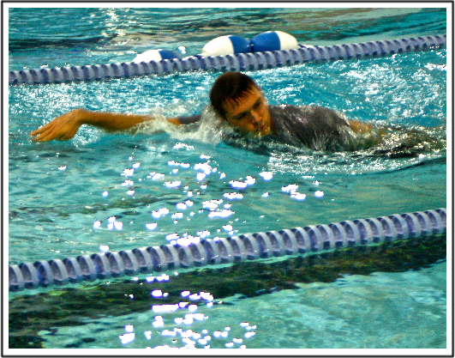
Military Science Classes
Advance Course Class (Contracted Cadets Only)
Squad Level Tactics (Patrolling, Ambush, Clearing Room Procedures, etc…)
Operation Orders Process – Planning and Leading
Advanced Physical Training
Water Skills/Survival

Slide 6

Financial Assistance
Army ROTC 4 Year / 3 Year / 2 Year Scholarship
Eligibility Requirements:
Age: Must be between 17 and 30 (non-negotiable)
Must be US Citizen
2.5 Minimum GPA
Meet Height and Weight standards
Physically fit – Must pass the Army Physical Fitness Test
Pass DODMERB (Physical Exam)
NO Civil Convictions
Cannot be participating in the SMP program
The Army ROTC Scholarship Covers:
100% Tuition and Fees OR $10K Room & Board Reimbursement
$1200.00 / year for Books ($600/semester)
Monthly Stipend when contracted (Max 10 Months/Academic School Year):
$420.00/month Freshman, Sophomore, Junior and Senior

Slide 7

Financial Assistance – National Guard
Simultaneous Membership Program (SMP)
- TN STRONG (100% State Tuition Assistance [STA]) or – Fed Tuition $4000/year
- $375 GI BILL **
- $350 GI BILL KICKER **
- $303 E5 DRILL PAY **
- $420 ROTC STIPEND **
SMP benefits and ROTC Scholarship
Benefits can be combined via
Guaranteed Reserve Forces Duty (GRFD)

Slide 8
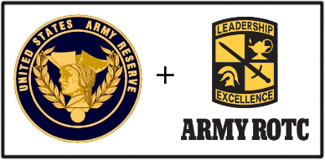
Financial Assistance – Army Reserve
Simultaneous Membership Program (SMP)
- Fed Tuition $4000/year
- $375 GI BILL **
- $350 GI BILL KICKER **
- $303 E5 DRILL PAY **
- $420 ROTC STIPEND **
SMP benefits and ROTC Scholarship
Benefits can be combined via
Guaranteed Reserve Forces Duty (GRFD)

Slide 9
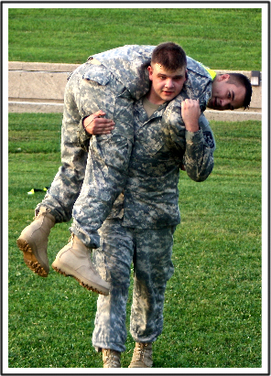
Long Term Benefits of ROTC
Serve your country as a soldier & leader.
Learn physical fitness techniques to help you stay in shape.
Leadership lessons with practical application =
Experience.
  Personnel Management
  Asset & Logistical Management
  Operational Planning and Project
  Management
Time Management Skills.
Friendships that last a lifetime.

Slide 10
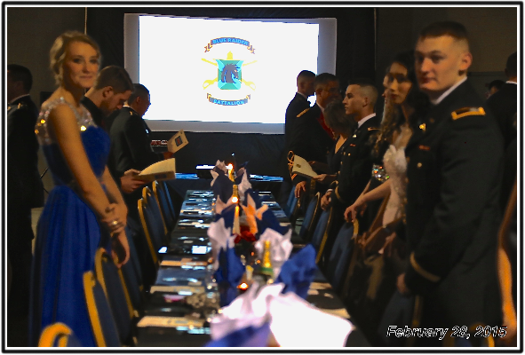
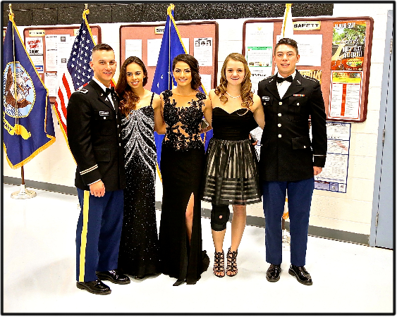
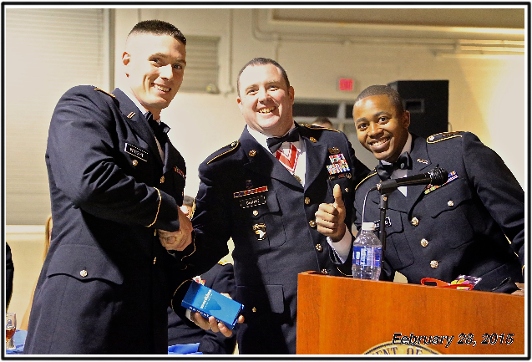
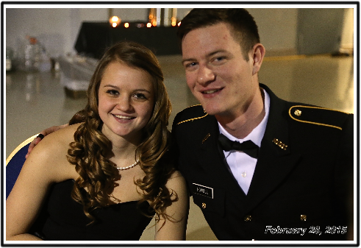
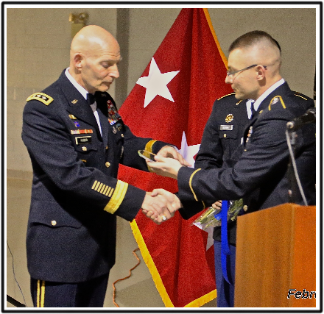
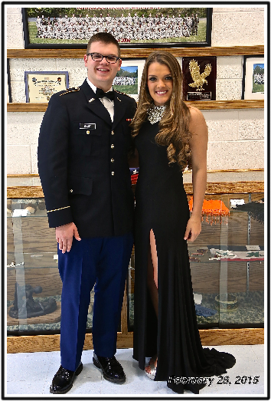
Military Ball

Slide 11
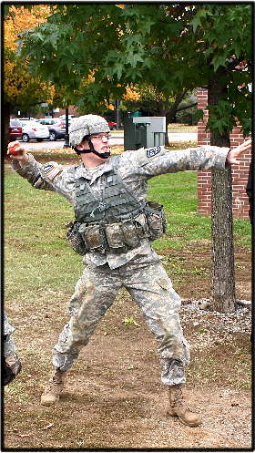

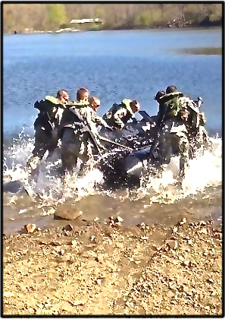
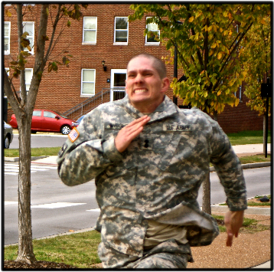
Ranger Challenge

Slide 12
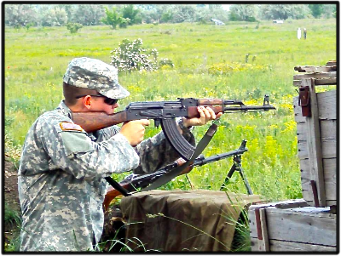
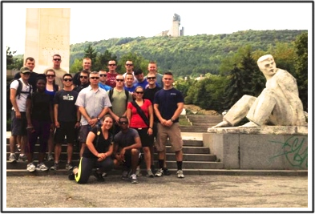
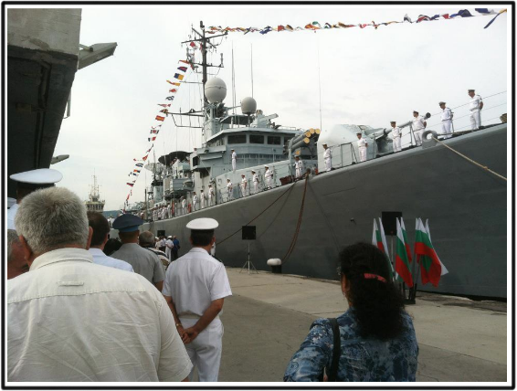
Cultural Understanding
& Language Proficiency Program

Slide 13
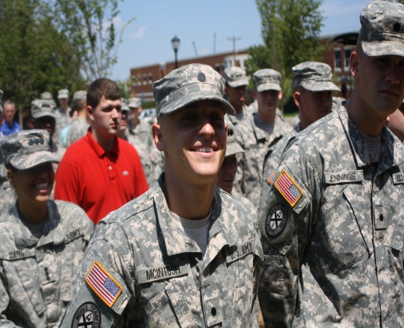
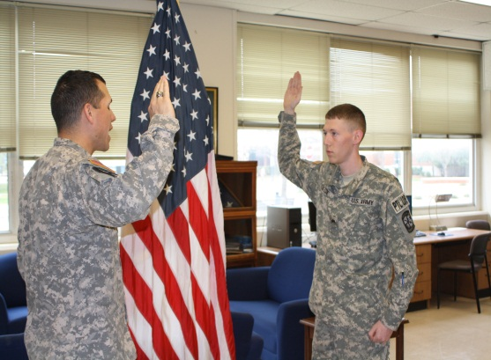
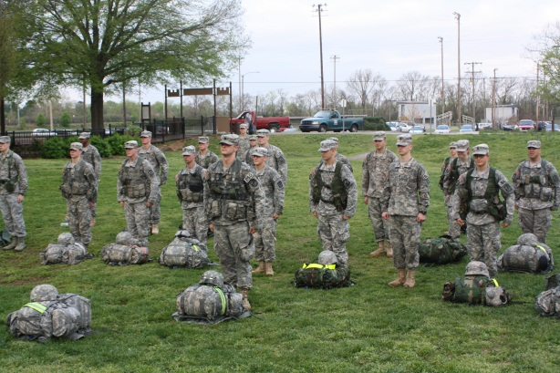
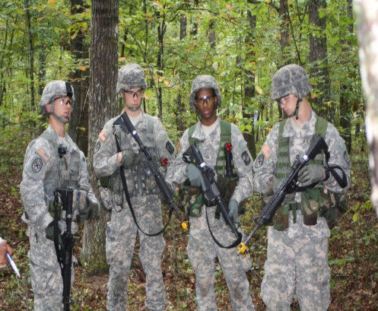
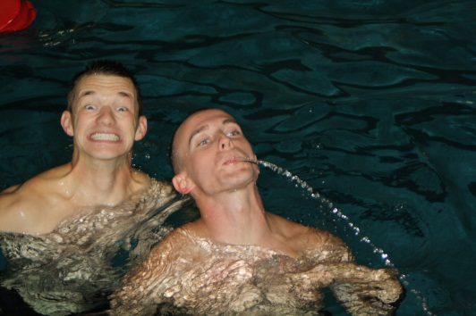
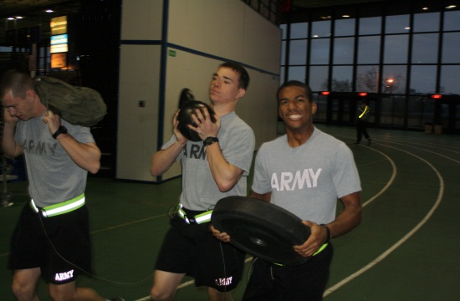
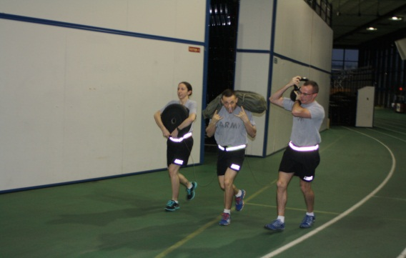
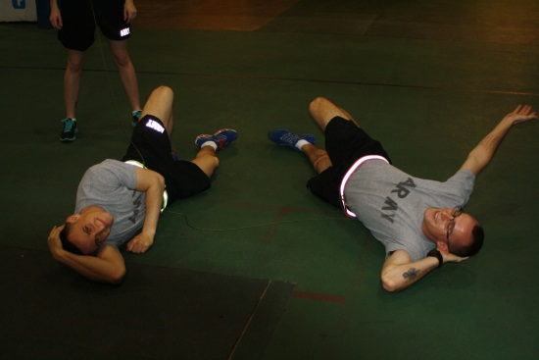
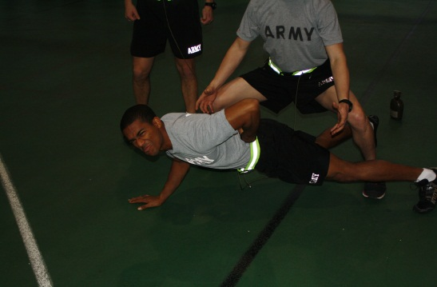
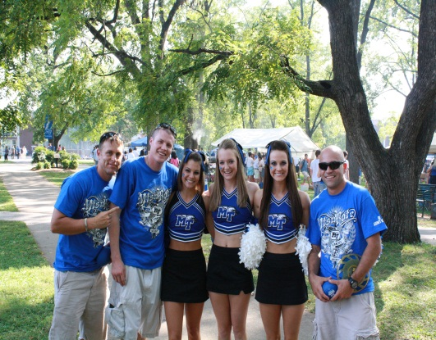
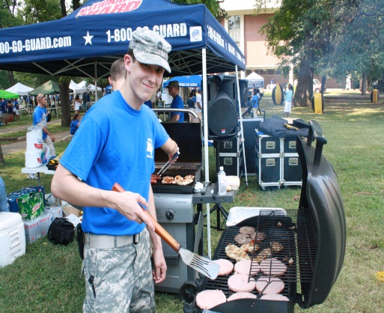
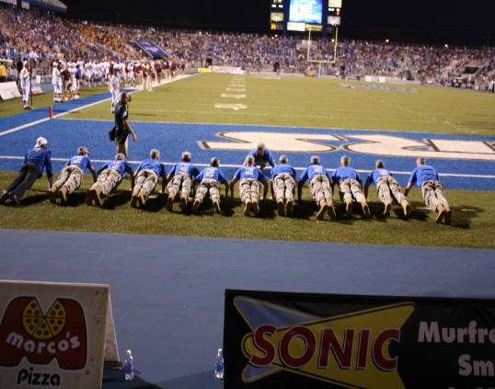
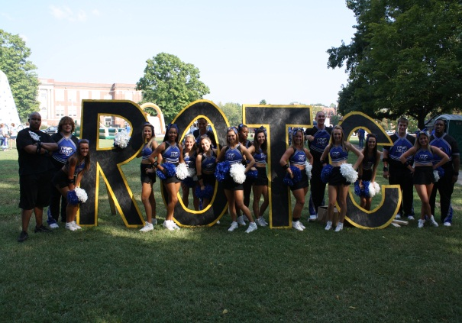
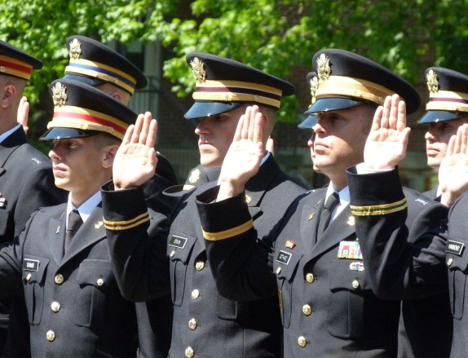
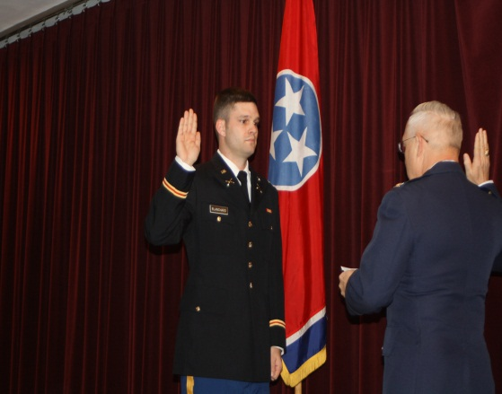
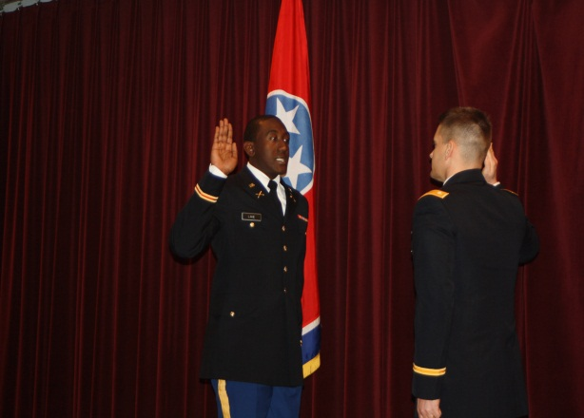


Slide 14
CCF 104-R
Academic Roadmap / Academic Contracting
Typing
Accuracy
Post-Term Periodic Reviews

Slide 15
FY20 OML Model
CG Approval 1 March 2019
Notes:
The Order of Merit List Model is a combination of academics, leadership evaluation by the PMS, and Physical readiness.
Each CG changes the model slightly year to year, but the categories have remained the same.
As you can see from the model academics and leadership outcomes carry the most weight

Slide 16
THE ACADEMIC PATHWAY
MIL SCI Level I
Freshman
MIL SCI Level II
Sophomore
***MS 3080
MIL SCI MIL HISTORY
2 credits
???
BASIC
COURSE
ADVANCED
COURSE
Fall
MS 1010
2 cr
Spring
MS 1020
2 cr
Fall
MS 2010
2cr
Spring
MS 2020
2 cr
Summer
Basic Camp
MIL SCI Level III
Junior
MIL SCI Level IV
Senior
Fall
MS 3110
3 cr
Spring
MS 3120
3 cr
Summer
MS 3130
6 cr
Fall
MS 4110
3 cr
Spring
MS 4120
3 cr
Graduation &
Commissioning!
Advanced Camp
***MS 3080
MIL SCI MIL HISTORY (2 credits)

Slide 17
First Steps?
Enroll in the Freshman level Military Science course
or for the Military Science Physical Training (PT) Class:
MS 1010 – 1st Year Basic Military Science, 2 credits, TR
Two sections: 001: 1:00 pm – 2:25 pm (CRN: 80676)
002: 2:20 pm – 4:05 pm (CRN: 80677)
MS 1000, MS Practicum/PT Class, MW, (CRN: 80675),1 credit

Slide 18
How to Get Started?
WE’RE ALL LOCATED IN FORREST HALL!
Mr. John Bautch – MTSU Army ROTC Recruiting
john.bautch@mtsu.edu
(615) 898-5702
SFC Geno Gardner – USAREC/USAR Recruiting
geno.l.gardner.mil@mail.mil
(615) 294-8826
SSG Deantre Trotter – TNARNG Recruiting
deantre.l.trotter.mil@mail.mil
(615) 4557-4257

Slide 19
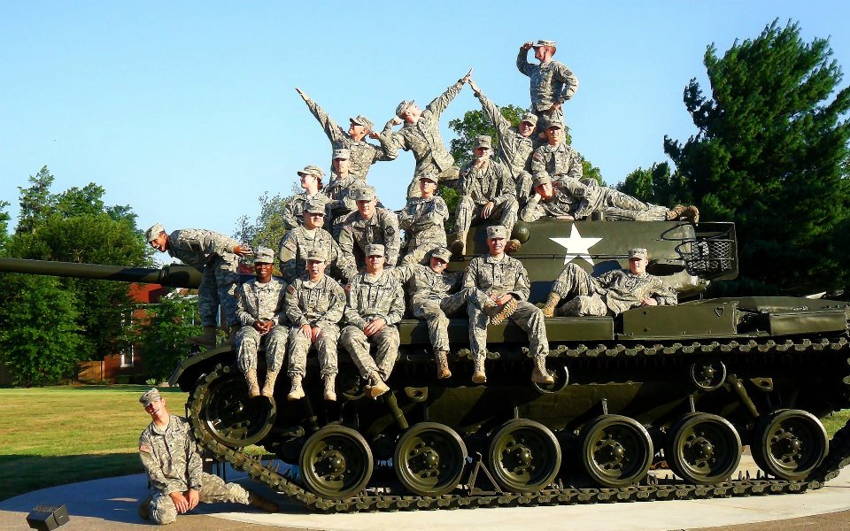
Questions?
QUESTIONS?

