Slide 1
HR Budget Training
Budget Office

Slide 2
Budget Office HR Forms List
NBAPOSN- Position Definition- Indicates the position title, employee class, salary grade, and position they report to
NBAPBUD Position Budget – Indicates if a position is single or pool/group position, budget for the position, and the index(es) where the salary and benefits will be expensed
NBIPINC- Position Incumbent List - List the employees that have been in the position based on the query date, status active or terminated
NBIPORG Position List by Organization -List of all positions tied to the specific org code, may include multiple indexes
NHIDIST Labor Distribution Data Inquiry – Reports all the encumbrances, expenditures based on the criteria entered
NHIEDST Employee Distribution Inquiry Reports all the expenditures for an employee based on the date selected

Slide 3
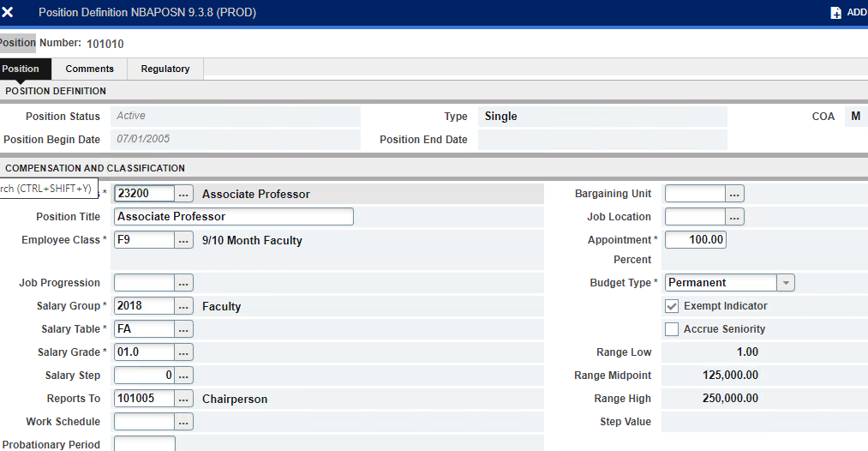
Budget Office HR Forms NBAPOSN
Indicates position title, e-class, who the position reports to
Indicates full time or part time

Slide 4
Budget Office HR Forms- NBAPBUD
Enter position number and fiscal year
Active position
Indicates single or group position
Grant positions have end dates

Slide 5
Budget Office HR Forms NBAPBUD
Index number where salary and benefits will be charged

Slide 6
Budget Office HR Forms NBIPORG
Single position
Group/pooled position

Slide 7
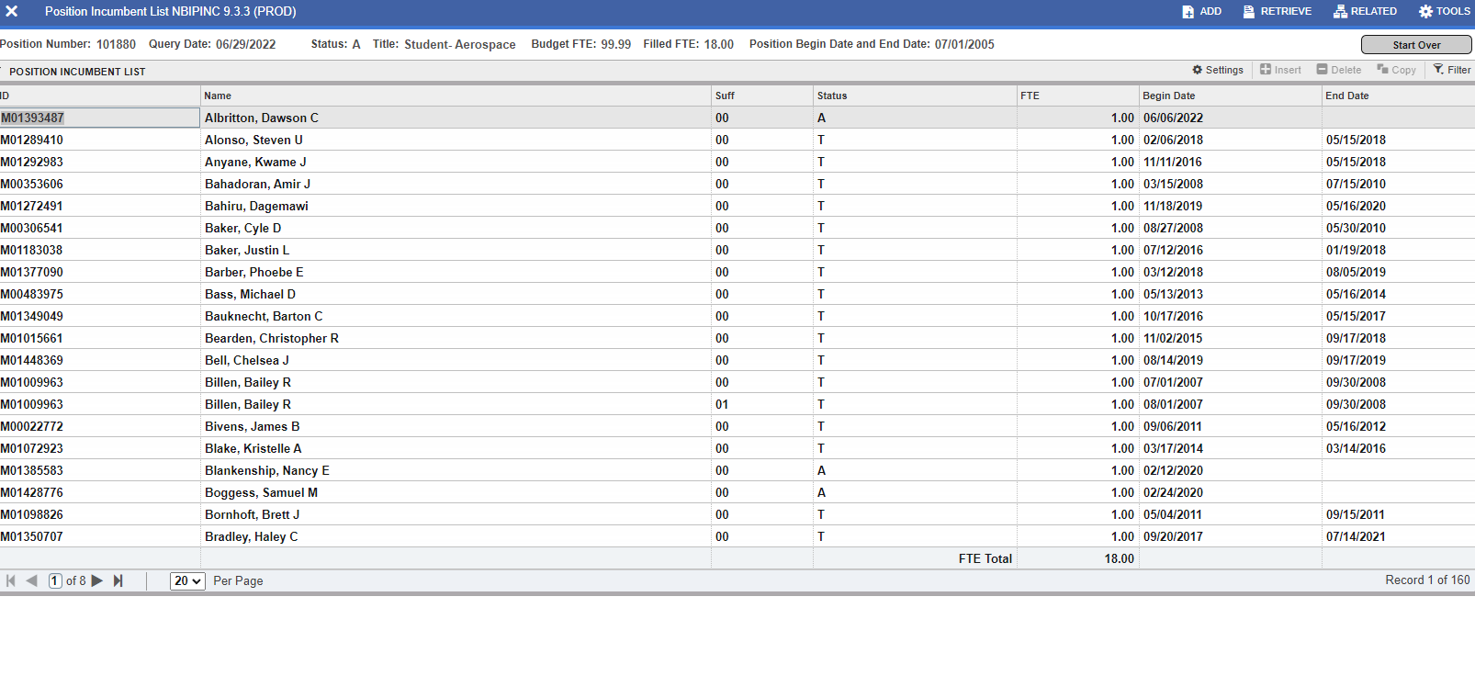
Budget Office HR Forms NBIPINC
Active
Terminated
NBIPINC lists the individuals that have been in position as of the query date. Reports the begin date and the end date for the position if an end date has been established

Slide 8
Budget Office HR Forms NHIDIST
Enter index number
To narrow search enter a specific account code ex. 61210, 61610, 61310, etc
Enter beginning date MM/DD/YYYY
Drop down box select “Expenses”
If you don’t enter a beginning date or ending date you may receive a large amount of data. In order to see the payroll for a month, example June, be sure to enter 06/01/2022 “From Date” field and 06/30/2022 in the “To Date” field to see June’s payroll expenditures

Slide 9
Budget Office HR Forms NHIEDST
Must enter From Date and To Date before going down into the form. The form will show all salary and benefits for the time period selected
This form will show all earnings for the employee, summer school, extra comp, overtime etc. during the time period entered

Slide 10
Budget Office HR Forms NBIEDST
Do you have any questions?
Jennifer Coppinger
Director Budget and Financial Planning
(615)898-5377
or
Susan England
Assistant Director Budget and Financial Planning
(615)898-5791

