Slide 1
Safe Sleep Prevention Activities May 13 , 2021

Slide 2
Safe Sleep Diaper Bag Project- UPDATE
Diaper Bag
2-sided Door Hanger
Sleep Baby Safe and Snug Book
Calm Baby Gently Book
TWO Infant Sleep Sack
Infant Onesie

Slide 3
Expanding the Diaper Bag Project
All 95 counties for CHANT
All 95 Counties for expanded evidence- based home visiting
Sustaining through the next year
Submitted abstract to City MatCH
Continuing to collect data to learn about education and family’s safe sleep behaviors

Slide 4
BEST for Babies-Birthing Facility Award
Breastfeeding
Early Elective Delivery
Safe sleep
for Tennessee Babies
14 Facilities Awarded in 2020
Continuing award for 2021!

Slide 5
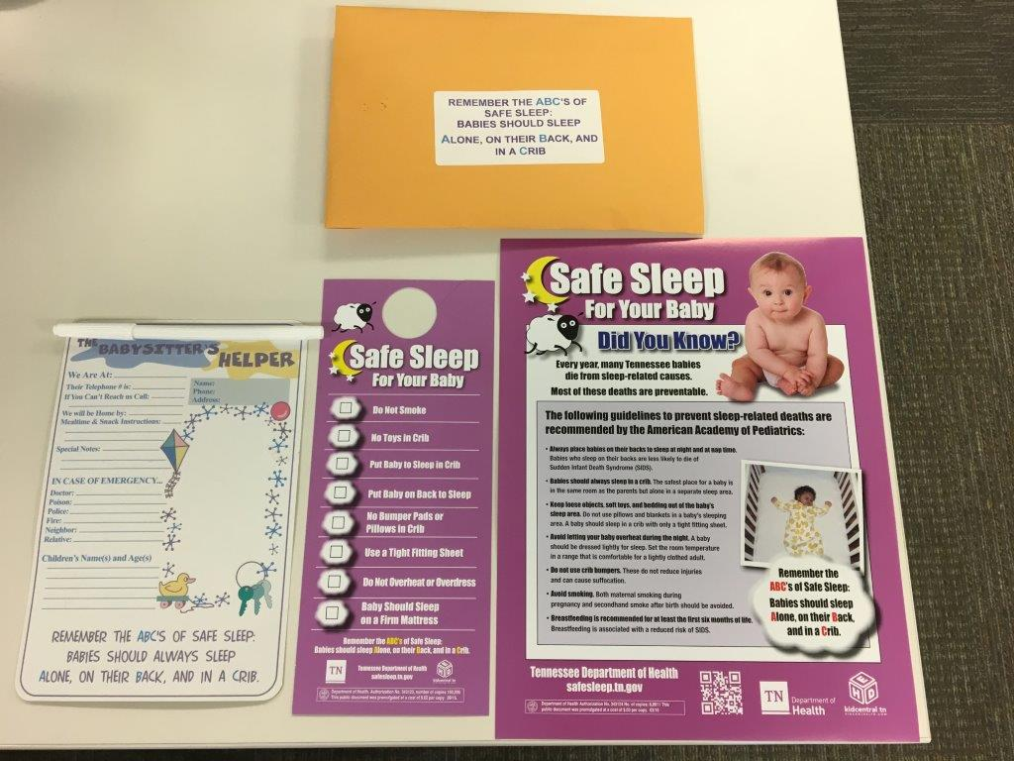
DOSE- First Responders
Educates maintenance staff and first responders to recognize an unsafe sleep environment
Provides resources to residents and assists in obtaining a safe sleep environment

Slide 6
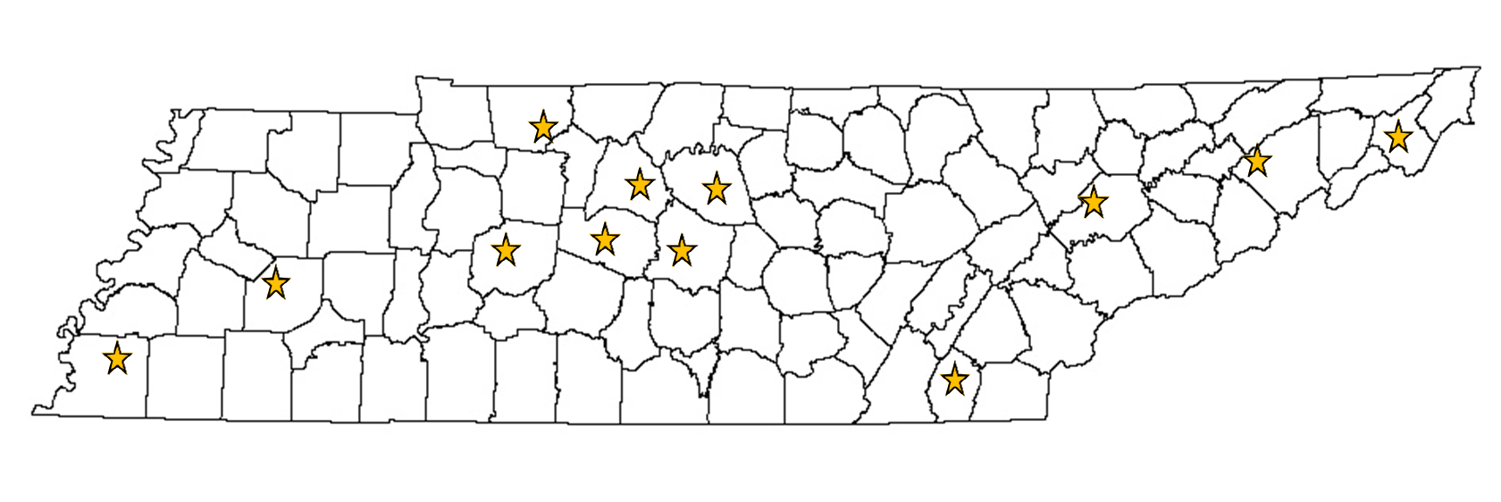
DOSE Locations

Slide 7
Housing authorities and safe sleep
Train maintenance staff and office staff on infant safe sleep
Provide education and resources to families with infants
Provide a portable crib either directly through the housing authority or local health department

Slide 8
WIC Educational Module
Safe Sleep and Breastfeeding
Utilizes the stages of change to assess and provide appropriate education to the learner
Combines messages of safe sleep and the importance of breastfeeding, and how a parent can do both
Available at WIC online nutrition education at www.wichealth.org

Slide 9
Addressing other caregivers
Providing education to intergenerational caregivers on safe sleep to influence how infant sleep is talked about in the home.

Slide 10
CFR Recommendation
Analyze data to determine areas with the largest disparities to specifically target efforts such as the safe sleep diaper bag project, hospital project, safe sleep education to intergenerational caregivers, faith communities, and general distribution of safe sleep materials.

Slide 11
Questions
Type in the chat box:
What are some ways you can support the activities described today?
What community partners are you already working with to provide safe sleep education?
What additional unique partners can you collaborate with for infant safe sleep?

Slide 12
Thank you
If you are interested in any of our safe sleep materials or building partnerships please contact:
April Kincaid
april.kincaid@tn.gov

