Slide 1
Student Handbook Program Governance Sigma Theta Tau International

Slide 2
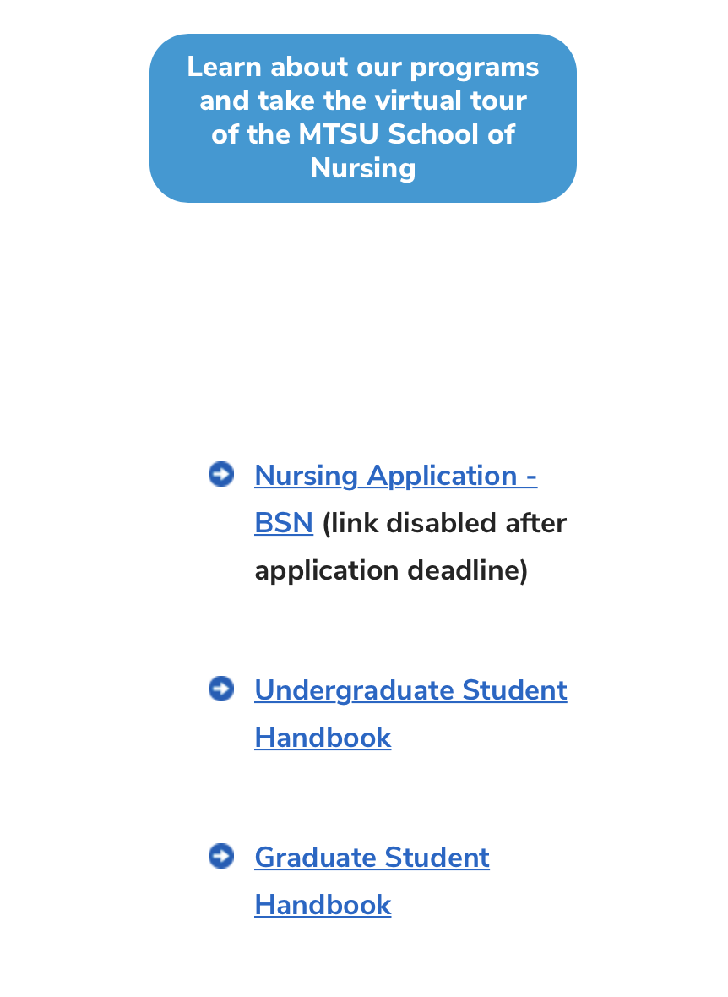
Student Handbook
www.mtsu.edu/nursing
Outlines admission/progression
Professional standards and behaviors
Do’s and Don’ts of the program
Grades, Graduation and timelines
Registration and advising suggestions

Slide 3
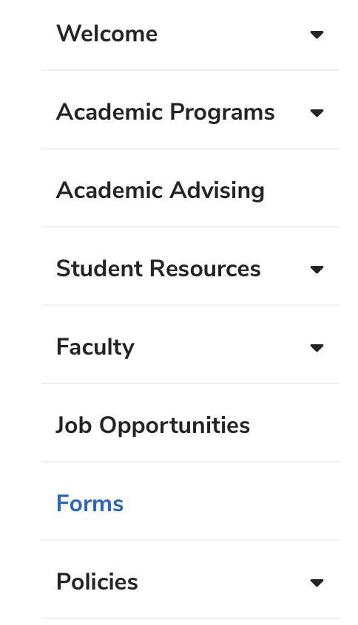
MSN Forms
www.mtsu.edu/nursing
All forms needed for MSN program
Health and Medatrax forms
Preceptor Request forms
Background and drug screen
MSN in all form names used in program

Slide 4
Program Governance
SON seeks your participation in program governance.
Opportunities exist on
Student Success Committee
Curriculum
Please email Dr. Meeks if interested
Richard.meeks@mtsu.edu

Slide 5
Sigma Theta Tau International
Your honor society for Nursing!
Local chapter- Xi Alpha
Professional & Service Activities
Added addition to your resume

Slide 6
Student Handbook Program Governance Sigma Theta Tau International

