Slide 1
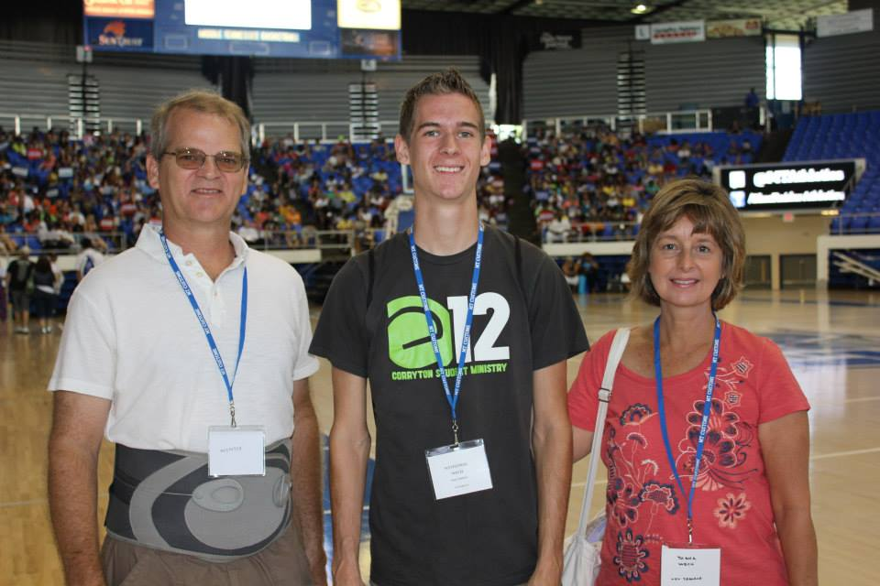
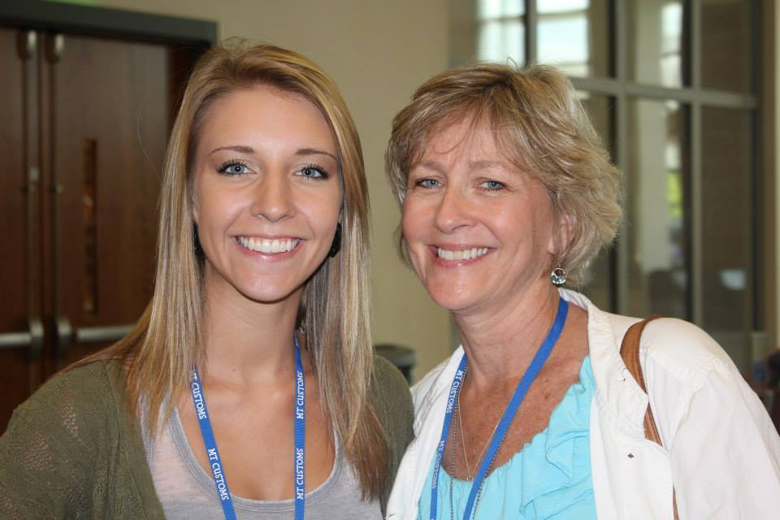
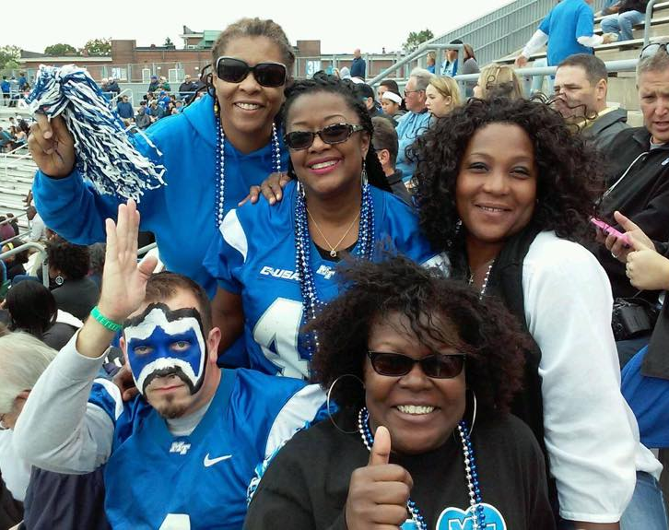
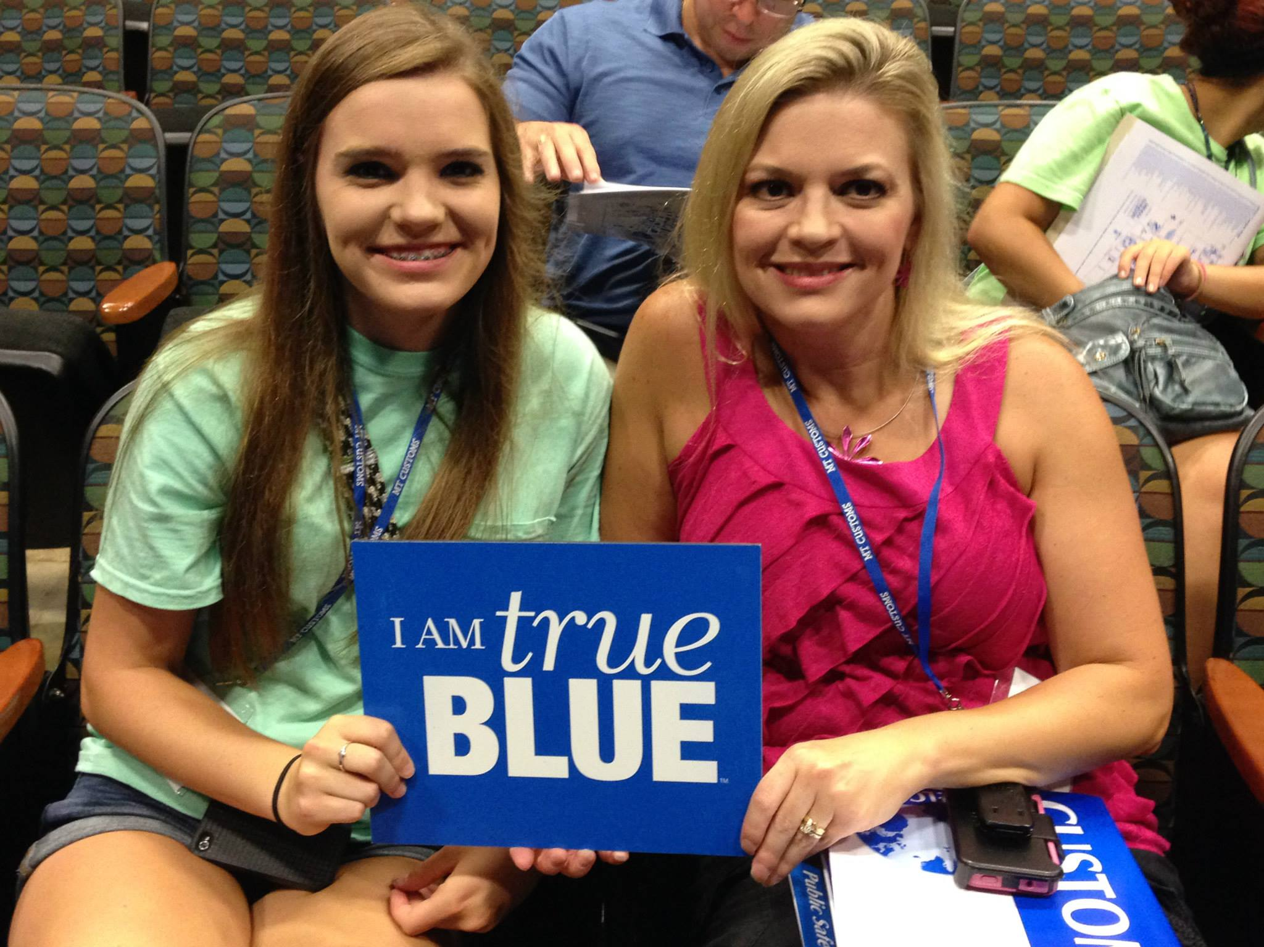
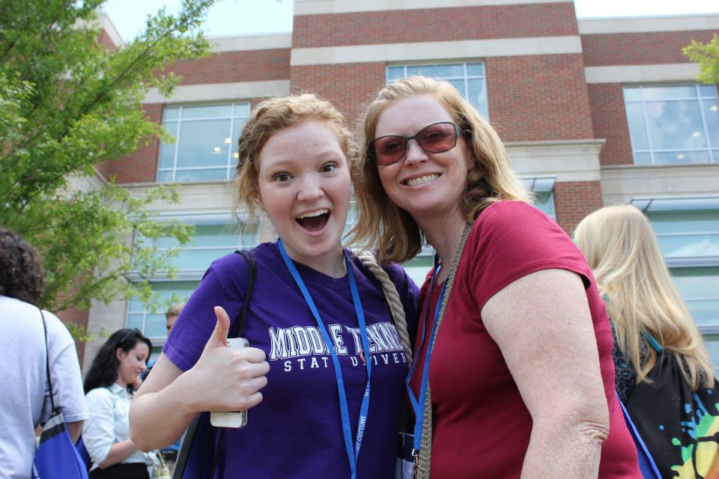
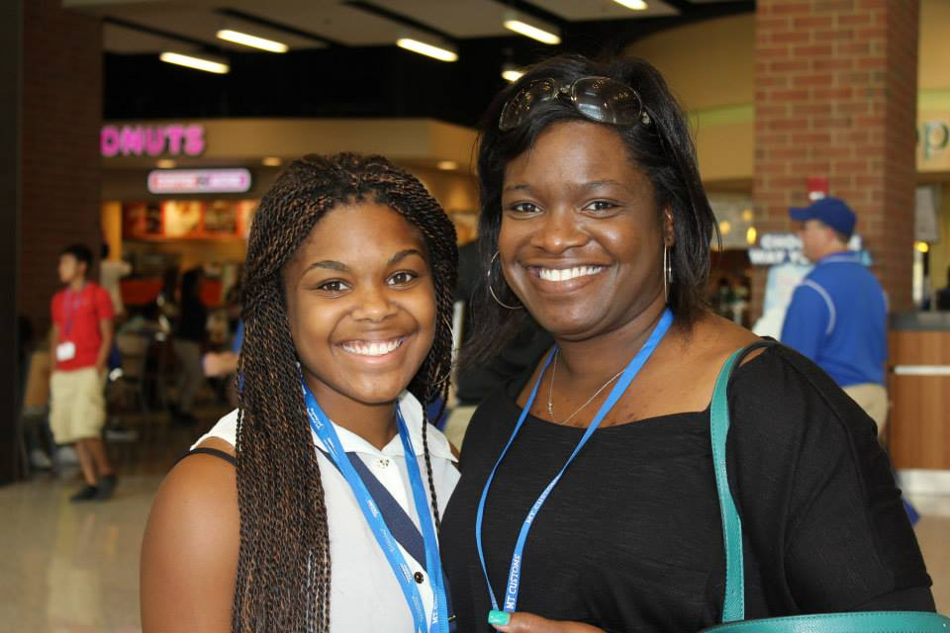
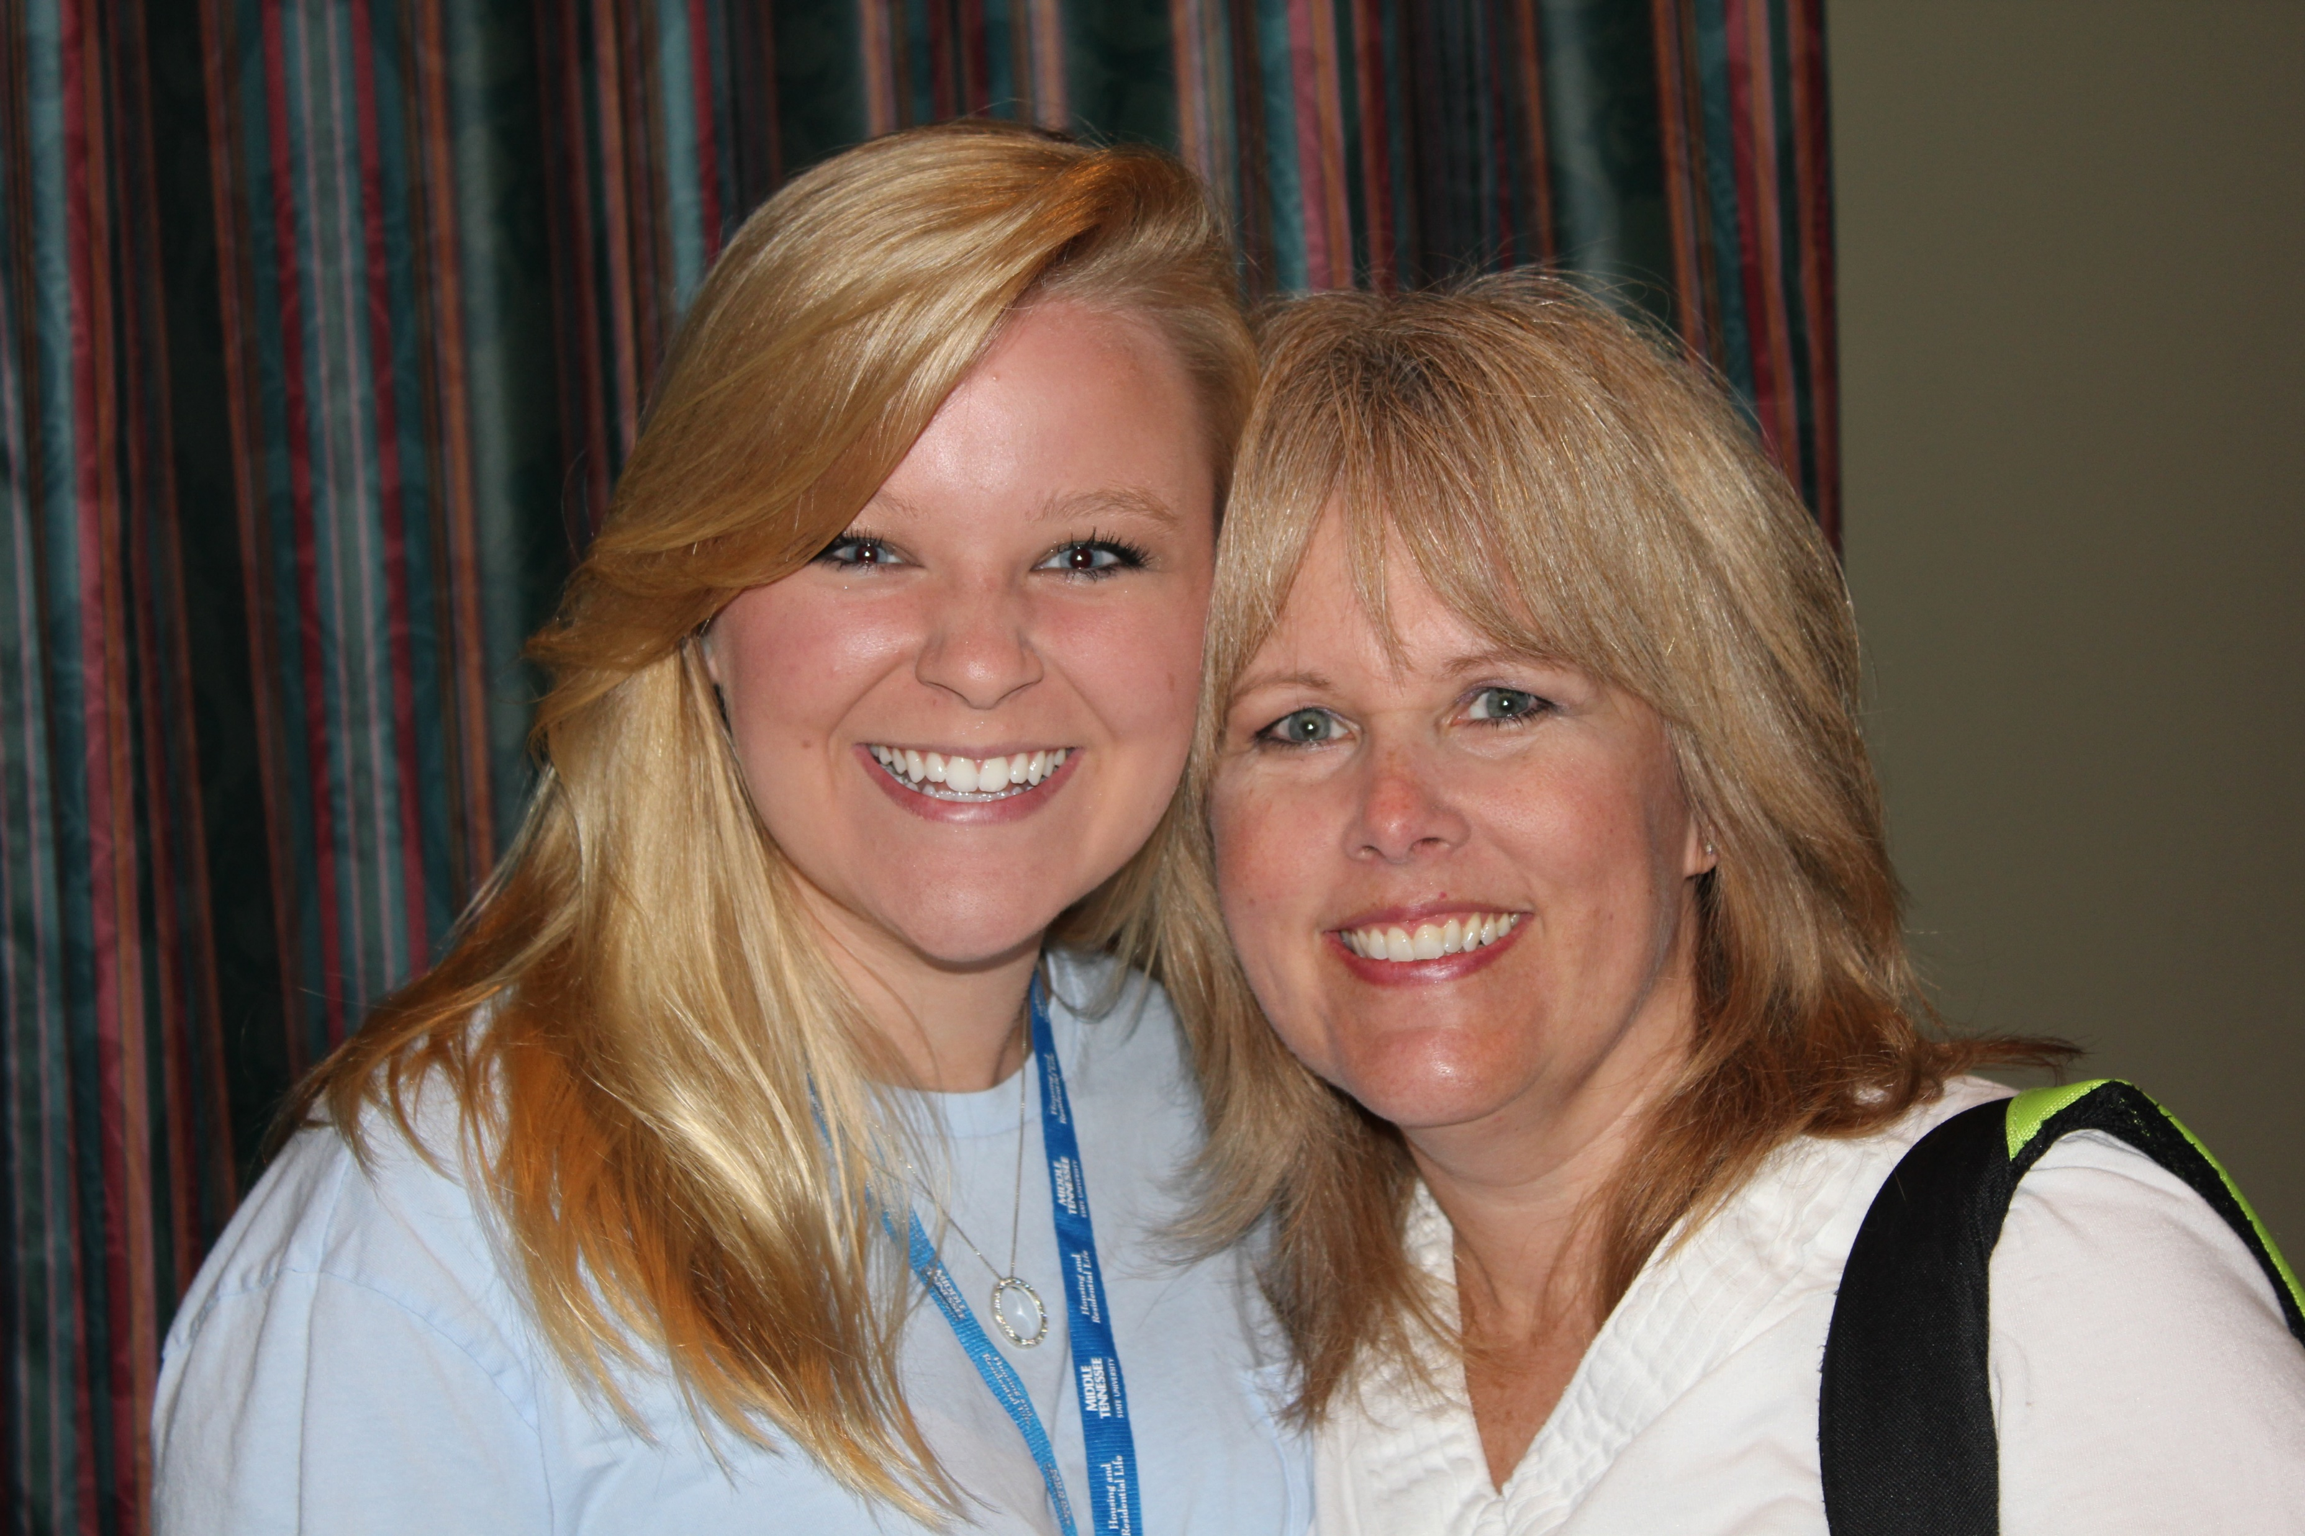
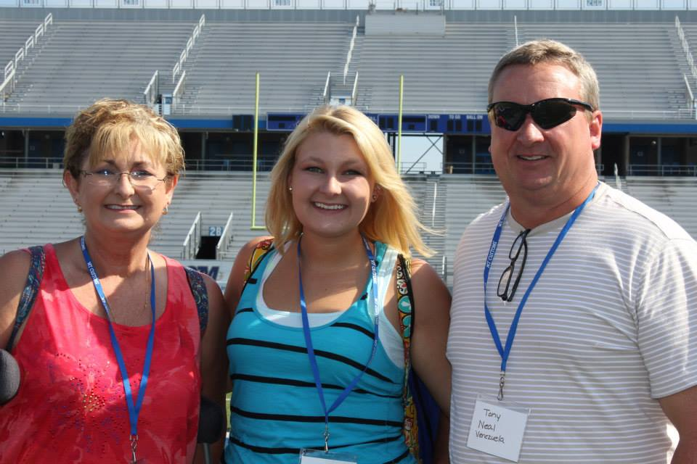
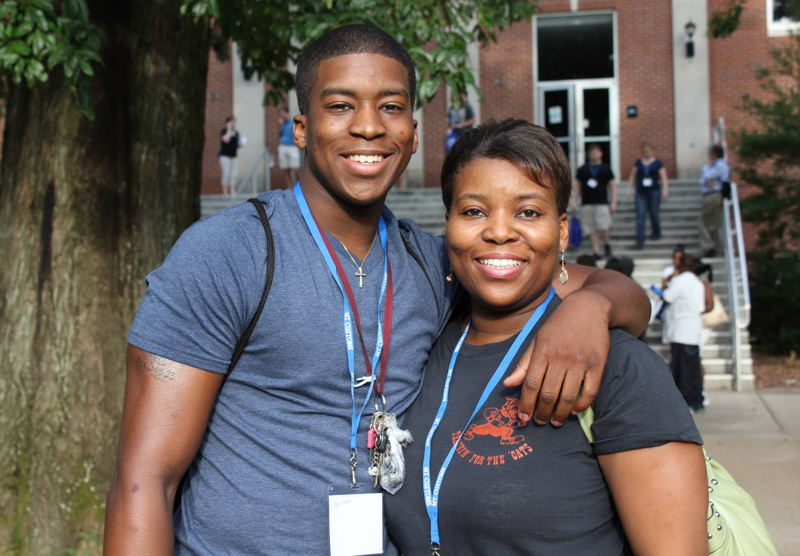
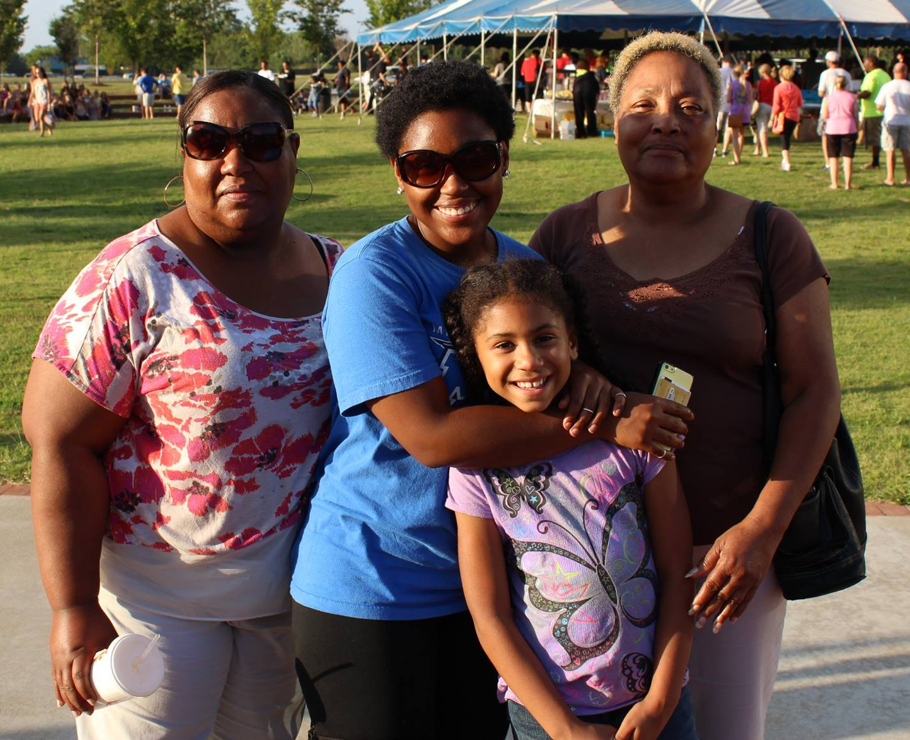
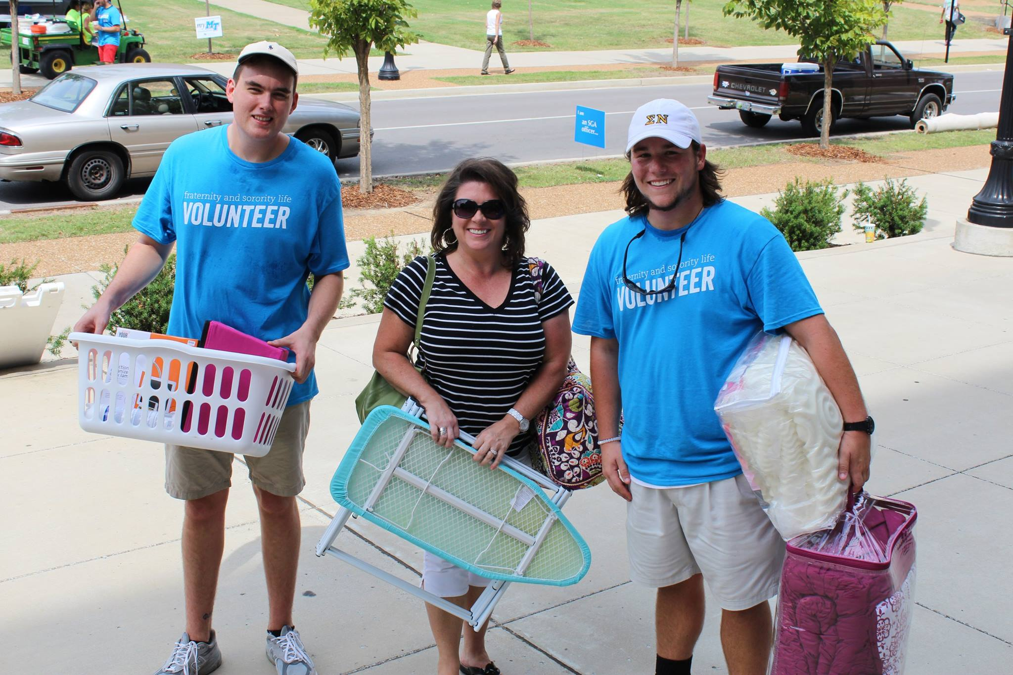
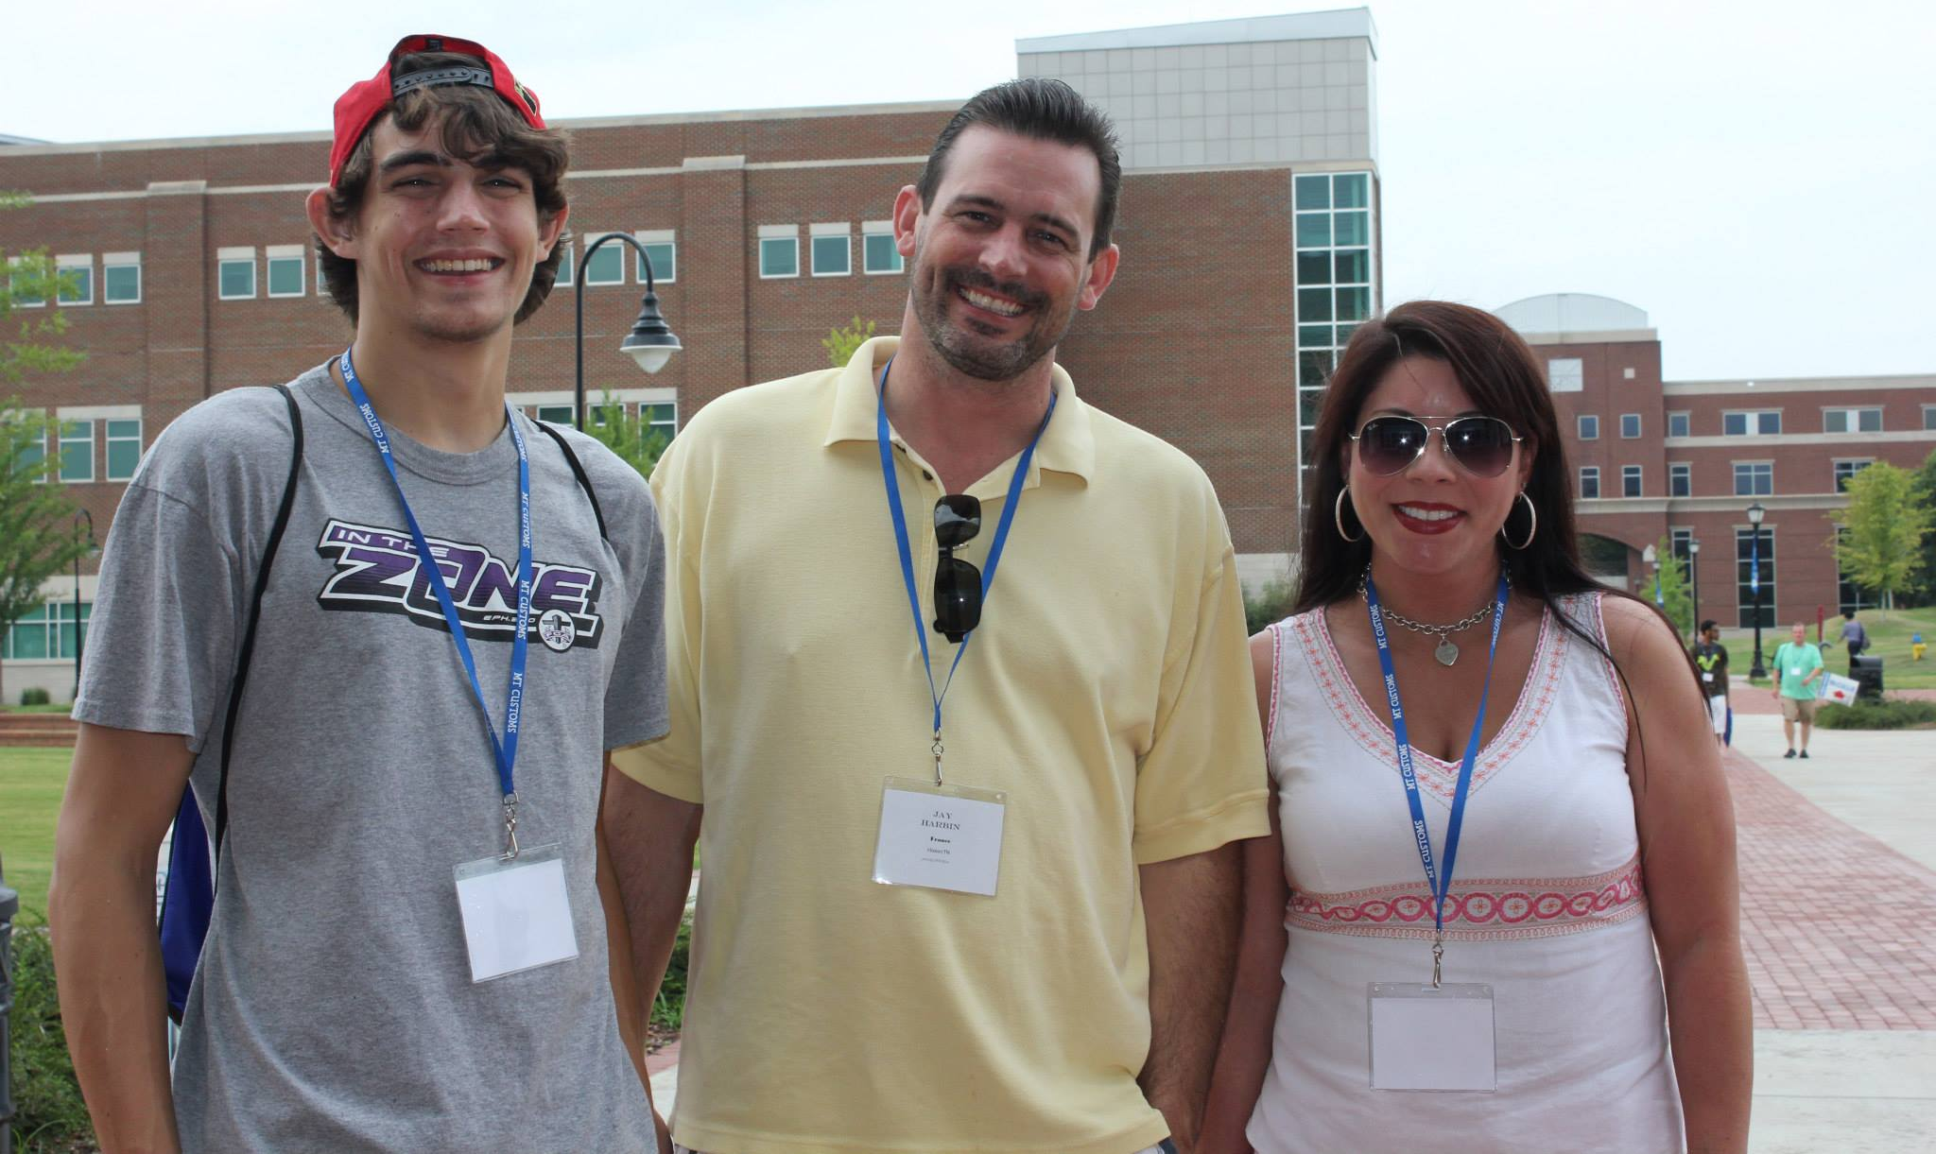
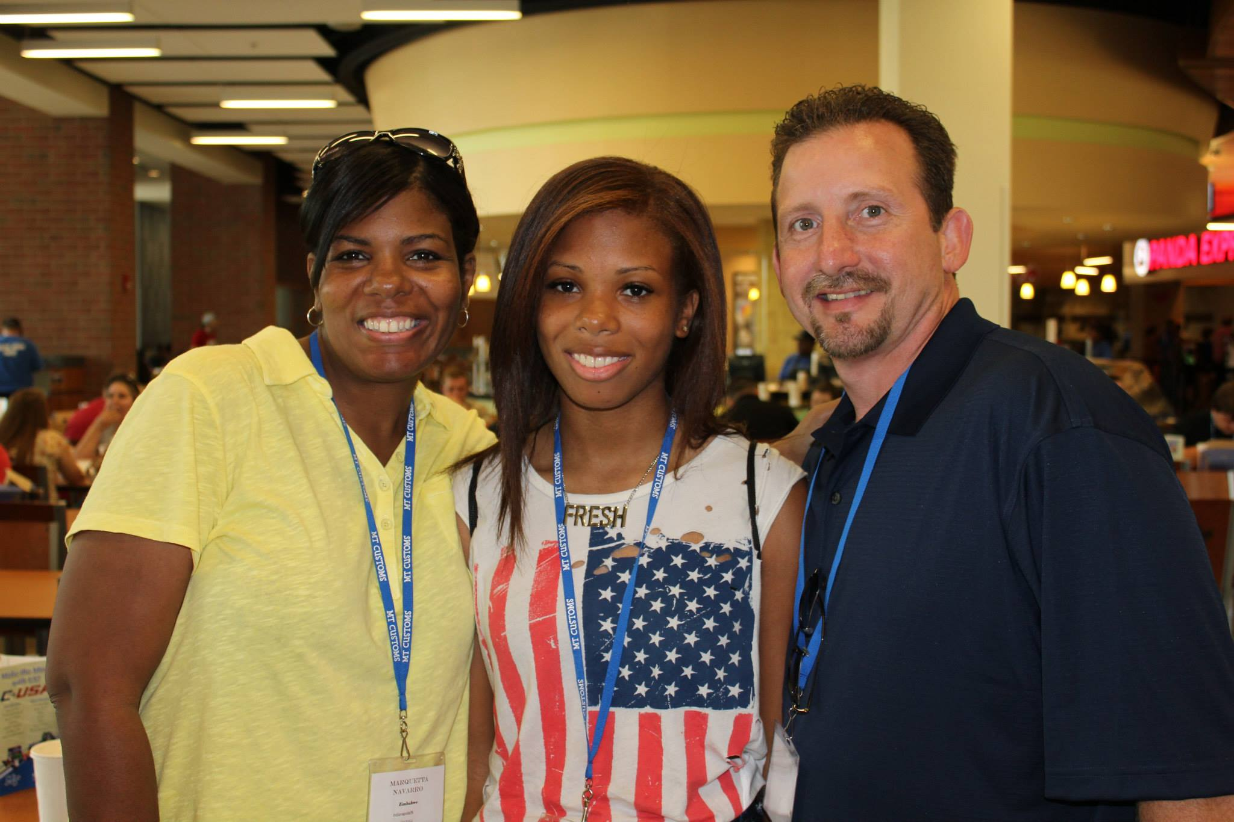
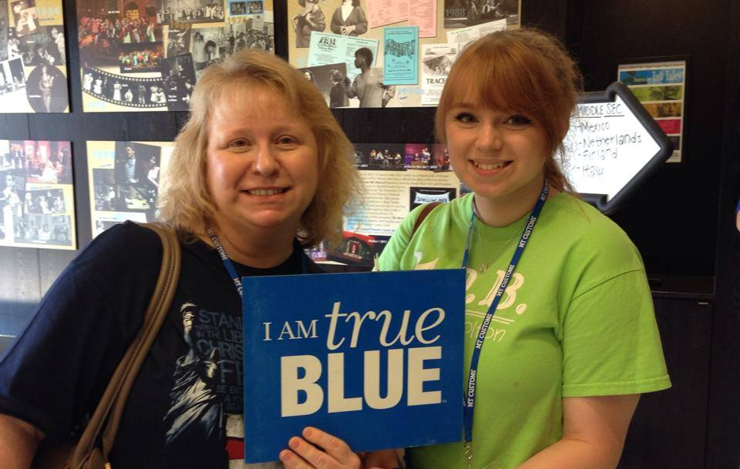
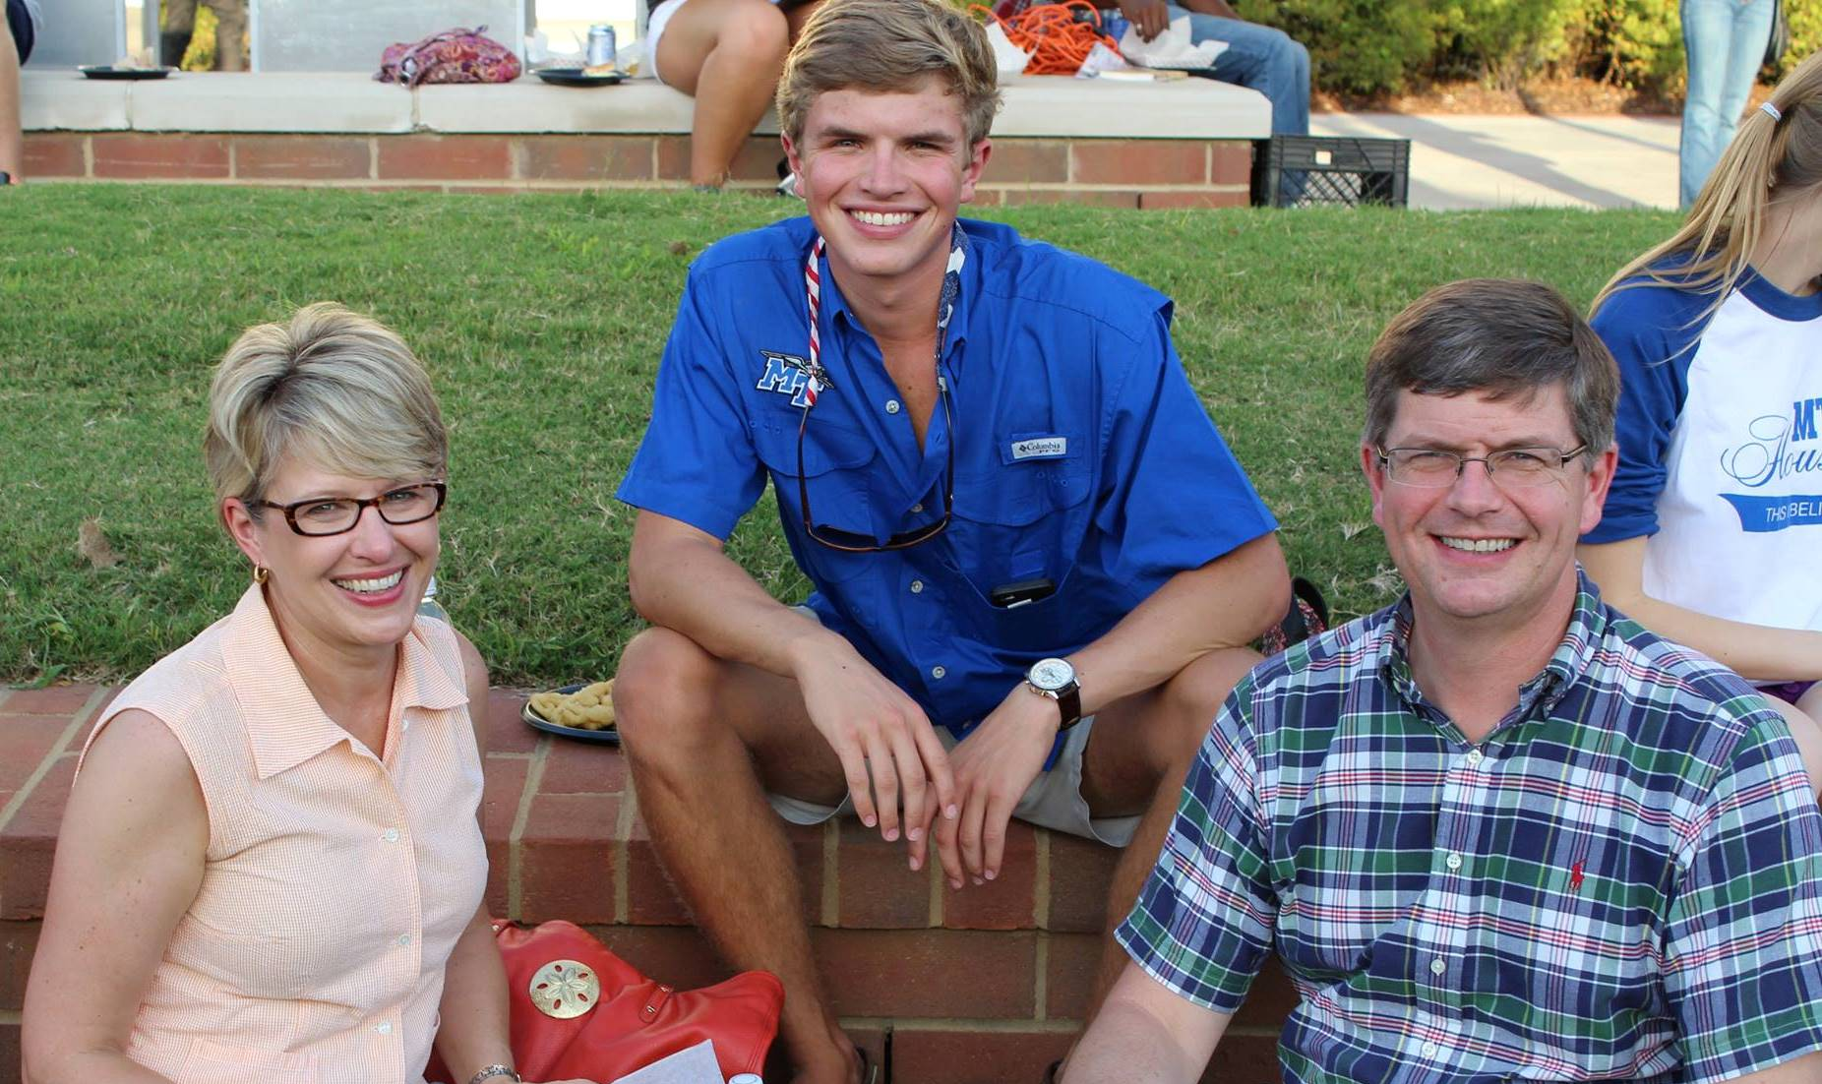
Welcome to the MTSU Family!

Slide 2
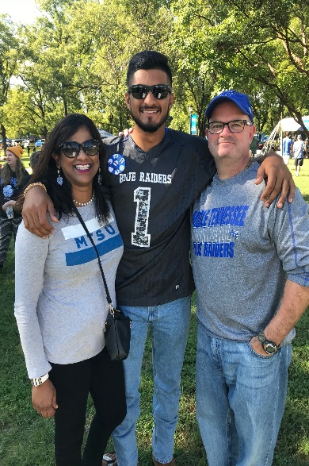
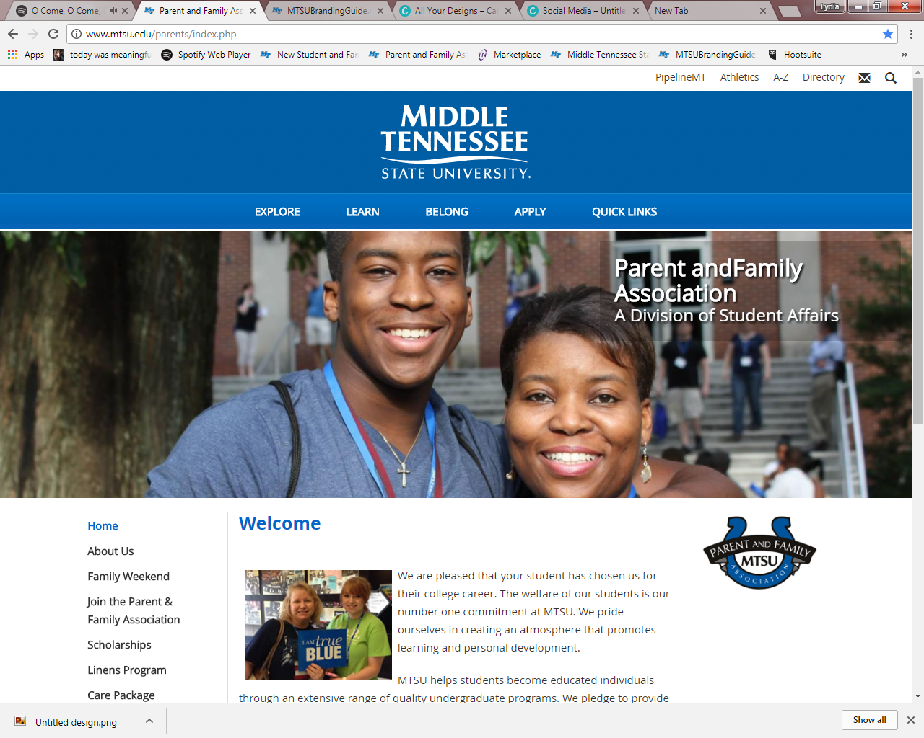
Why should I join the MTSU Parent &
Family Association (PFA)?
We want to support the families of our students by:
Sharing information
Serving as a point-of-contact
Offering memorable experiences through our events (such as Fall Family Weekend, Nov. 7-8)
Networking with other families
Notes:
Information via monthly e-newsletter, Facebook group, etc.

Slide 3
PFA Membership Options
Annual Membership ($30/year)
Lifetime Membership ($60 total)

Slide 4
Annual Membership Benefits
Annual Membership MUST be renewed each year to stay a member of the association- $30
Welcome Kit (receive at Orientation or mailed to you)
Receive 10 eNewsletters – directly to your inbox (August-May)
Scholarship Opportunities
Notes:
Scholarships are available now (www.mtsu.edu/parents) and are due August 4 by 4pm.

Slide 5
Lifetime Membership Benefits
One time fee of $60 – membership valid for length that ANY of your students is enrolled at MTSU
Welcome Kit (receive at Orientation or mailed to you)
Proud PFA t-shirt – can purchase one additional for $5
Receive 10 eNewsletters – directly to your inbox(August-May)
Scholarship Opportunities

Slide 6
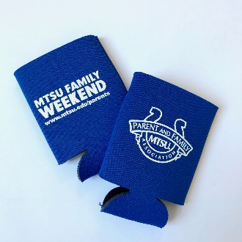
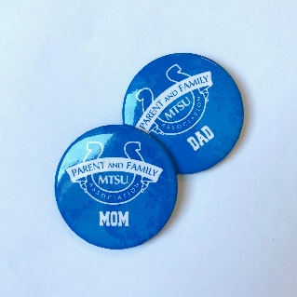
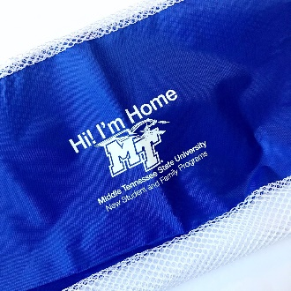
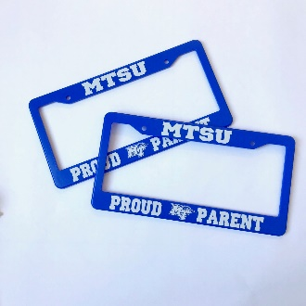
What’s included in the Welcome Kit?
Koozies
T-shirt for Lifetime Membership only
Handheld Fan
Buttons
Notebook
& Ink Pen
Laundry
Bag
Resource Magnet
License Plate Frames
Proud PFA t-shirt
PFA Clear Stadium Tote
Notes:
Welcome Kit
Click- 2 Koozies, Laundry Bag (Hi! I’m Home), 2 License Plate Frames
Click- sanitizer, 2 Coffee Mugs, Parent Calendar
Click- Mom& Dad, 2 Ink Pens, PFA Bag

Slide 7
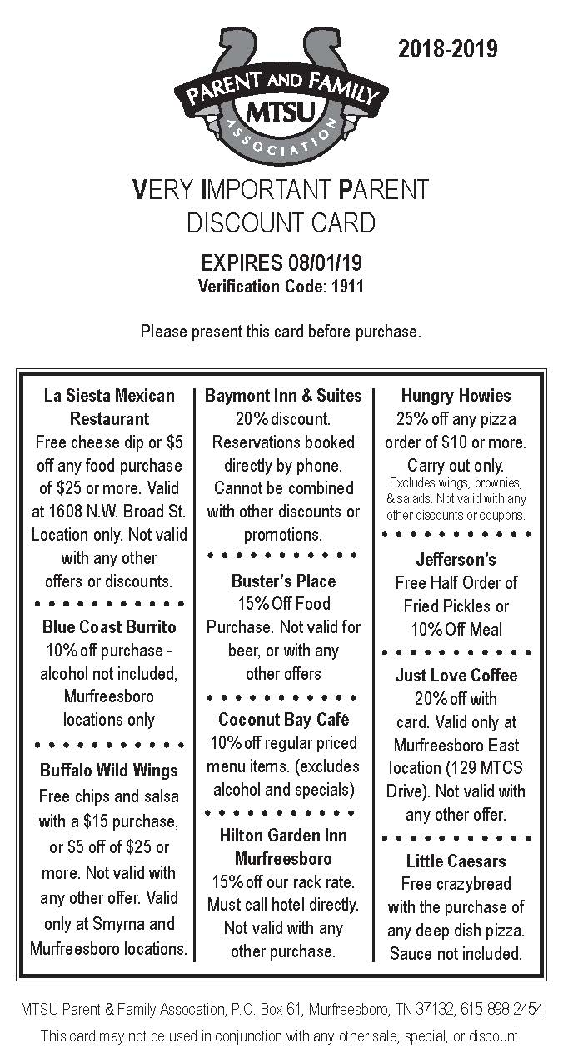
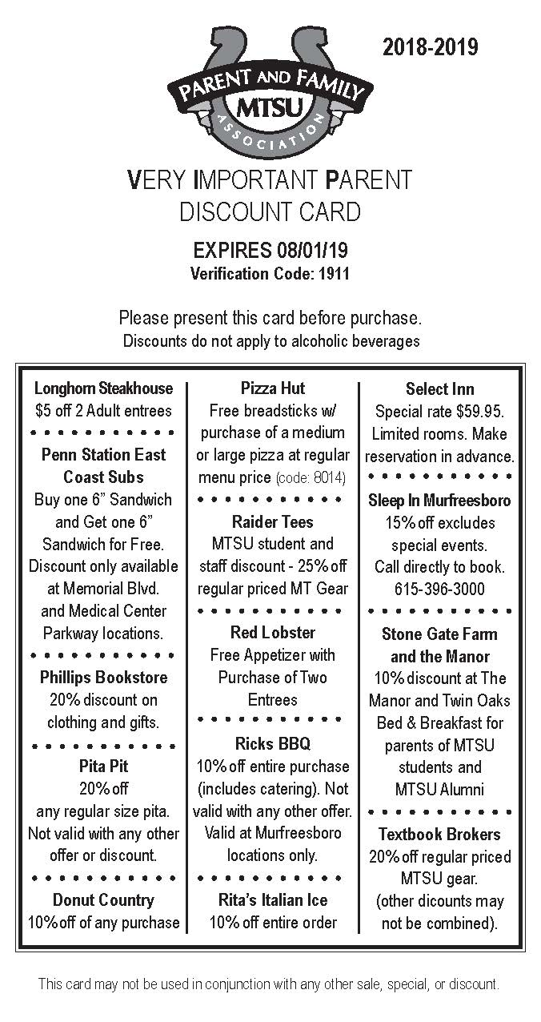
Very Important Parent (VIP)
Discount Card
Includes discounts to local restaurants, bookstores, and businesses in the Murfreesboro area

Slide 8
VIP Discount Card

Slide 9
Scholarships
ONLY available to students of PFA Members to apply
4-6 Book Scholarships - new students: $250 book scholarships given every year
2 Returning Student Scholarships: $1000 scholarship(s) awarded every year to a returning student
Applications are available in the Summer.
Scholarships will be awarded in August.

Slide 10
How do we use your membership fees?
To support and provide programming/opportunities FREE to students
Notes:
What do we do with the money?
-RAK: cookies, lemonade, brownies, etc. during finals week
-Scholarships
-MT After Dark Events
-Thanksgiving Dinner

Slide 11
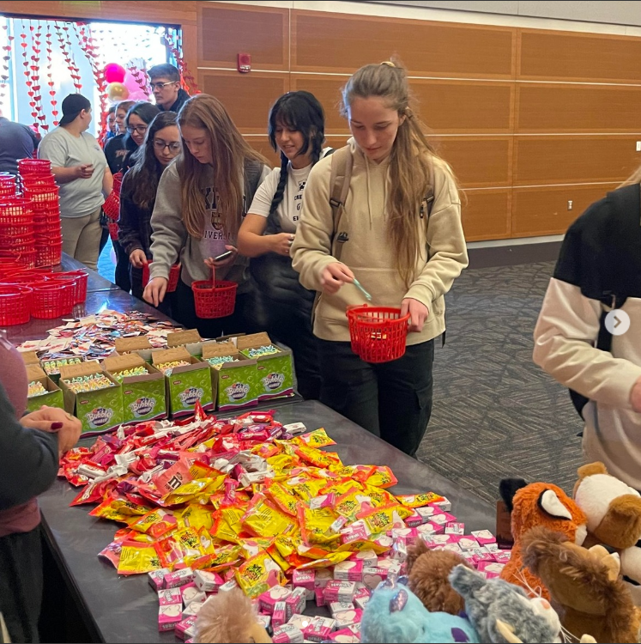
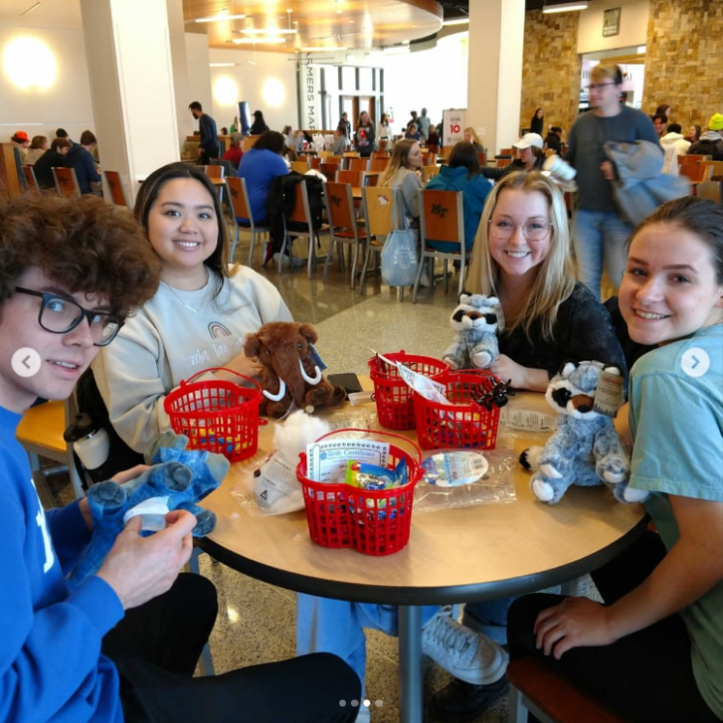
Events
Co-sponsor events with S.P.A.R.E.
(Student Programming and Raider Entertainment)
Valentine’s Day

Slide 12
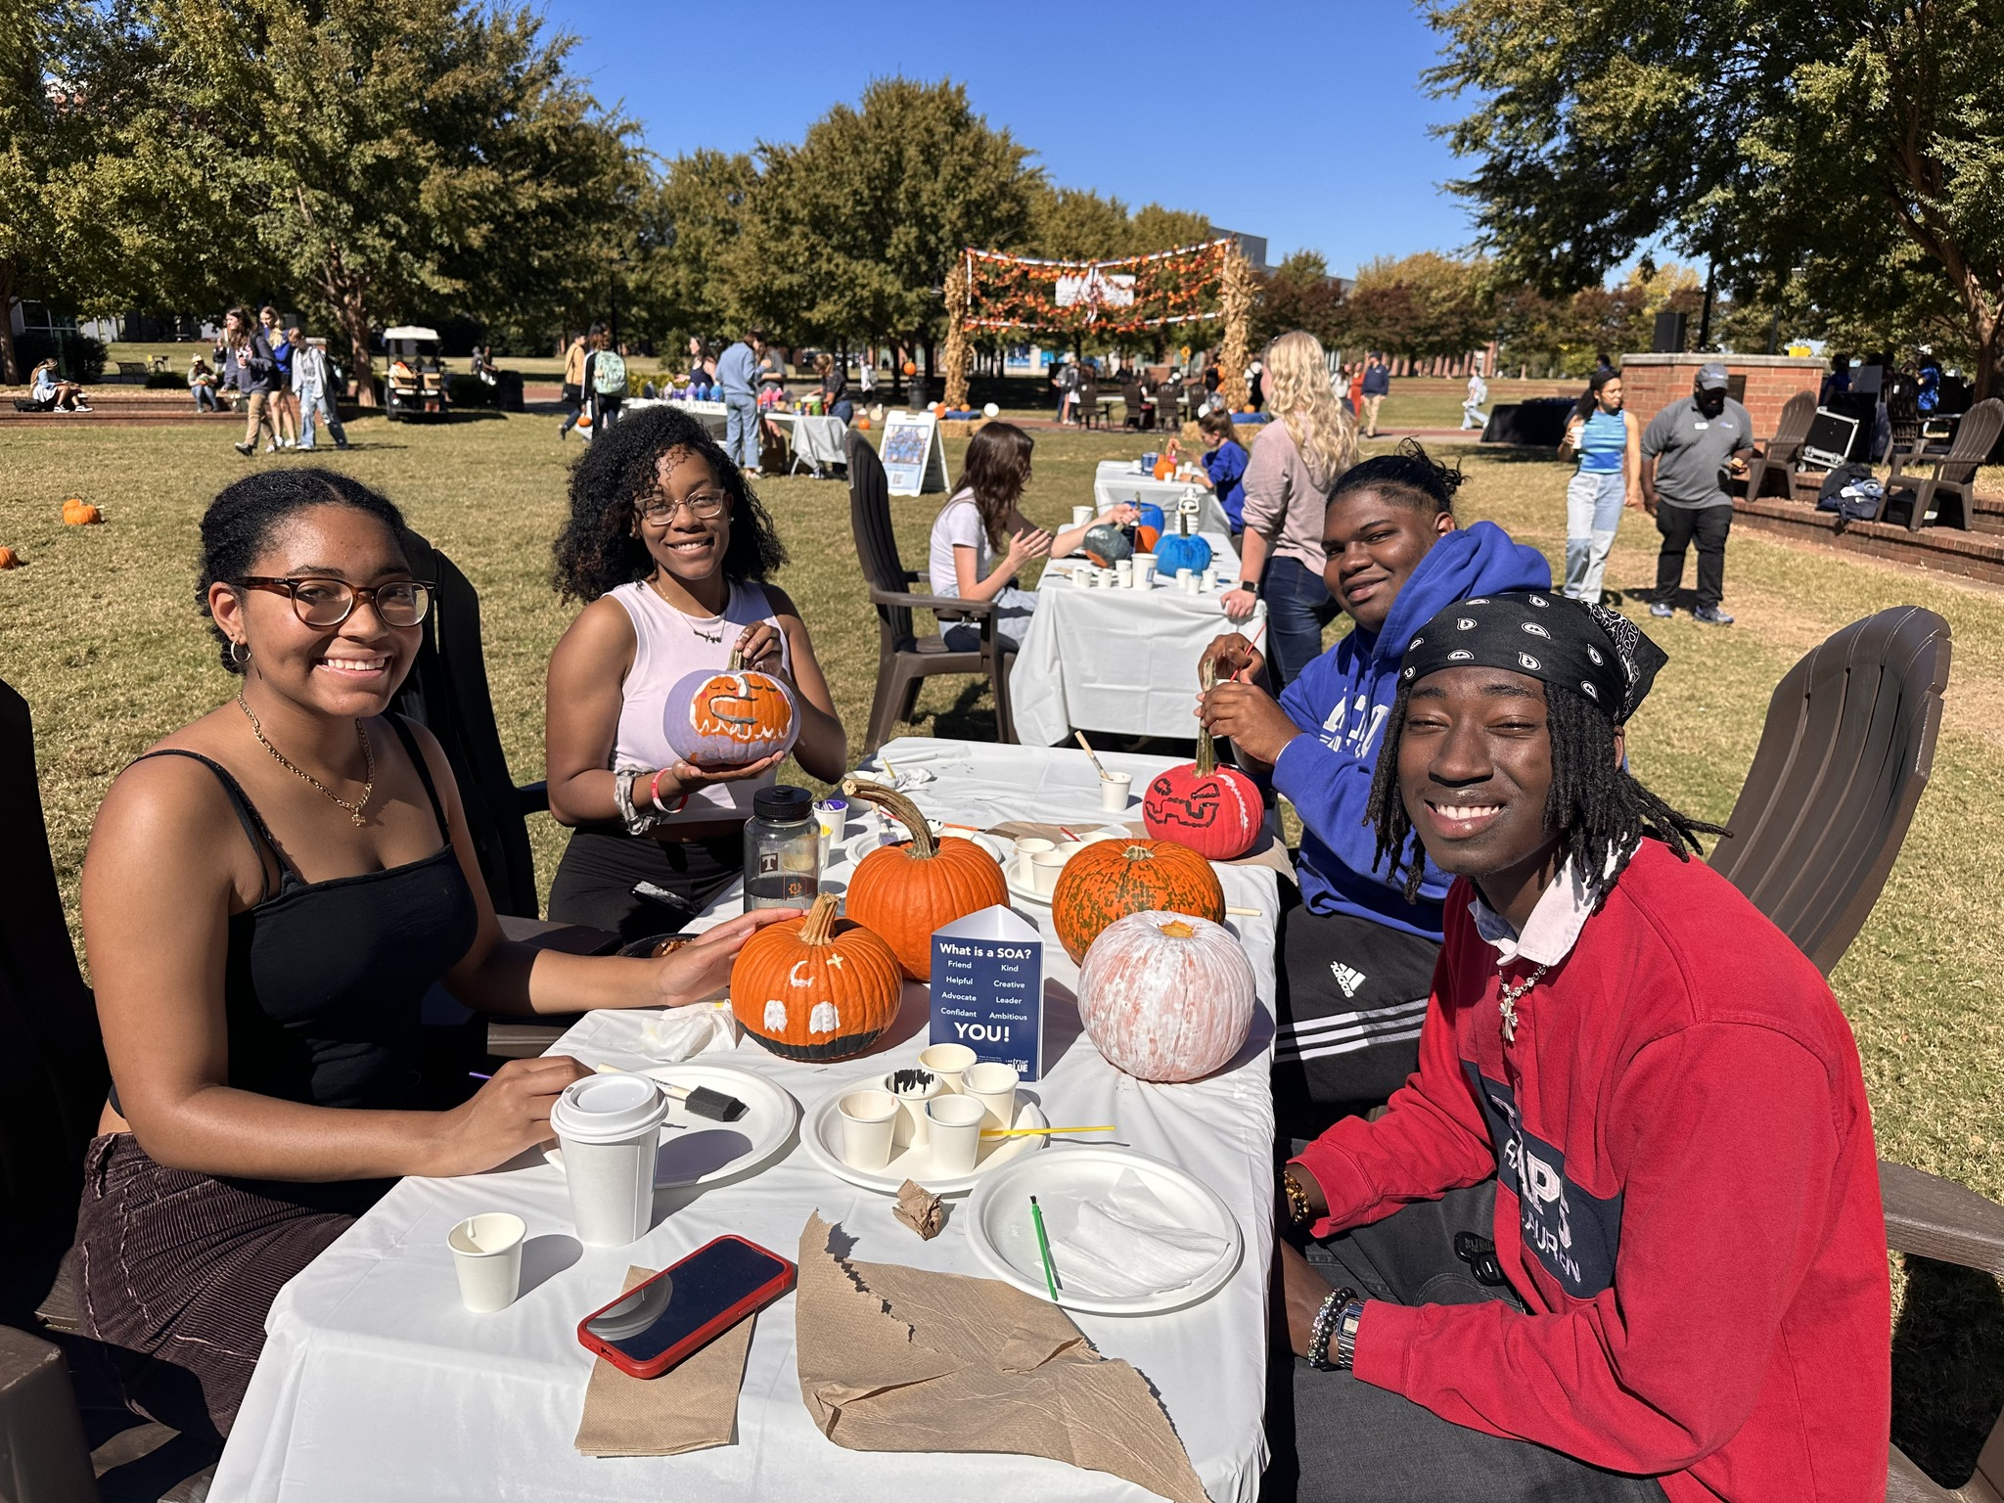
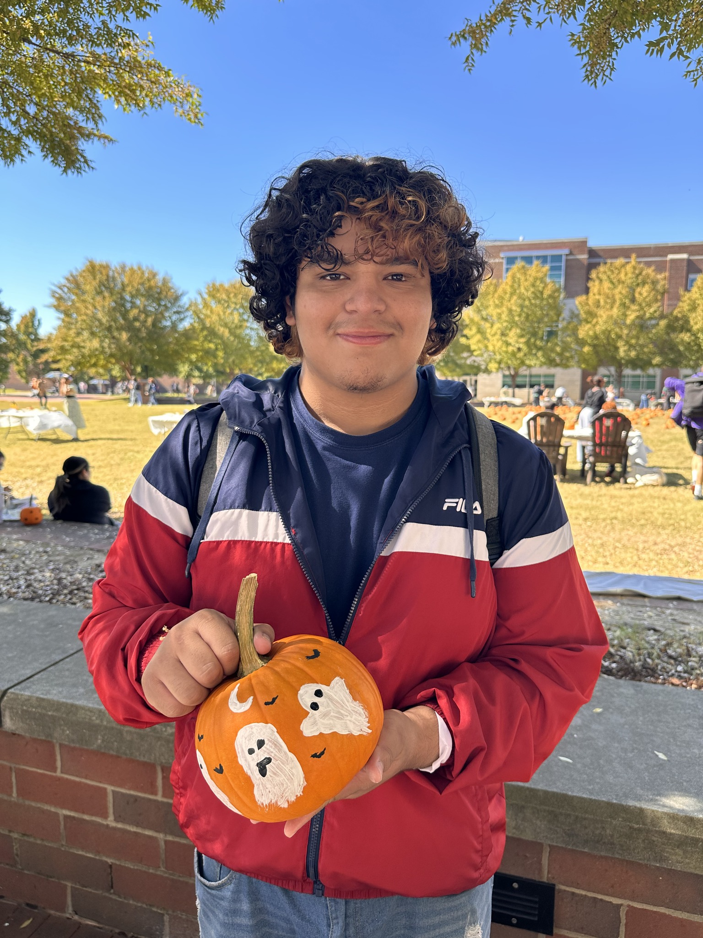
Events
Co-sponsor events with S.P.A.R.E.
(Student Programming and Raider Entertainment)
Pumpkin Painting

Slide 13
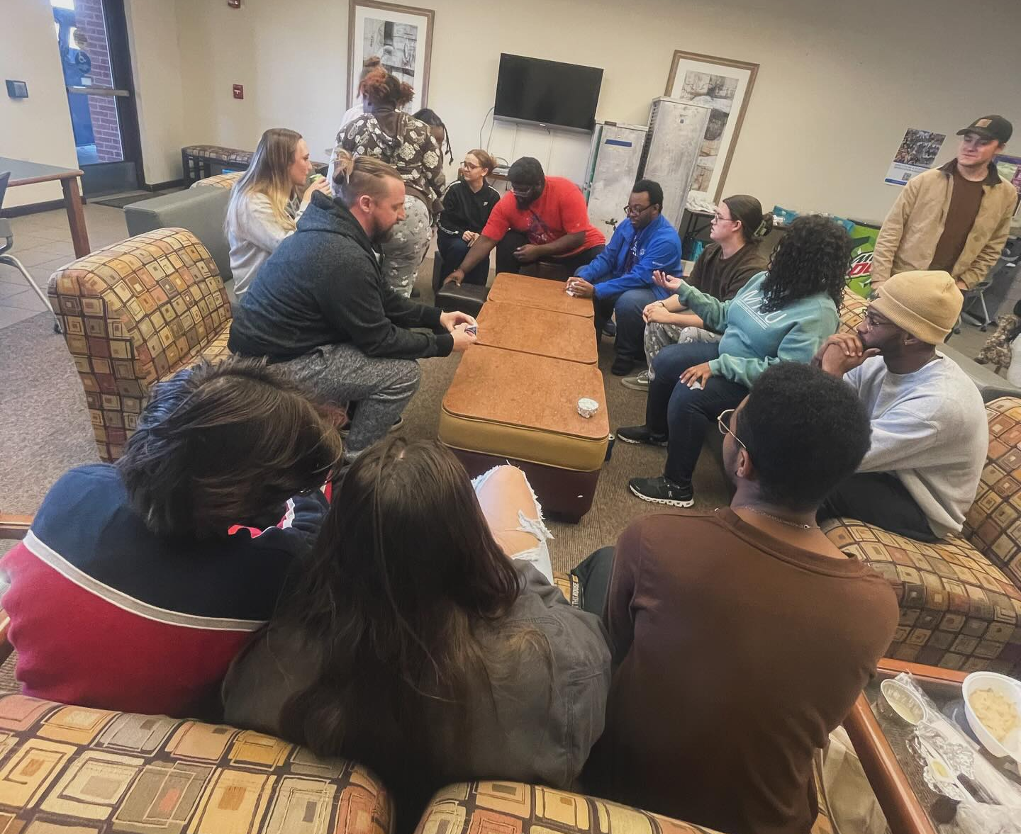
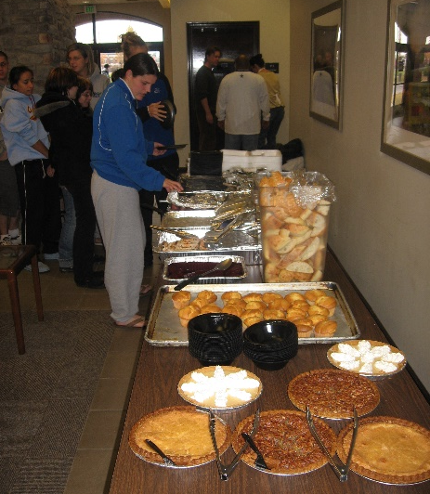
Events
Thanksgiving Dinner
Held on Thanksgiving day for student staying on campus
Students that live both on and off campus are welcome to attend

Slide 14
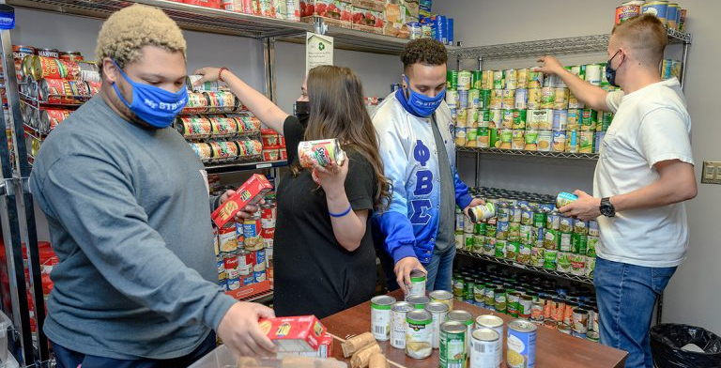
Support

Slide 15
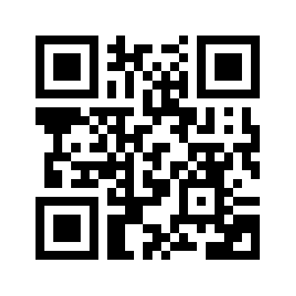
How can I join?
Join today at Orientation:
Use QR Code and join online. Your Welcome Kit can be picked up in the express line at Meet MT

Slide 16
How can I join?
Fill out registration form & pay membership fee at Yard Party Tent
We accept Visa, MasterCard, American Express, Discover, Checks, & Cash
Join online anytime:
www.mtsu.edu/parents/join.php
Credit Card payments only
Welcome Kit will be mailed to you in 5-7 business days

Slide 17
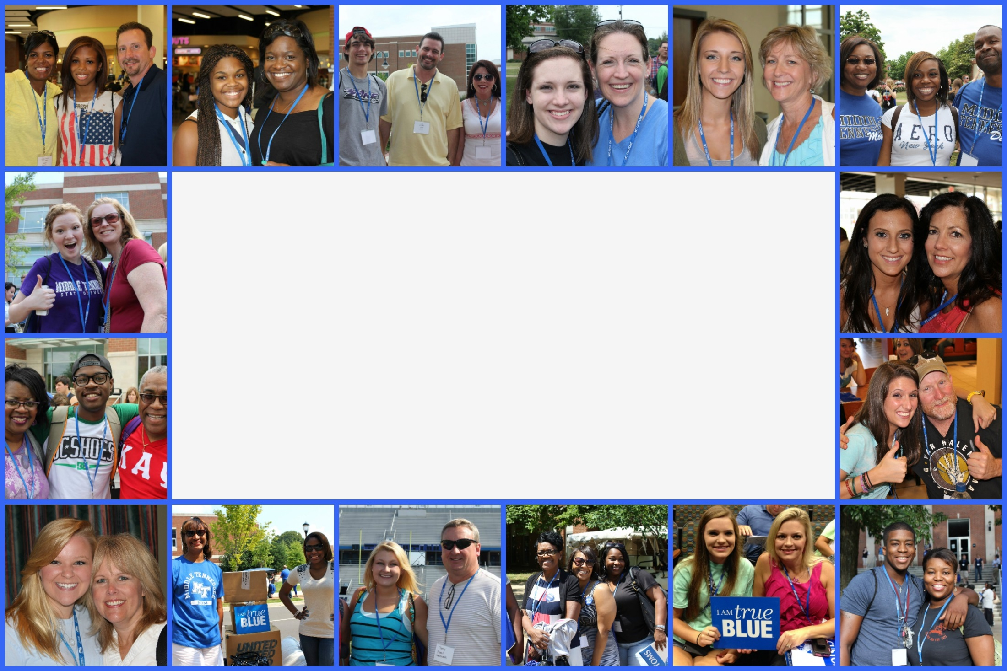
Thank you for your support!
PFA Facebook Group: facebook.com/groups/MTSU.PFA
Website: mtsu.edu/parents
Email: parents@mtsu.edu

Slide 18
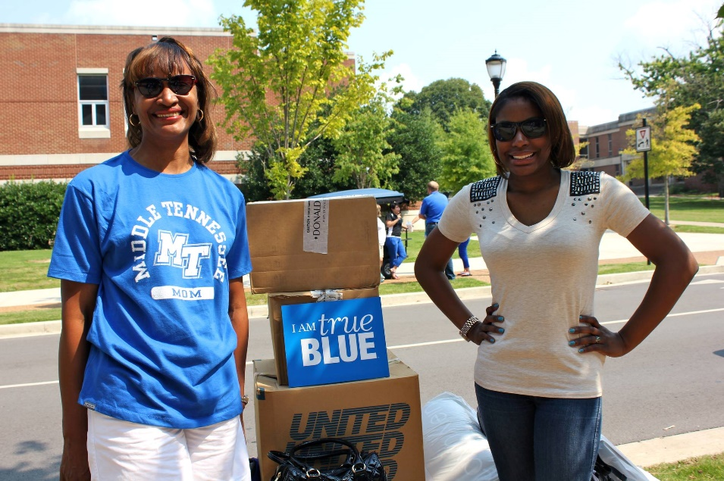
Parent Ponderings…
Who can help if they need support?
Do you feel safe on campus?
How is parking on campus?
What if they get sick?
How does my student get involved?
What about tutoring?

Slide 19
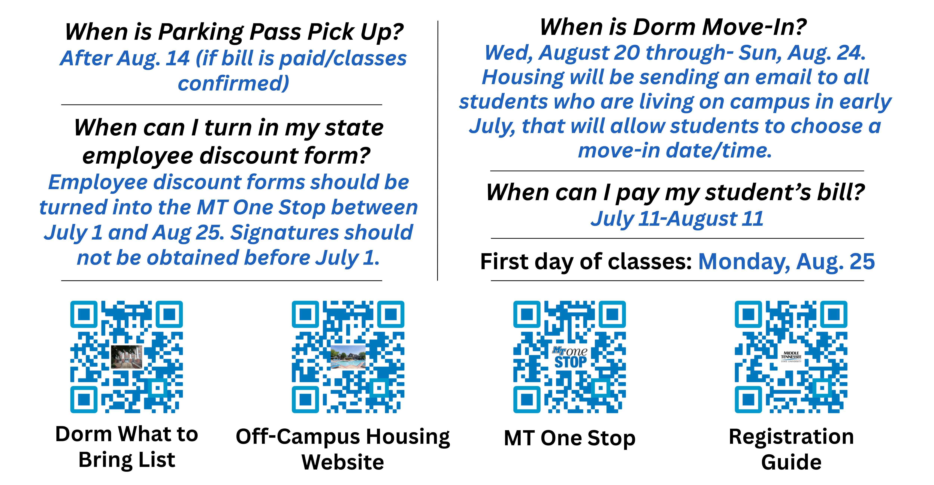
Important Resources (Take a Photo)

