Slide 1


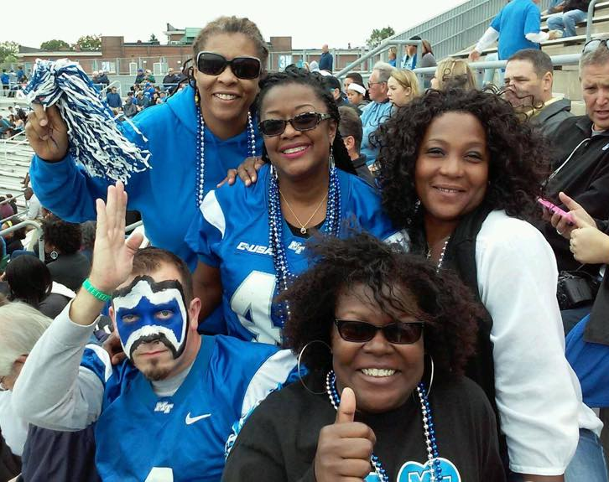

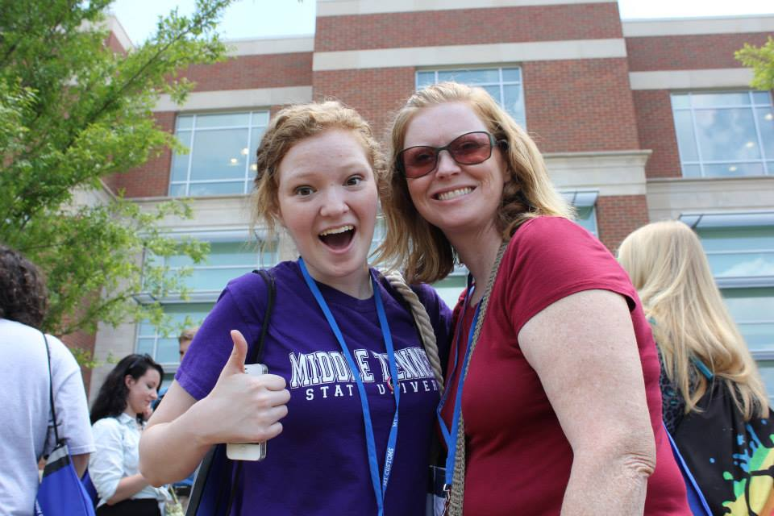
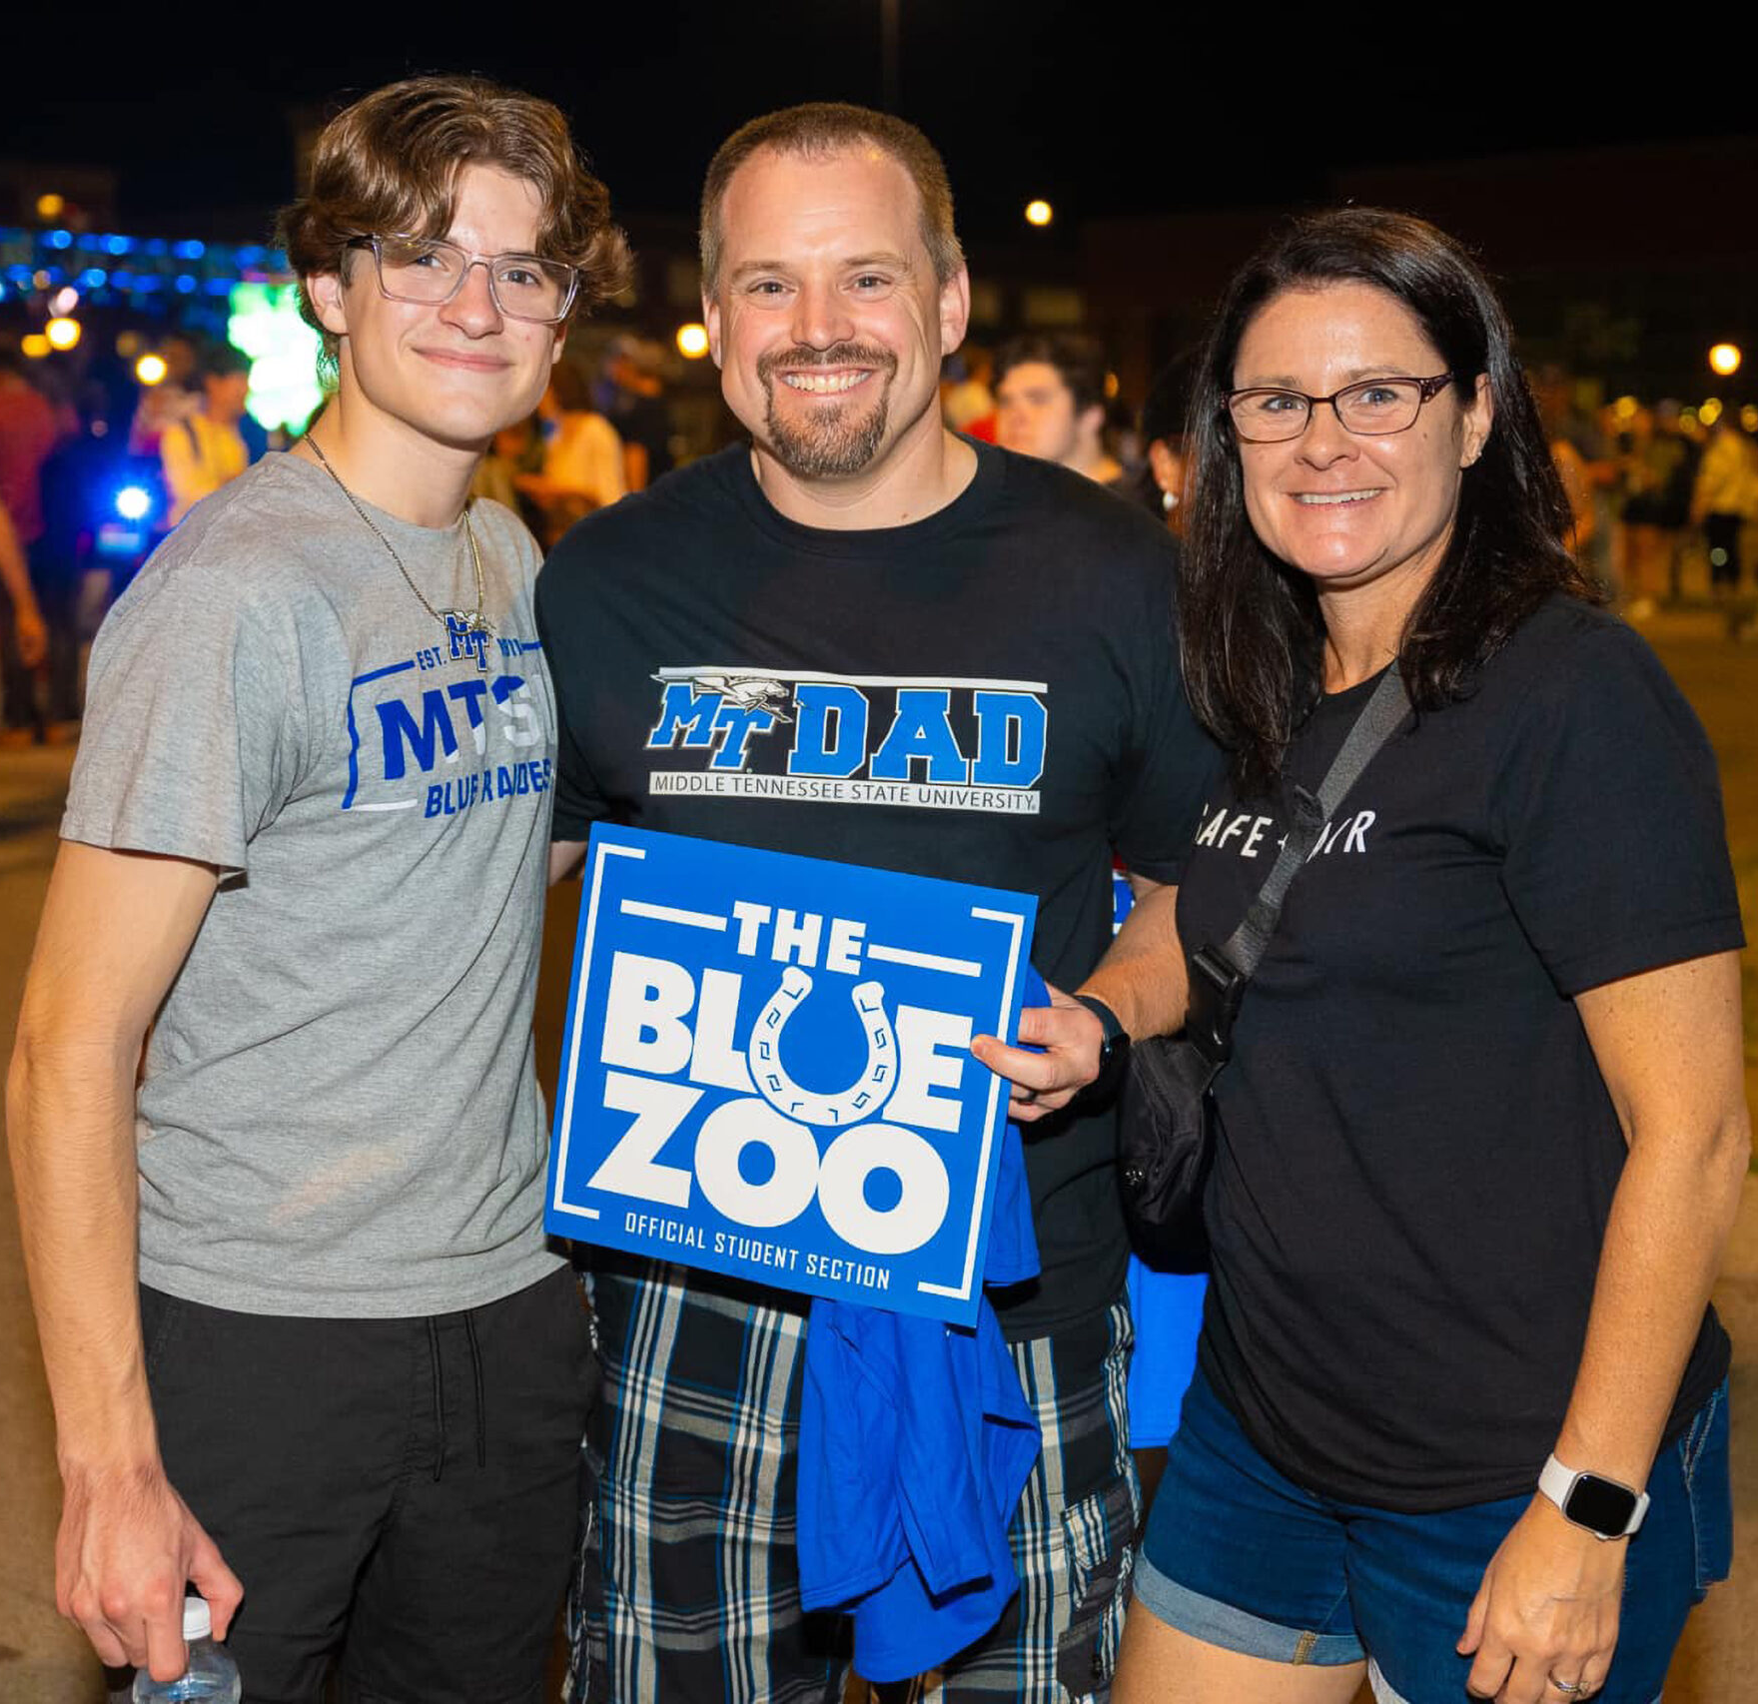
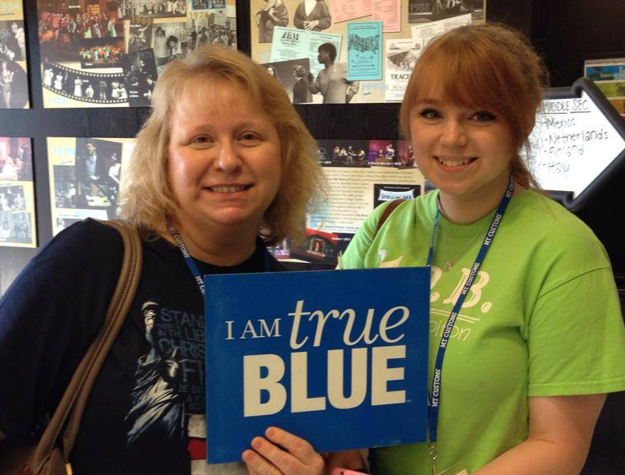

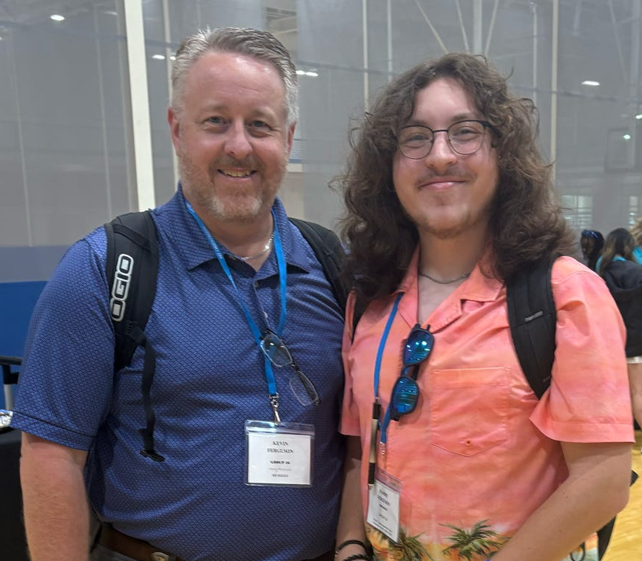
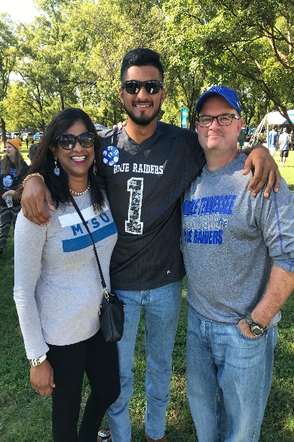
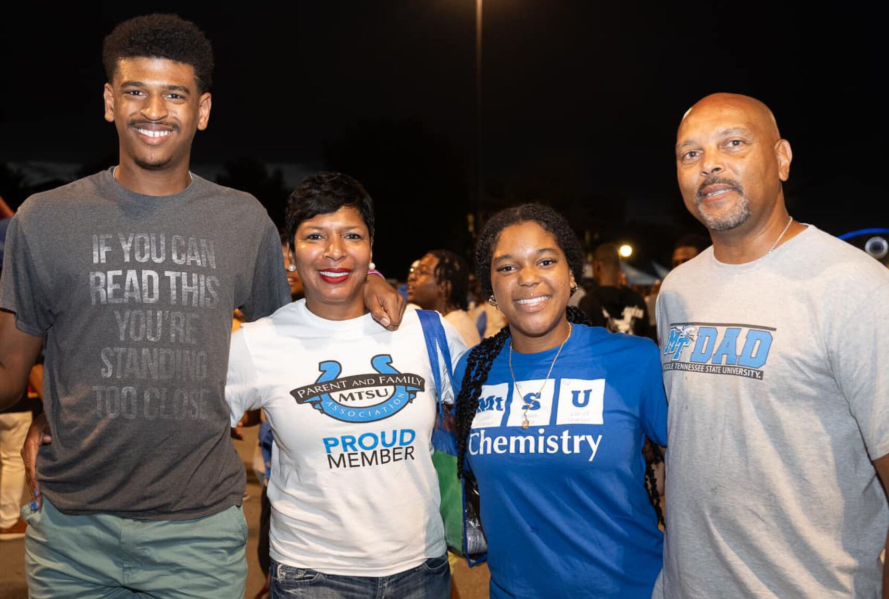
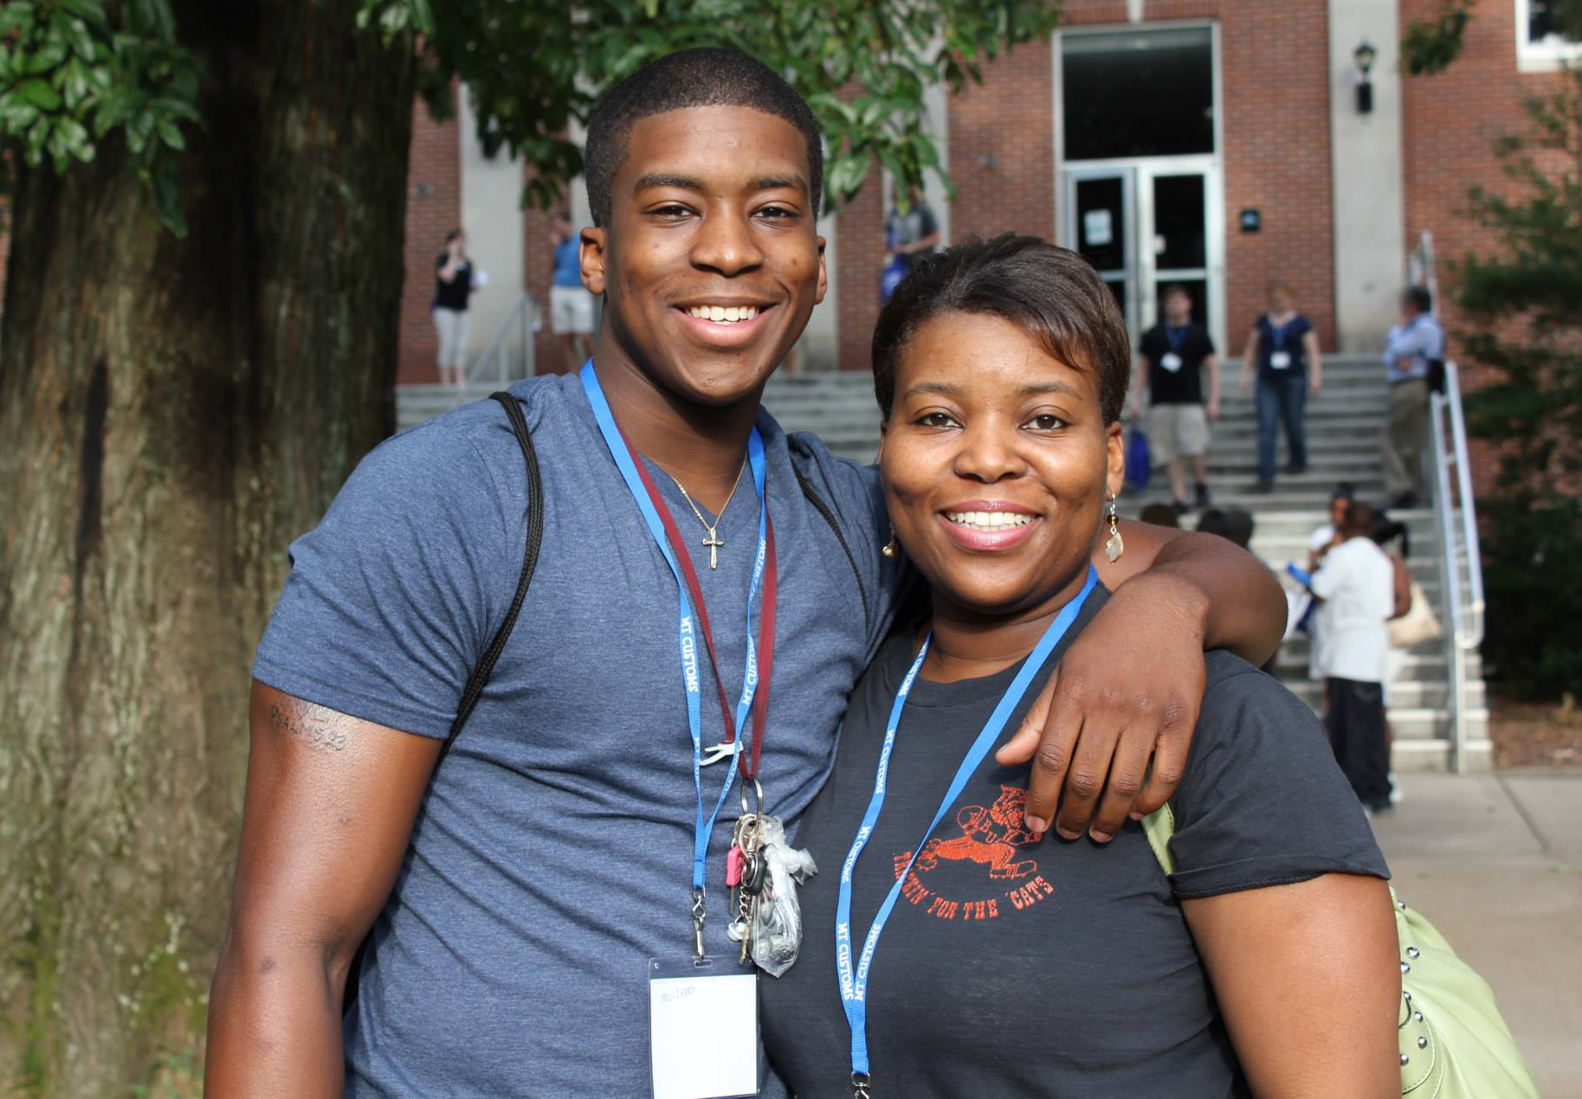
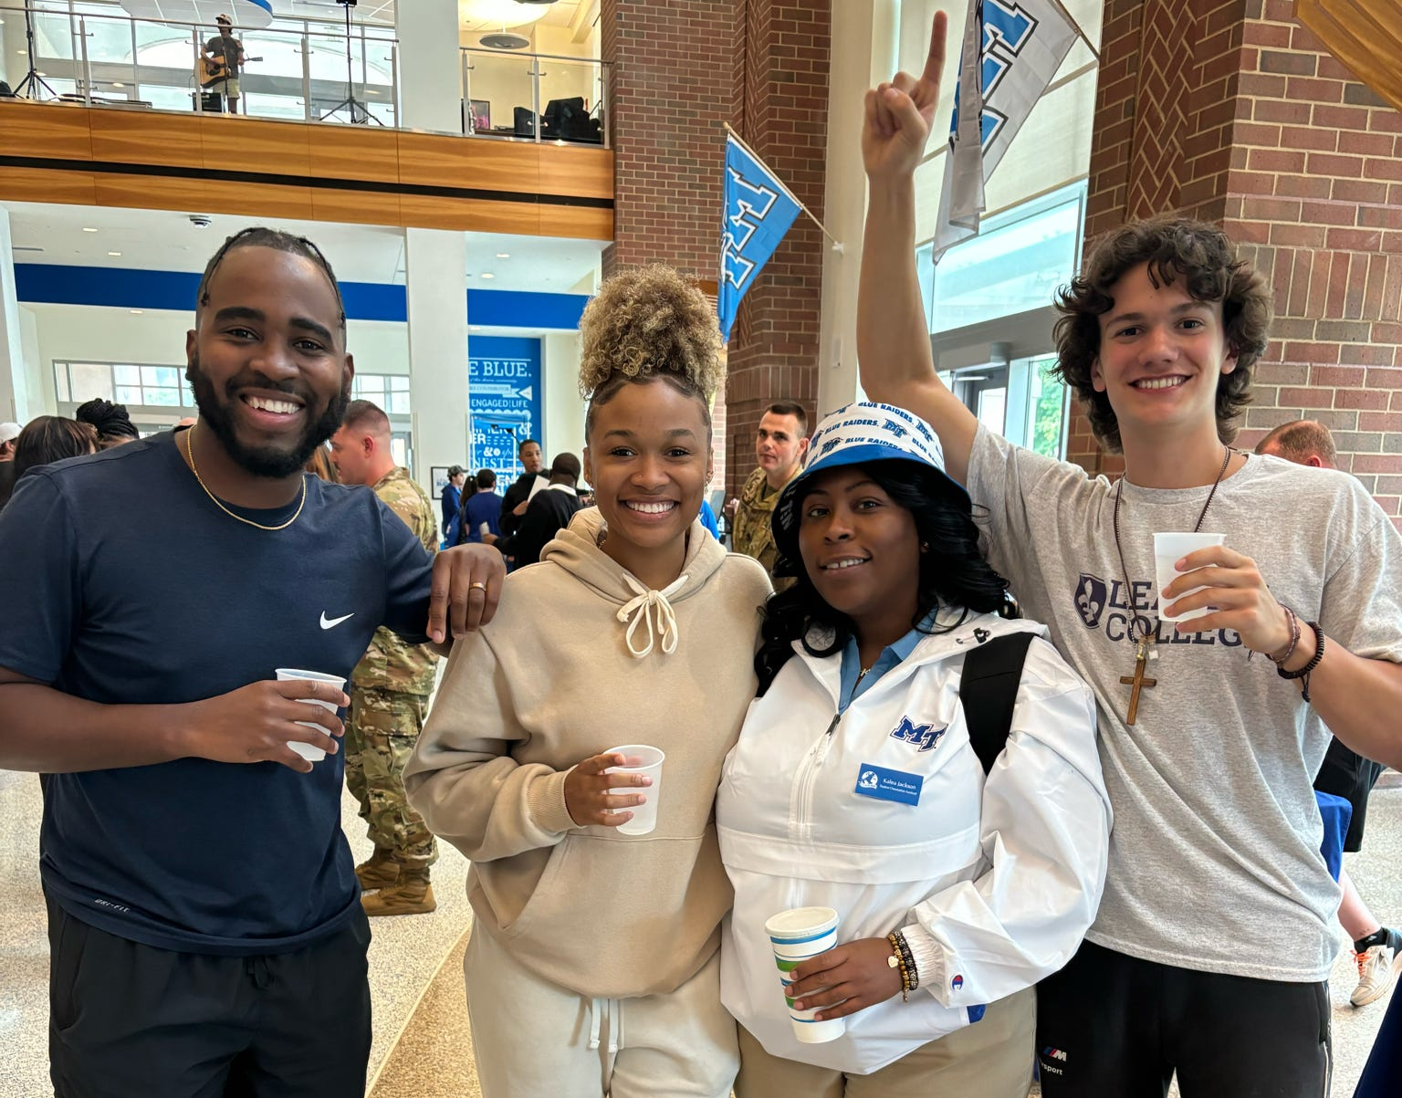
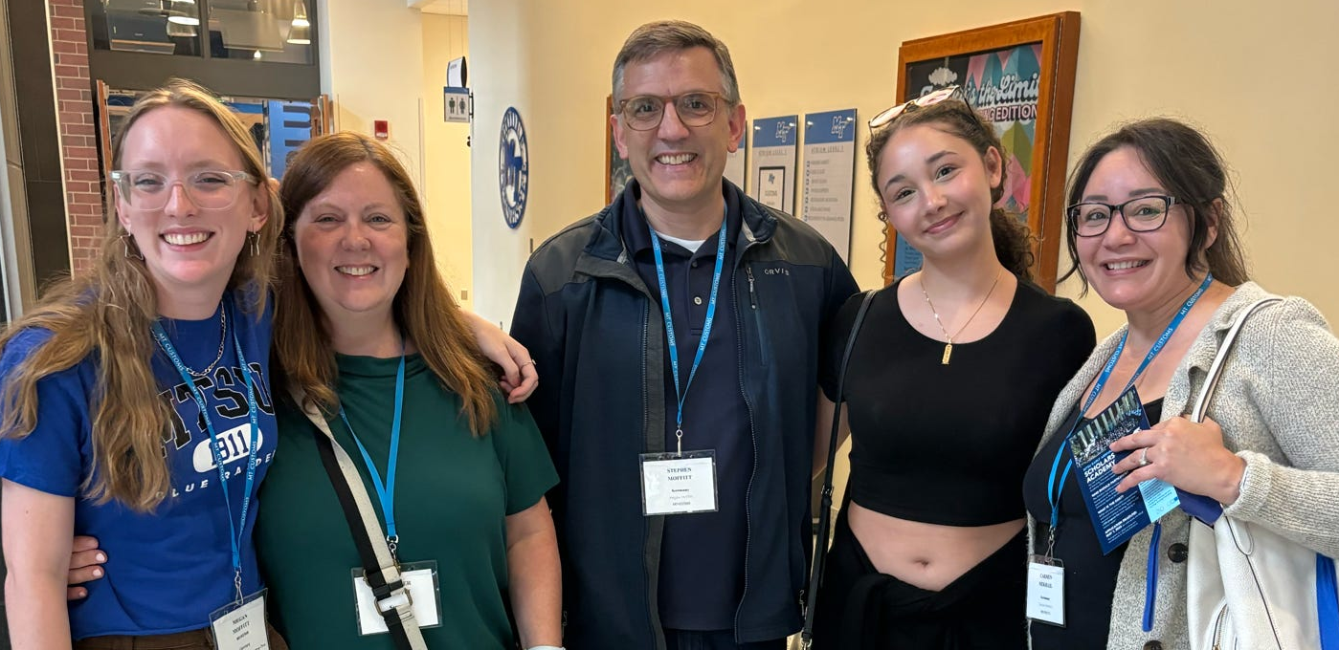
Welcome to the MTSU Family!

Slide 2

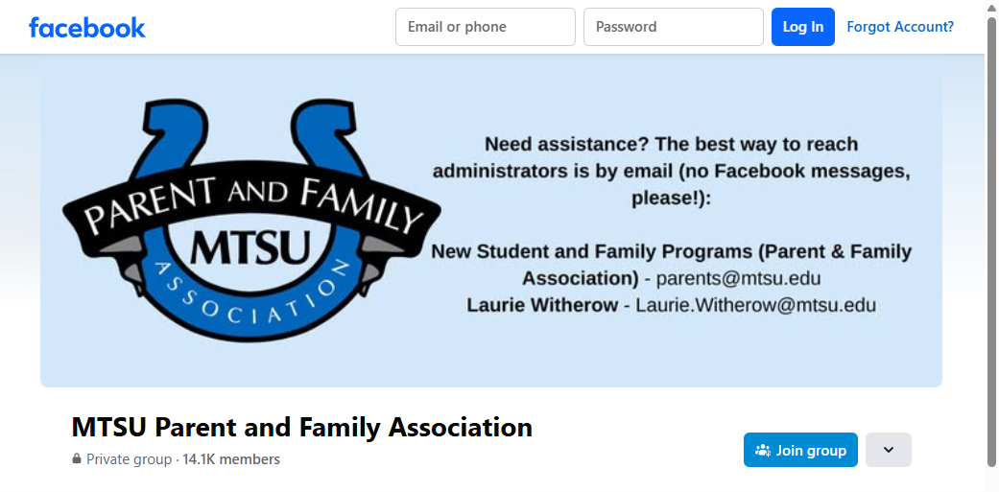
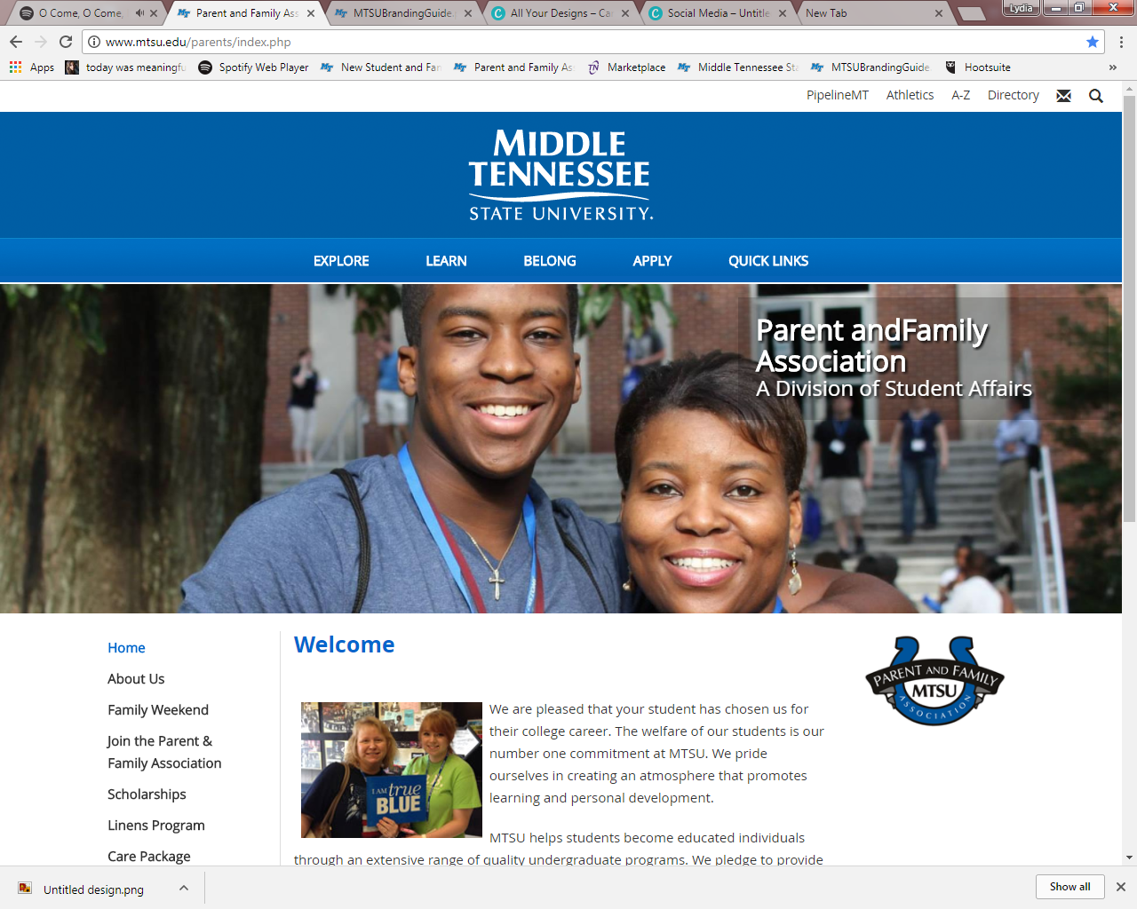
What does the Parent and Family Association do?
We support MTSU families by:
  Sharing information,
  Serving as a point of contact,
  Networking with other families,
  Coordinating the Care Package and Linens Programs, &
  Offering memorable experiences through our events, such as Family Weekend!
Contact Us: mtsu.edu/parents | parents@mtsu.edu

Slide 3

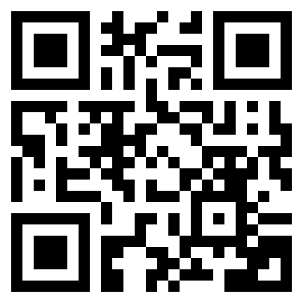
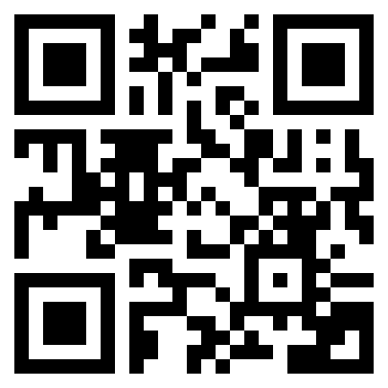
Programs & Family Events
Care Packages
2026 Family Weekend: September 18-20
Signature Events
Family Weekend Virtual 5K, all proceeds go to the Student Food Pantry
Friday
Family Meet N’ Greet,1-3:30pm
Saturday
Party in the Grove Tailgate
MTSU Football v. Nevada
Sunday
Farewell Brunch
Linens Store
mtsu.edu/parents/family_weekend

Slide 4
PFA Membership Options:
Annual Membership ($30/yr)
Lifetime Membership ($60/yr)

Slide 5
Annual Membership Benefits
Annual Membership MUST be renewed each year to stay a member of the association- $30
Welcome Kit (receive at Orientation or mailed to you)
Receive 10 eNewsletters – directly to your inbox (August-May)
Scholarship Opportunities

Slide 6
Lifetime Membership Benefits
One time fee of $60 – membership valid for length that ANY of your students is enrolled at MTSU
Welcome Kit (receive at Orientation or mailed to you)
PFA T-shirt – can purchase additional shirts for $5
Receive 10 eNewsletters – directly to your inbox (August-May)
Scholarship Opportunities

Slide 7



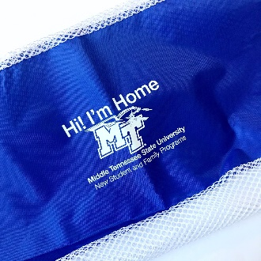
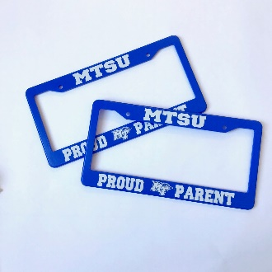

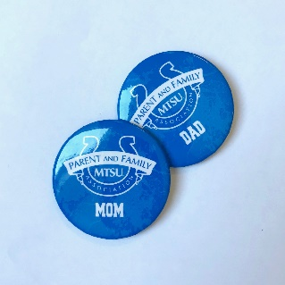


What’s included in your Welcome Kit?
Laundry
Bag
License Plate Frames
Clear Stadium Tote
PFA Lifetime
T-Shirt
Resource Magnet
Notebook
& Pen
Koozies
Buttons
T-shirt for Lifetime Membership only
Handheld Fan

Slide 8
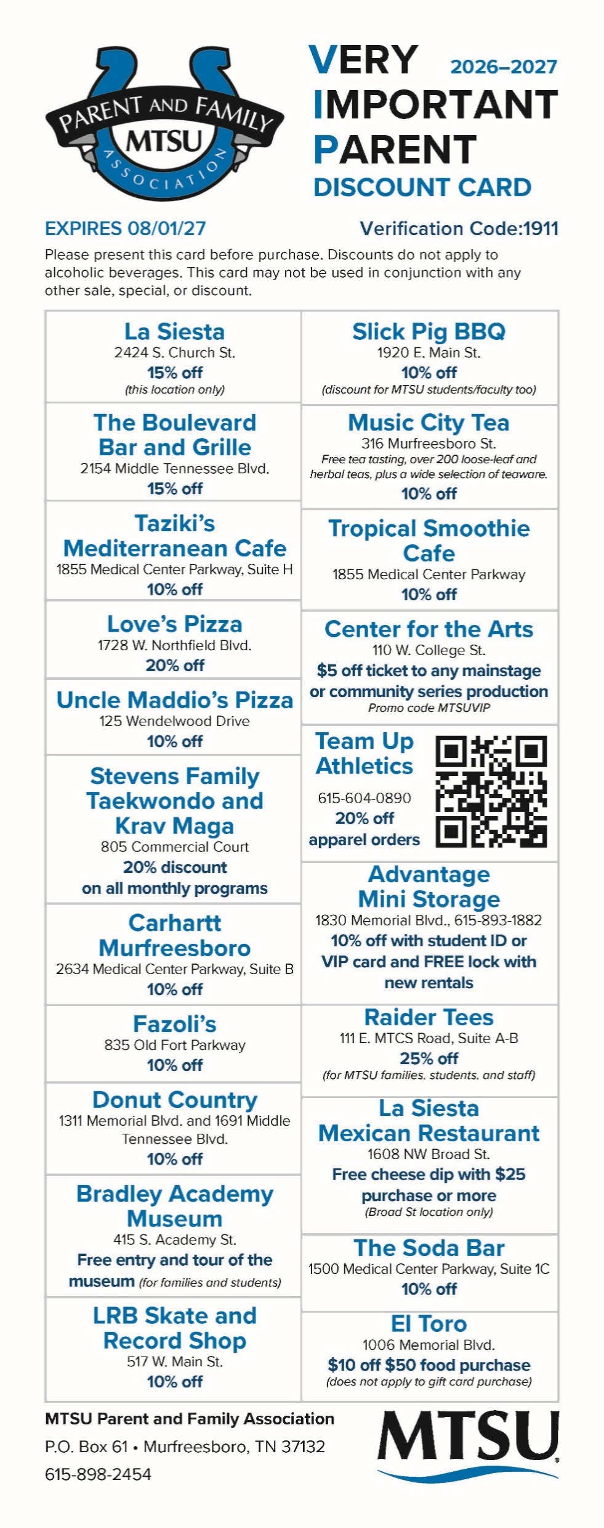
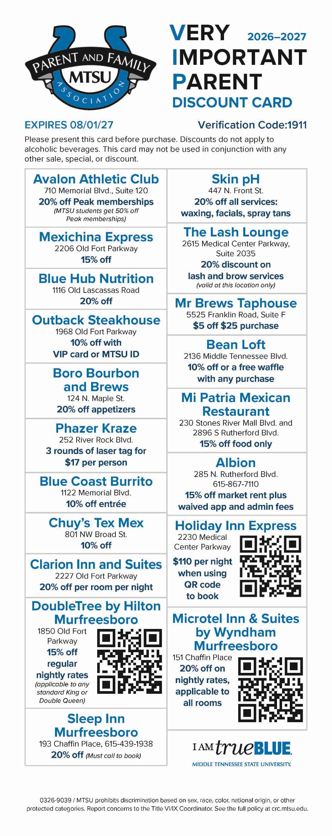
Very Important Parent (VIP)
Discount Card
Includes discounts to local restaurants, bookstores, and businesses in the Murfreesboro area.

Slide 9






































2026 VIP Discount Card Participants

Slide 10
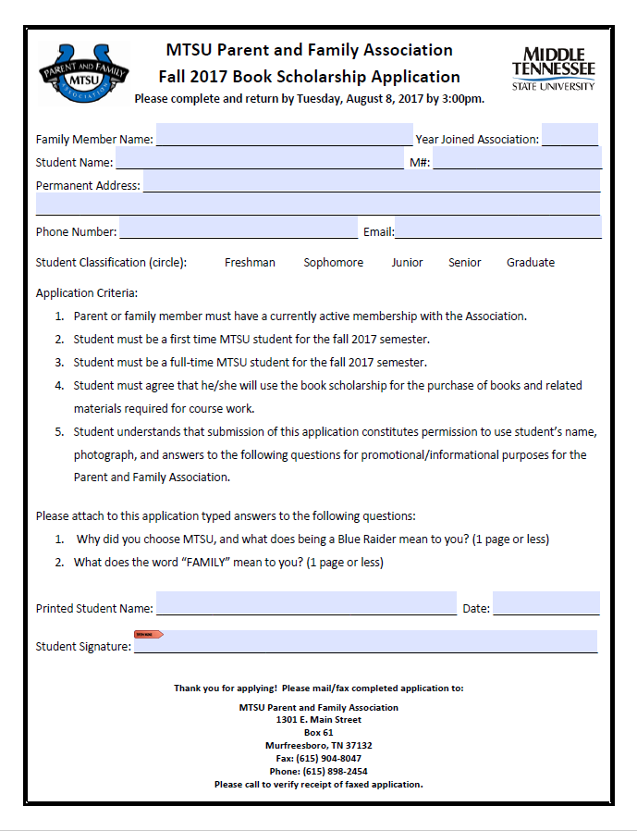
Scholarships
ONLY available to students of PFA Members to apply
4-6 Book Scholarships - new students: $250 book scholarships given every year
2 Returning Student Scholarships - $1000 scholarship(s) awarded every year to a returning student
Applications are available in the Summer.
Scholarships will be awarded in August.

Slide 11
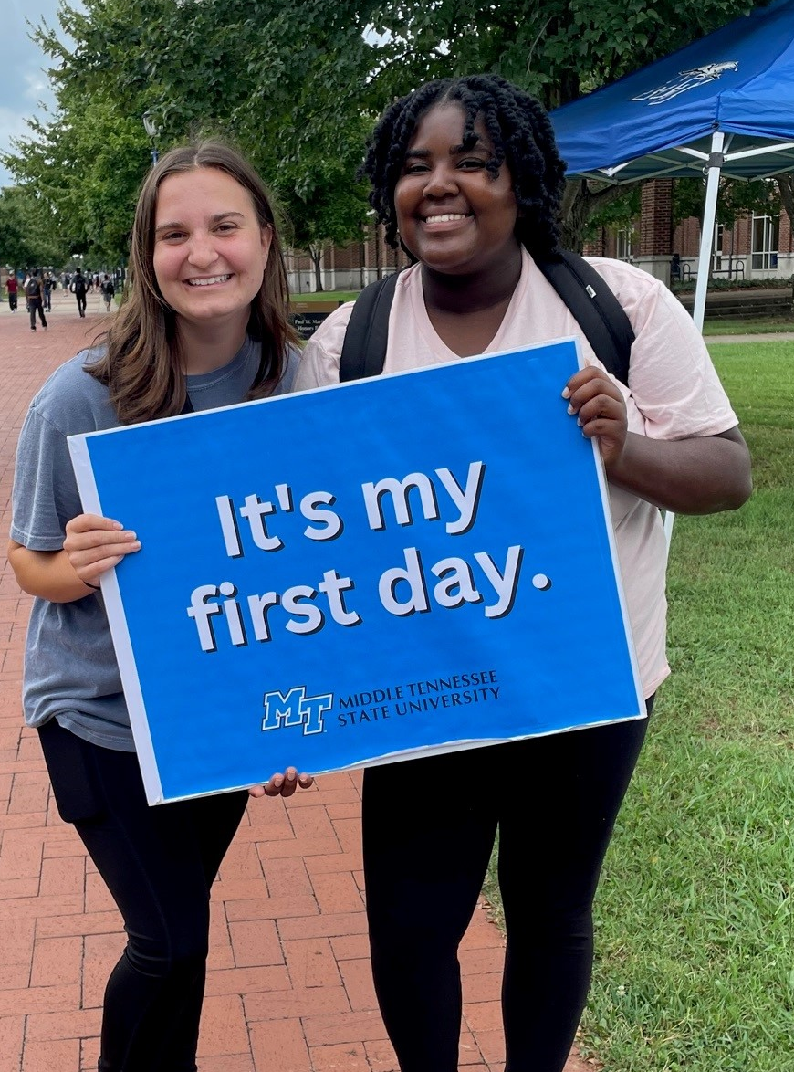
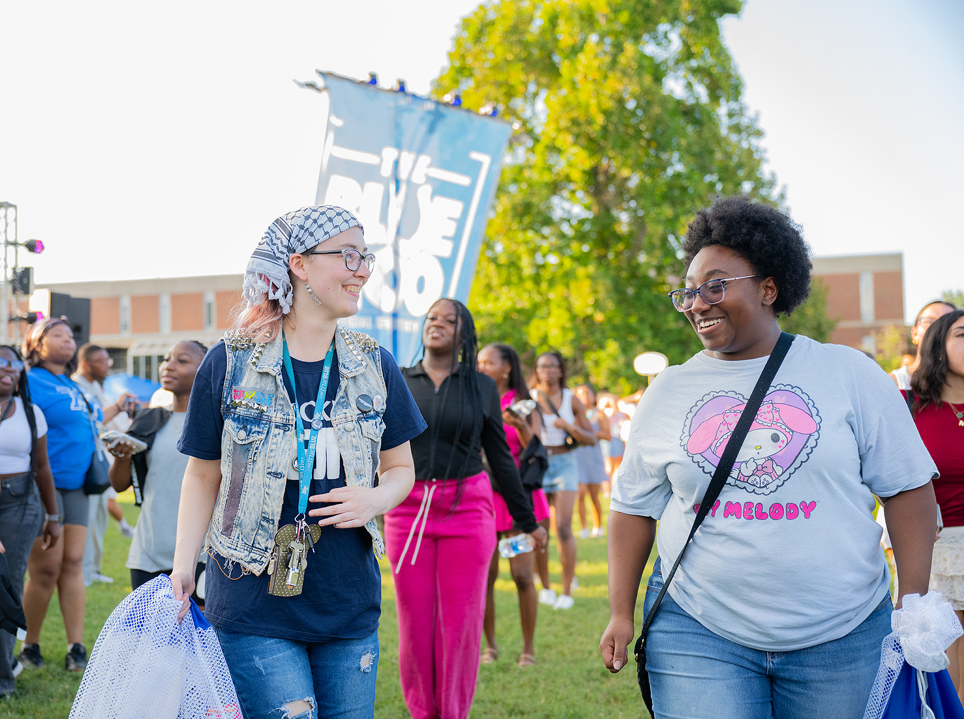
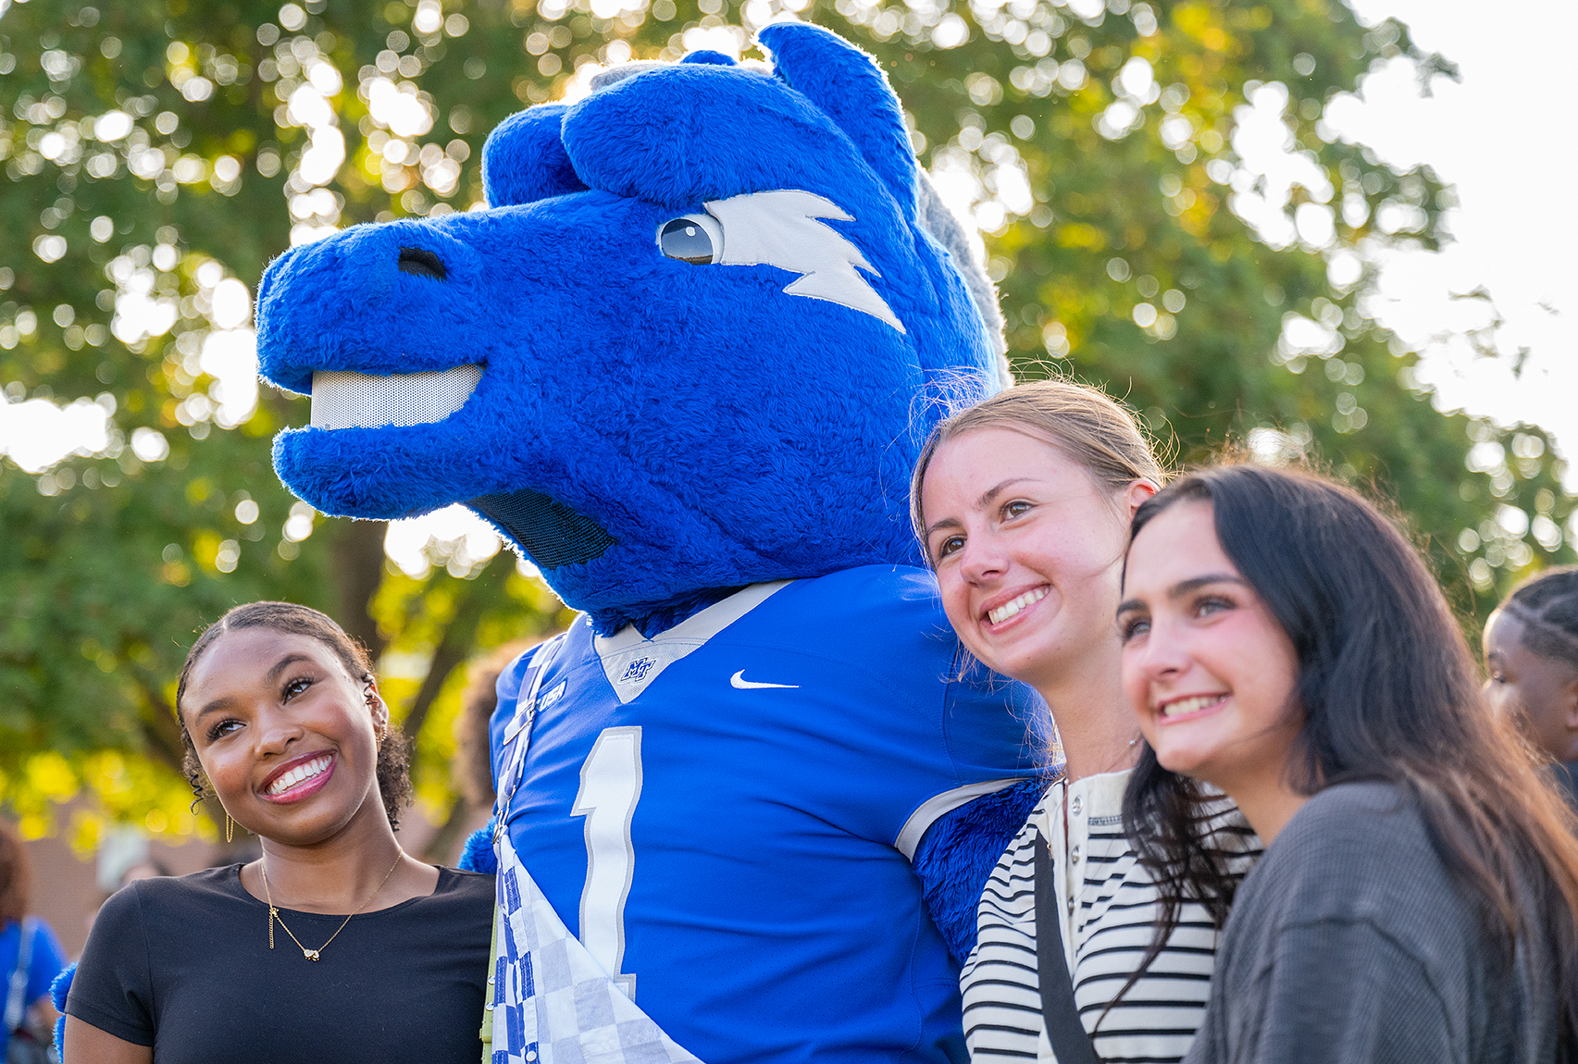
How do we use your membership fees?
To support and provide programming
and opportunities for FREE for MTSU students.

Slide 12
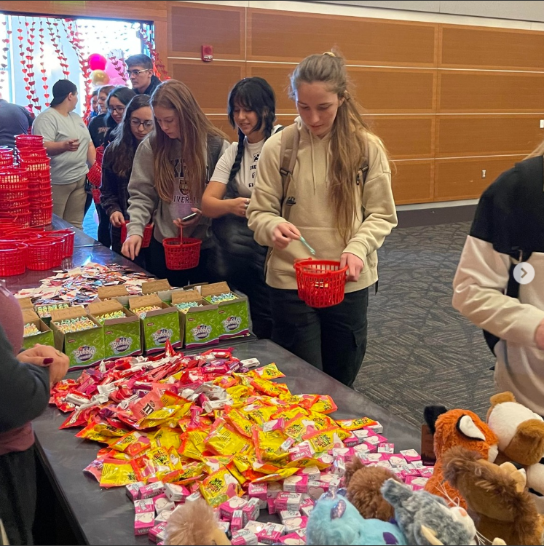
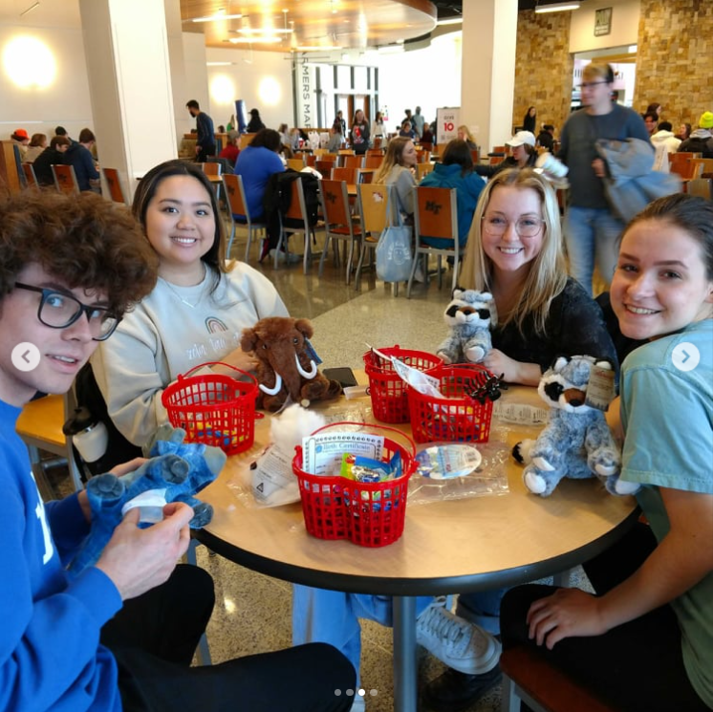
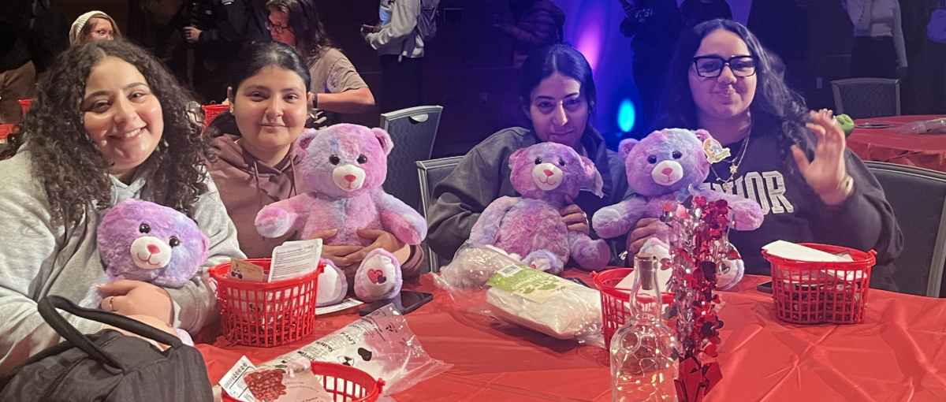
Events
  Co-sponsor events with S.P.A.R.E. (Student Programming and Raider Entertainment)
  Valentine’s Day Stuff-A-Critter

Slide 13

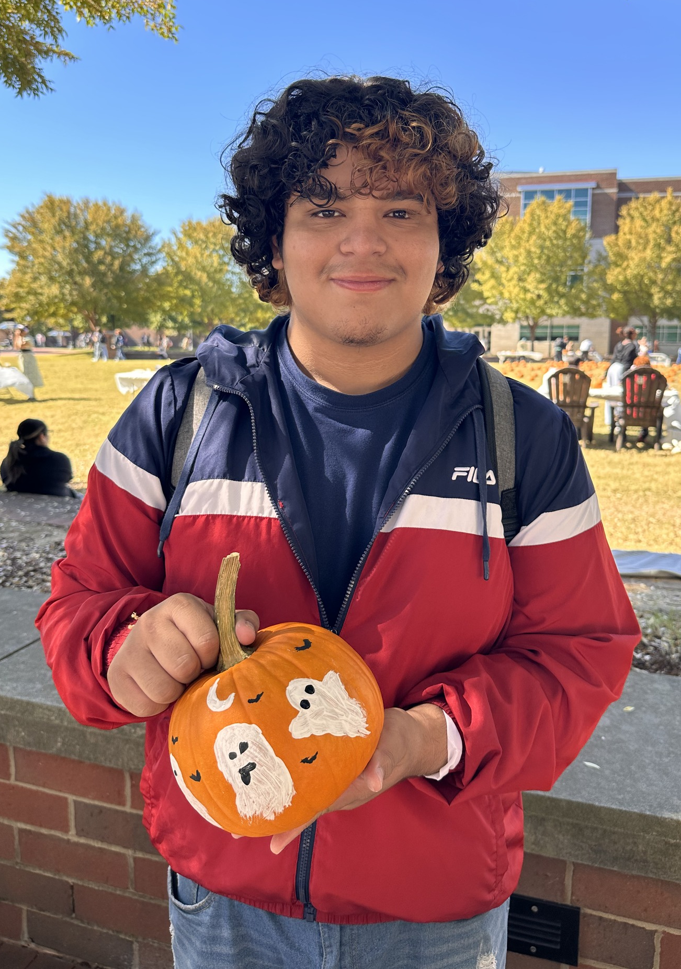
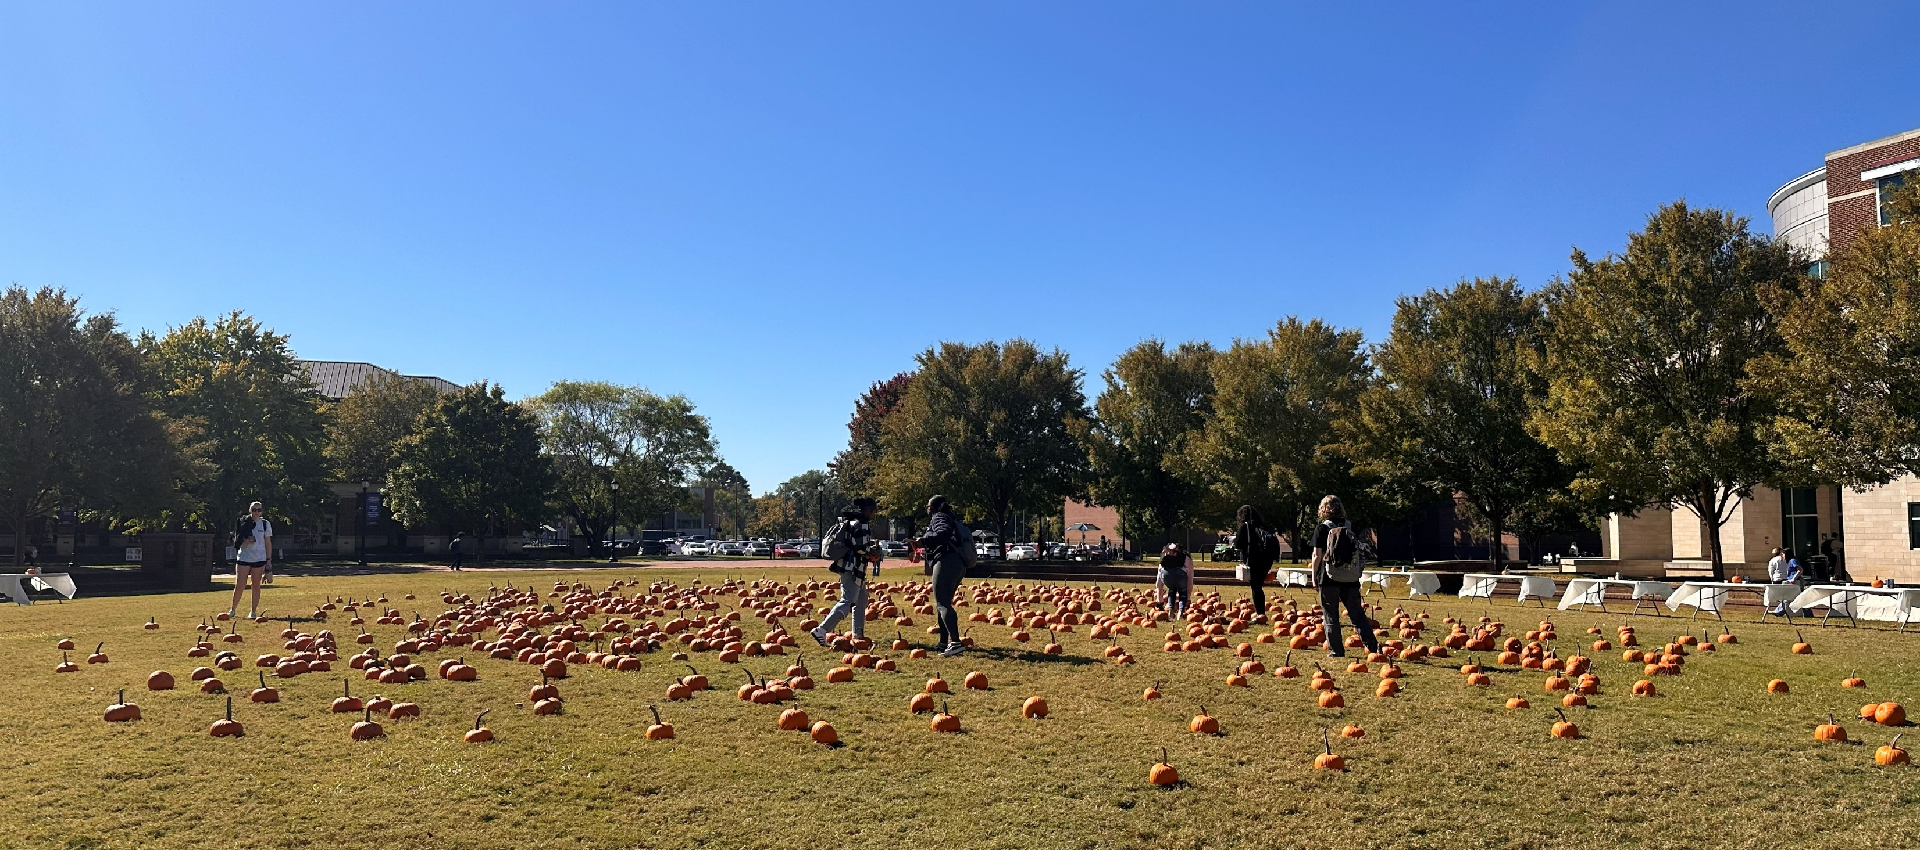
Events
  Co-sponsor events with S.P.A.R.E. (Student Programming and Raider Entertainment)
  Pumpkin Patch

Slide 14
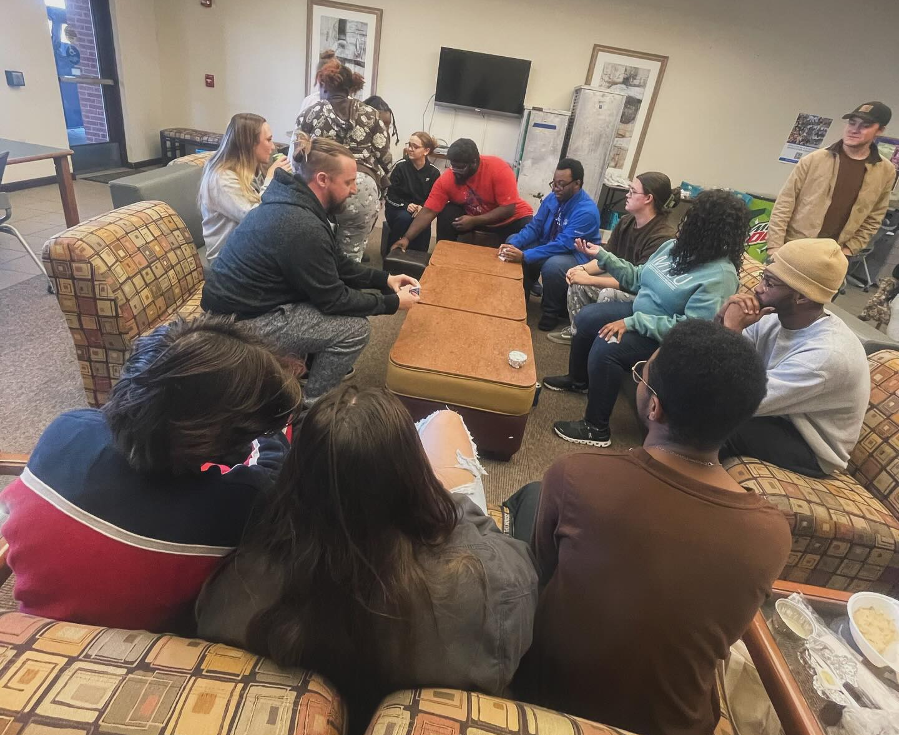
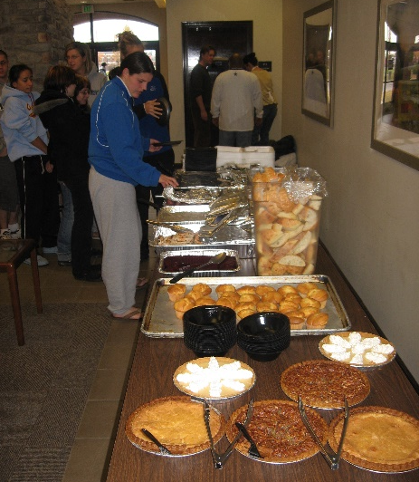

Events
  Thanksgiving Dinner
  Held on Thanksgiving day for student staying on campus
  Students that live both on and off campus are welcome to attend

Slide 15
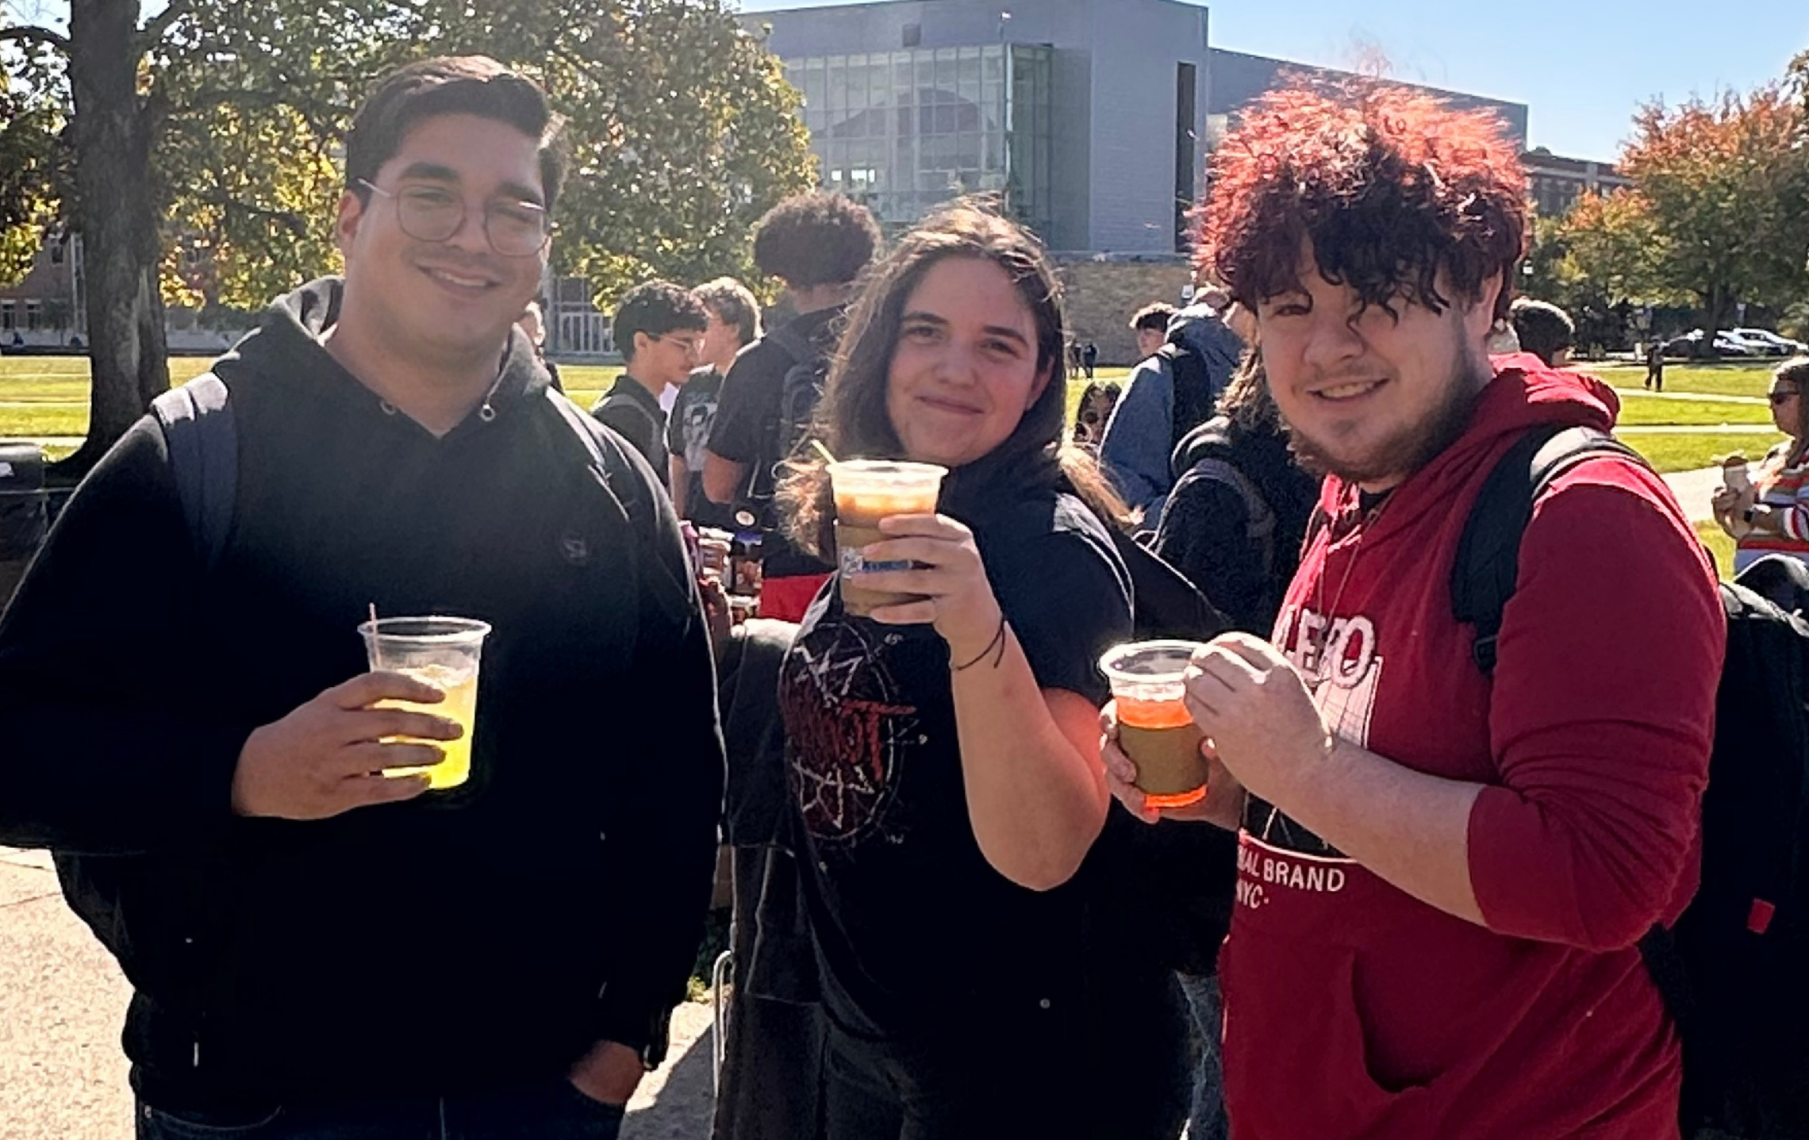
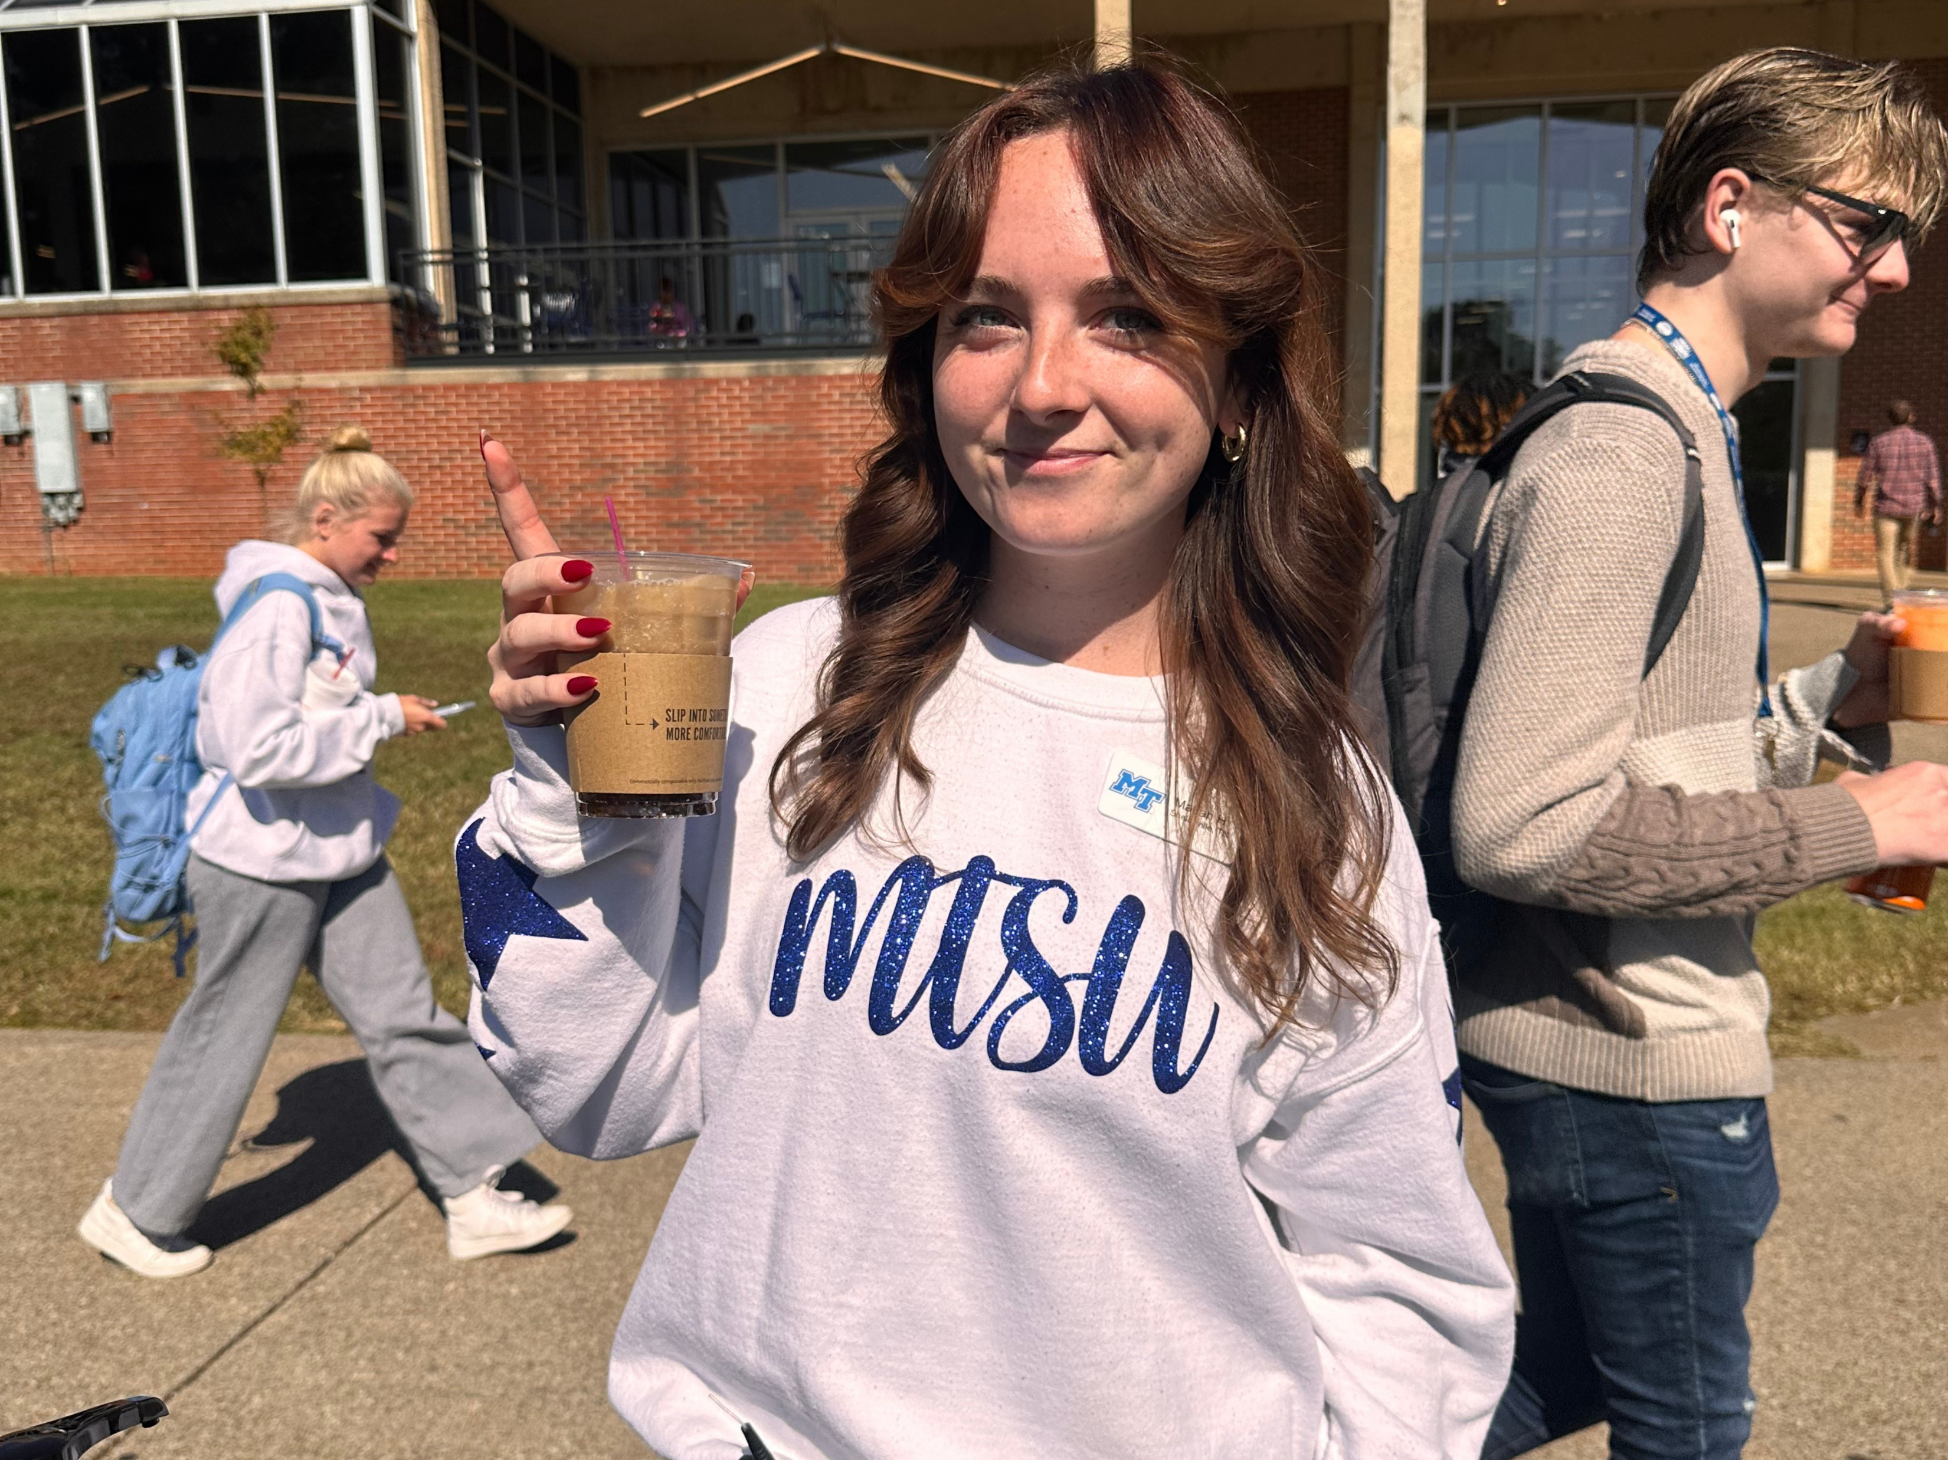
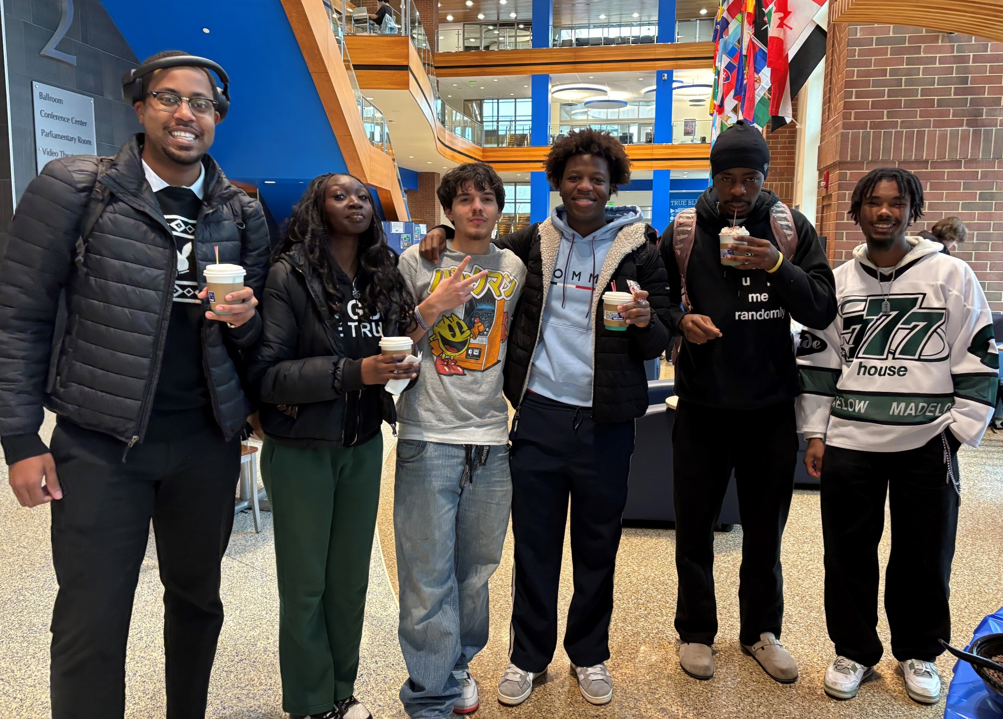
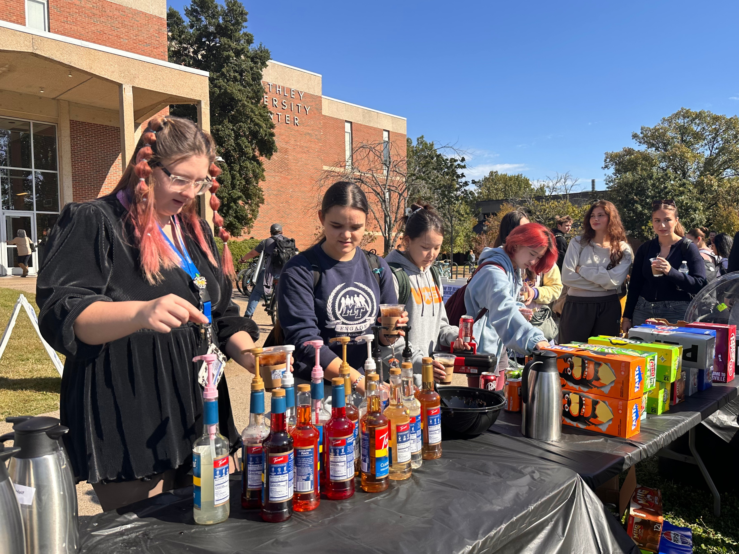
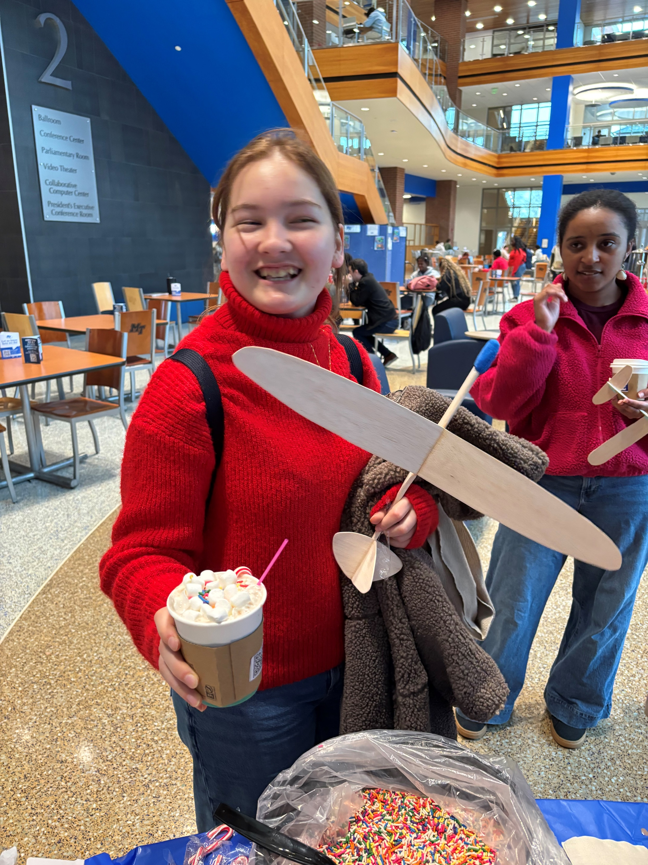
Random Acts of Kindness

Slide 16
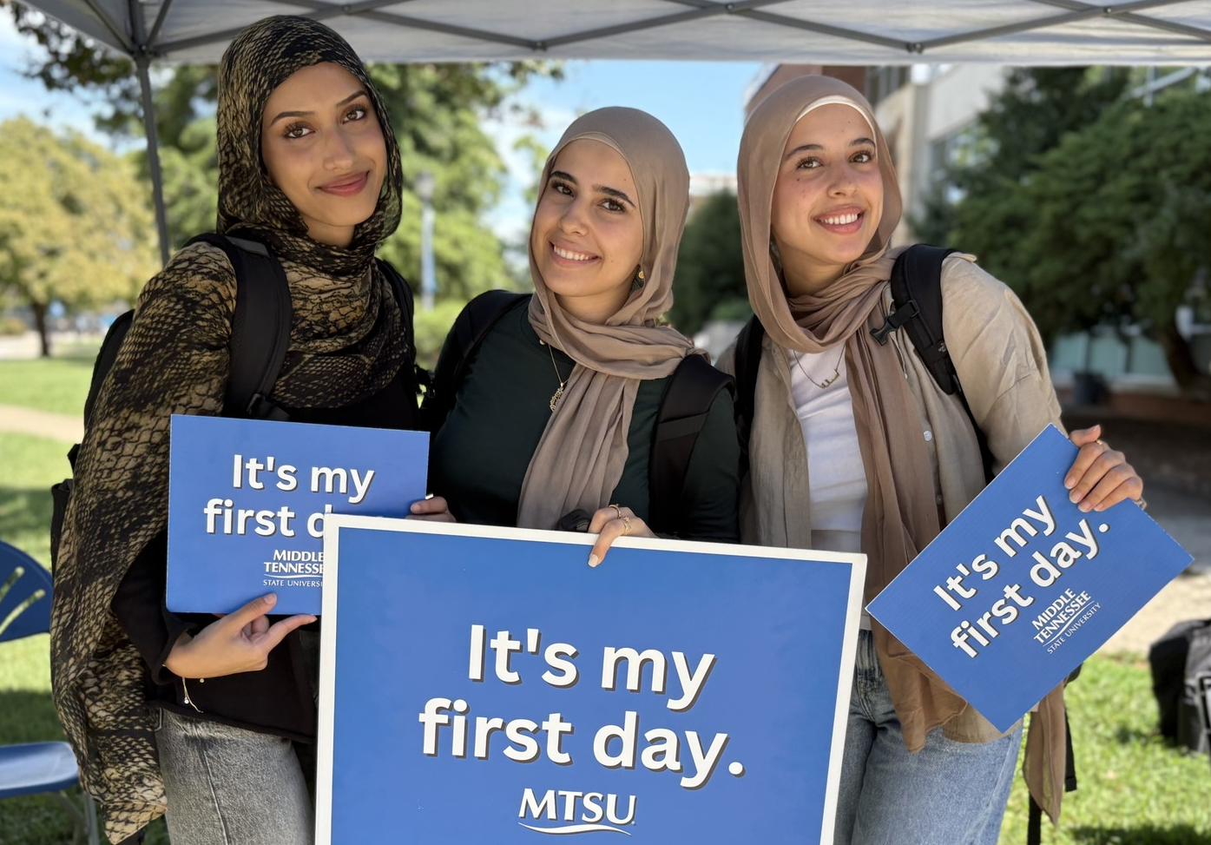
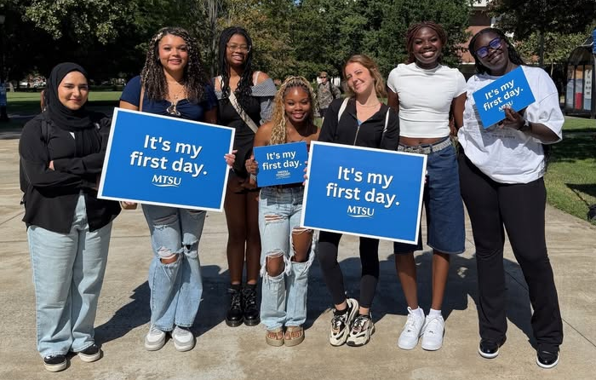
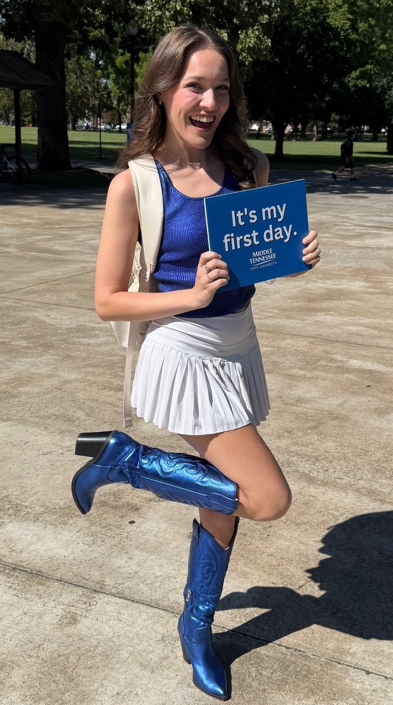
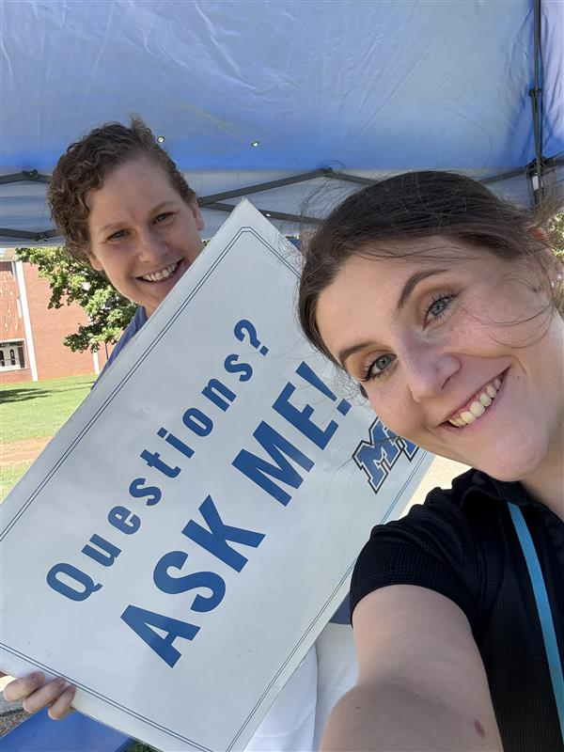
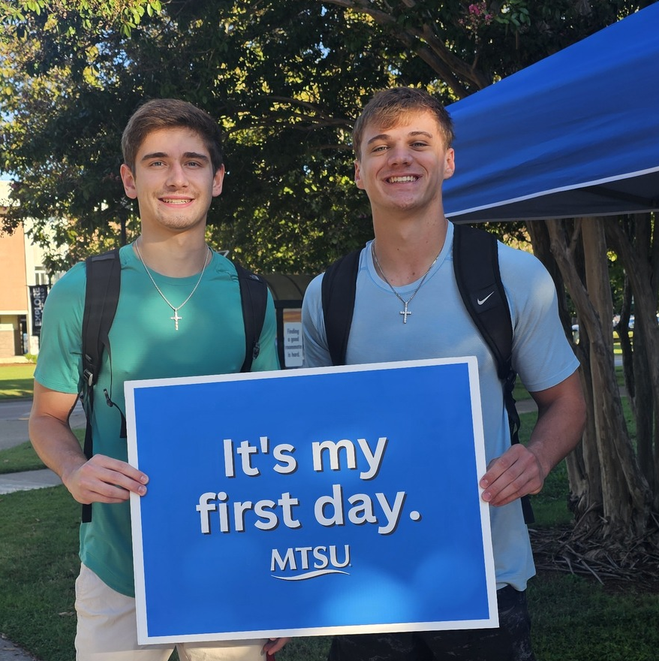
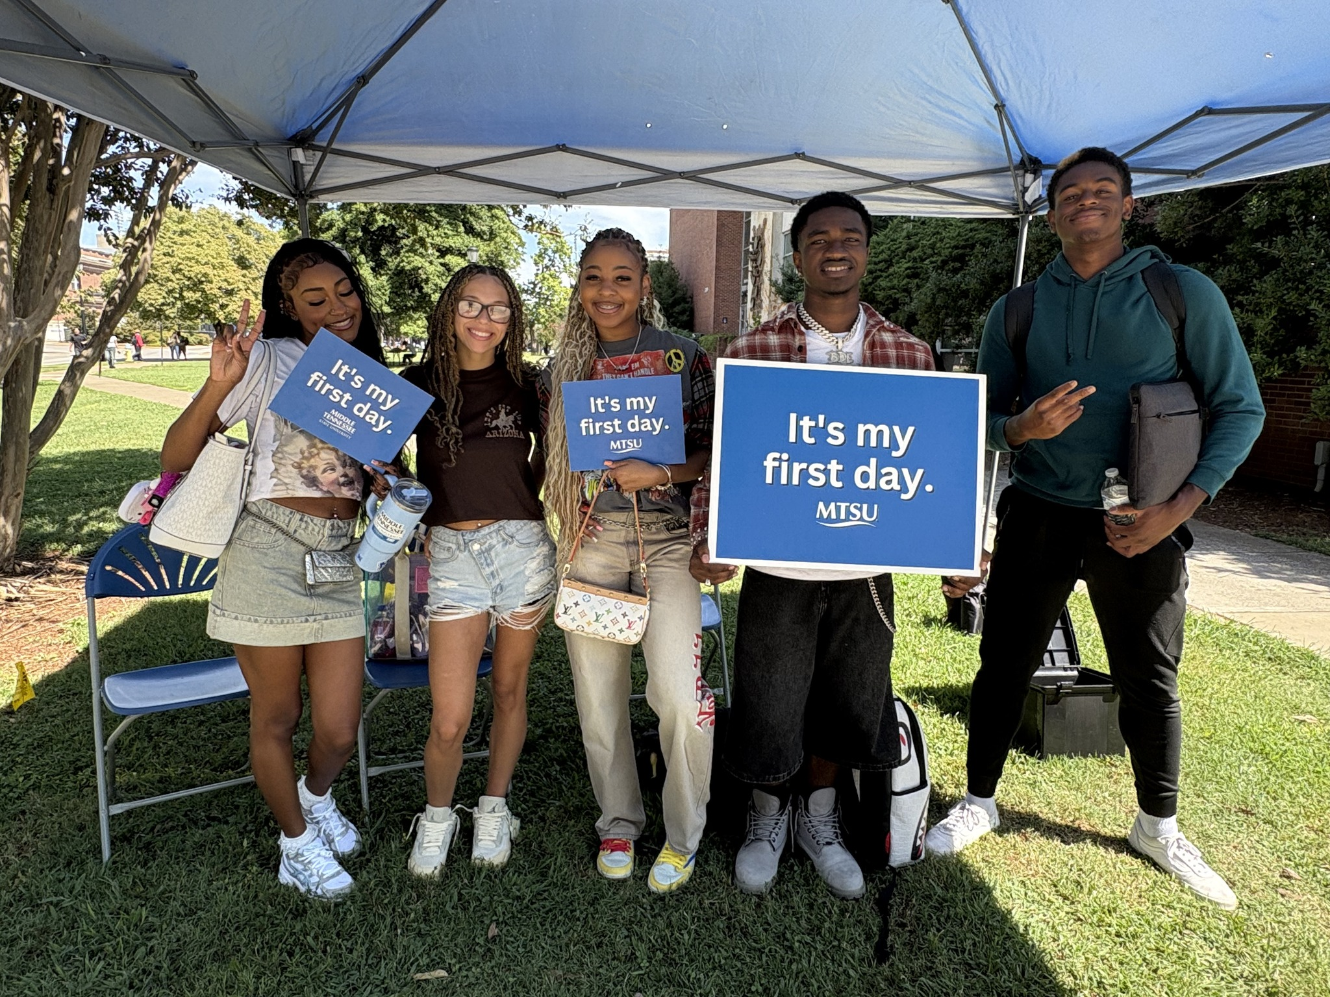
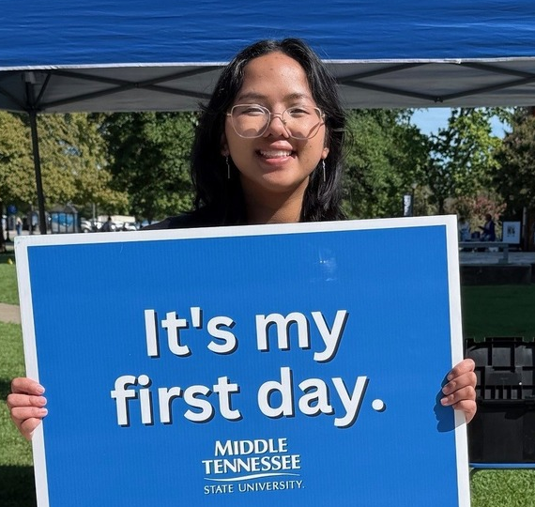
Ask Me Tents

Slide 17

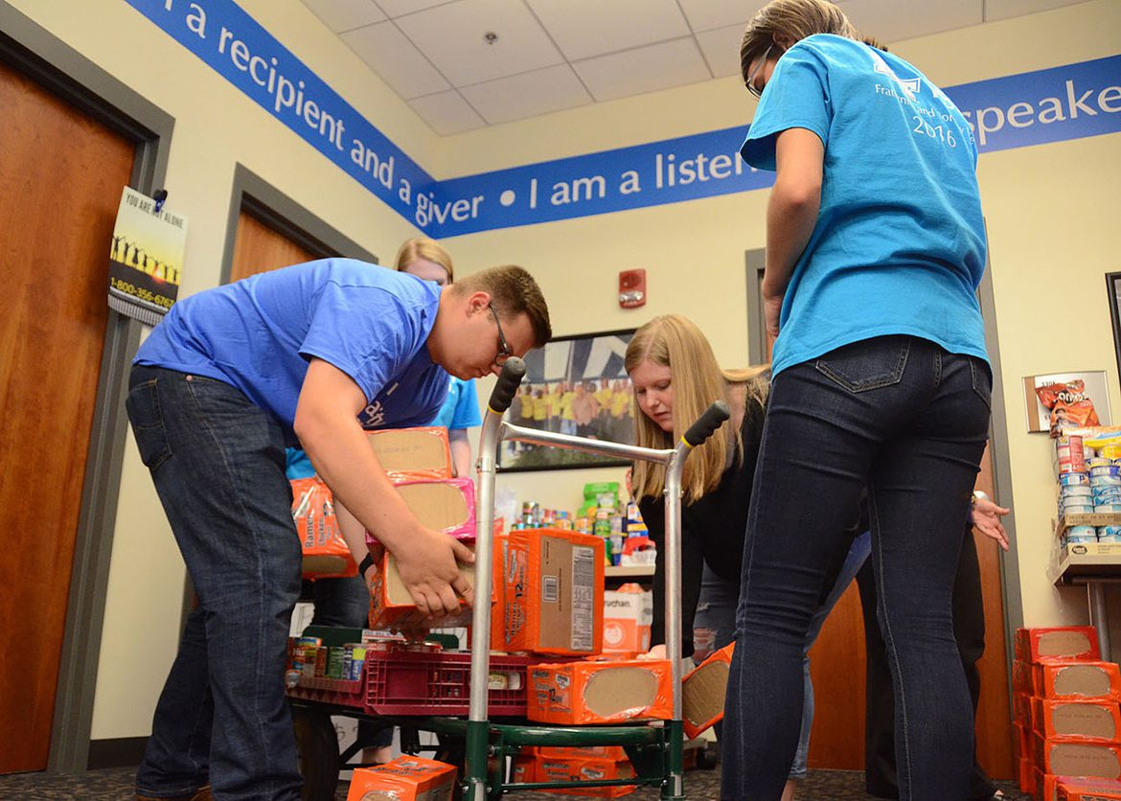
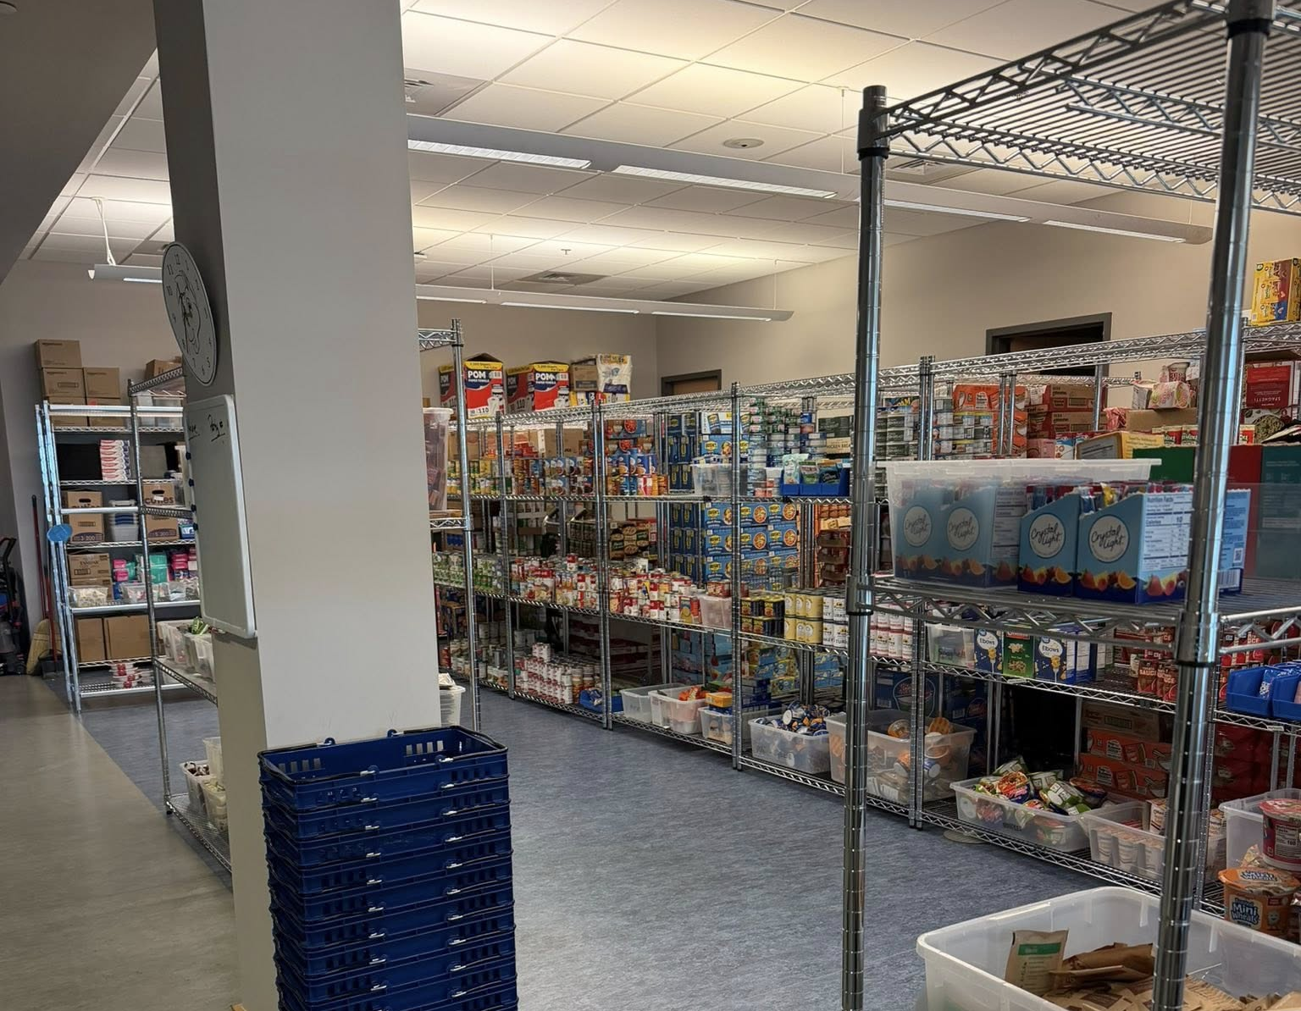
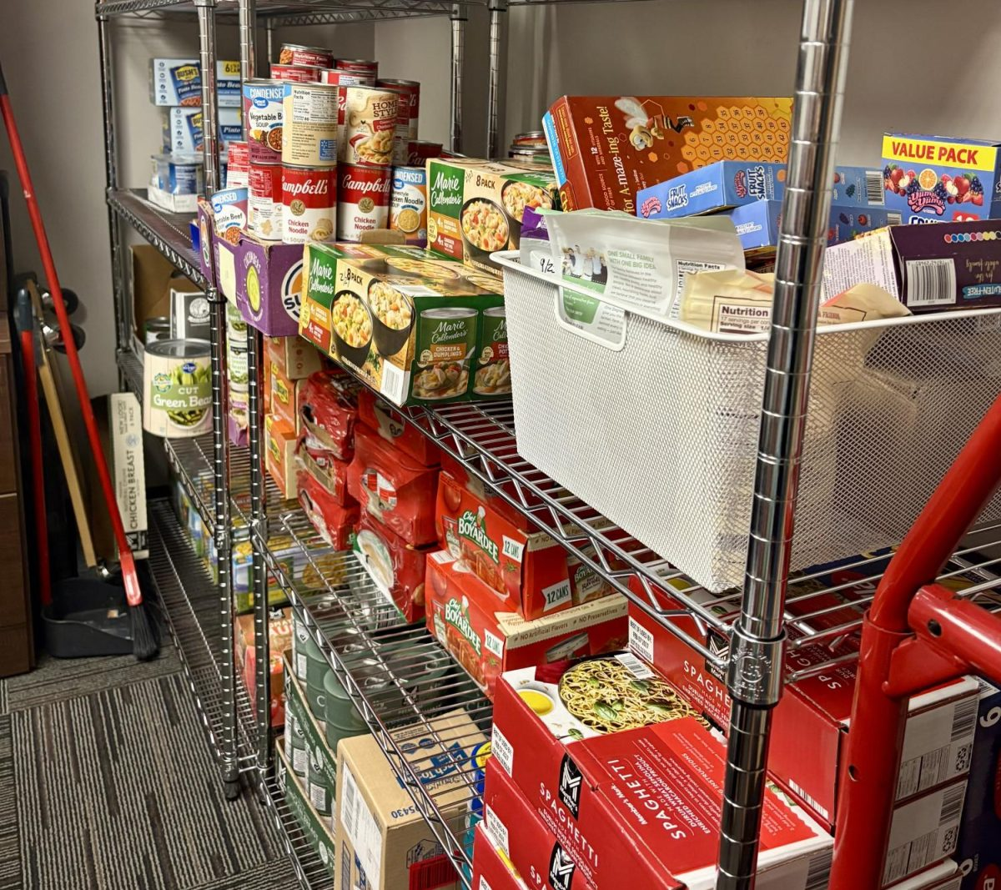

Support

Slide 18
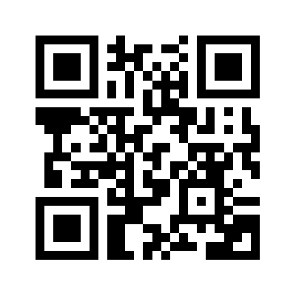
How can I join?
Join today at Orientation:
Use QR Code and join online.
Your Welcome Kit can be picked up at Meet MT from 2:00-4:00pm in the Rec Center.

Slide 19
How can I join?
Fill out a paper registration form & pay membership fee at Meet MT:
  We accept Visa, MasterCard, American Express, Discover, Checks, & Cash
Join online anytime:
  mtsu.edu/parents/join.php
    Credit Card payments only
    Welcome Kit mailed to you in 5-7 business days

Slide 20
Thank you for your support!
PFA Facebook Group: facebook.com/groups/MTSU.PFA
Website: mtsu.edu/parents
Email: parents@mtsu.edu

Slide 21
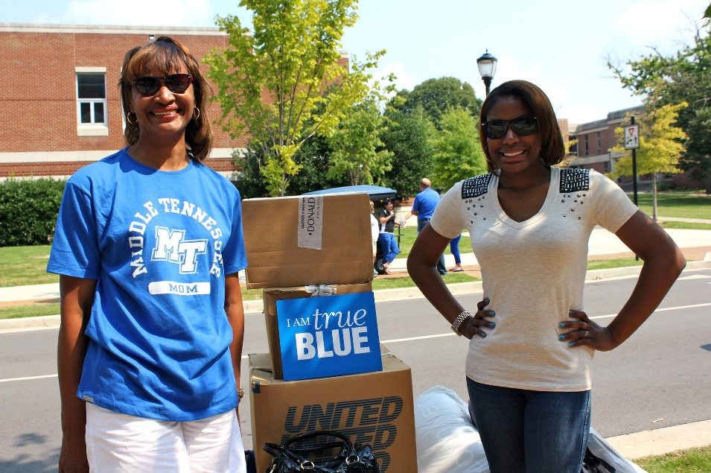
Parent Ponderings…
Who can help if they need support?
What about tutoring?
What if they get sick?
How is parking on campus?
Do you feel safe on campus?
How does my student get involved?

Slide 22


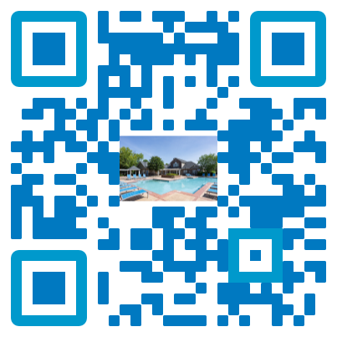
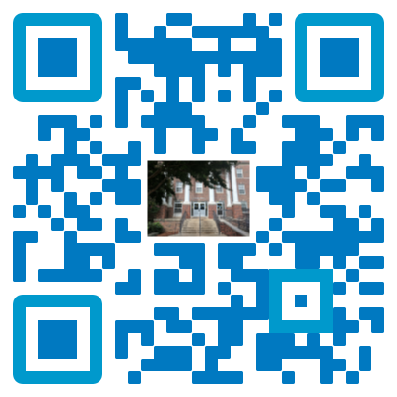
Important Resources (Take a Photo📸)
When is dorm move-in?
Wednesday, August 19 through Sunday, August 23. Housing will send an email in early July that will allow students to select a move-in day and time.
When can I turn in my state employee discount form?
Employee discount forms should be turned into the MT One Sop between July 1 and August 24. Signatures should not be obtained before July 1.
When is parking pass pick up?
Living off-campus: starting Aug. 10 (if bill is paid/confirmed)
Living on-campus: during move-in!
When can I pay my student’s bill?
July 10 – August 10
First day of classes: Monday, August 24
Registration Guide
MT One Stop
(Financial Aid)
Off-Campus Housing Website
Dorm What to Bring List

