Slide 1
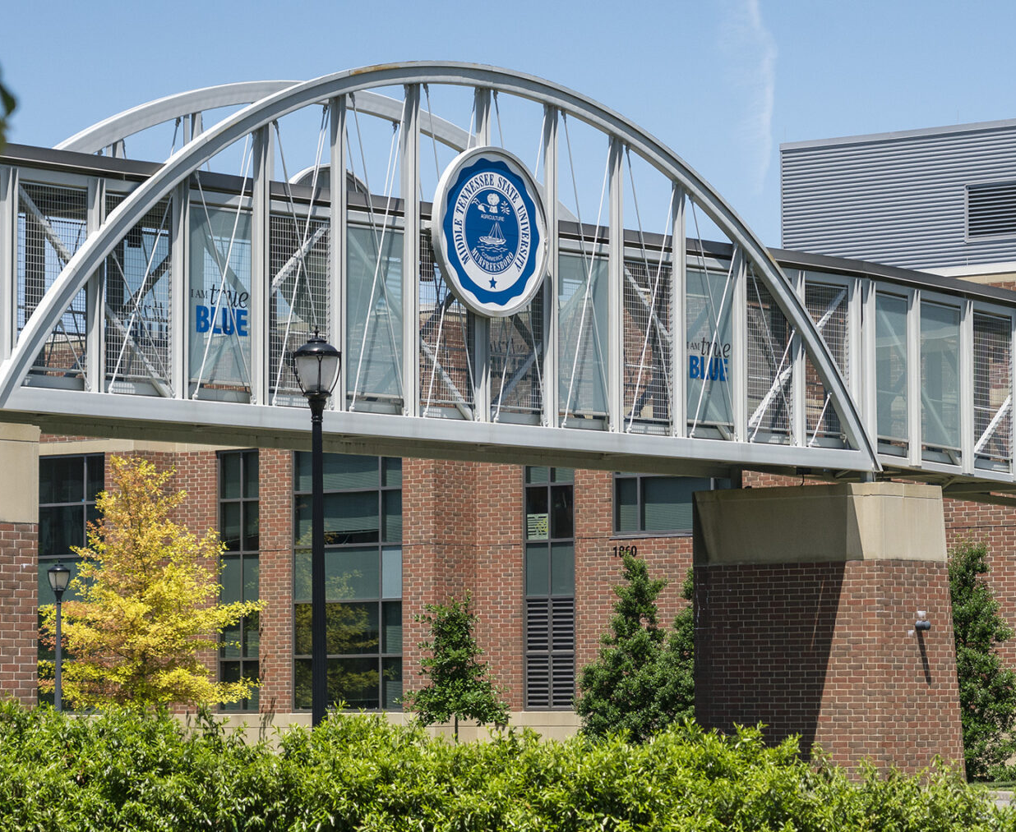

Meeting with Administration

Slide 2
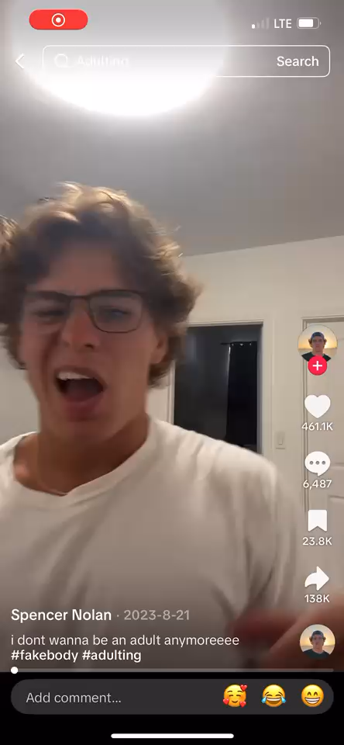
Want to see what we’re working with?

Slide 3
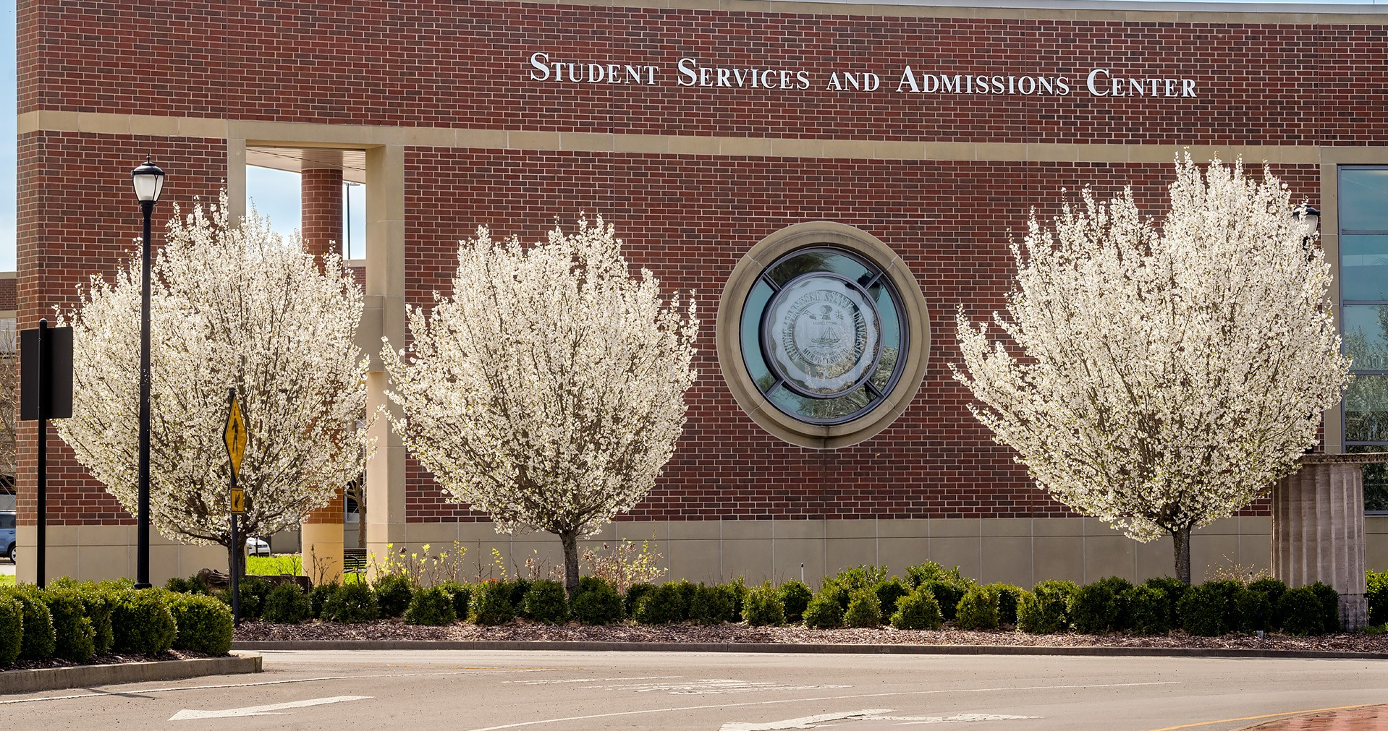
Welcome Parents and Families!
Welcome Parents and Families!

Slide 4
Laurie Witherow
Vice Provost for
Enrollment Management
Laurie.Witherow@mtsu.edu
615-898-2239

Slide 5
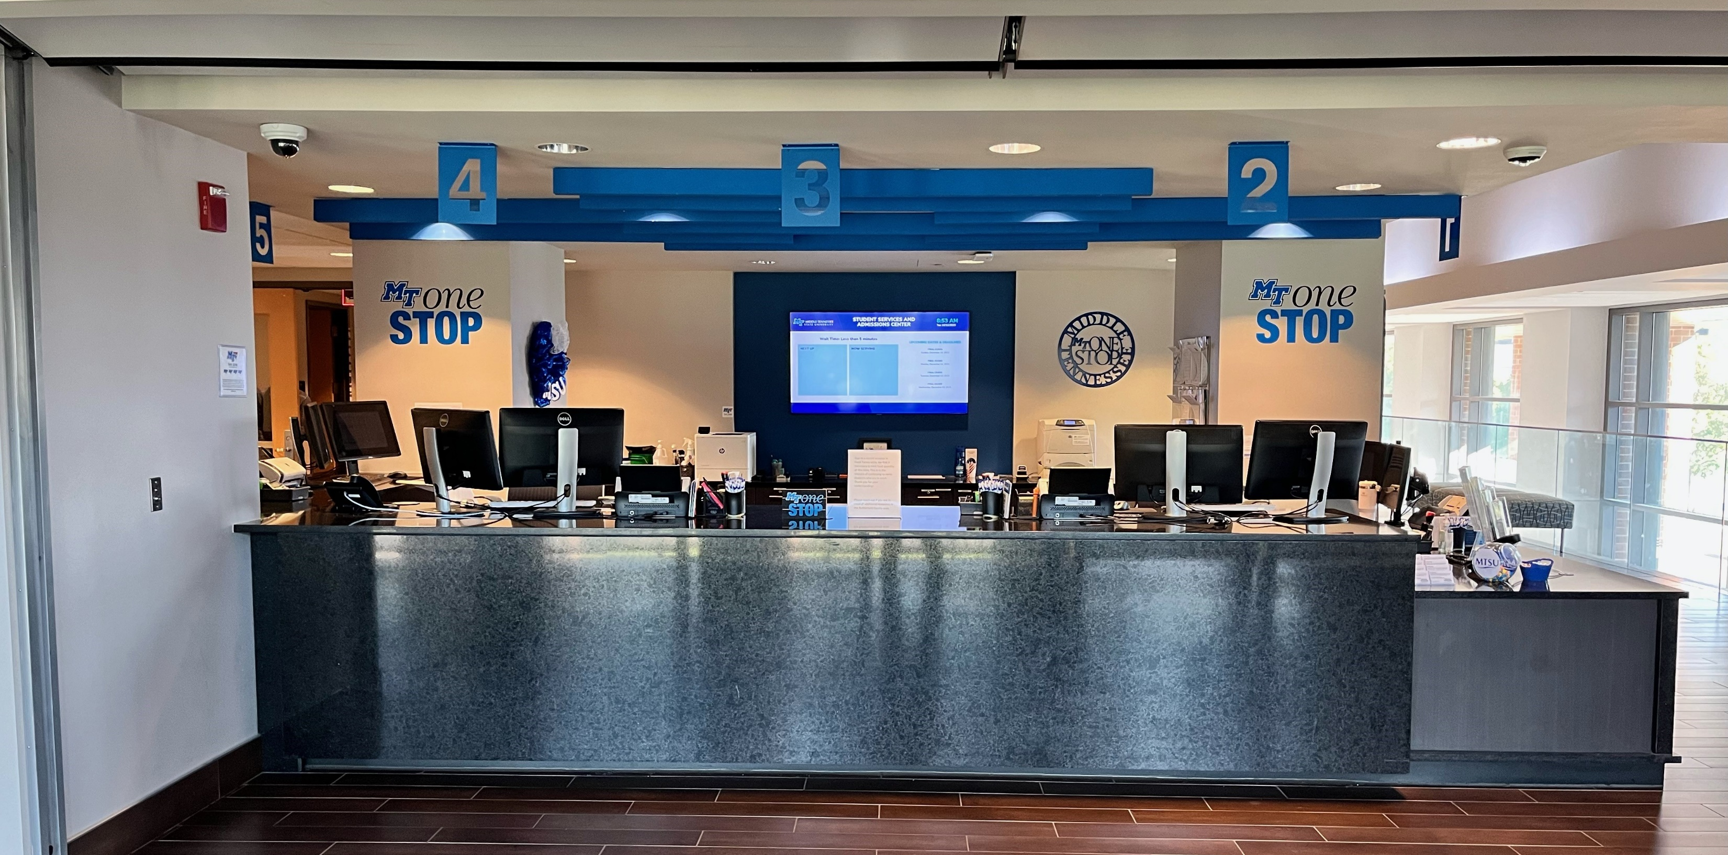
MT One Stop

Slide 6
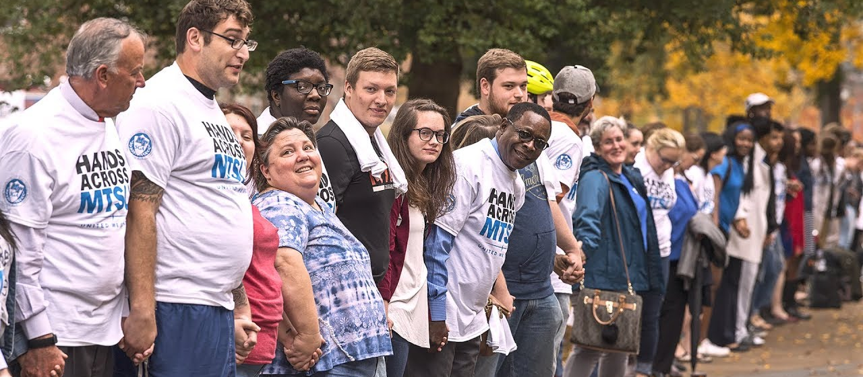
Will anyone care about your son or daughter?

Slide 7
Family Educational Rights and Privacy Act
The custodian of the record has the right to:
    Inspect, review, and amend educational records
    Have some control over the disclosure of information from educational records – written consent required for disclosure
Your student can sign you up for PIE on Pipeline
    No access to health or mental health records
    Always contact MT One Stop for assistance with questions
    We will NOT call parents to report potential problems, even through PIE

Slide 8

What can you do to help your student succeed?

Slide 9
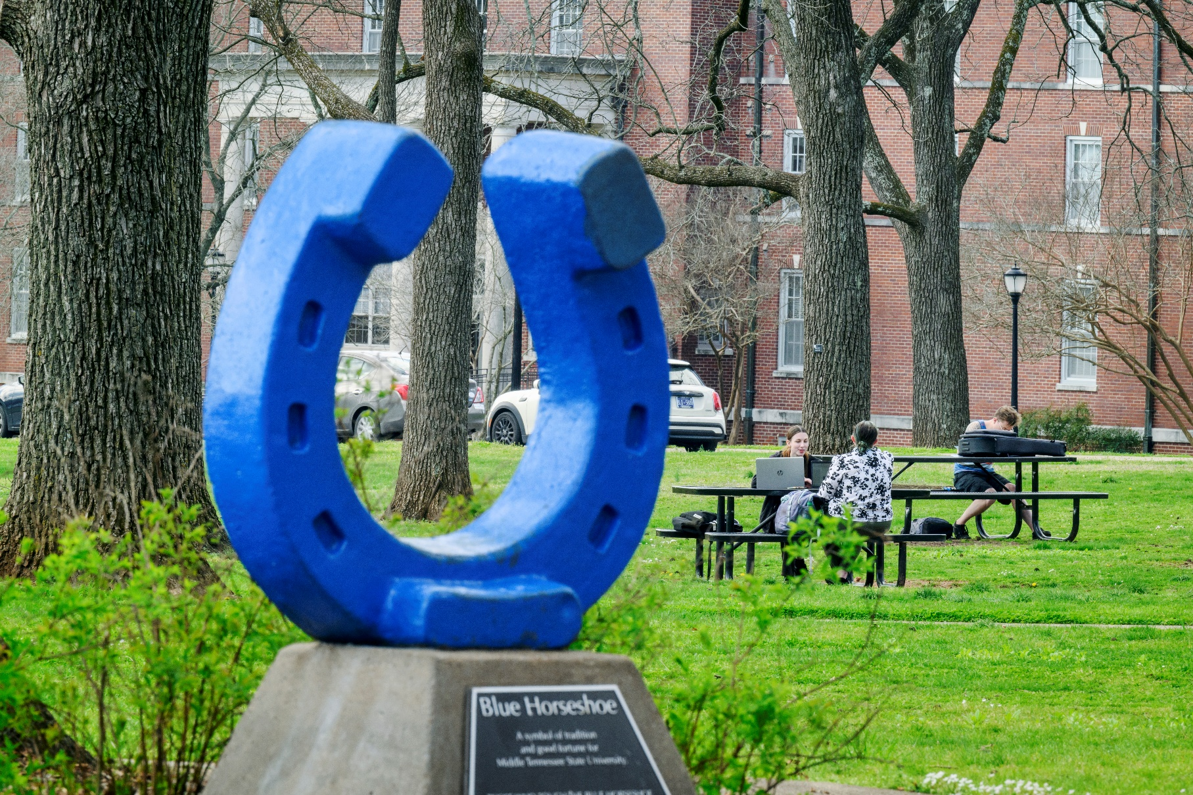
First six weeks are most crucial!
First six weeks are the most crucial!
Two major tasks in the first term:
Academic integration
Social integration
Success = Time on task.
To succeed, students need
to be on the campus.

Slide 10

Connection Point
Connection Point
2026-2027 Events
Coming Soon!
Check out Events Calendar below:
https://www.mtsu.edu/campuslife/events/

Slide 11
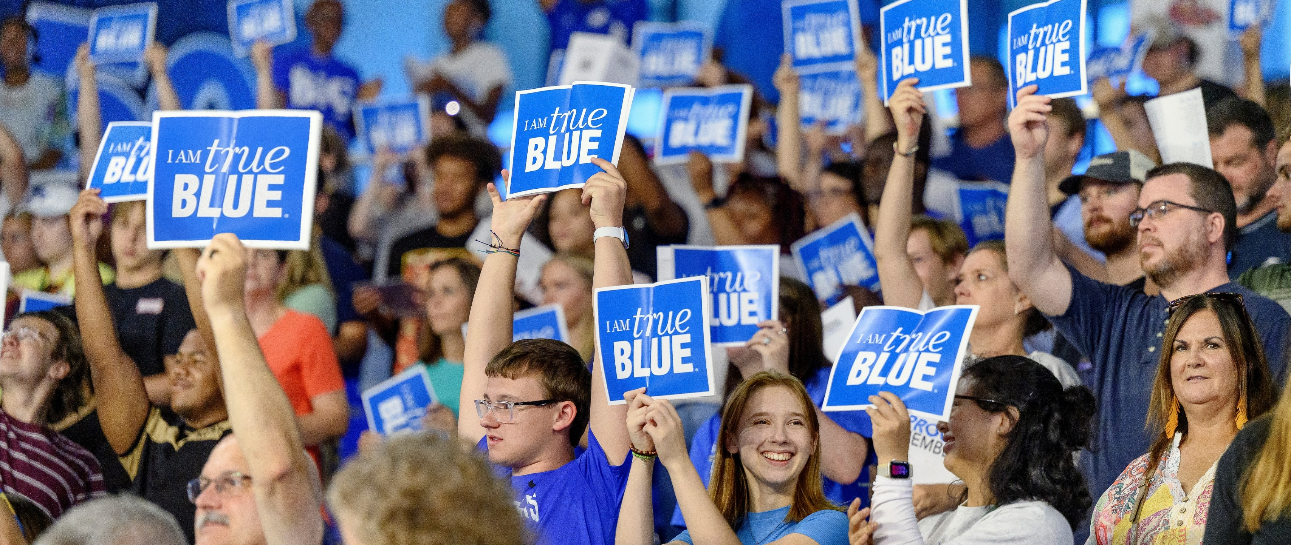
We will help them work towards adulthood as a team!

Slide 12
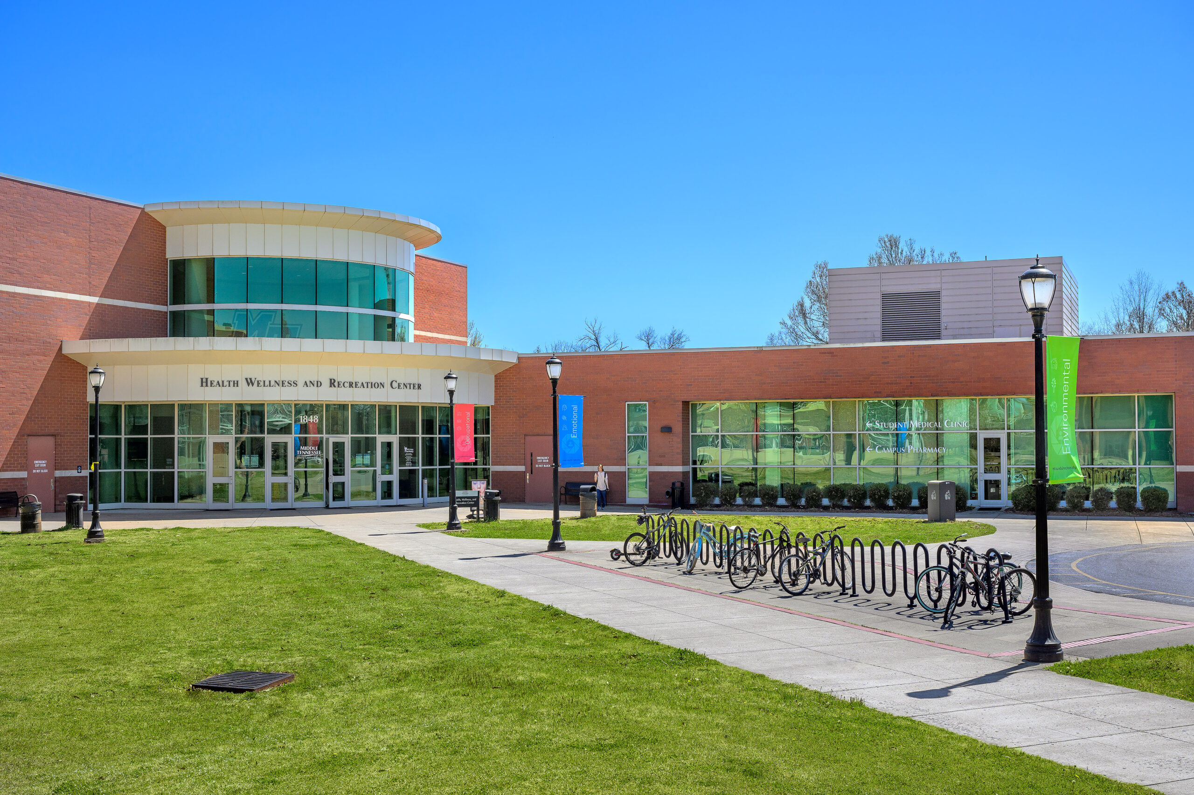
Encourage the use of Health Services!
Offer free and low-cost appointments
Well visits, X-rays, physicals, allergy testing, women’s health, vaccination clinics
Campus Pharmacy
Fill prescriptions,
transfer prescriptions,
maintain prescriptions

Slide 13
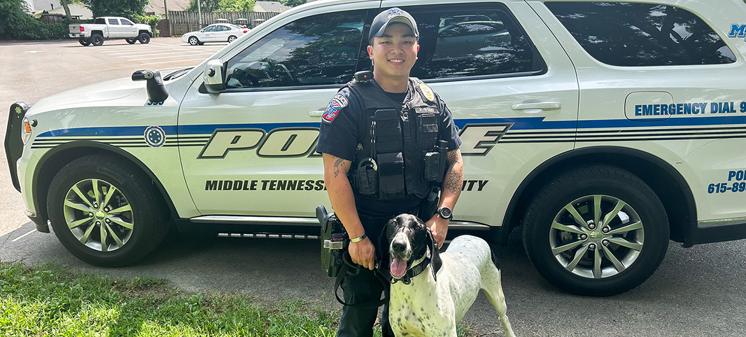
What about campus safety?
What about campus safety?

Slide 14
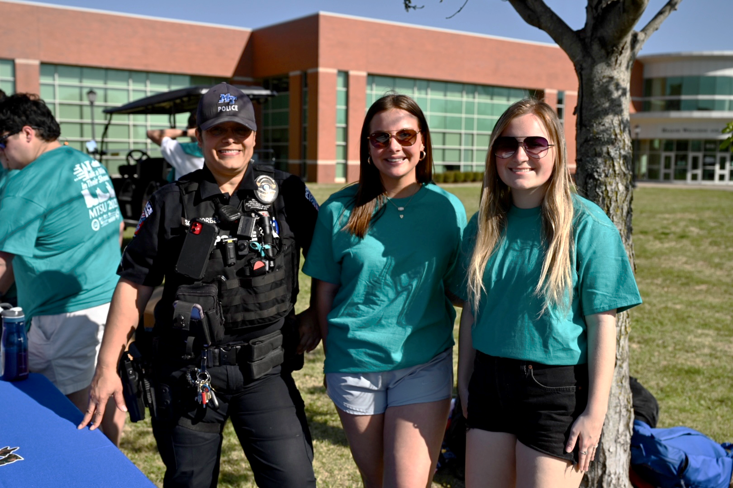
Safety is our priority!
Safety is Our Priority!
An open, 515-acre Campus. More than 30,0000 students, faculty, and staff.
See our crime report at http://police.mtsu.edu.
The very good news is that 78% of MTSU students report feeling safe on this campus.

Slide 15

University Police Department Staff

Slide 16
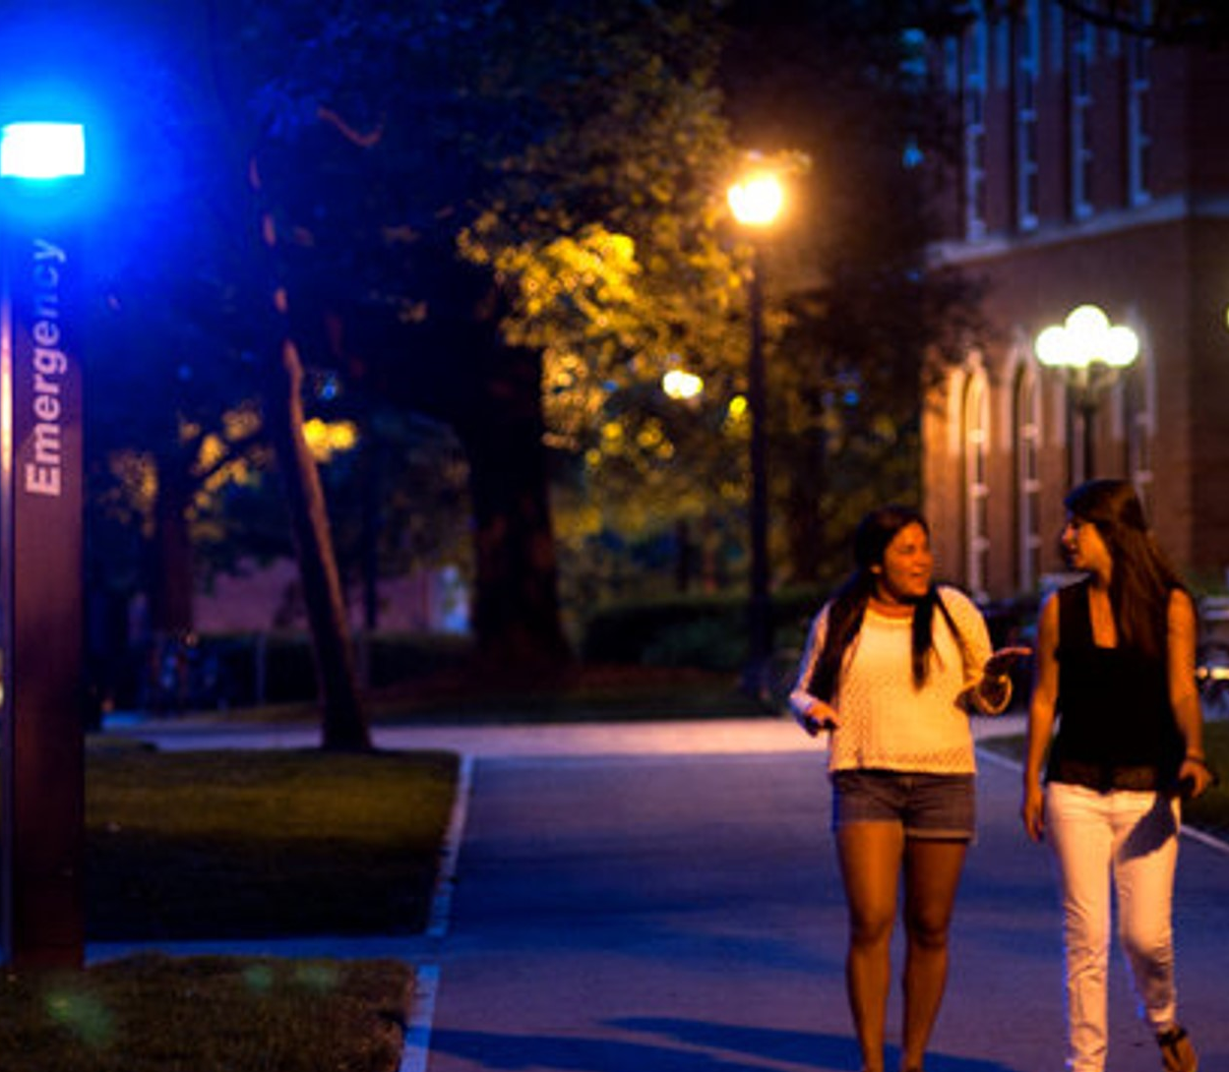
Becoming Responsible is a SKILL
Becoming Responsible is a Skill!
Walk with a buddy
Use the police escort service
Be aware of your surroundings
Be cautious with social media
Document serial numbers
Rave Alert 4U: text, email, and voice alerts to registered students
Active Shooter on Campus training: RUN, HIDE, FIGHT.
Police.mtsu.edu | mtsu.edu/alert4u/

Slide 17
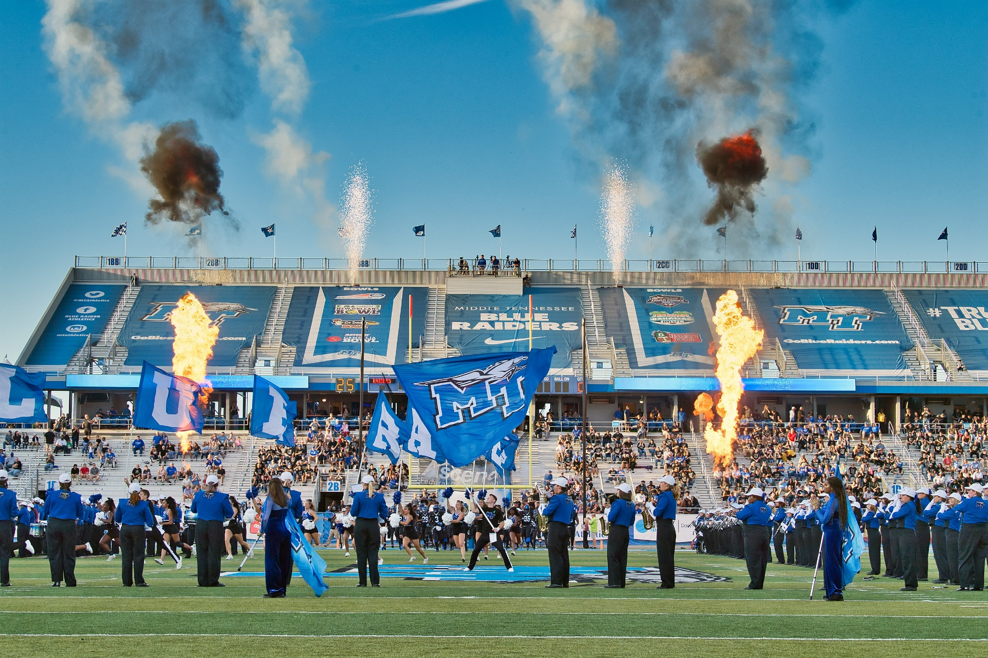
Pro Tips to Remember
Pro Tips to Remember
Work closely with academic advisors
Limit work to 15 hours/week
Get involved on campus
Visit MT One Stop when needed
Get a duplicate insurance card!
Make arrangements, if needed, for
long-term counseling or psychiatric
medication management.
Discuss timing of first visit home.
Make a list NOW of what to send with your student!

Slide 18
Laurie Witherow
Vice Provost for
Enrollment Management
Laurie.Witherow@mtsu.edu
615-898-2239

