Slide 1
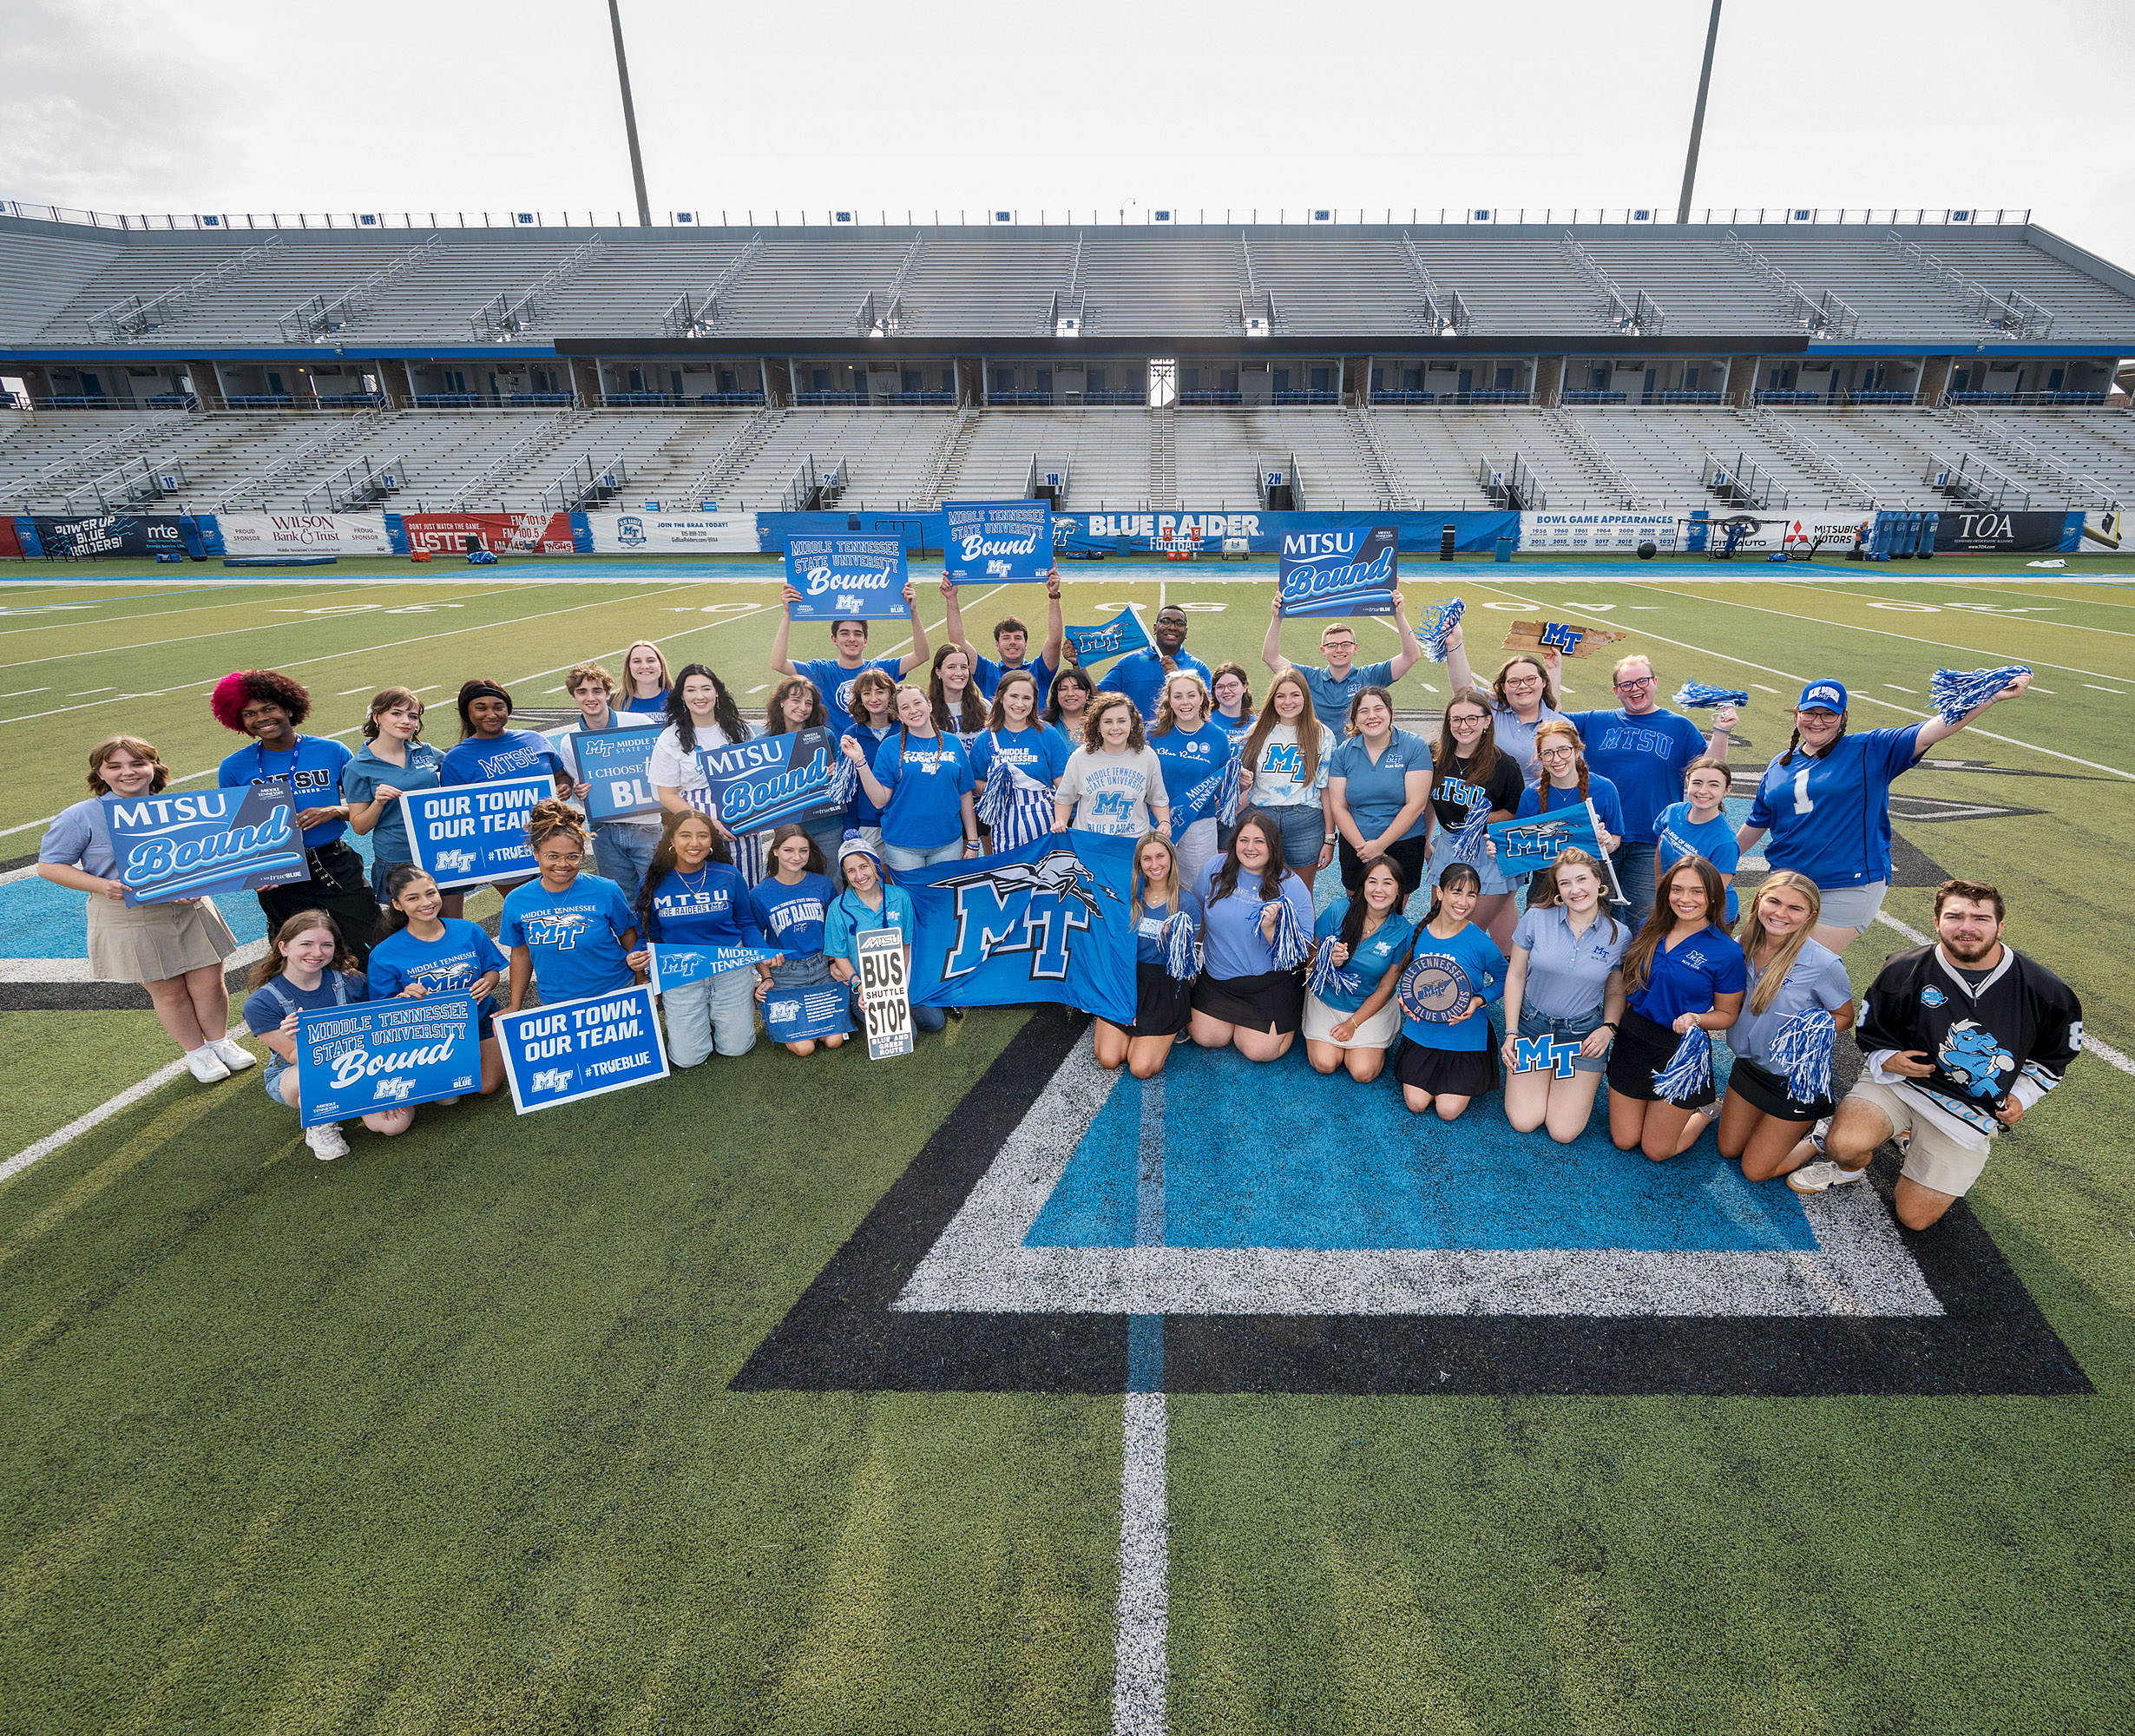
Starting Off Right!

Slide 2
Becca Smitty
Director
MT One Stop
mtonestop@mtsu.edu
Becca.Smitty@mtsu.edu

Slide 3
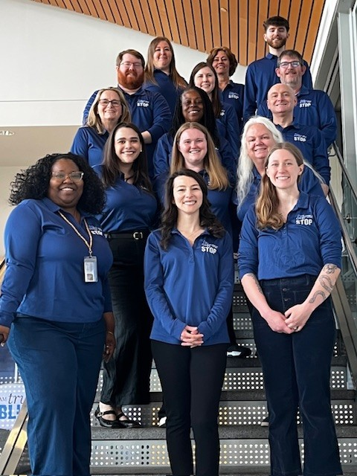

MT One Stop
Student Services and Admissions Center, 2nd floor
MTOneStop@mtsu.edu
https://www.mtsu.edu/one-stop/onestopcounter.php

Slide 4
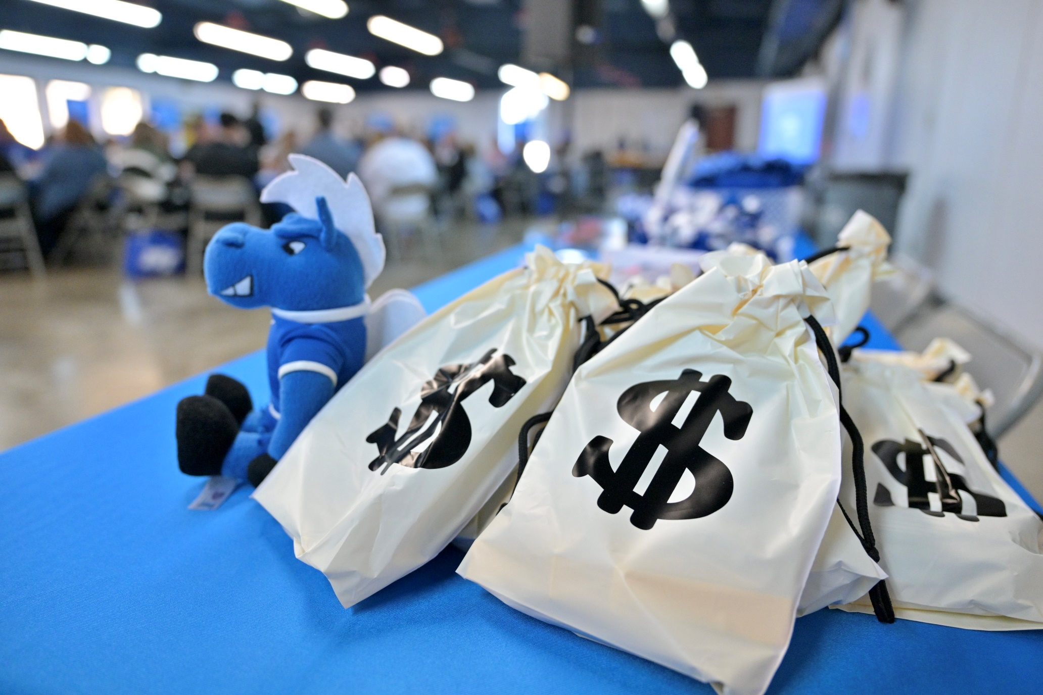
What do we do here?
Financial Aid
Registration Assistance
Billing Questions & Discount
Forms
Registrar Services
Notary Services
Outreach & Support
Financial Literacy
Summer Reading
Lightning Stop

Slide 5
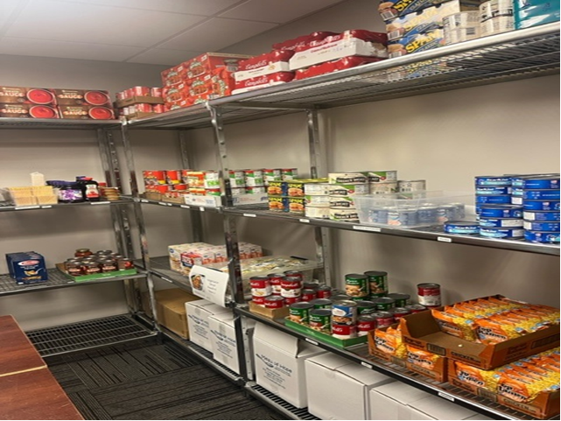
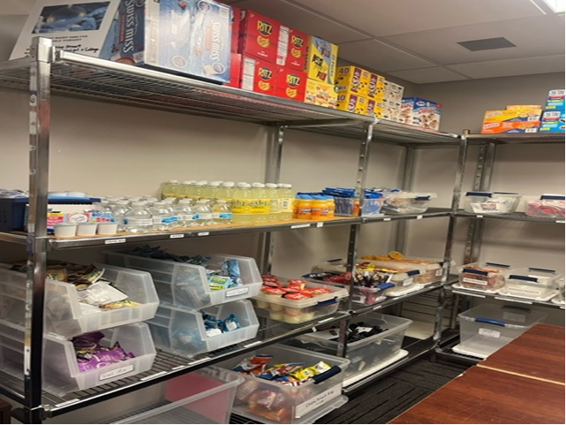
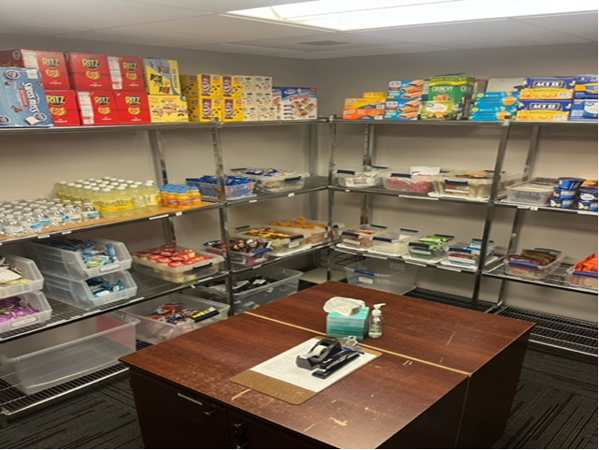
Lightning Stop @ MT One Stop

Slide 6
Financial Aid
Apply with the FAFSA as soon as it’s available (the earlier the better)
Federal aid: federal rules
    Pell Grants and student loans
    You have to attend class until the end of the semester
Remain eligible- remember these three things!
    2.0 GPA
    Pass 67%
    Graduate in 180 credits or less
CPoS (Coursework toward Program of Study)
mtsu.edu/financial-aid

Slide 7
Plan for the Unexpected
If you have to withdraw or drop classes:
Drop your class(es) by August 23 = all tuition and fees removed
September 6 = you owe 25%
September 19 = you owe 75%
After September 19 = you owe 100%
Remember, if you withdraw or stop attending, you can owe back some or all of your financial aid. Always go to class and talk to both your advisor and the
MT One Stop if you are considering dropping or withdrawing completely.
https://mtsu.edu/registration/registration-guide.php

Slide 8
Common Questions (so far)
When will I get a bill?
When is it due?
What if financial aid covers it?
What if it doesn’t?
July 10
August 10
Confirm on Pipeline
Pay/Installment Plan
*If you have anything outstanding with financial aid or verification, go to the MTOS today!

Slide 9
Where do you start?
Anything academic: Contact your advisor
  https://mtsu.edu/advising/
Anything financial (or change in enrollment):
MT One Stop
  Email: MTOneStop@mtsu.edu
Virtual Counter: www.mtsu.edu/one- stop/onestopcounter.php

Slide 10
Your To-Do List
Be sure to set up your Student Privacy Pin and PIE partners on Pipeline asap.
Rave Alert4U: text, email and voice alerts to registered students. https://www.mtsu.edu/alert4u
Complete the Active Shooter on Campus training: RUN, HIDE, FIGHT on the website at https://www.mtsu.edu/alert4u/active-shooter.php
Think about your responsibility for your safety: walk with a buddy or Raider Patrol, be careful with social media.
Join MTSU Parent and Family Association on Facebook

Slide 11


