Slide 1
Nine Types Workshop
What is the Enneagram and how can it help you?

Slide 2
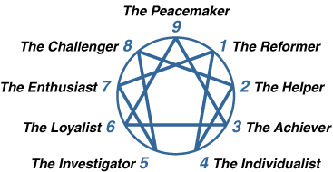
The Structure

Slide 3
Wings
Your wing is the type on either side of your number.
2’s either have wing 1 or wing 3.
6’s either have wing 5 or wing 7.
Pay attention to the types on either side of yours to find your wing!

Slide 4
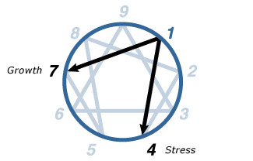
Type 1
The Reformer
Idealistic, perfectionist, and rule-oriented
Wants to be right and has high standards
Basic Desire: Be good, have integrity and balance
Basic Fear: Being corrupt or evil
Michelle Obama
Maggie Smith
Plato
Nelson Mandela
Mufasa - The Lion King

Slide 5
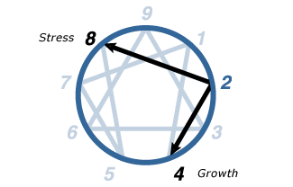
Type 2
The Helper
Generous, considerate, loving, nurturing
Wants to be needed/helpful
Basic Desire: To feel loved
Basic Fear: Of being unwanted or unworthy of love.
Dolly Parton
Eleanor Roosevelt
Lionel Richie
Anna - Frozen

Slide 6
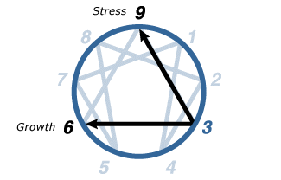
Type 3
The Achiever
Ambitious, competitive, worried about image
Goal oriented and focused on accomplishments
Basic Desire: Feel valuable and worthwhile
Basic Fear: Being worthless
Michael Jordan
Taylor Swift
Will Smith
Reese Witherspoon
Tiana - Princess and the Frog

Slide 7
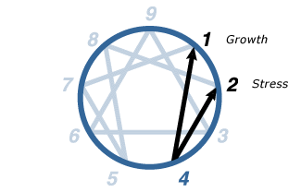
Type 4
The Individualist
Self-Aware, creative, sensitive
Wants to express themselves and surround themselves with beauty.
Basic Desire: Find themselves and create an identity
Basic Fear: Not having an identity or personal significance
Edgar Allen Poe
Frida Kahlo
Winona Ryder
Belle - Beauty and the Beast

Slide 8
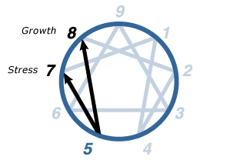
Type 5
The Investigator
Curious, independent, innovative
Wants to possess knowledge and understand the environment
Basic Desire: To be competent and capable
Basic Fear: Being useless or helpless
Agatha Christie
Albert Einstein
Vincent van Gogh
Jane Porter - Tarzan

Slide 9
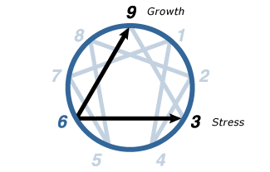
Type 6
The Loyalist
Reliable, hard-working, and responsible
Wants to have security and reassurance
Basic Desire: Have support and security
Basic Fear: Not having guidance and support
J. Edgar Hoover
Chris Rock
Mark Twain
Mulan - Mulan

Slide 10
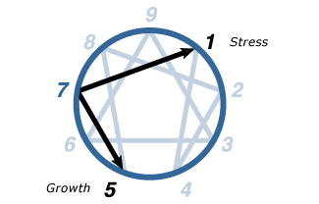
Type 7
The Enthusiast
Optimistic, spontaneous, scattered
Wants to avoid missing out on experiences and to keep themselves excited and occupied
Basic Desire: To have their needs filled (satisfied and content)
Basic Fear: Being deprived and in pain
Galileo Galilei
John F. Kennedy
Miley Cyrus
Ariel - The Little Mermaid

Slide 11
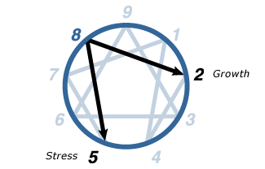
Type 8
The Challenger
Confident, assertive, resourceful, protective
Wants to be self-reliant and stay in control of the situation
Basic Desire: Be in control of their life and protect themselves
Basic Fear: Being controlled or harmed by others
Martin Luther King Jr.
Serena Williams
Jack Black
Jasmine - Aladdin

Slide 12
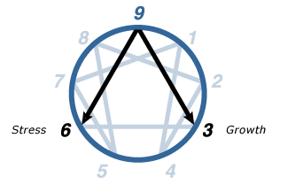
Type 9
The Peacemaker
Accepting, supportive, and trusting
Wants to avoid conflict and create harmony in their environment
Basic Desire: To have “peace of mind” or inner stability
Basic Fear: Loss and separation
Abraham Lincoln
Walt Disney
Audrey Hepburn
Pocahontas - Pocahontas

Slide 13
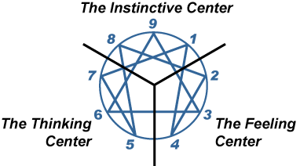
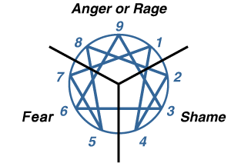
Centers
Instinctive: motivated by gut instinct.
Feeling: motivated by relationships and emotions.
Thinking: motivated by knowledge and logic.

Slide 14
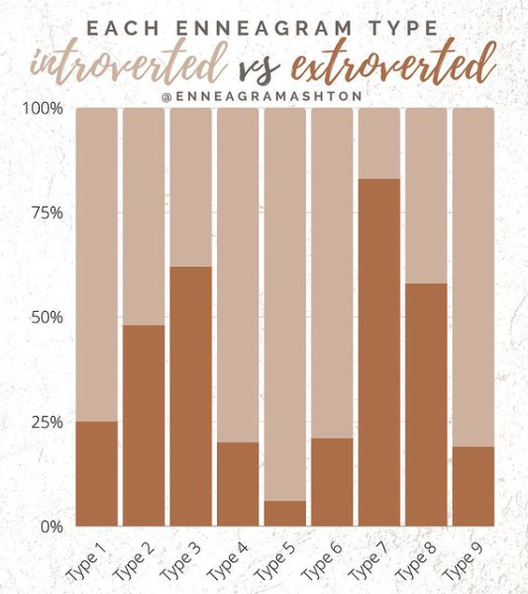
What do you think?

Slide 15
Questions?

Slide 16
Sources
The Enneagram Institute: https://www.enneagraminstitute.com/how-the-enneagram-system-works
Best and Worst: https://prezi.com/p/_hqlpwoffwpw/the-enneagram-presentation/
Centers: https://enneagramexplained.com/enneagram-centers-of-intelligence/
Disney Characters: https://www.psychologyjunkie.com/2020/05/26/the-enneagram-types-of-your-favorite-disney-characters/

